Slide 1
SEAT BOOKING SYSTEM
Presented by-Sakshi Kumari

Slide 2
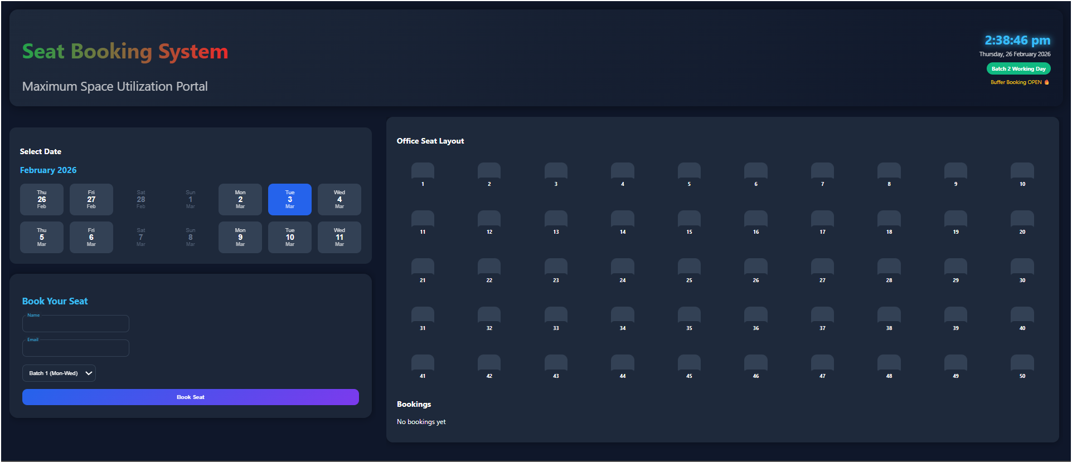
Mentioned upcoming days for the designated batch users.
Buffer timer is allocated for the user’s convenience.

Slide 3
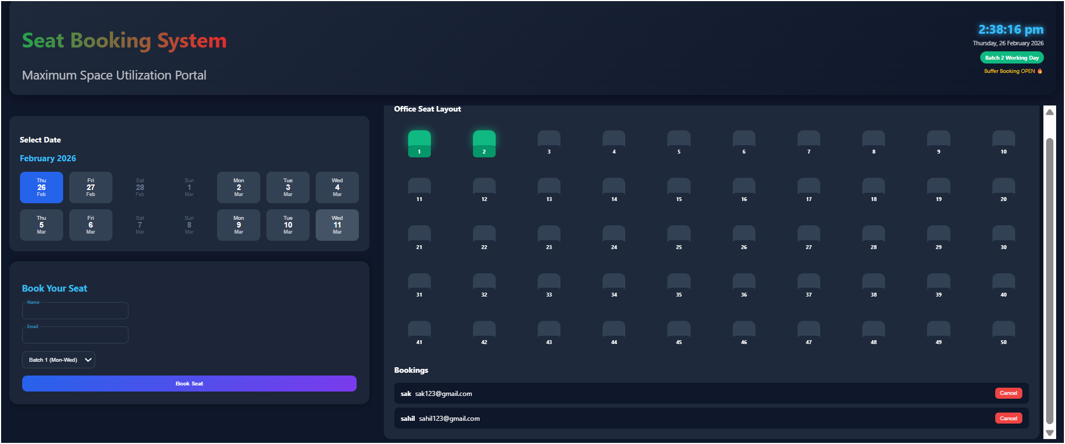
Designated seat allocation

Slide 4
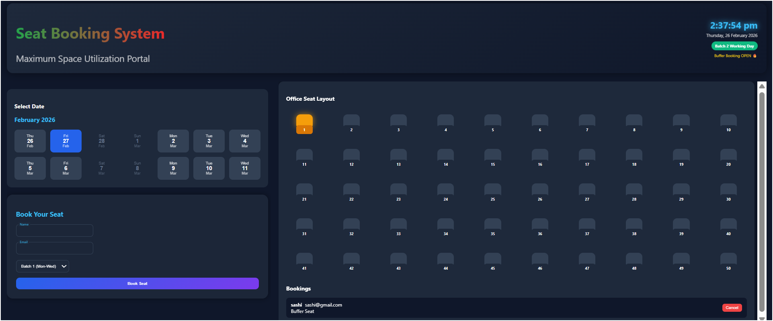
Buffer seat allocation

Slide 5
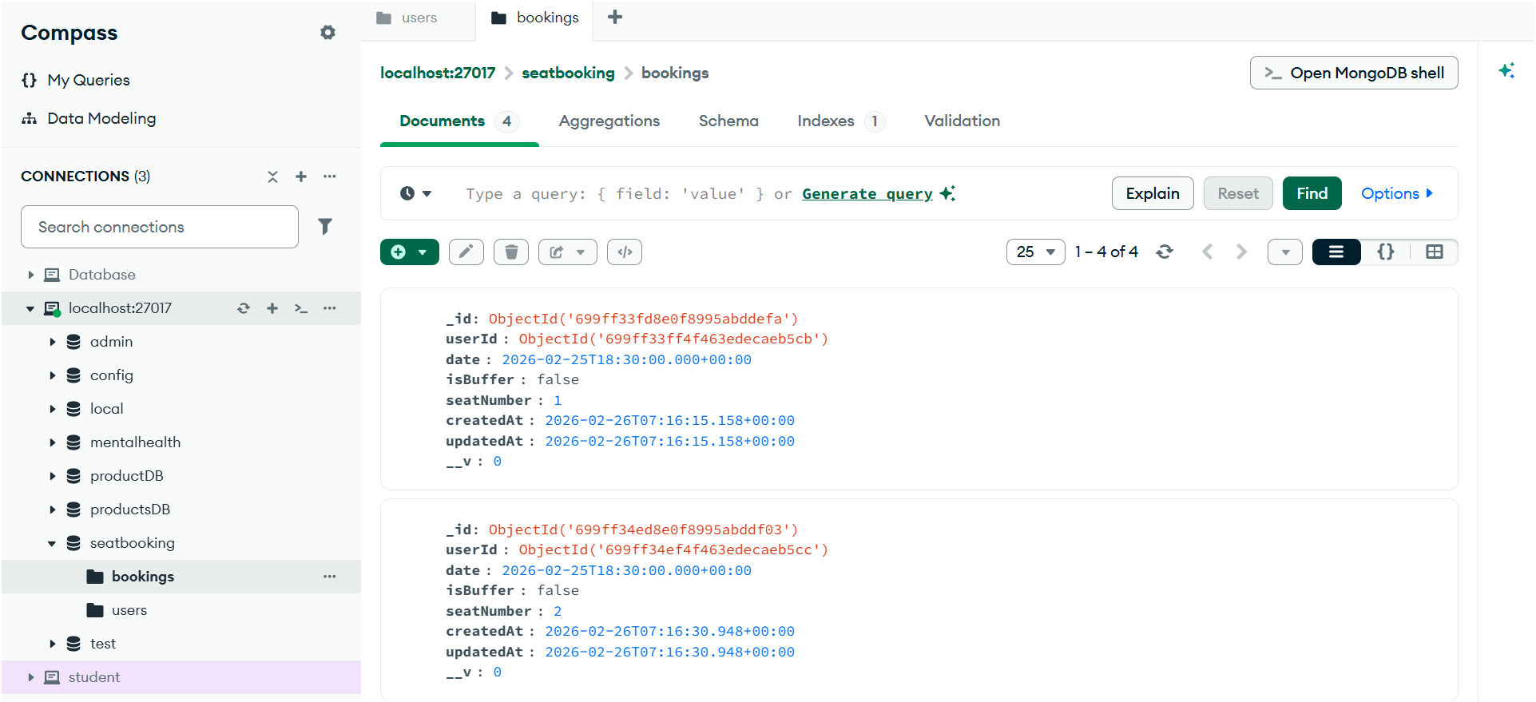
Database for the bookings

Slide 6
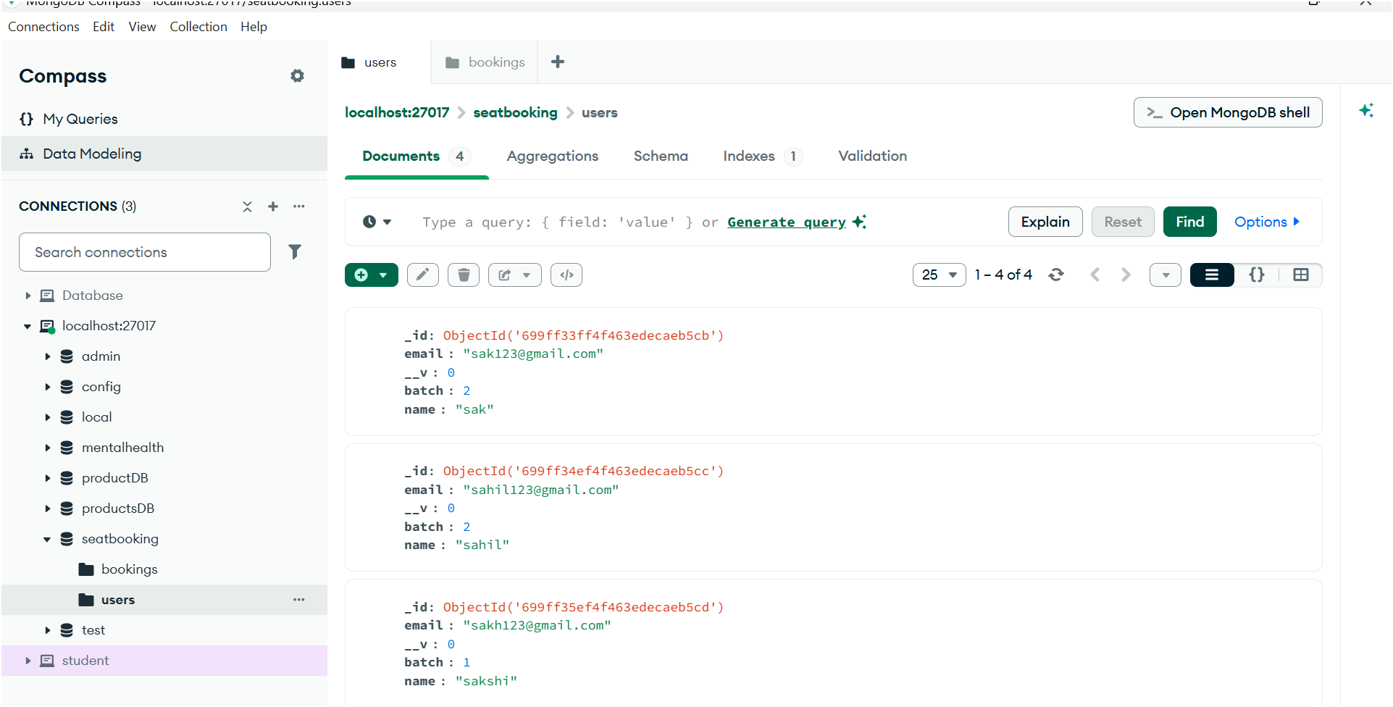
Database for users

Slide 7
THANK YOU

