Slide 1
Predictive Analysis of Diabetic Patient Readmissions
Presenter: Sakshi Jadhav

Slide 2
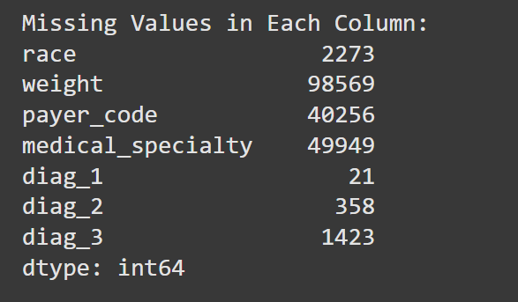
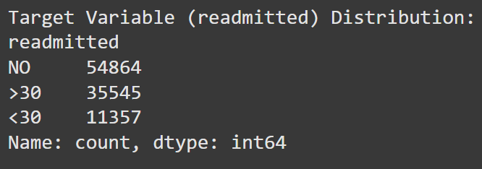
Project Overview
Objective:
Goal: To develop a predictive model that accurately forecasts the likelihood of hospital readmissions within 30 days after discharge.
Importance: Effective prediction can help in implementing preventive measures and improving patient care, thus reducing the financial strain on healthcare systems.
Key Challenges:
Data Imbalance: The class variable readmitted is imbalanced with fewer instances of readmissions within 30 days compared to no readmissions or readmissions after 30 days This imbalance poses a challenge in training predictive models that accurately detect the minority class.
Missing Values: Significant amounts of missing data in key variables, such as patient weight and specific medical test results, which are critical for predictive accuracy.
Complexity in Feature Selection: The large number of features necessitates robust feature selection to identify the most impactful predictors while avoiding overfitting.

Slide 3
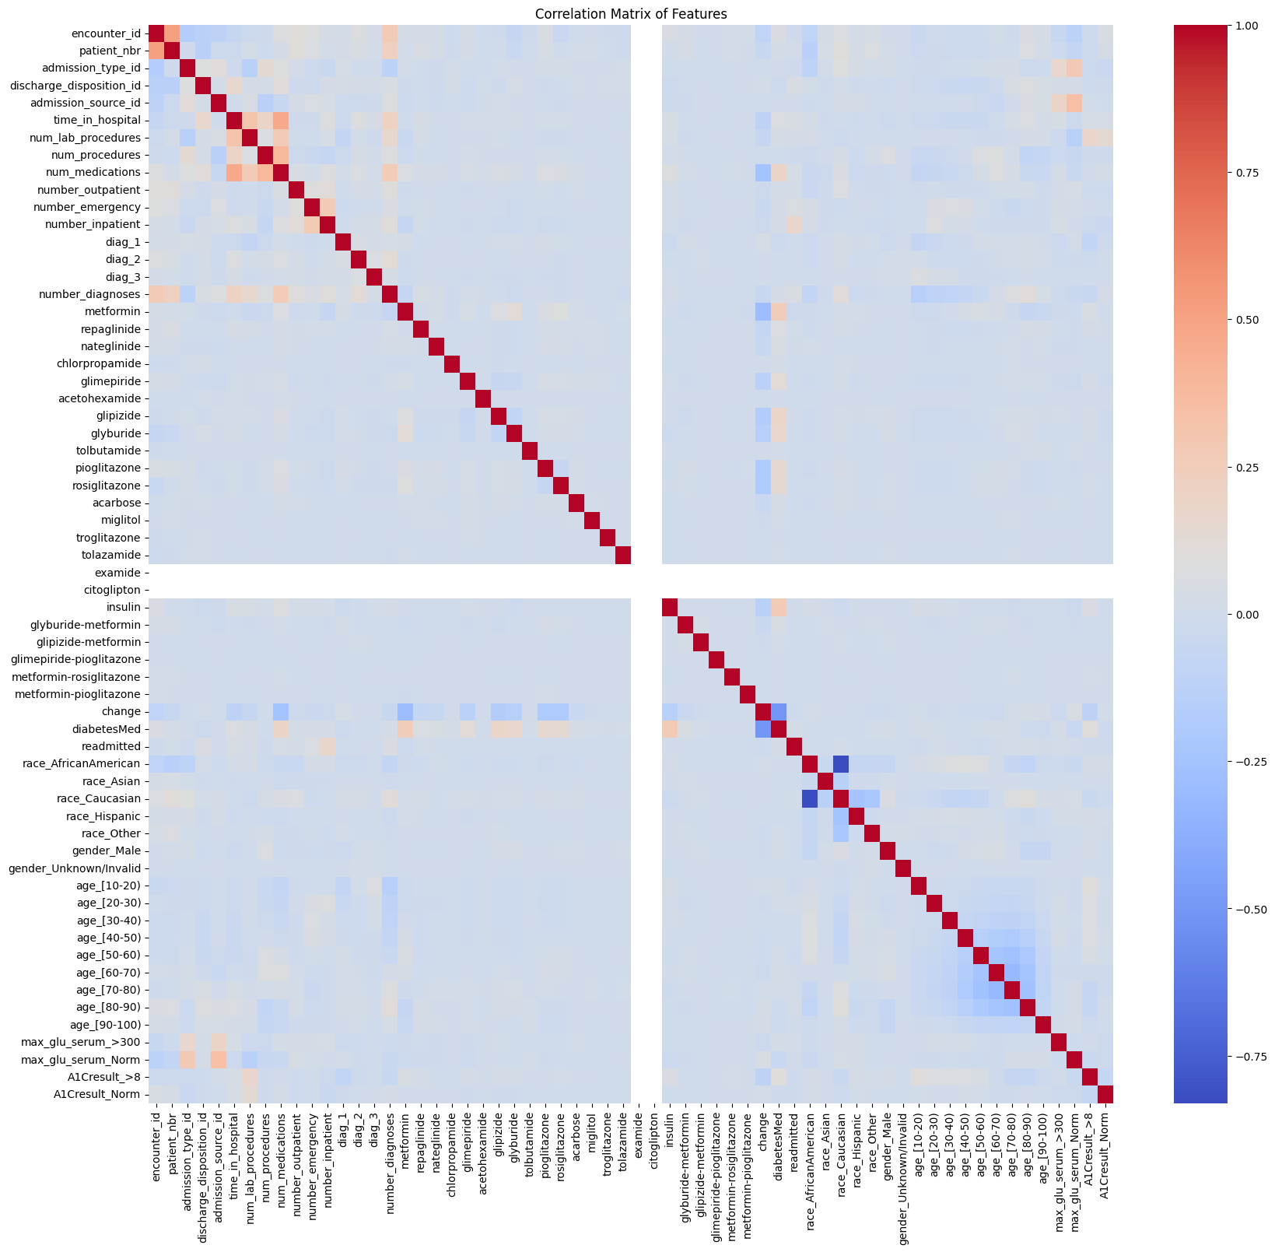
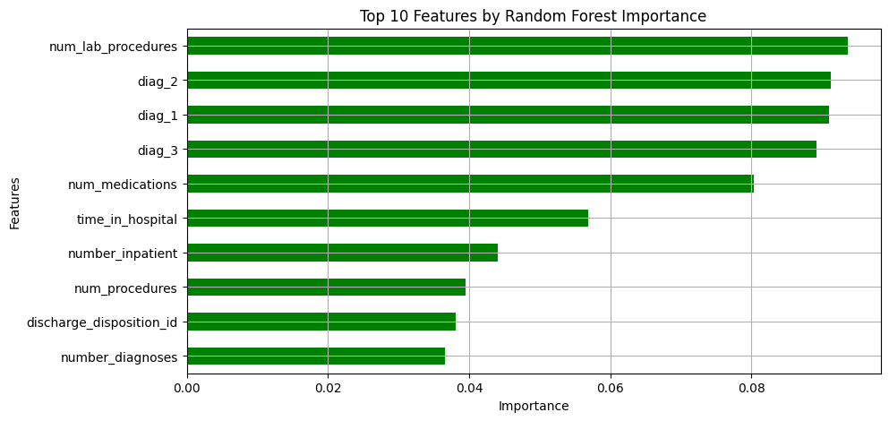
Data Cleaning and Preprocessing
Handling missing values: Removed 'Weight', 'Payer Code', and 'Medical Specialty' due to excessive missing values.
Categorical Encoding:
One-hot Encoding: Applied to features with fewer unique categories (Race, Gender, etc).
Label Encoding: Used for diagnostic codes (diag_1, diag_2, diag_3) due to their high cardinality, reducing data dimensionality.
Scaling and Normalization: Applied standard scaling to the features
Outcome: Successfully transformed the dataset into a fully numerical format, crucial for effective model training.
Exploratory Data Analysis (EDA)
Correlation Matrix: Used to calculate the correlation coefficients between the 'readmitted' variable and all other features within the dataset.
Sorting and Selection: The correlation values were sorted in descending order to highlight the features with the strongest associations, whether positive or negative.
Feature Engineering
Random Forest for Feature Selection

Slide 4
Choice of Models and Parameters
Model Selection :
Logistic Regression: Chosen for its simplicity and effectiveness in binary classification problems.
Decision Trees : Utilized for its ability to model non-linear decision boundaries and to offer intuitive decision rules.
Random Forest:An ensemble method used to improve upon the Decision Tree's tendency to overfit, enhancing generalization.
XGBoost:Advanced ensemble model known for high performance and speed, particularly effective in large datasets.
Parameter Tuning:
Utilized grid search and cross-validation to fine-tune hyperparameters, optimizing model performance.

Slide 5
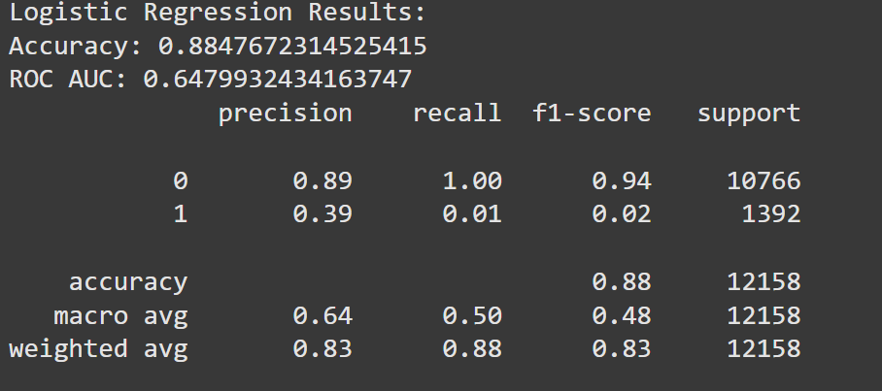
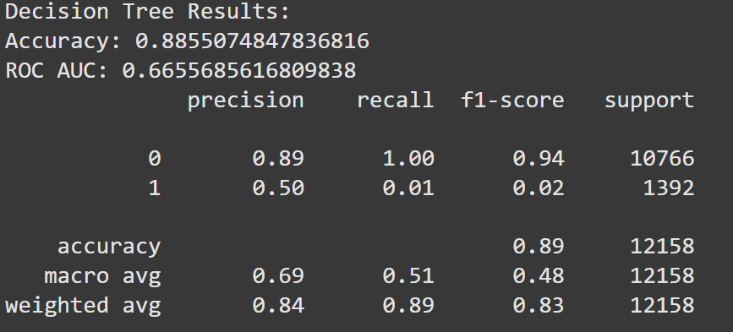
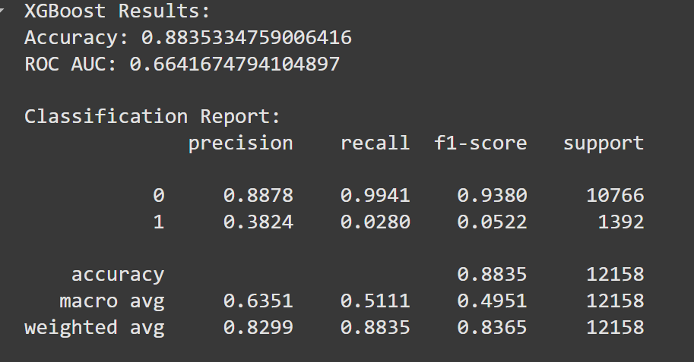
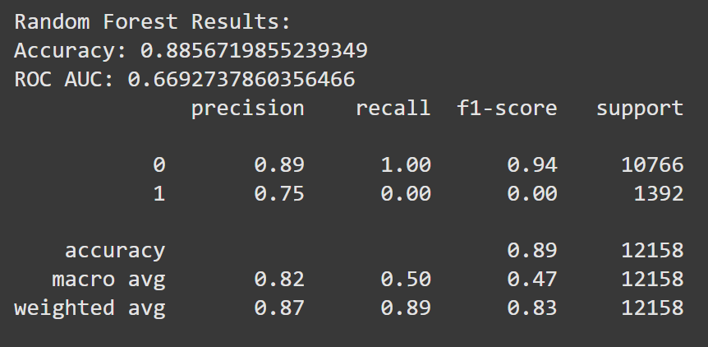
Model Evaluation

Slide 6
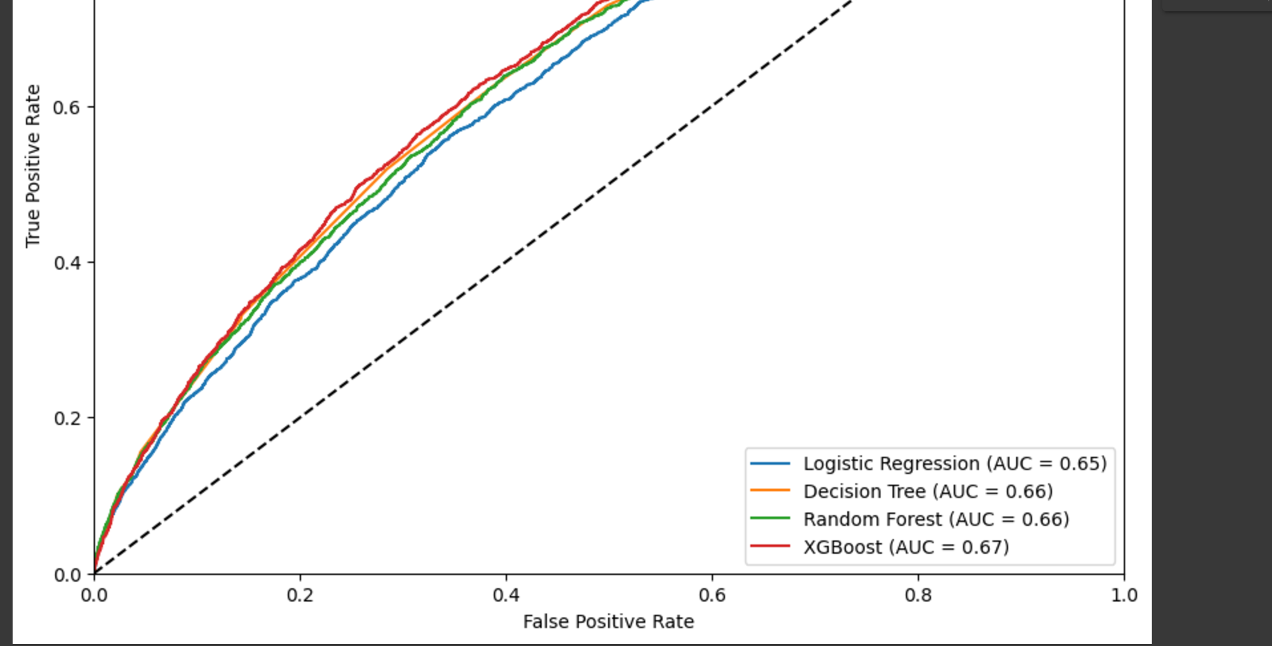
Best Model Selection
XGBoost was identified as slightly more effective compared to others, given its slightly higher recall and F1 Score, despite all models showing similar ROC AUC scores.
Insights from Model Analysis:
Challenges with Class Imbalance: The low recall rates highlighted the impact of class imbalance, where models tended to favor the majority class (no readmission). This was a crucial insight, as failing to predict actual readmissions can lead to inadequate patient care planning and increased healthcare costs.
Model Limitations: Despite high overall accuracy, the inability of models to effectively predict true positives (actual readmissions) suggested limitations in the current modeling approach or possibly in the features available.
Conclusion:
Summary of Findings: The analysis highlights the need for improved modeling strategies to enhance recall without significantly compromising precision, ensuring that models are practically useful in real-world healthcare settings.
Next Steps: Continue refining models and exploring additional data integration to improve prediction accuracies and handle class imbalances more effectively.

Slide 7
Thank you

