Slide 1


Slide 2



Text Categorization using Supervised Machine Learning Techniques
Paper ID:
Analysis of Sentiments on Russia-Ukraine Conflict using Machine Learning Techniques
Presented by: Sakshi Negi, DIT University
Sakshi Negi, Ishaan Dawar, Rishabh Prakash, Prashant Tiwari, Megha Bhushan, Ajay Kumar
2

Slide 3
Table of Content
Introduction
Objectives
Methodology
Data Preprocessing
Data Structure and Contents
Natural Language Processing
Applied Models
Model Evaluation
Conclusion & Future Work
References
3

Slide 4
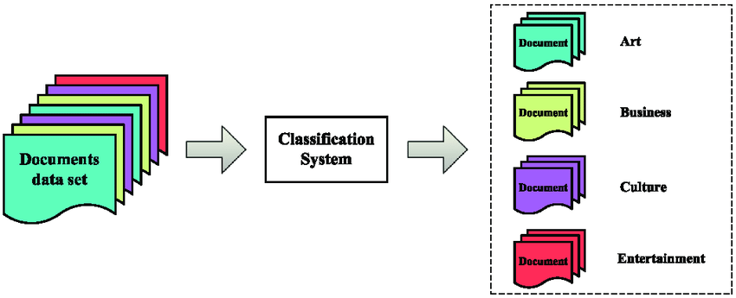
Introduction
Text Categorization is the activity of labeling natural language texts with relevant categories from a predefined set.
Text classification is a process of extracting generic tags from unstructured text [1].
Example: Document organization and retrieval, email filtering, a standard classification problem
Text categorization working method:
Pre-given categories and labeled document
Classify the new documents
A standard classification problem
Fig 1: Text categorization example
4

Slide 5
Objectives
To develop a text classifier that will streamline the process of categorizing the news that is published into various categories.
Classify BBC news articles into five categories using natural Language Processing and Machine Learning. Each document is automatically assigned one or more categories from a set of predetermined categories.
The five news topics are: Politics, Entertainment, Sports, Technology, and Business
5

Slide 6
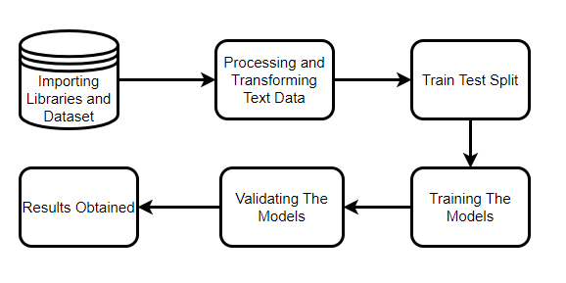
Methodology
Divide the labelled dataset into training and testing data.
Based on the training data feature extraction is done for the features which play a significant role.
Using this data the machine learning algorithm creates a predictive model.
Then the testing data used to validate the model.
Based on the results, work can be done for the improvement of model.
Fig 2: Text categorization step-by-step approach
6

Slide 7
Dataset Description
Dataset consists of 2225 news articles extracted from the BBC website between 2004 and 2005.
Published open source by Insight Resources and was collected by UC Davis for research
URL: http://mlg.ucd.ie/datasets/bbc.html
7

Slide 8
Data Preprocessing
Combining text files into one while preserving observation labels.
Dropping empty lines from data frame.
Under sampling to prevent bias from data imbalance
Samples of data from each category contain 386 observations
Removing all non-alphanumeric characters and symbols
8

Slide 9
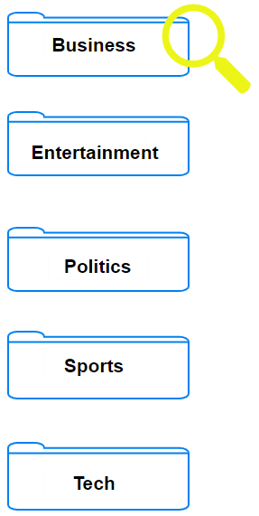
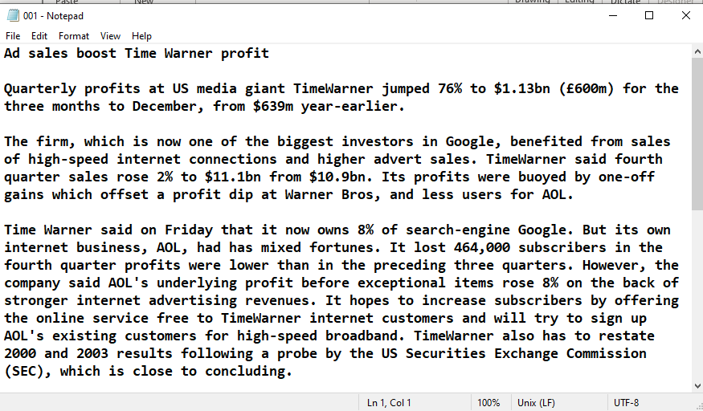
Data Format
001.txt
002.txt
003.txt
004.txt
.
.
.
336.txt
Fig 3: Structure and example of text file
9

Slide 10
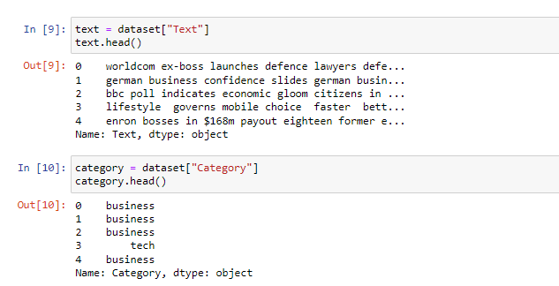
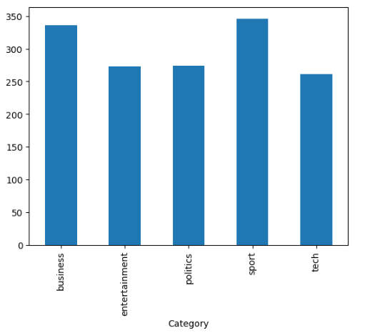
Class Distribution and Resampling
Fig 4: News class distribution and code
10

Slide 11
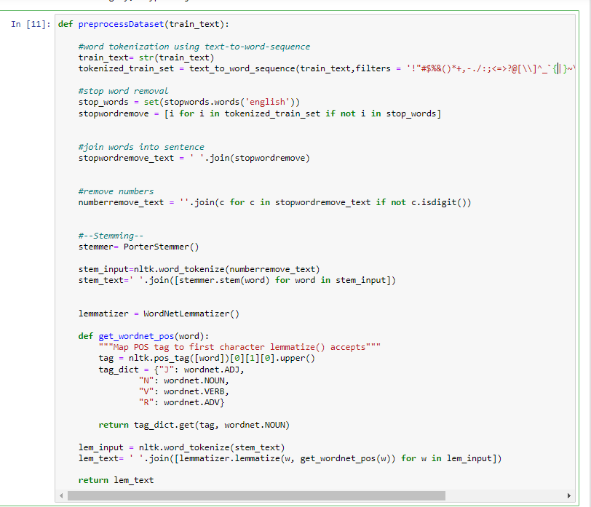
Text Preprocessing
Removing non-alphanumeric characters
Removing stop words
Converting the text into upper case
Fig 5: Text preprocessing function
11

Slide 12
Applied Models
The models that have been used in the study are as follows:
Logistic Regression
Random Forest
Naïve Bayes
Decision Tree
Support Vector Machine
AdaBoost
12

Slide 13
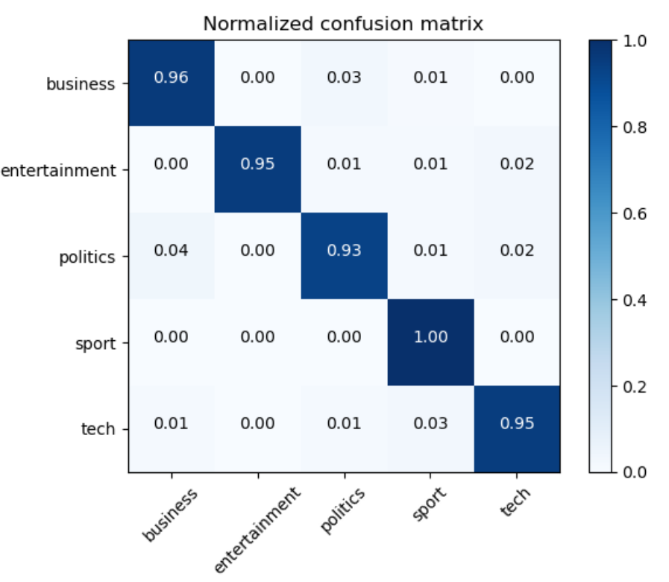
Logistic Regression
It is one of the most utilized methods. It is used to forecast the categorized dependent variable by making use of a group of independent variables that have already been identified.
Logistic regression is used to make predictions about the output when the dependent variable is categorical. Because of this, the value of the result has to be either discrete or categorical.
Assumption: a linear combination of the observed features and parameters used to predict the label.
Table 1: Evaluation metrics and training time for logistic regression
Fig 6: Logistic regression confusion matrix
Model | Accuracy | Precision | Recall | F1-Score | Training Time
LR | 95.74 | 96.0 | 96.0 | 95.8 | 4.621
13

Slide 14
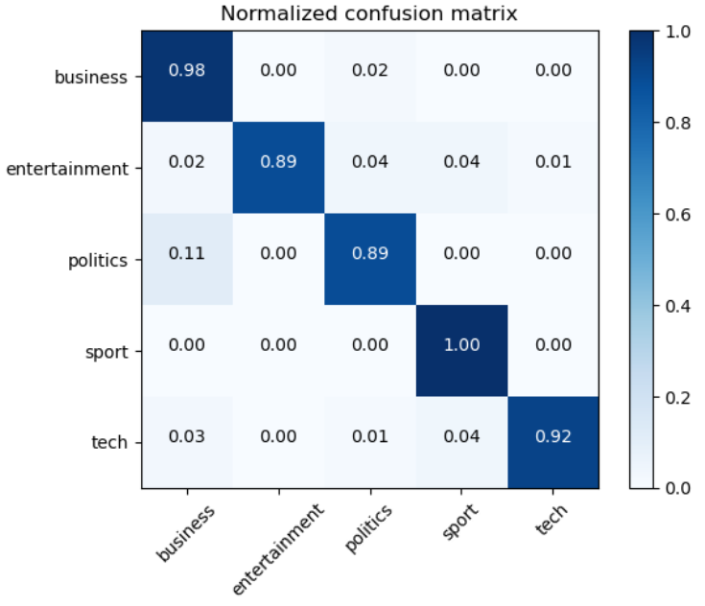
Random Forest
It is based on the concept of ensemble methods, which is a strategy that involves merging several different classifiers to solve challenging problems and improve model performance.
Top-down classification method with classification decision at terminal nodes
More trees and larger depth means less bias but more variance
When Implementing random forest, we have used 100 decision trees.
Table 2: Evaluation metrics and training time for random forest
Fig 7: Random forest confusion matrix
Model | Accuracy | Precision | Recall | F1-Score | Training Time
RF | 95.07 | 99.0 | 91.7 | 95.2 | 3.231
14

Slide 15
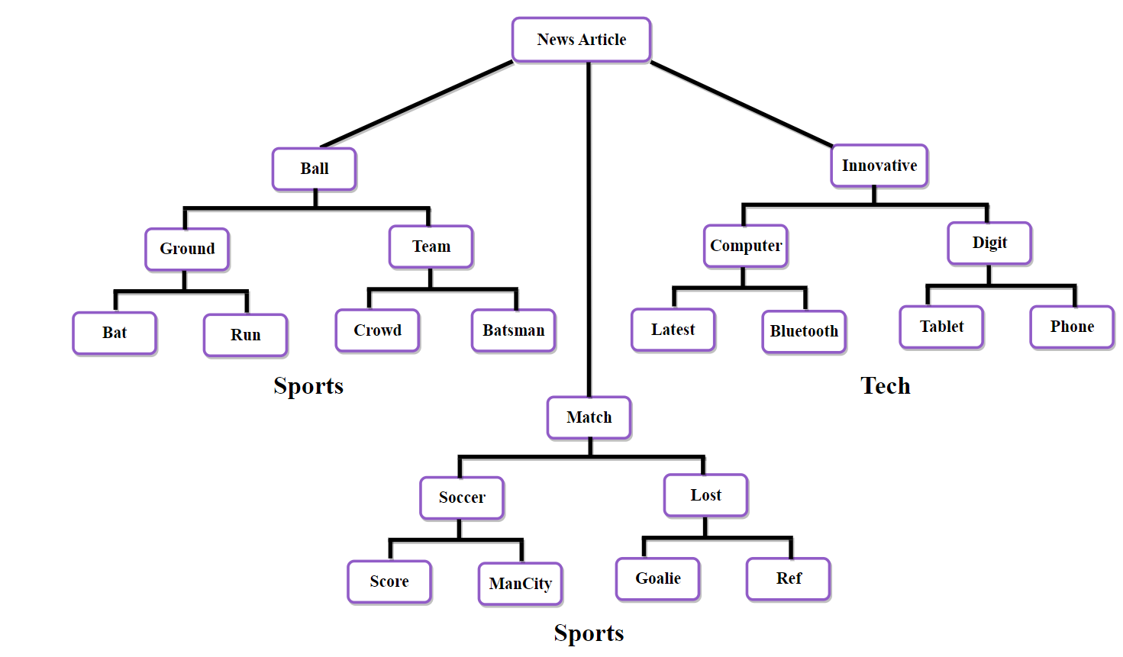
Class : Sports
Fig 8: Random forest example
15

Slide 16
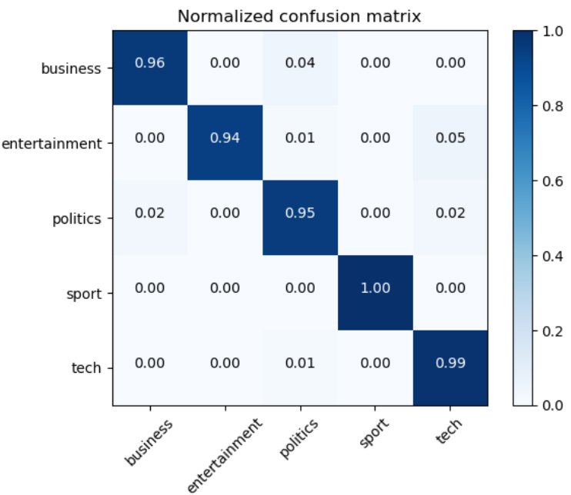
Naïve Bayes
The Naive Bayes algorithm is a supervised learning technique that may be used to classify problems; it is based on the Bayes theorem.
P( w | Sports) * P(Sports)
P( Sports | w ) = ----------------------------- (1)
P(w)
Where for the text “the team won the game”:
P(team won game) = P(team) * P(won) * P(game) (2)
Table 3: Evaluation metrics and training time for naïve bayes
Fig 9: Naïve bayes confusion matrix
Model | Accuracy | Precision | Recall | F1-Score | Training Time
NB | 96.86 | 96.0 | 97.9 | 97.0 | 1.495
16

Slide 17
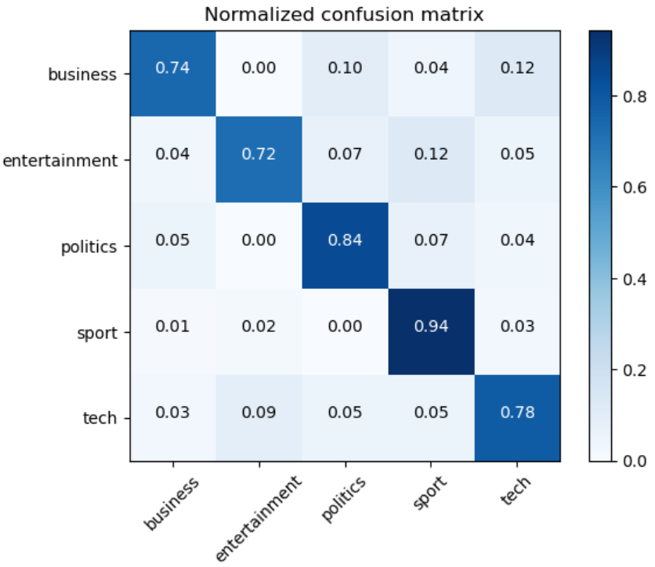
Decision Tree
It is a decision-making method that uses a representation of options and possible outcomes that resembles a tree.
The two nodes that make up a decision tree are referred to respectively as the Decision Point and the Leaf Node.
Decision nodes are used to make choices and contain several branches, while leaf nodes are the consequences of decisions and do not include any more branches.
Leaf nodes are also known as terminal nodes.
Table 4: Evaluation metrics and training time for decision tree
Fig 10: Decision Tree confusion matrix
Model | Accuracy | Precision | Recall | F1-Score | Training Time
DT | 82.77 | 78.2 | 89.7 | 83.5 | 1.278
17

Slide 18
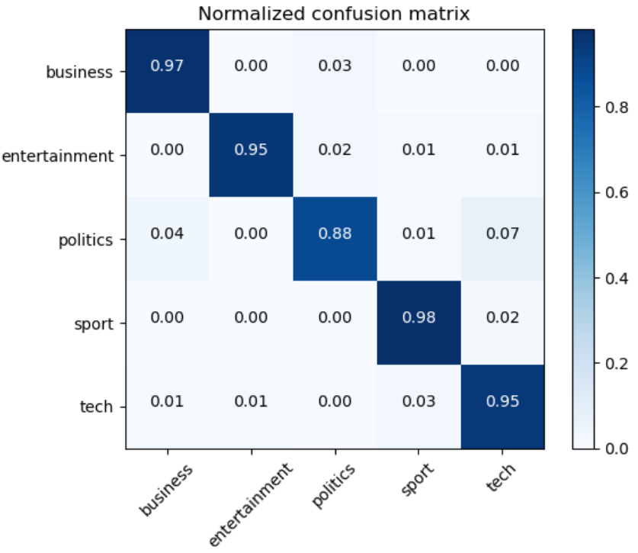
Support Vector Machine
It is one of the techniques for supervised learning that is used the most often, and its applications include the resolution of problems involving classification and regression.
It finds broad use in solving issues requiring categorization in ML. In support vector machines (SVM), each data point is represented as a point in n-dimensional space.
Productive in high dimensional space, memory systematic.
Table 5: Evaluation metrics and training time for support vector machine
Fig 11: Support vector machine confusion matrix
Model | Accuracy | Precision | Recall | F1-Score | Training Time
SVM | 94.85 | 97.0 | 96.0 | 96.5 | 7.466
19

Slide 19
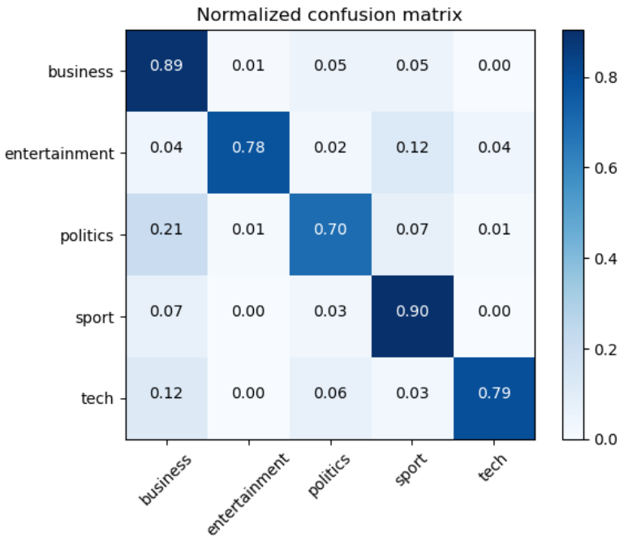
AdaBoost
AdaBoost is an ensemble approach that is used in ML, which is also known as Adaptive Boosting.
The most common implementation of the AdaBoost method is decision trees that include just a single branch, sometimes known as those with a single level.
It is ease of implement, flexibility and less parameter tweaking is required.
Table 6: Evaluation metrics and training time for AdaBoost
Fig 12: AdaBoost confusion matrix
Model | Accuracy | Precision | Recall | F1-Score | Training Time
AdaBoost | 74.49 | 72.2 | 65.7 | 70.2 | 2.169
20

Slide 20
Comparing the Results of the Models
The dataset contains documents from five categories: entertainment, business, politics, sports, and technology. We used various machine learning algorithms on the entire data set. To evaluate the classification algorithm's performance, we used traditional measures like accuracy, precision, etc.
So based on the below table we can say that the Naïve Bayes approach is the best-suited method with a high accuracy and minimal execution time.
Table 7: Evaluation metrics and training time
S.No | Model | Accuracy | Precision | Recall | F1-Score | Training time (in seconds)
1 | LR | 95.74 | 96.0 | 96.0 | 95.8 | 4.621
2 | DT | 82.77 | 78.2 | 89.7 | 83.5 | 1.278
3 | RF | 95.07 | 99.0 | 91.7 | 95.2 | 3.231
4 | NB | 96.86 | 96.0 | 97.9 | 97.0 | 1.495
5 | SVM | 94.85 | 97.0 | 96.0 | 96.5 | 7.466
6 | AdaBoost | 74.49 | 72.2 | 65.7 | 70.2 | 2.168
21

Slide 21
Conclusion and Future Work
The algorithm for machine learning offers a variety of solutions to the problems associated with text categorization and text mining.
The process of text categorization, along with several supervised machine-learning techniques, has been covered in this study.
The effectiveness of six different types of supervised ML classifiers support vector machine, random forest, logestic regression, naïve bayes, decision tree, and AdaBoost has been evaluated and compared.
The naïve bayes is the most efficient with its execution time and accuracy in addition to other metrics.
An additional deep learning methodology and the usage of neural networks are two methods that may be used to improve performance.
22

Slide 22
References
[1] R. Johnson and T. Zhang, “Supervised and Semi-Supervised Text Categorization using LSTM for Region Embeddings.” PMLR, pp. 526–534, Jun. 11, 2016. Accessed: Feb. 11, 2023. [Online]. Available: https://proceedings.mlr.press/v48/johnson16.html
[2] R. Aly, S. Remus, … C. B. the 57th A. M. of the, and undefined 2019, “Hierarchical multi-label classification of text with capsule networks,” aclanthology.org, pp. 323–330, Accessed: Feb. 11, 2023. [Online]. Available: https://aclanthology.org/P19-2045/
[3] Y. Chen, “Convolutional neural network for sentence classification,” 2015, Accessed: Feb. 11, 2023. [Online]. Available: https://uwspace.uwaterloo.ca/handle/10012/9592
[4] S. Albawi, O. Bayat, S. Al-Azawi, and O. N. Ucan, “Understanding of a convolutional neural network,” ieeexplore.ieee.org, 2018, doi: 10.1155/2018/6973103.
[5] J. Devlin, M.-W. Chang, K. Lee, K. T. Google, and A. I. Language, “Bert: Pre-training of deep bidirectional transformers for language understanding,” arxiv.org, Accessed: Feb. 11, 2023. [Online]. Available: https://arxiv.org/abs/1810.04805
[6] Z. Yang, D. Yang, C. Dyer, X. He, … A. S.-P. of the, and undefined 2016, “Hierarchical attention networks for document classification,” aclanthology.org, pp. 1480–1489, Accessed: Feb. 11, 2023. [Online]. Available: https://aclanthology.org/N16-1174.pdf
24

Slide 23

Thank you

