Slide 1
PROJECT TITLE
CAPSTONE PROJECT
Presented By:
Sakshi Srivastava - SRM Institute of Science and Technology, Kattankulathur, Tamil Nadu - MCA

Slide 2
OUTLINE
Problem Statement
Proposed System/Solution
System Development Approach
Algorithm & Deployment
Result
Conclusion
Future Scope
References

Slide 3
Problem Statement
JobSetu — AI Job Mentor for Informal Workers Challenge – Millions of informal workers such as daily wage laborers, artisans, gig workers, and self-employed individuals face difficulty in accessing job opportunities, skill development programs, and financial resources. Most of them are unaware of government schemes, training courses, or nearby job openings that could improve their income and career prospects. The lack of digital literacy, guidance, and personalized information further widens the opportunity gap — especially in semi-urban and rural communities. There is a strong need for a personalized, always-accessible, and vernacular-language job mentorship platform that empowers informal workers to find better jobs and build sustainable livelihoods.

Slide 4
Proposed Solution
JobSetu — An AI-driven, multilingual job mentorship platform designed specifically for informal workers (daily wage laborers, artisans, gig workers).
To address the challenges faced by informal workers in accessing job opportunities, government schemes, and skill development resources, the proposed solution is an AI-powered mentor, JobSetu, built using IBM Cloud Lite services and enhanced with Retrieval-Augmented Generation (RAG) architecture.
AI Job Mentor powered by IBM Granite and RAG.
Acts as a personal assistant for informal workers.
Provides localized job leads, upskilling suggestions, scheme benefits.
Supports queries in vernacular languages.
Delivered via Mobile App, IVR, or WhatsApp Chatbot (Low-tech user reach).

Slide 5
System Approach
The "System Approach" section outlines the overall strategy and methodology for developing and implementing the rental bike prediction system. Here's a suggested structure for this section:
System requirements
IBM Granite LLM for language understanding.
IBM Watson Discovery for document retrieval (RAG pipeline).
IBM Cloud Lite Services for backend APIs.
Object Storage for managing documents and datasets.

Slide 6
User Interaction Layer
A multilingual chatbot interface that allows users to interact in their preferred language (English, Hindi, Marathi, Gujarati, Telugu, Tamil).
Accessible via web/mobile.
Backend Logic (IBM Cloud Functions)
Manages conversation flow and API integrations.
Handles dynamic prompts for language-specific responses.
Retriever Module (API Integration)
Searches trusted external sources (Google Search API, Government Portals).
Retrieves up-to-date information on job listings, schemes, and training programs.
Generator Module (Granite-3-3-8b-instruct Model)
Processes user queries and generates human-like, localized responses.
Ensures responses are simplified and contextual to informal workers' needs.
Language Support
Multi-language conversation support using Prompt Engineering and AI response conditioning.
Future scope to add auto-language detection.
Feedback Loop
Logs user feedback and common queries.
Used for improving prompts, updating retrieval sources, and enhancing model accuracy over time.

Slide 7
Algorithm
User Query Intake:
User inputs a question via chatbot interface (Web/Mobile).
Preferred language is captured and stored.
Prompt Formulation (Backend Logic):
Dynamic prompt is generated using the user’s query and selected language.
Example: "User asked: @user_query. Reply in @preferred_language."
Retriever Module Activation:
External API calls (e.g., Google Search) are triggered if required.
Retrieves job listings, schemes, or resources from trusted sources.
LLM Inference (Granite-3-3-8b-instruct):
User query along with retrieval data is passed to the Granite LLM.
LLM generates a simplified, localized response in the selected language.
Response Delivery:
AI-generated answer is displayed back to the user via chatbot interface.
Feedback is collected (optional).

Slide 8
Deployment
Frontend:
Web-based Chatbot UI / Mobile Integration.
Multilingual input support.
IBM Watsonx.ai Studio:
Agentic Lab used to design conversational flow.
Manages prompt engineering and response orchestration.
IBM Cloud Functions (Lite Plan):
Handles API calls to external sources (Retriever Module).
Controls backend business logic for prompt formation.
IBM Granite LLM API:
Processes user prompts and generates natural language responses.
Ensures vernacular accuracy and contextual relevance.
Optional Database (For Offline Datasets):
Can store localized job listings and government scheme documents.
Deployment Flow Summary:
User ➔ Chatbot UI ➔ Backend Logic (IBM Cloud Functions) ➔ Retriever (API Calls)
➔ Granite LLM Inference ➔ AI Response to User.

Slide 9
IBM cloud services used
IBM Watsonx.ai Studio (Agentic Lab)
IBM Granite LLM API (3-3-8b-instruct)
IBM Cloud Functions (Lite Plan)
Google Search API (Lite Integration)
Custom Database/API for offline job listings.
IBM Cloud Object Storage

Slide 10
Result
Key Metrics:
Languages Supported: 6
Average Response Time: Under 5 seconds
API Calls Triggered per Query: Conditional (based on need)
Multilingual Conversations:
Successfully responds in Hindi, Marathi, Gujarati, Telugu, Tamil, and English.
User-selected language is maintained throughout the conversation.
Job & Scheme Information Retrieval:
Provides relevant responses to user queries regarding job opportunities, skill programs, and government schemes.
Retrieves real-time data using API calls and LLM reasoning.
Vernacular Response Accuracy:
Simplified and localized replies ensuring easy understanding for informal workers.
Seamless User Experience:
Web-based chatbot interface with intuitive language selection flow.
Cost-Efficient Deployment:
Deployed on IBM Cloud Lite Plan ensuring free-tier usage with scalable architecture.

Slide 11
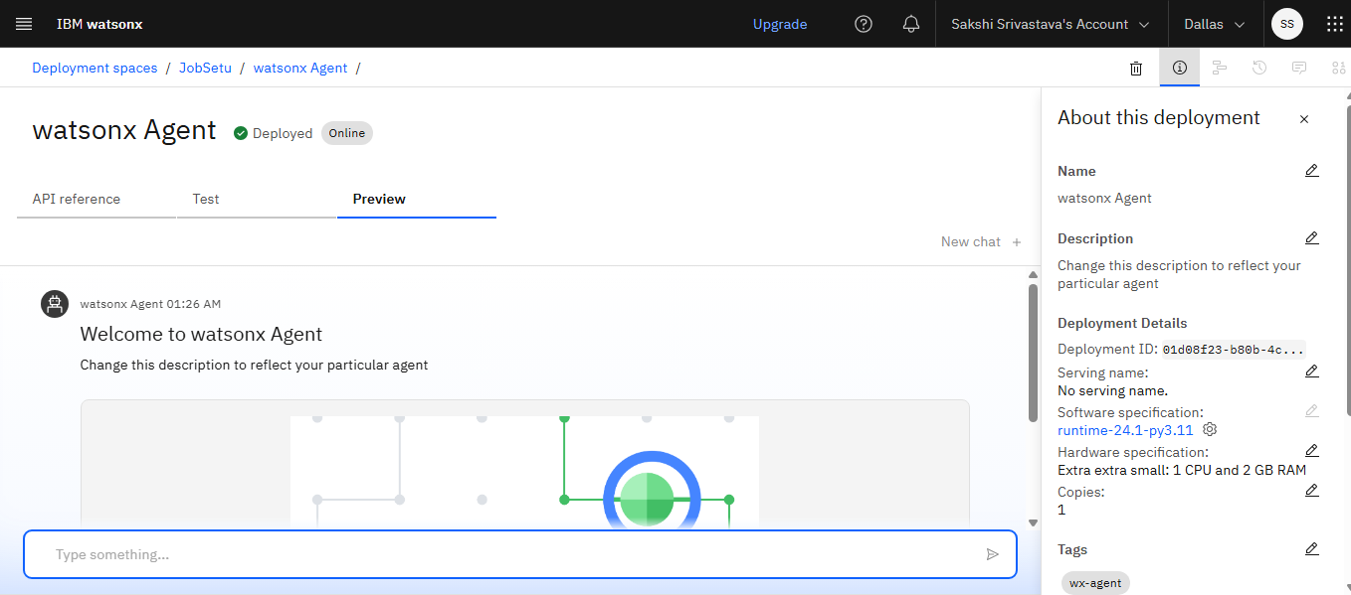

Slide 12
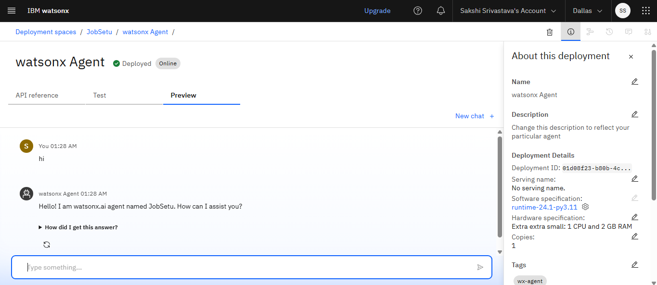

Slide 13
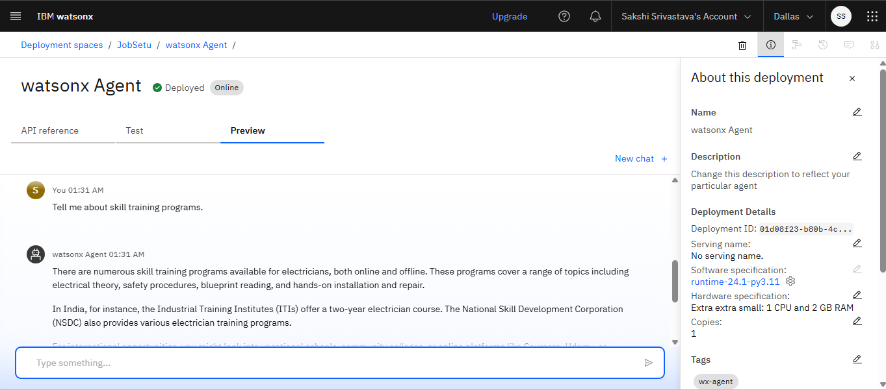

Slide 14
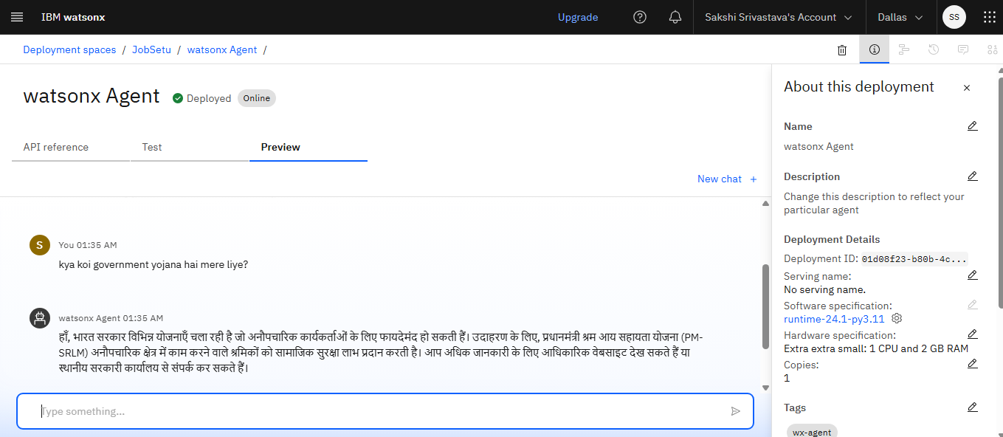

Slide 15
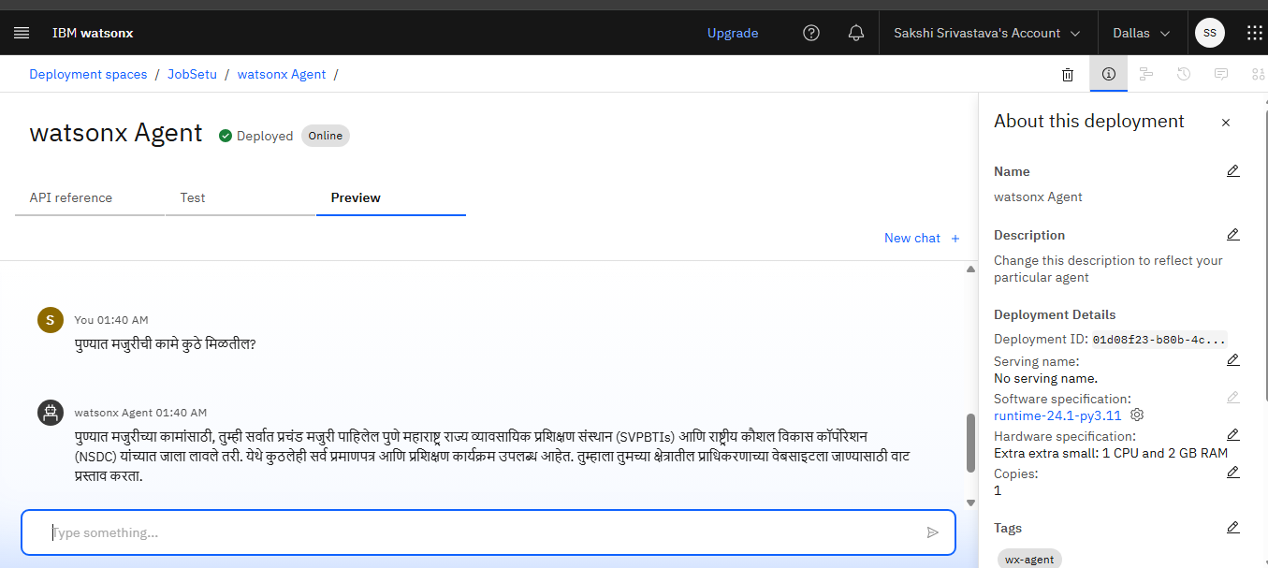

Slide 16
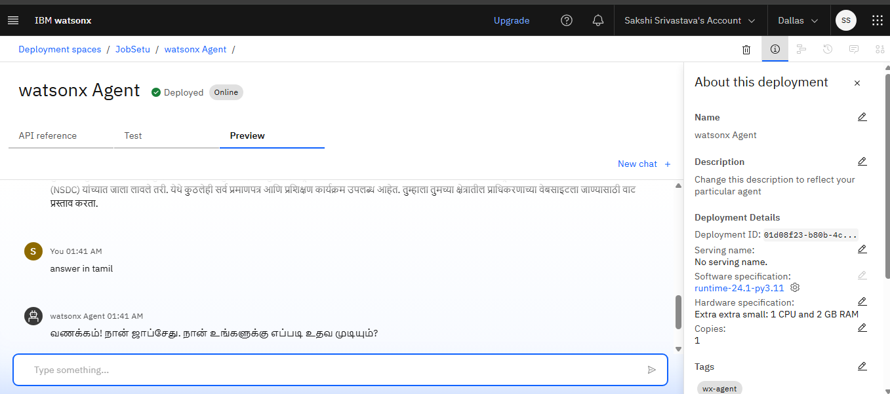

Slide 17
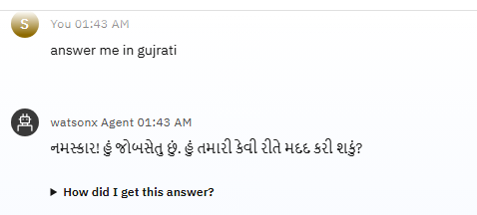
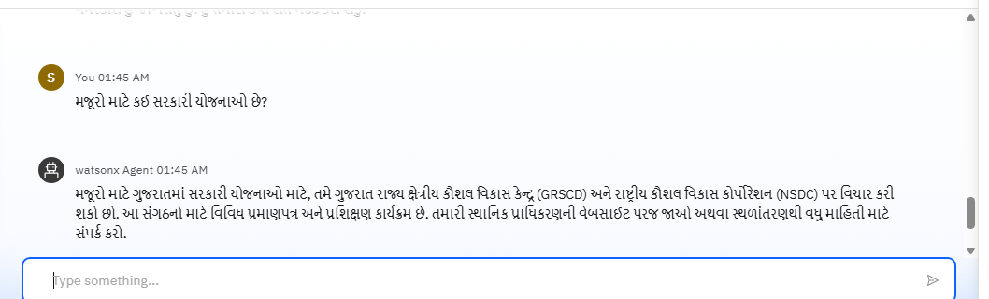
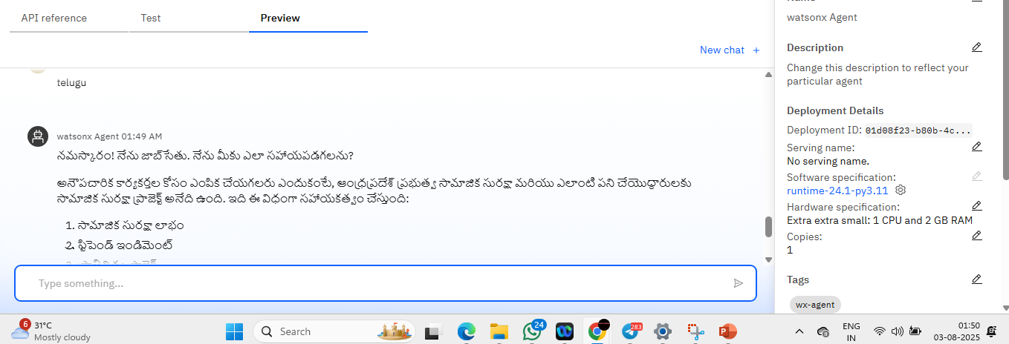

Slide 18
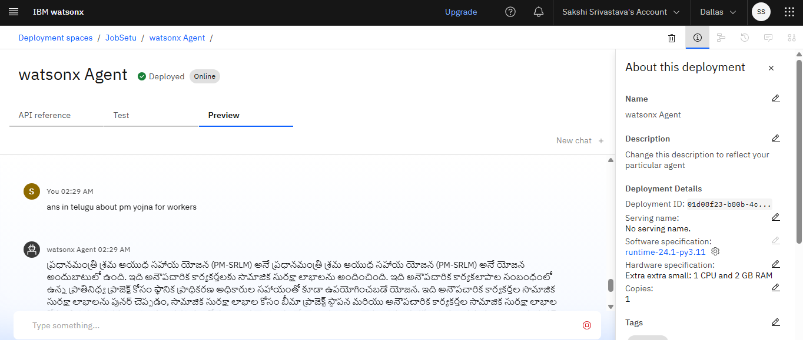

Slide 19
Conclusion
Empowering millions of informal workers with personalized, always-accessible
career guidance, fostering sustainable livelihoods.
JobSetu bridges the information gap for informal workers by providing job opportunities, schemes, and
skill guidance in local languages.
Built using IBM Watsonx.ai and Granite LLM, ensuring an accessible and scalable AI-driven
mentorship platform.
Simple, multilingual interface makes it usable for digitally less-savvy users.

Slide 20
Future scope
Expand to IVR for non-smartphone users.
Real-time integration with local employers.
Voice AI with dialect recognition.
Collaborations with Skill India initiatives.
Expand language support to more regional dialects.
Add auto-language detection capabilities.
Include real-time job listing APIs and offline database sync.
Deploy on mobile apps for wider accessibility.

Slide 21
References
https://cloud.ibm.com/docs
https://www.ibm.com/products/watsonx-ai
https://www.ibm.com/docs/en/watsonx-ai/granite https://developers.google.com/custom-search/v1/overview
Government Schemes Reference (e-SHRAM, PM-SYM, PMKVY)
https://maandhan.in
https://eshram.gov.in
https://www.pmkvyofficial.org/
Language Translation References
Google Translate API (for prompt engineering best practices)
IBM AI Multilingual Guidelines

Slide 22
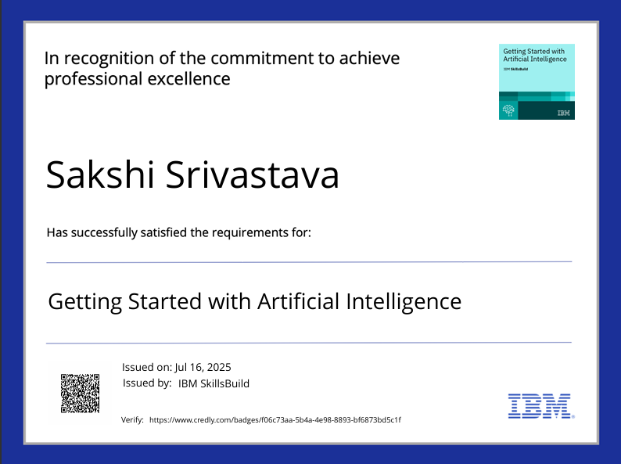
IBM Certifications
Screenshot/ credly certificate( getting started with AI)

Slide 23
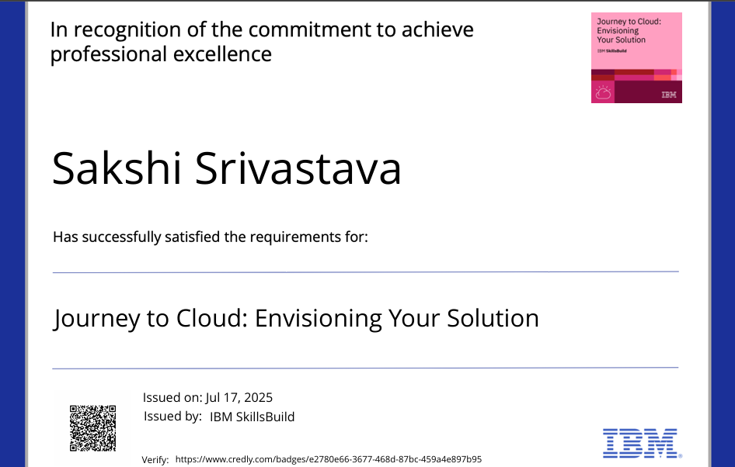
IBM Certifications
Screenshot/ credly certificate( Journey to Cloud)

Slide 24
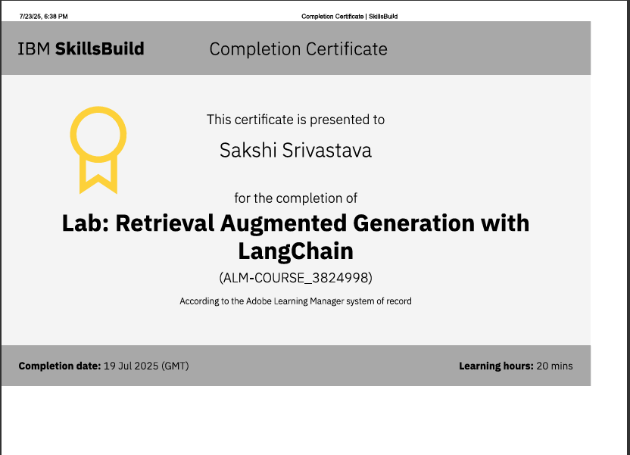
IBM Certifications
Screenshot/ credly certificate( RAG Lab)

Slide 25
THANK YOU

