Slide 1

SANJIVANI COLLEGE OF ENGINEERING
SMART FARMING × INTELLIGENT INDIA
DEPARTMENT OF ELECTRONICS AND COMPUTER ENGINEERING
INDUSTRY 4.0 | PROJECT-BASED LEARNING (PBL)
KrushiAI
AI-IoT based soil testing and intelligent crop recommendation system
TEAM MEMBERS
Sakshi Ramdas Zurale
Sakshi Vijay Thakare
UEC23F1069 | Roll No. 69
UEC23F1064 | Roll No. 64
PROJECT GUIDE Prof. A. D. Sangale
Notes:
Introduce KrushiAI, the team, the guide and the Smart Farming x Intelligent India theme. Artwork is illustrative vector art; replace with real photographs if available.

Slide 2









Presentation Roadmap
01
02
03
Introduction and Problem Statement
Objectives and Proposed Solution
KrushiAI System Architecture
04
05
06
Soil Testing and NPK Monitoring
AI Crop Recommendation Methodology
Implementation and Application Workflow
07
08
09
Results and Report Generation
Innovation and Patent Registration
Conclusion and Future Scope
Notes:
Walk through the nine sections of the presentation.

Slide 3

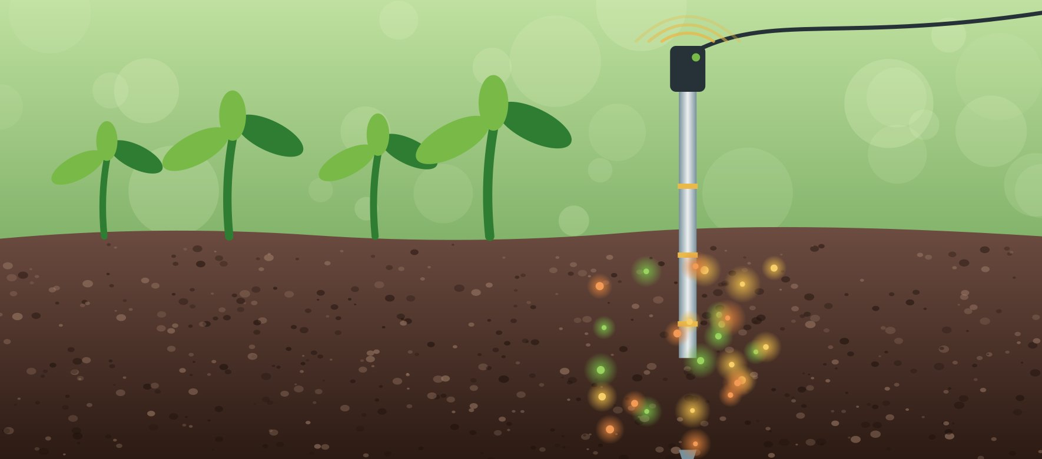




Why Smart Crop Selection Matters
Traditional decision-making
Data-assisted workflow
Crop choices depend on soil conditions and local context
Manual assessment can be slow, with no integrated view
Nutrients, moisture, temperature and humidity can shape suitability
Farmers need clear, accessible and actionable guidance
KrushiAI is an intelligent farming platform that supports informed crop-selection decisions through soil measurements, machine learning and location-related analysis.
Notes:
Left: traditional decision-making challenges. Right: data-assisted workflow. We do not claim guaranteed yield improvements.

Slide 4

Our Vision: Smarter Decisions for Every Field
Soil Intelligence
Location-Aware Analysis
Collect or enter soil nutrient measurements and environmental readings.
Capture farmer and farm location details to support location-related analysis.
AI-Based Crop Recommendation
Accessible Reporting
Use a machine-learning model to rank candidate crops using supported input features.
Downloadable soil-analysis and crop-recommendation reports in English and English + Marathi.
SOIL DATA
ANALYSIS
AI CROP RECOMMENDATIONS
FARMER REPORT
Designed to support decisions, improve access to information and present recommendations clearly. It does not guarantee profit, crop yield or universal suitability.
Notes:
Four objective cards around the farmer, with the SOIL DATA to FARMER REPORT flow below.

Slide 5



From Soil Signals to Intelligent Recommendations
Results shown in the UI · reports downloaded
LAYER 1
LAYER 3
LAYER 4
LAYER 5
User Interface
Backend
AI & Knowledge
Output
React frontend
Farmer & farm details
Manual soil-data entry
Results & recommendations
PDF download options
Python + FastAPI
Input validation and processing
Soil analysis
Location-related analysis
Recommendation workflow
Scikit-learn Random Forest
Crop prediction / ranking
Local knowledge retrieval (where implemented)
Recommendation explanation
Soil analysis
Ranked crop recommendations
Suitability labels & model scores
English PDF report
Bilingual English + Marathi PDF
LAYER 2
Data Collection
NPK sensor readings (where hardware is used)
Manual N, P, K entry
Soil moisture, air temperature, humidity
Soil → sensor / entry → AI recommendation
Items marked "where…" depend on the deployed setup. Future enhancements are listed on slide 10.
Notes:
Layered architecture: React UI, data collection (ESP32/NPK sensor or manual entry), FastAPI backend, Random Forest AI layer and PDF outputs. Only confirm implemented components.

Slide 6
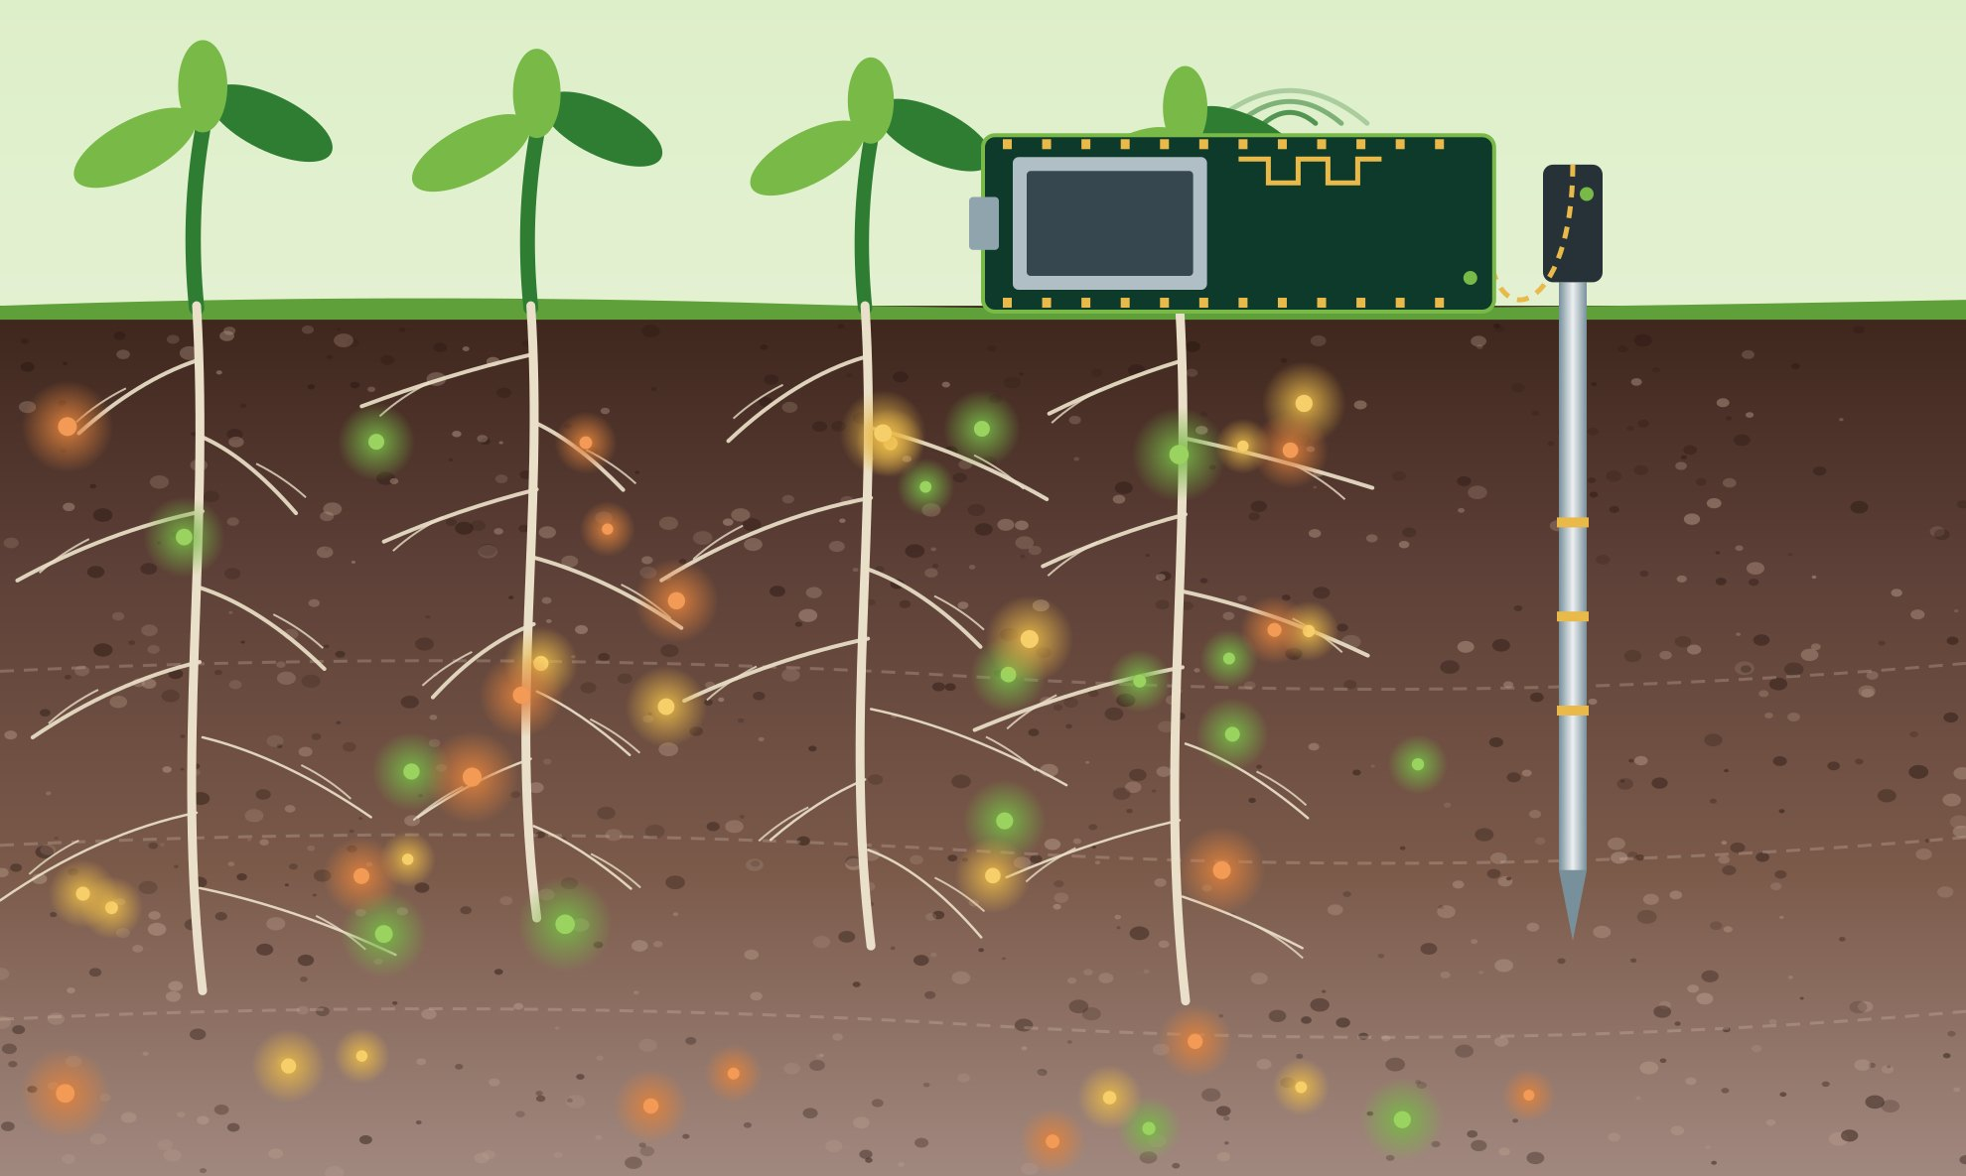
Understanding the Soil Beneath Every Crop
N
Nitrogen
Supports vegetative growth and leaf development.
ESP32 / IoT gateway
P
Phosphorus
Contributes to root development and energy-transfer processes.
K
Potassium
NPK soil probe
Supports water regulation and multiple plant functions.
N · P · K
+
Soil moisture
+
Air temperature
+
Humidity
SOIL ANALYSIS
Measured or entered inputs
Derived analysis
Readings should be interpreted according to sensor calibration and the applicable measurement method. Measured or entered values are kept distinct from model-generated information.
Notes:
N, P, K roles, plus moisture, temperature and humidity. No sensor accuracy claims are made.

Slide 7





How KrushiAI Recommends Crops
01
02
03
04
05
06
Collect Inputs
Validate & Process
Random Forest Model
Rank Candidate Crops
Present Results
Farmer Review
Soil and environmental inputs
Check and prepare input values
Trained model uses supported features
Candidate crops are ranked
Scores and supporting information shown
Farmer reviews the results
Illustrative output layout
A model score is not a guaranteed probability of crop success, yield or profit.
1 Crop A
2 Crop B
Model inputs: supported soil and environmental features. Location details support location-related analysis.
Soil data
Random Forest
3 Crop C
Report
Notes:
Pipeline from inputs to ranked crops. No accuracy or evaluation metrics are stated because none were supplied. Verify which fields are actual model inputs before presenting.

Slide 8
From Field Inputs to Farmer-Friendly Reports
Farmer details
Soil input / sensor readings
Soil analysis
Location analysis
AI crop recommendations
Report generation
1
2
3
4
5
6
N
1 Candidate crop
P
2 Candidate crop
K
Moisture
3 Candidate crop
English
EN + मराठी
SCREENSHOT PLACEHOLDER
SCREENSHOT PLACEHOLDER
SCREENSHOT PLACEHOLDER
SCREENSHOT PLACEHOLDER
Application dashboard
Soil input / sensor screen
Crop recommendation results
English and bilingual reports
IMPLEMENTED DELIVERABLES
Farmer & farm information capture
Manual soil entry + sensor workflow (where implemented)
AI crop recommendations
Soil analysis results
Location-related analysis
English PDF report
Bilingual English + Marathi PDF
Notes:
Wireframes are illustrative placeholders. Replace with real application screenshots before presenting.

Slide 9

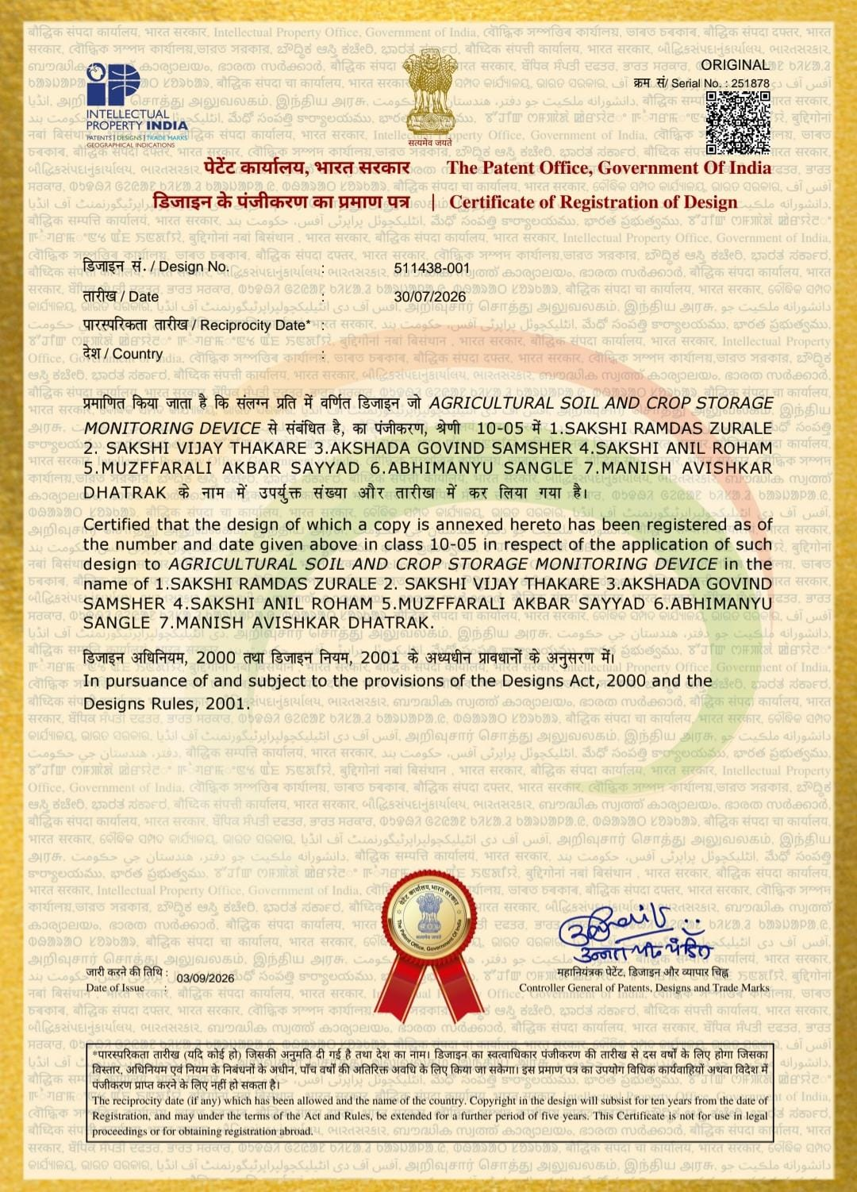


Innovation Protected: Registered Design
REGISTERED DESIGN · ASSOCIATED PROJECT: KRUSHIAI
Agricultural Soil and Crop Storage Monitoring Device
DESIGN REGISTRATION NO.
511438-001
Space reserved for the official design registration certificate image (if supplied)
SERIAL NO.
CLASS
REGISTRATION DATE
251878
10-05
30 July 2026
This is a design registration, not a patent. It is an innovation and IP milestone associated with KrushiAI and does not imply protection of every software module.
Notes:
Verified details only: Design Registration No. 511438-001, Serial No. 251878, Class 10-05, registered 30 July 2026. Do not describe this as a patent.

Slide 10





Building the Future of Intelligent Farming
CONCLUSION · TODAY
FUTURE SCOPE · NEXT (planned enhancements, not yet implemented)
KrushiAI combines soil information, machine learning and location-related analysis in a farmer-oriented workflow.
It provides AI-supported crop recommendations based on the supported inputs.
Soil analysis and recommendation reports are available in English and bilingual English + Marathi formats.
It shows how AI and IoT can contribute to digital agriculture.
Field validation with agronomy experts and farmers
Broader sensor calibration and testing
More robust location-specific recommendations
Verified live weather and market data integration
Additional Indian-language support
Explainable AI and improved model evaluation
Mobile-friendly or offline-capable access
Market price and profit decision support
Notes:
Conclusion lists current capabilities. Future scope items are proposals only.

Slide 11


KrushiAI
THANK YOU
KrushiAI — From Crop Selection to Market Profit
Empowering smarter farming through soil intelligence and AI.
Questions & Discussion
Department of Electronics and Computer Engineering | Sanjivani College of Engineering

