Slide 1
Single-Cell RNA-seq Data Analysis: Understanding Cellular Heterogeneity
By – Sakshi Sharma & Pakhi
MSc. Bioinformatics (Sem III)
Department of Computer Science
Jamia Millia Islamia (Central University), New Delhi - 110025
Year 2034-2025

Slide 2
Table of Contents
Introduction
Overview of Single-Cell RNA Sequencing
Workflow of RNA sequencing
Technologies in RNA sequencing
Identifying Cell Types
Differential Expression Analysis
Case study
Challenges in RNA seq
Future Directions

Slide 3
Introduction
What is single-cell RNA sequencing?
RNA sequencing (RNA-seq) is a genomic approach for the detection and quantitative analysis of messenger RNA molecules, useful for studying cellular responses.
Single-cell RNA sequencing (scRNA-seq) is a powerful technique used to describe RNA molecules and analyze gene expression of individual cells with high resolution.
It allows researchers to examine the complete set of RNA transcripts within a single cell, providing insights into the cell's functional state, identity, and behavior.
First single-cell RNA-sequencing (scRNA-seq) study was published in 2009
What is Cellular Heterogeneity?
Cellular heterogeneity is the diversity in characteristics among individual cells within a population, tissue, or organism.
This variation can occur in terms of cellular morphology, gene expression, protein levels, metabolic activity, or responses to environmental stimuli.
Cell heterogeneity has been appreciated in many studies of diseases, such as cancers, infectious diseases, and brain disorders.
Research on cellular heterogeneity has been performed in different areas, including genomics, transcriptomics, proteomics, and metabolomics.
Importance of scRNA-seq to capture cellular diversity
ScRNA-seq permits comparison of the transcriptomes of individual cells.
A major use of scRNA-seq has been to assess transcriptional similarities and differences within a population of cells.
Revealing previously unappreciated levels of heterogeneity, for example in embryonic and immune cells.
Thus, heterogeneity analysis remains a core reason for embarking on scRNA-seq studies.
Benefits of scRNA-seq for studying tissue-specific expression, rare cell populations and other studies
Identifying Rare Cell Populations: scRNA-seq can detect rare cell types, like malignant tumor cells or highly responsive immune cells, which are often missed in bulk cell analyses.
Tracking Unique Cells: It is particularly useful for studying naturally diverse cells, such as T lymphocytes with different T-cell receptors, neurons in the brain, or early-stage embryo cells.
Tracing Lineage and Development: scRNA-seq helps track how cells evolve over time, such as during embryo development, cancer progression, and immune cell differentiation.
Gene Expression Insights: It uncovers details of gene expression at the single-cell level, revealing patterns like monoallelic gene expression, splicing variations, and transcriptional noise.
Understanding Gene Regulation: By analyzing single-cell co-expression, scRNA-seq can identify groups of co-regulated genes and infer gene networks that drive cell behavior and specialization.

Slide 4
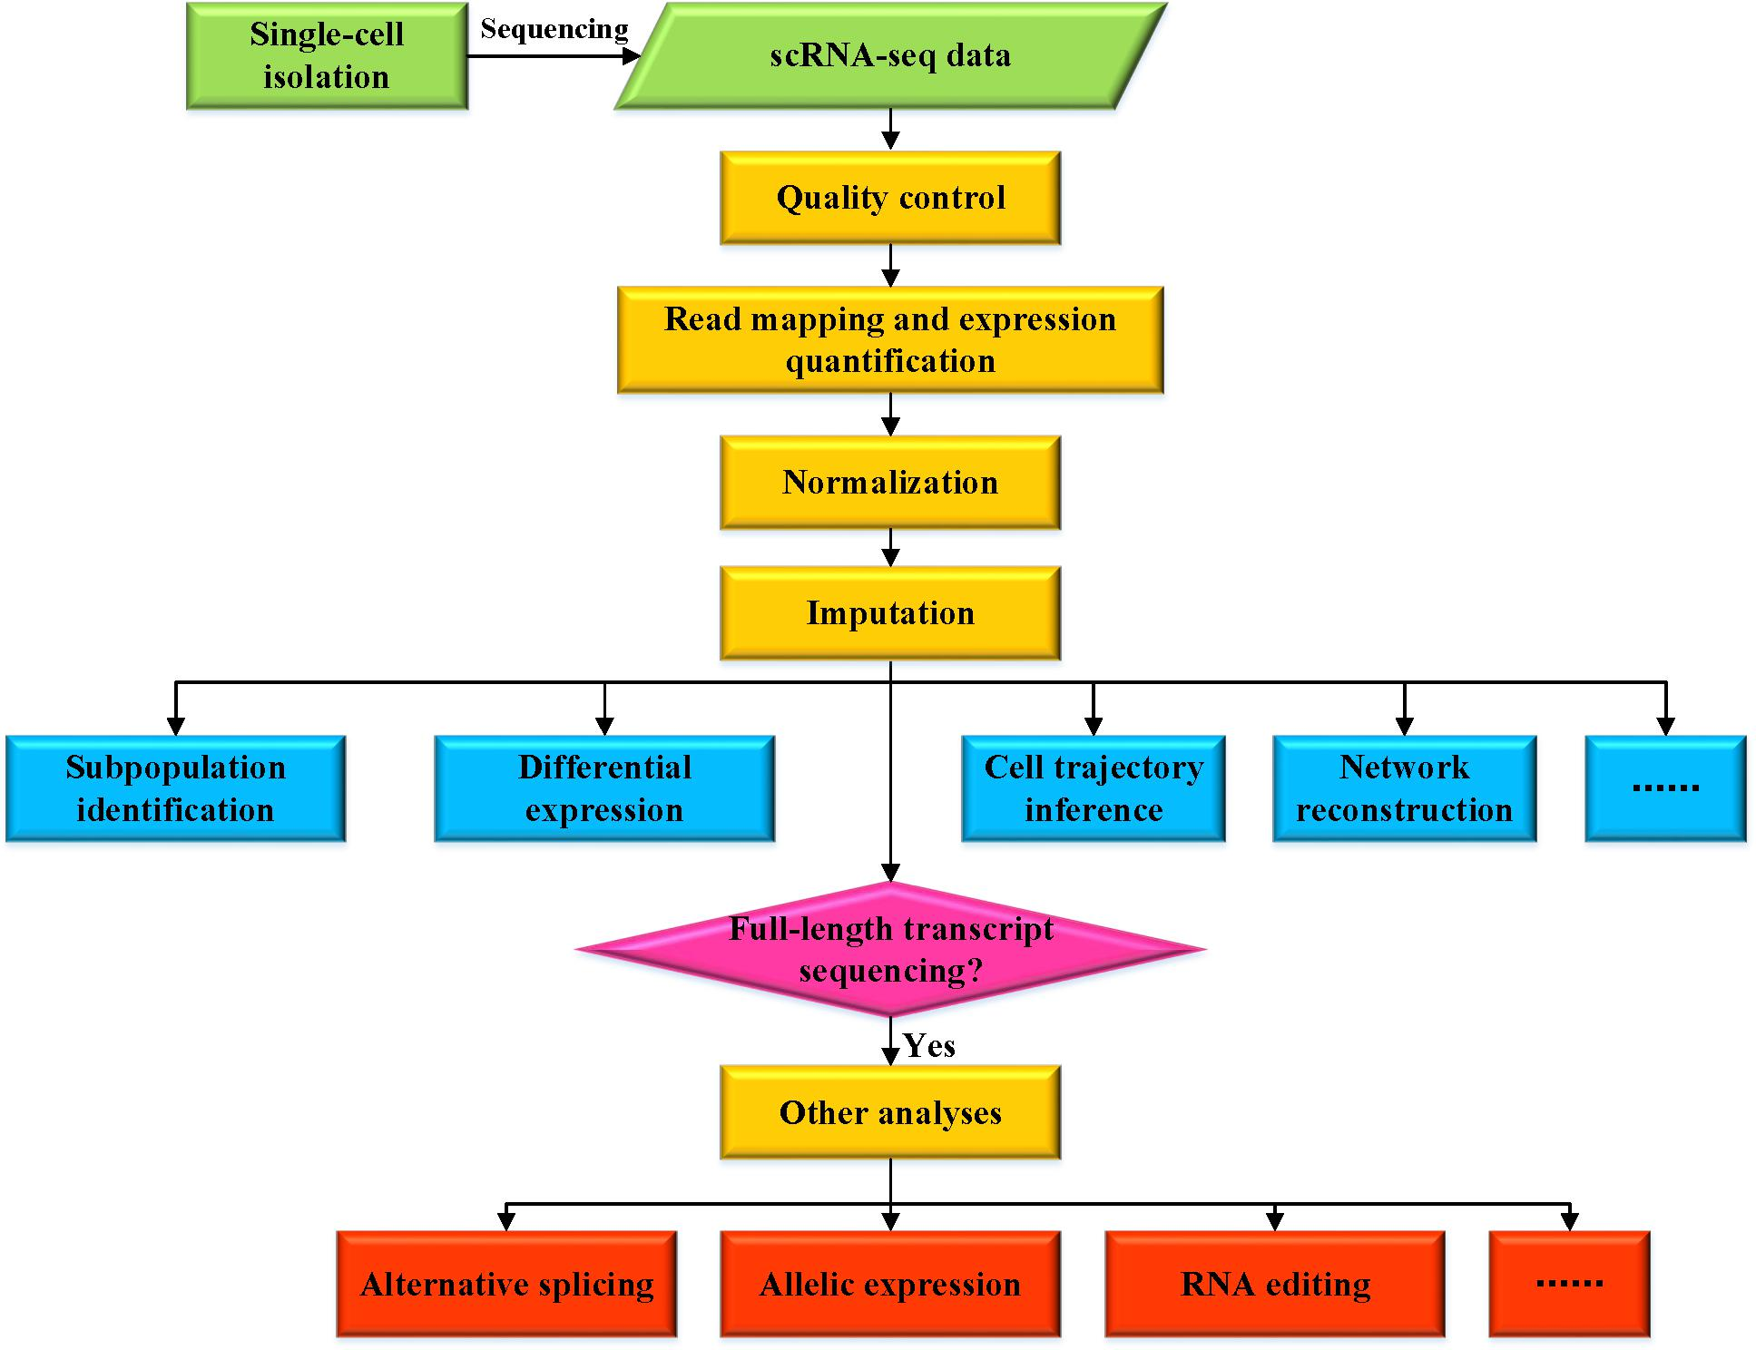
What is single-cell RNA sequencing?
RNA sequencing (RNA-seq) is a genomic approach for the detection and quantitative analysis of messenger RNA molecules, useful for studying cellular responses.
Single-cell RNA sequencing (scRNA-seq) is a powerful technique used to describe RNA molecules and analyze gene expression of individual cells with high resolution.
It allows researchers to examine the complete set of RNA transcripts within a single cell, providing insights into the cell's functional state, identity, and behavior.
First single-cell RNA-sequencing (scRNA-seq) study was published in 2009
What is Cellular Heterogeneity?
Cellular heterogeneity is the diversity in characteristics among individual cells within a population, tissue, or organism.
This variation can occur in terms of cellular morphology, gene expression, protein levels, metabolic activity, or responses to environmental stimuli.
Cell heterogeneity has been appreciated in many studies of diseases, such as cancers, infectious diseases, and brain disorders.
Research on cellular heterogeneity has been performed in different areas, including genomics, transcriptomics, proteomics, and metabolomics.
Importance of scRNA-seq to capture cellular diversity
ScRNA-seq permits comparison of the transcriptomes of individual cells.
A major use of scRNA-seq has been to assess transcriptional similarities and differences within a population of cells.
Revealing previously unappreciated levels of heterogeneity, for example in embryonic and immune cells.
Thus, heterogeneity analysis remains a core reason for embarking on scRNA-seq studies.
Benefits of scRNA-seq for studying tissue-specific expression, rare cell populations and other studies
Identifying Rare Cell Populations: scRNA-seq can detect rare cell types, like malignant tumor cells or highly responsive immune cells, which are often missed in bulk cell analyses.
Tracking Unique Cells: It is particularly useful for studying naturally diverse cells, such as T lymphocytes with different T-cell receptors, neurons in the brain, or early-stage embryo cells.
Tracing Lineage and Development: scRNA-seq helps track how cells evolve over time, such as during embryo development, cancer progression, and immune cell differentiation.
Gene Expression Insights: It uncovers details of gene expression at the single-cell level, revealing patterns like monoallelic gene expression, splicing variations, and transcriptional noise.
Understanding Gene Regulation: By analyzing single-cell co-expression, scRNA-seq can identify groups of co-regulated genes and infer gene networks that drive cell behavior and specialization.
Introduction
Source: https://www.frontiersin.org/journals/genetics/articles/10.3389/fgene.2019.00317/full

Slide 5
Introduction
Source: https://www.frontiersin.org/journals/genetics/articles/10.3389/fgene.2019.00317/full

Slide 6
Overview of Single-Cell RNA-seq
Difference between Bulk RNA-seq and scRNA-seq
Feature | Bulk RNA-seq | Single-Cell RNA-seq
Cellular Resolution | Averages gene expression across many cells | Captures gene expression for individual cells
Heterogeneity Detection | Unable to detect cellular heterogeneity within a sample | Detects heterogeneity and identifies distinct cell types, states, or rare cell populations
Sensitivity | Lower sensitivity to rare cell types and subtle differences | Higher sensitivity; can detect rare cell populations and distinct cellular states
Data Complexity | Simpler, but averages out differences | More complex due to many individual profiles
Cell State Information | Cannot reveal information on individual cell states or cell-to-cell variability | Reveals detailed information about cell states, trajectories, and functions
Cell Population Analysis | Cannot distinguish between different cell types or states | Identifies different cell types and subtypes in complex tissues
Cost & Data Size | Cheaper and produces smaller data sets | More expensive with larger, more complex data sets

Slide 7
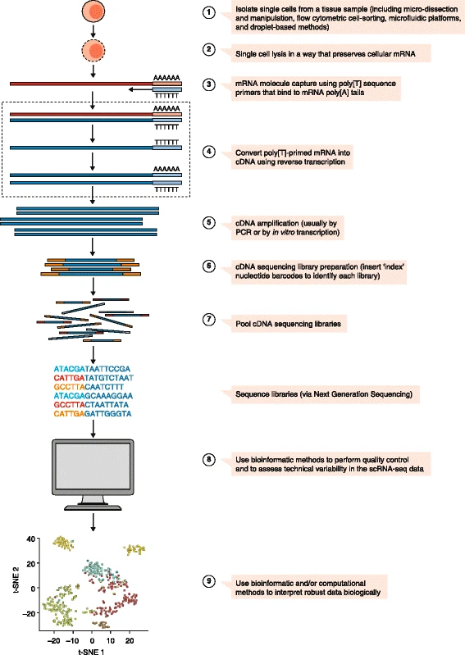
Workflow of Single-Cell RNA-seq

Slide 8
Workflow of Single-Cell RNA-seq

Slide 9
Workflow of Single-Cell RNA-seq
Source:https://genomemedicine.biomedcentral.com/articles/10.1186/s13073-017-0467-4

Slide 10
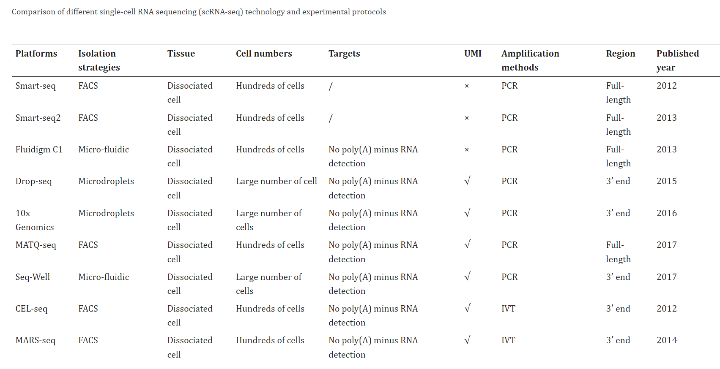
Technologies in scRNA-seq
Source: https://www.frontiersin.org/journals/genetics/articles/10.3389/fgene.2019.00317/full

Slide 11
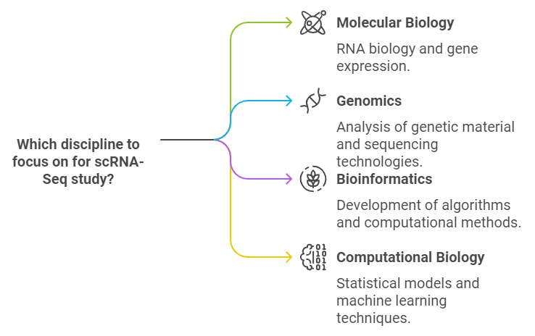
Disciplines contributing scRNA studies
Systems Biology
Cell Biology
Pharmacology
ScRNA Seq Studies
Immunology
Clinical Research
Statistics

Slide 12
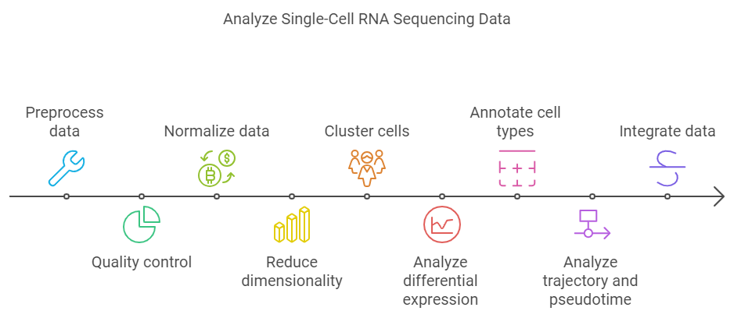
Steps In Single-cell RNA sequencing Data Analysis
Count Matrix

Slide 13
Pre-Processing Quality Control Normalization
Read alignment & Barcode filtering, UMI quantification
Handles sparsely expressed genes (also known as Dropouts)
Noise from technical variations (e.g., amplification, sequencing depth).
Variability in RNA, difficult to differ from technical noise (Heterogeneity)
Filter cells, Filter genes.
Distinguish high-quality cells and low-quality cells (e.g., doublets, empty droplets, damaged cells).
High dropout rates also obscure the true expression of low-abundance genes.
Handles technical variations and biases
adjusting for differences in sequencing depth, dropout events or technical variation
Allows Meaningful comparison between cells, allows accurate identification of differentially expressed genes and cell types.

Slide 14
Alignment:
STARsolo (STAR-based, UMI quantification, & assigns barcode)
celSeq2
scPipe
Scruff
zuMIs
Alignment Free tools
Kallisto Bustools: A fast, pseudoalignment-based method for read quantification
Salmon
Barcode Filtering
CellRanger(10x Genomics): UMI counting, barcode identification, & gene quantification.
UMI Quantification:
UMI-tools: Corrects for UMI errors and reduces PCR amplification bias.
Gene Expression Filtering
Seurat: Filters cells based on total gene counts, removes low-quality cells with high mitochondrial gene expression, and discards cells with too few or too many features (genes).
Scanpy: total counts per cell, gene count per cell, and mitochondrial gene content to filter out poor-quality cells.
Doublet Detection:
Scrublet: Identifies and removes doublets (false cell multiplets).
Empty Droplet Removal:
DropletUtils: Removes empty droplets from droplet-based scRNA-seq data, distinguish real cells from background noise.
Cell Cycle Scoring:
Cyclone (in Scater): Scores cells based on their cell cycle phase to control for cell cycle effects on gene expression.
Log-Normalization:
Seurat: Log-normalizes the data.
DESeq2
Scaling Factors:
Scater: Adjust counts for different sequencing depths while retaining biological variability.
SCTransform: variance-stabilizing transformation
Scran: Bioconductor tool that pools similar cells to estimate size factors and normalizes by controlling for technical variation
Batch Correction:
Harmony or MNNCorrect (Mutual Nearest Neighbors): Corrects for batch effects while preserving biological heterogeneity across different experimental conditions or samples.
Pre-processing
Quality Control
Normalization

Slide 15
Feature Selection
Feature selection for downstream analysis.
Capture biological variation.
Eliminate non-informative genes (technical noise).
Improve computational efficiency.
Subset of Genes with significant expression variation between cells.
Selecting highly informative genes from dataset.
Reflect biological differences in cell types or states.
Help distinguish true biological signals from
technical noise.
Highly Variable Genes
Methods for Feature Selection
Tools and Techniques
Tools and Techniques
1. High-Variance Gene (HVG) Selection technique:
Seurat: FindVariableFeatures()
Scanpy: highly_variable_genes()
2. Variance-based feature selection methods:
Scran:R-package; modelGeneVar()
3. Dropout-Based Feature Selection:
M3Drop: R-package, Identify DEGs
4. Machine Learning Approaches:
Random Forest
Lasso Regression
Support Vector Machines
Methods for Feature Identification
Mean-Variance Relationship
Mean & variance relationship of gene expression
Identify genes exceeding expected variance
Dispersion Estimates
Normalize variance by mean expression
Select genes with high normalized dispersion

Slide 16
Dimensionality Reduction in Single-Cell RNA-Seq
Common Methods
Principal Component Analysis (PCA)
Linear technique for initial denoising.
Tools: Seurat (RunPCA()), Scanpy (sc.pp.pca())
t-SNE (t-distributed Stochastic Neighbor Embedding)
Non-linear method for visualization
Preserves local structure
Tools: Seurat (RunTSNE()), Scanpy (sc.tl.tsne())
UMAP (Uniform Manifold Approximation and Projection)
Non-linear method preserving global structure
Better for continuous trajectories
Tools: Seurat (RunUMAP()), Scanpy (sc.tl.umap())
Diffusion Maps
Useful for trajectory inference
Tool: Scanpy (sc.tl.diffmap())
Independent Component Analysis (ICA)
Linear method, Separates data into independent components based on source of variation.
Tools: Seurat (RunICA()), Scanpy (custom implementations)
Others
Multidimensional Scaling (MDS)
Force-Directed Layout
Latent Semantic Indexing (LSI)
Simplifies complex, high-dimensional datasets into lower dimensions.
Preserves relevant biological variations.
Reduces noise and sparsity.
Enables visualization in 2D or 3D.
Improves computational performance.

Slide 17
Clustering & Cell Type Identification in scRNA-seq Aims to identify distinct cell populations and assign biological meanings to clusters. Grouping cells based on gene expression profiles to identify cell types or states.
Clustering Algorithms
Graph-Based Clustering (Louvain/Leiden)
Graphs, Captures cell-type relationship, maximize modularity (Louvain) or refining the partitioning (Leiden).
Tools: Seurat (FindClusters()), Scanpy (sc.tl.louvain()/leiden())
K-means Clustering
Divides cells into pre-defined number of clusters
Tools: R (kmeans()), Scanpy (sc.tl.kmeans())
Hierarchical Clustering
Builds cluster hierarchy based on distance.
Tools: R (hclust()), Scanpy (sc.tl.dendrogram())
Density-Based Clustering (DBSCAN)
Identifies dense regions, mark sparsity as noise.
Tool: Scanpy (scikit-learn DBSCAN)
Gaussian Mixture Model (GMM)
Finds Clusters that fits Gaussian distributions.
Tool: Scanpy (sklearn.mixture)
Cell Type Annotation Approaches
Assign biological label to each cluster, represents different cell types, based on known marker genes.
Manual Annotation
Using known marker genes
Databases: PanglaoDB, CellMarker
Automated Annotation Tools
SingleR: Reference-based annotation
ScType: Marker-based classification
CellAssign: Probabilistic model
Garnett: Marker-based machine learning
Tools | Methodology | Input | Application
SingleR | Reference-based | Reference dataset | For automated, flexible, and high-quality annotation.
ScType | Marker-based | Marker gene list | Fast annotation using curated markers.
CellAssign | Probabilistic model | Marker genes, gene expression matrix | Ideal for datasets with known marker genes.
Garnett | Interpretable ML-based | Marker genes, training dataset | For interpretable results and large datasets.

Slide 18


Identifying Cell Types
Marker Gene Identification:
Classifying individual cells based on their unique gene expression profiles.
Each cell expresses a distinct set of genes depending on its function and state
scRNA-seq allows profiling of the transcriptomes of individual cells, leading to the discovery of different cell types, within a heterogeneous tissue.
Each cluster is annotated by identifying marker genes—genes that are uniquely or predominantly expressed in certain cell types.
Annotation and Validation:
Once clusters are identified, they are annotated to specific cell types based on known biology or de novo discovery of novel cell types.
Validation may be done using other techniques like flow cytometry, immunohistochemistry, or by comparing with existing reference datasets.
Identifying cell types is crucial in various biological contexts, such as :
Understanding Cellular Heterogeneity
Disease Mechanisms
Discovery of New Cell Types or States
Developmental Biology
Therapeutic Targeting

Slide 19

Differential Expression Analysis
Identifying genes that show statistically significant differences in expression levels between different groups of cells
Identifying DEGs helps to understand how cellular functions differ across cell types, developmental stages, or disease states.
It highlights genes that may play key roles in driving certain biological processes or phenotypic differences.
Tools for Finding DEGs:
Seurat (R package): Integrates various clustering, visualization, and differential expression analysis functions. It uses methods like the Wilcoxon rank-sum test for DEA.
Scanpy (Python package): A scalable tool for analyzing single-cell data with functionalities similar to Seurat but for Python users.
DESeq2 (R package): A tool designed primarily for bulk RNA-seq but can be adapted for scRNA-seq to find DEGs. Uses negative binomial distribution models.
edgeR (R package): Focuses on identifying DEGs using empirical Bayes methods and precise dispersion estimates.
CellRanger (10X Genomics): A suite of software tools from 10X Genomics designed for processing and analyzing scRNA-seq data. Includes functions for mapping reads to the genome, counting transcripts, and identifying DEGs between clusters of cells.
Source: https://satijalab.org/seurat/articles/install.html

Slide 20

Differential Expression Analysis
Identifying genes that show statistically significant differences in expression levels between different groups of cells
Identifying DEGs helps to understand how cellular functions differ across cell types, developmental stages, or disease states.
It highlights genes that may play key roles in driving certain biological processes or phenotypic differences.
Tools for Finding DEGs:
Seurat (R package): Integrates various clustering, visualization, and differential expression analysis functions. It uses methods like the Wilcoxon rank-sum test for DEA.
Scanpy (Python package): A scalable tool for analyzing single-cell data with functionalities similar to Seurat but for Python users.
DESeq2 (R package): A tool designed primarily for bulk RNA-seq but can be adapted for scRNA-seq to find DEGs. Uses negative binomial distribution models.
edgeR (R package): Focuses on identifying DEGs using empirical Bayes methods and precise dispersion estimates.
CellRanger (10X Genomics): A suite of software tools from 10X Genomics designed for processing and analyzing scRNA-seq data. Includes functions for mapping reads to the genome, counting transcripts, and identifying DEGs between clusters of cells.
Source: https://google.com

Slide 21

Differential Expression Analysis
Identifying genes that show statistically significant differences in expression levels between different groups of cells
Identifying DEGs helps to understand how cellular functions differ across cell types, developmental stages, or disease states.
It highlights genes that may play key roles in driving certain biological processes or phenotypic differences.
Tools for Finding DEGs:
Seurat (R package): Integrates various clustering, visualization, and differential expression analysis functions. It uses methods like the Wilcoxon rank-sum test for DEA.
Scanpy (Python package): A scalable tool for analyzing single-cell data with functionalities similar to Seurat but for Python users.
DESeq2 (R package): A tool designed primarily for bulk RNA-seq but can be adapted for scRNA-seq to find DEGs. Uses negative binomial distribution models.
edgeR (R package): Focuses on identifying DEGs using empirical Bayes methods and precise dispersion estimates.
CellRanger (10X Genomics): A suite of software tools from 10X Genomics designed for processing and analyzing scRNA-seq data. Includes functions for mapping reads to the genome, counting transcripts, and identifying DEGs between clusters of cells.
Source: https://google.com

Slide 22
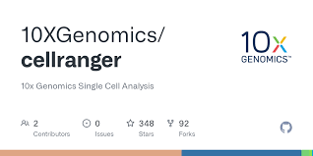
Differential Expression Analysis
Identifying genes that show statistically significant differences in expression levels between different groups of cells
Identifying DEGs helps to understand how cellular functions differ across cell types, developmental stages, or disease states.
It highlights genes that may play key roles in driving certain biological processes or phenotypic differences.
Tools for Finding DEGs:
Seurat (R package): Integrates various clustering, visualization, and differential expression analysis functions. It uses methods like the Wilcoxon rank-sum test for DEA.
Scanpy (Python package): A scalable tool for analyzing single-cell data with functionalities similar to Seurat but for Python users.
DESeq2 (R package): A tool designed primarily for bulk RNA-seq but can be adapted for scRNA-seq to find DEGs. Uses negative binomial distribution models.
edgeR (R package): Focuses on identifying DEGs using empirical Bayes methods and precise dispersion estimates.
CellRanger (10X Genomics): A suite of software tools from 10X Genomics designed for processing and analyzing scRNA-seq data. Includes functions for mapping reads to the genome, counting transcripts, and identifying DEGs between clusters of cells.
Source: https://google.com

Slide 23
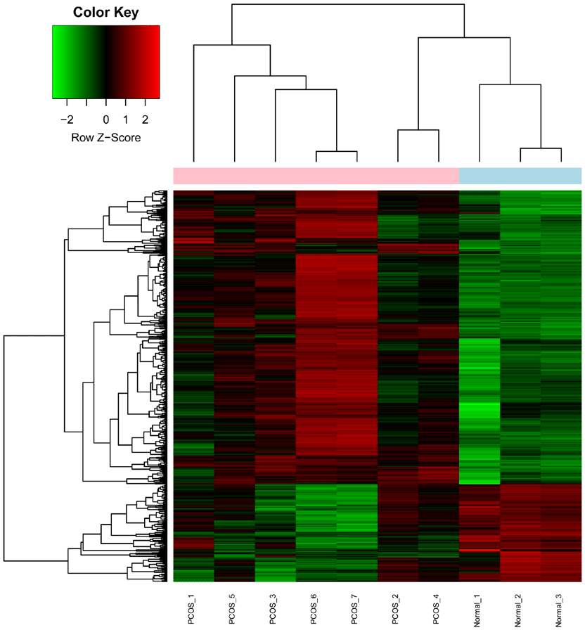
Differential Expression Analysis
Identifying genes that show statistically significant differences in expression levels between different groups of cells
Identifying DEGs helps to understand how cellular functions differ across cell types, developmental stages, or disease states.
It highlights genes that may play key roles in driving certain biological processes or phenotypic differences.
Tools for Finding DEGs:
Seurat (R package): Integrates various clustering, visualization, and differential expression analysis functions. It uses methods like the Wilcoxon rank-sum test for DEA.
Scanpy (Python package): A scalable tool for analyzing single-cell data with functionalities similar to Seurat but for Python users.
DESeq2 (R package): A tool designed primarily for bulk RNA-seq but can be adapted for scRNA-seq to find DEGs. Uses negative binomial distribution models.
edgeR (R package): Focuses on identifying DEGs using empirical Bayes methods and precise dispersion estimates.
CellRanger (10X Genomics): A suite of software tools from 10X Genomics designed for processing and analyzing scRNA-seq data. Includes functions for mapping reads to the genome, counting transcripts, and identifying DEGs between clusters of cells.
Source: https://www.researchgate.net/publication/319942046_Pathway_and_network-based_analysis_of_genome-wide_association_studies_and_RT-PCR_validation_in_polycystic_ovary_syndrome/figures?lo=1
Source: https://google.com

Slide 24
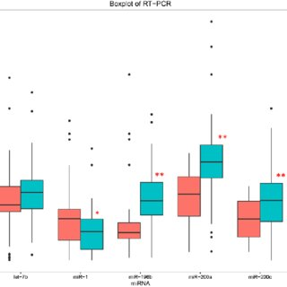

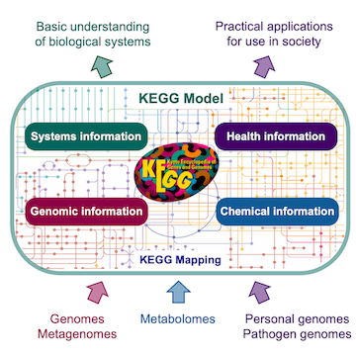
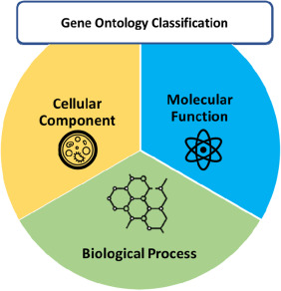
Differential Expression Analysis
Pathway and Gene Set Enrichment Analysis:
Pathway analysis is used to identify biological pathways that are significantly enriched in a set of DEGs.
This helps to understand the broader biological processes and molecular functions influenced by the genes identified.
Tools for Pathway and Gene Set Enrichment:
GO (Gene Ontology)
KEGG (Kyoto Encyclopedia of Genes and Genomes)
Source:
https://www.researchgate.net/publication/319683444_MicroRNA-196b_inhibits_late_apoptosis_of_pancreatic_cancer_cells_by_targeting_CADM1/figures?lo=1
Source: https://google.com

Slide 25
Pseudo-Time Analysis
To study Dynamic changes in biological processes,
cell differentiation,
proliferation, or
disease progression.
It aims to order cells along a developmental or differentiation trajectory, based on their gene expression profiles
Do not requires explicit time-series data.
Reconstruct a continuous trajectory that orders cells based on similarities in their gene expression profiles.
Monocle and Slingshot - complex branching trajectories.
SCORPIUS and TSCAN are ideal for simpler linear trajectories.
DPT offers a robust alternative, especially in noisy or subtle datasets.
Tools for Pseudotime Analysis
Monocle3: (R package)
Combines dimensionality reduction, clustering, and trajectory inference.
Highly flexible, handles both linear and branching trajectories.
Slingshot: (R package)
A simple, effective tool that can infer multiple branching lineages.
Compatible with popular dimensionality reduction tools like PCA or UMAP.
SCORPIUS: (R package)
Linear trajectory tool, highly intuitive and computationally efficient.
TSCAN(Time Series Clustering Analysis): (R package)
Good for identifying non-branching trajectories, lightweight.
DPT (Diffusion Pseudotime): (Scanpy library)
Robust and noise-tolerant method, particularly good for non-linear trajectories.

Slide 26
Visualization
Visual representation of lineage differentiation or cellular progression in single-cell RNA
help to interpret pseudotime analysis and highlight distinct branches and pathways
Types of Visualization | Function | Tools used
Trajectory Plot | Visualizing cell progression along pseudo-time trajectory. | Monocle, Slingshot
Lineage Trees | Mapping branching lineages in differentiation pathways. | Slingshot, Monocle
Gene Expression Heatmaps | Showing HVGs dynamics along pseudo-time. Visualize change in Gene expression patterns. | Monocle, SCORPIUS
Branch Plot | Visualizing cell transitions between branches. | Monocle3
Pseudotime Color Maps | Overview of pseudotime progression early to late stages of the cellular progression. | Monocle, Slingshot, TSCAN

Slide 27
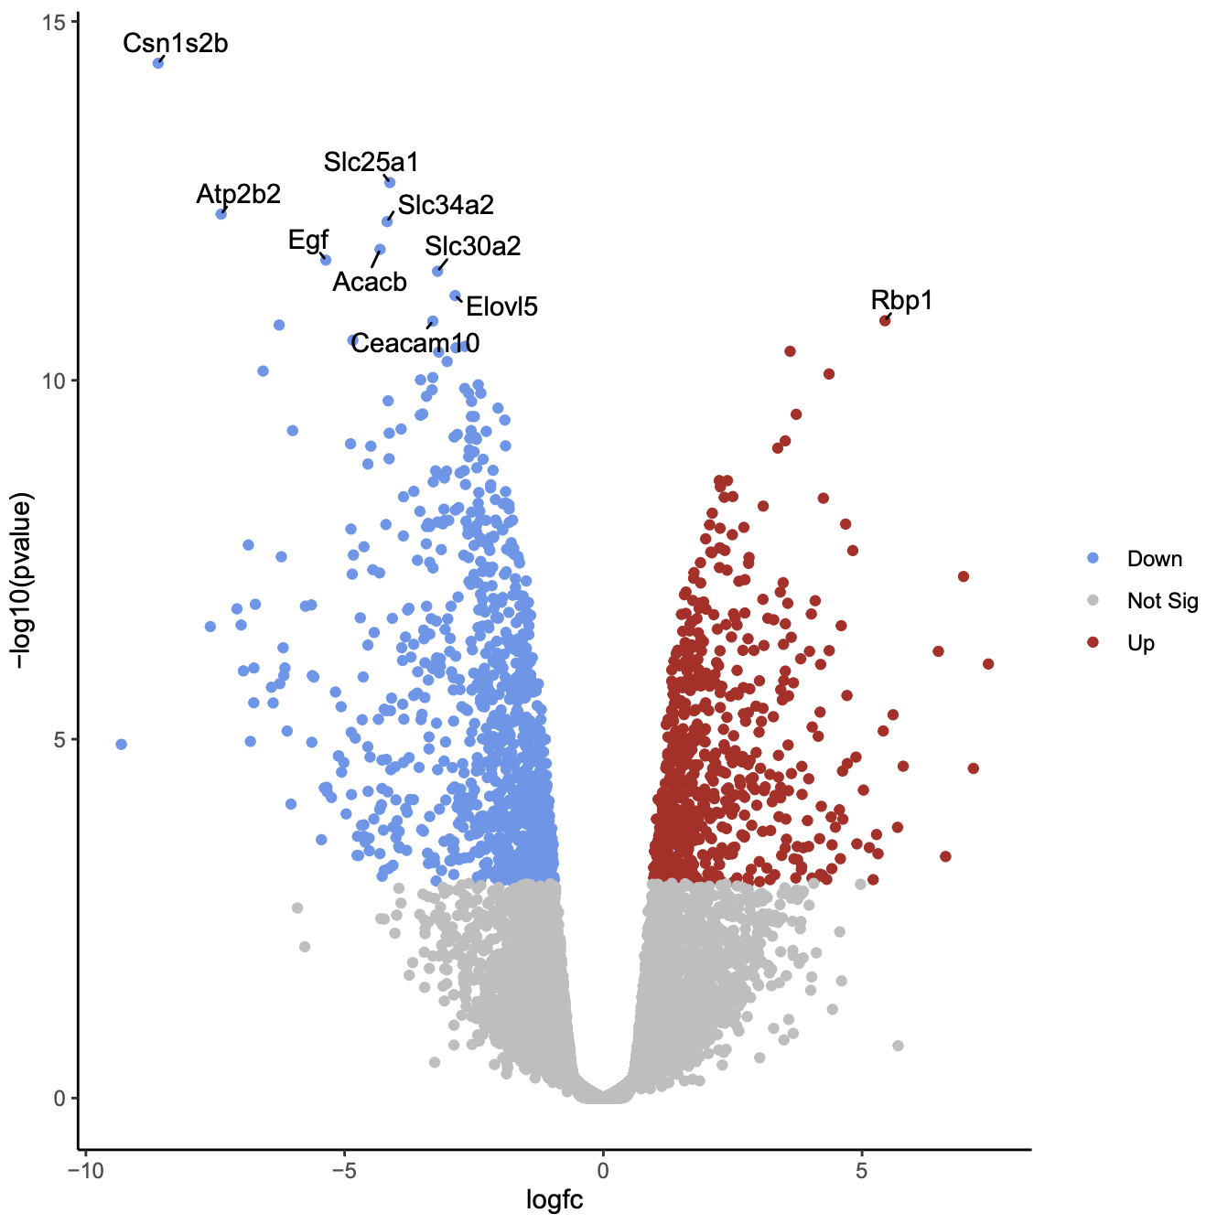
Differential Expression Analysis
Visualization:
The results can be visualized as heatmaps, volcano plots, or dot plots the x-axis represents the log fold change, and the y-axis represents the statistical significance (p-value).
Source:
https://training.galaxyproject.org/training-material/topics/transcriptomics/tutorials/rna-seq-viz-with-volcanoplot/tutorial.html
Source: https://www.researchgate.net/publication/319942046_Pathway_and_network-based_analysis_of_genome-wide_association_studies_and_RT-PCR_validation_in_polycystic_ovary_syndrome/figures?lo=1

Slide 28
Differential Expression Analysis
Visualization:
The results can be visualized as heatmaps, volcano plots, or dot plots the x-axis represents the log fold change, and the y-axis represents the statistical significance (p-value).
Source:
https://www.researchgate.net/publication/319683444_MicroRNA-196b_inhibits_late_apoptosis_of_pancreatic_cancer_cells_by_targeting_CADM1/figures?lo=1
Source: https://www.researchgate.net/publication/319942046_Pathway_and_network-based_analysis_of_genome-wide_association_studies_and_RT-PCR_validation_in_polycystic_ovary_syndrome/figures?lo=1
Source:
https://training.galaxyproject.org/training-material/topics/transcriptomics/tutorials/rna-seq-viz-with-volcanoplot/tutorial.html

Slide 29
Differential Expression Analysis
Visualization:
The results can be visualized as heatmaps, volcano plots, or box plots the x-axis represents the log fold change, and the y-axis represents the statistical significance (p-value).
Source:
https://training.galaxyproject.org/training-material/topics/transcriptomics/tutorials/rna-seq-viz-with-volcanoplot/tutorial.html
Source: https://www.researchgate.net/publication/319942046_Pathway_and_network-based_analysis_of_genome-wide_association_studies_and_RT-PCR_validation_in_polycystic_ovary_syndrome/figures?lo=1
Source:
https://www.researchgate.net/publication/319683444_MicroRNA-196b_inhibits_late_apoptosis_of_pancreatic_cancer_cells_by_targeting_CADM1/figures?lo=1

Slide 30
Multi-Omics Integration with ScRNA seq study
Types of Multi-Omics Integrations:
1. Genomics:
Combining scRNA-seq with single-cell DNA sequencing (scDNA-seq) to study genetic variations (somatic mutations, copy number variations), cancer heterogeneity and evolutionary dynamics.
2. Epigenomics
Merging scRNA-seq data with single-cell epigenomic profiling (e.g., ATAC-seq for chromatin accessibility or methylation profiling).Helps in study of gene regulation mechanisms, cellular differentiation
3. Proteomics
Incorporating single-cell proteomics data, such as mass cytometry or CITE-seq To study cellular functions, protein modification effects on pathways and functional states.
4. Metabolomics
Provides insights into how metabolic states influence gene expression and cellular functions, particularly in cancer and immune responses.
5. Spatial Transcriptomics
Enables visualization of spatial organization and cellular interactions within tissues, enhancing the understanding of how microenvironments affect cellular behavior.
Combines multiple layers of biological information.
Uncovers complex biological mechanisms and interactions.
Contributes to personalized medicine and targeted therapies.
Requires cross-platform compatibility.
Tools Used to integrate & analyze multi-omics data:
Multi-Omics Frameworks (MOFA)
Seurat (R)
Harmony (R)

Slide 31
Implications of multi-omics integration
Omics Layer | Integration Method | Contributions to Heterogeneity | Implications
Genomics | Genetic variations (SNPs, CNVs) | Genetic variability | Genetic markers, targeted therapies
Transcriptomics | Epigenomic-transcriptomic integration | Gene expression variability | Gene regulation, therapeutic targets
Proteomics | scRNA-seq integration | Transcript-protein activity | Protein dynamics, targeted therapies
Metabolomics | Metabolic pathway analysis | Metabolic pathway identification | Biomarkers, metabolic therapies
Spatial Transcriptomics | Spatial data combination | Cell-cell interactions, tissue architecture | Tumor microenvironment, spatial therapies
Multi-Omics Integration | Holistic multi-layer analysis | Unique biomarker profiles | Personalized medicine, targeted therapies
Machine Learning | Predictive modeling | Cellular behavior predictions | Enhanced treatment strategies

Slide 32
Case Study 1- Single-cell RNA sequencing reveals the gene expression profile and cellular communication in human fetal heart development By Hou et al. (2024)
Analysis of 19,808 cells across four gestational time points
Gestational weeks examined: GW8, GW10, GW11, and GW17
Method: Single-cell RNA sequencing (scRNA-seq)
KEY Findings and Implications:
11 major cell types discovered: • Erythroid cells, Fibroblasts, Heart endothelial cells, Ventricular and atrial cardiomyocytes, Macrophages and dendritic cells (DCs), Smooth muscle cells, Pericytes, Neural cells, Schwann cells
Gene Expression Dynamics: Significant differences in gene expression profiles across gestational weeks showed dynamic cellular functions during development
Signaling Pathways such as ANNEXIN, MIF, PTN, and GRN pathways were analyzed
GW8: Simpler signaling pathways, fewer intercellular connections
GW10, GW11, GW17: More complex signaling networks, enhanced intercellular communication
Cellular Composition Changed : Cell type proportions shift throughout gestational timeline
Potential impact on heart regeneration research, regenerative medicine & heart disease treatment

Slide 33
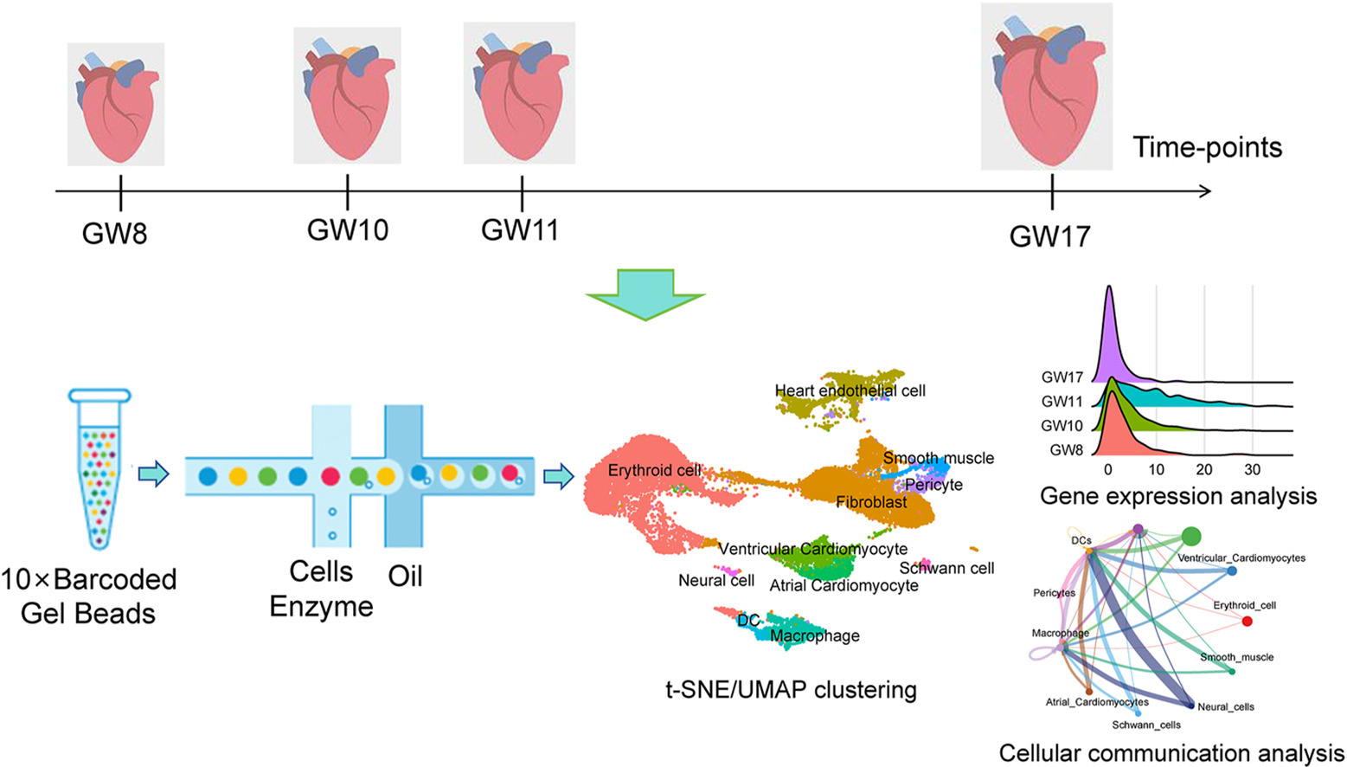
Case Study 1- Single-cell RNA sequencing reveals the gene expression profile and cellular communication in human fetal heart development By Hou et al. (2024)
Fig: The gene expression imprints from various gestational week , clustering of similar cell types and final expression and interactions analysis.

Slide 34
Case Study 2- Revealing Cellular Heterogeneity and Key Regulatory Factors of Triple-Negative Breast Cancer through Single-Cell RNA Sequencing
by - Hu Zhang et al; 2024
Methodology:
Data Acquisition: The scRNA-seq data from five primary breast cancer samples were obtained from the GEO database.
Preprocessing of Data: The Seurat R package was utilized for preprocessing the scRNA-seq data. This involved filtering the data based on specific criteria and normalizing the data using the sctransform function.
Dimensionality Reduction: PCA was performed to reduce the dimensionality of the data. Subsequently, batch effects were removed using the Harmony R package, and Uniform Manifold Approximation and Projection (UMAP) was applied for further dimensionality reduction.
Clustering: The FindNeighbors and FindClusters functions from the Seurat package were used to cluster the cells into distinct groups.
Marker Gene Identification: The FindAllMarkers function was employed to identify high-expressed genes in each cell subset, which helped in exploring the heterogeneity of gene expression patterns across different cell types.
Gene Function Enrichment Analysis: The identified genes of interest were analyzed for their biological functions using DAVID.
Single-Cell Regulatory Network Inference and Clustering (SCENIC) Analysis: This method was applied to analyze gene regulatory networks and identify key regulatory genes.
Cellular Experiments: Finally, the expression and potential biological functions were verified through cellular experiments, which included silencing specific genes and assessing their impact on cancer cell invasion.
Findings & Conclusion:
Significant Cellular Contributions: The study identified four epithelial cell subsets (EC2, EC3, EC4, and EC5) as being particularly impactful in the TNBC pathotype.
Key Regulatory Factors: The research highlighted two critical regulons—C-fos gene (FOS) and X-box binding protein 1 (XBP1)—as being involved in TNBC progression.
Mechanisms of Tumor Progression: ANXA3-expressing subset, interact with T cells and suppress immune responses through various mechanisms. This suppression of immune function is thought to facilitate tumor progression .
Implications for Therapy: The study concludes that understanding the specific epithelial cell subsets and their associated regulatory networks could provide insights into potential therapeutic targets for TNBC. The identified regulons, especially FOS and XBP1, may serve as promising candidates for developing effective treatment strategies aimed at overcoming the challenges posed by TNBC's heterogeneity

Slide 35
Methodology:
Data Acquisition: The scRNA-seq data from five primary breast cancer samples were obtained from the GEO database.
Preprocessing of Data: The Seurat R package was utilized for preprocessing the scRNA-seq data. This involved filtering the data based on specific criteria and normalizing the data using the sctransform function.
Dimensionality Reduction: PCA was performed to reduce the dimensionality of the data. Subsequently, batch effects were removed using the Harmony R package, and Uniform Manifold Approximation and Projection (UMAP) was applied for further dimensionality reduction.
Clustering: The FindNeighbors and FindClusters functions from the Seurat package were used to cluster the cells into distinct groups.
Marker Gene Identification: The FindAllMarkers function was employed to identify high-expressed genes in each cell subset, which helped in exploring the heterogeneity of gene expression patterns across different cell types.
Gene Function Enrichment Analysis: The identified genes of interest were analyzed for their biological functions using DAVID.
Single-Cell Regulatory Network Inference and Clustering (SCENIC) Analysis: This method was applied to analyze gene regulatory networks and identify key regulatory genes.
Cellular Experiments: Finally, the expression and potential biological functions were verified through cellular experiments, which included silencing specific genes and assessing their impact on cancer cell invasion.
Findings & Conclusion:
Significant Cellular Contributions: The study identified four epithelial cell subsets (EC2, EC3, EC4, and EC5) as being particularly impactful in the TNBC pathotype.
Key Regulatory Factors: The research highlighted two critical regulons—C-fos gene (FOS) and X-box binding protein 1 (XBP1)—as being involved in TNBC progression.
Mechanisms of Tumor Progression: ANXA3-expressing subset, interact with T cells and suppress immune responses through various mechanisms. This suppression of immune function is thought to facilitate tumor progression .
Implications for Therapy: The study concludes that understanding the specific epithelial cell subsets and their associated regulatory networks could provide insights into potential therapeutic targets for TNBC. The identified regulons, especially FOS and XBP1, may serve as promising candidates for developing effective treatment strategies aimed at overcoming the challenges posed by TNBC's heterogeneity
Case Study 2- Revealing Cellular Heterogeneity and Key Regulatory Factors of Triple-Negative Breast Cancer through Single-Cell RNA Sequencing
by - Hu Zhang et al; 2024

Slide 36
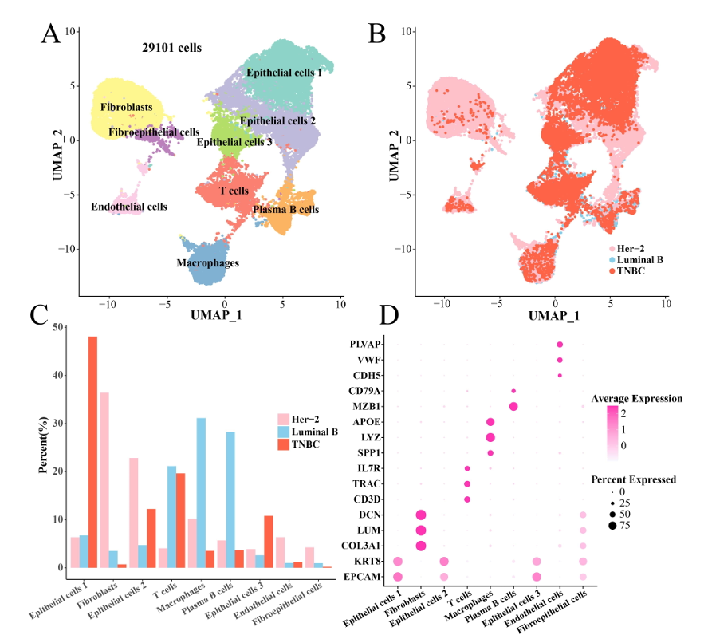
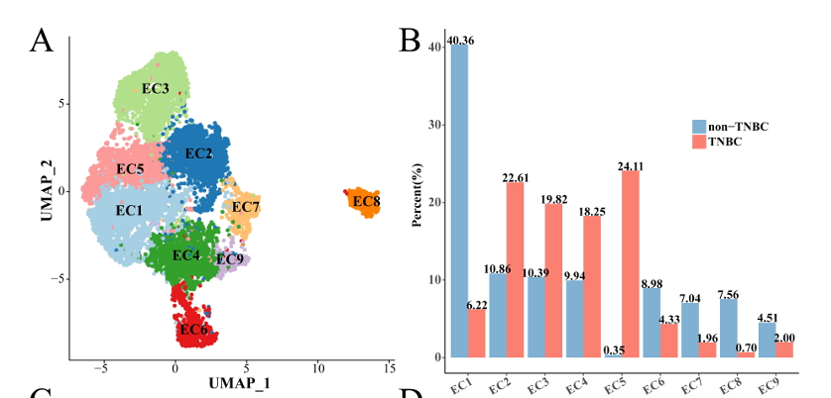
Case Study 2- Revealing Cellular Heterogeneity and Key Regulatory Factors of Triple-Negative Breast Cancer through Single-Cell RNA Sequencing
by - Hu Zhang et al; 2024
Fig. 1. Single-cell landscape of BCtissues. (A)UMAPplotofannotatedcellclusters.(B)UMAPdimensionalityreductionplotoftissue types of each cell. (C) Bar plot of the proportion of each cell cluster in three pathologies tissues. (D) Bubble plot of marker genes in each cell cluster.
Fig. 2. Identification of TNBC-specific epithelial cell subsets. (A) UMAP clustering plot of all epithelial cells. (B) Box plot of the proportion of each epithelial cell subset between TNBC and non-TNBC.
Challenges in scRNA-seq

Slide 37

Applications of scRNA-seq data analysis
Cancer Research: Characterizes tumor heterogeneity and micro-environment. Identifies cancer stem cells, subpopulations, and drug resistance mechanisms.
Neurodegenerative Diseases: Studies cell type-specific changes in diseases like Alzheimer’s and Parkinson’s. Reveals molecular mechanisms underlying neurodegeneration and identifies biomarkers.
Personalized Medicine: Identifies patient-specific gene expression signatures for tailored treatment strategies. Highlights individual responses to treatments, paving the way for personalized therapies.
Autoimmune Diseases: Profiles immune cell populations and their states in autoimmune conditions., Uncovers dysregulation in immune responses and identifies potential therapeutic targets.
Developmental Biology: Tracks cellular differentiation and lineage tracing during development. Maps out developmental trajectories and identifies genes regulating cell fate decisions.
Immune Cell Diversity: Characterizes various immune cell types and their functional states. Understands the complexity of immune responses and identifies cell-type-specific functions.
Challenges in scRNA-seq

Slide 38
Challenges in scRNA-seq
Technical Challenges
These challenges arise due to malpractices or machine errors.
1. Low RNA Input: scRNA seq typically requires low RNA input, which can result in incomplete reverse transcription and amplification, leading to inadequate coverage and technical noise.
Solution: RNA input can be optimized by standardizing the cell lysis and RNA extraction.
2. Amplification Bias: Amplification bias can arise due to stochastic variation in amplification efficiency, resulting in a skewed representation of specific genes and overestimating their expression levels.
Solution: Amplification bias correction can be done using several methods like unique molecular identifiers (UMIs) and spike-in controls.
3. Dropout Events: Occur when a transcript fails to be captured or amplified in a single cell, leading to a false-negative signal.
Solution: Dropout event mitigation uses several computational methods to account for dropout events and impute missing gene expression data.
4. Batch Effects: These can arise due to technical variation between different sequencing runs or experimental batches.
Solution: Batch effects correction, such as regression-based methods, batch normalization techniques, and clustering-based methods.
5. Cell Doublets: scRNA-seq can capture multiple cells in a single droplet, resulting in doublets.
Solution: Cell hashing is used to identify cell doublets.
Methodological Challenges
These challenges arise due to errors in methods or protocols of performing the sc-RNA seq.
1. Library Preparation: The library preparation involves multiple steps which can introduce technical noise and biases.
Solution: Standardizing library preparation protocols and quality control measures.
2. Cell Selection, Dissociation, and Handling: the dissociation of cells from tissues or organs, can cause stress and alter gene expression profiles.
Solution: Optimize the sample preparation process to ensure high-quality single-cell suspensions.

Slide 39
Technical Challenges
These challenges arise due to malpractices or machine errors.
1. Low RNA Input: scRNA seq typically requires low RNA input, which can result in incomplete reverse transcription and amplification, leading to inadequate coverage and technical noise.
Solution: RNA input can be optimized by standardizing the cell lysis and RNA extraction.
2. Amplification Bias: Amplification bias can arise due to stochastic variation in amplification efficiency, resulting in a skewed representation of specific genes and overestimating their expression levels.
Solution: Amplification bias correction can be done using several methods like unique molecular identifiers (UMIs) and spike-in controls.
3. Dropout Events: Occur when a transcript fails to be captured or amplified in a single cell, leading to a false-negative signal.
Solution: Dropout event mitigation uses several computational methods to account for dropout events and impute missing gene expression data.
4. Batch Effects: These can arise due to technical variation between different sequencing runs or experimental batches.
Solution: Batch effects correction, such as regression-based methods, batch normalization techniques, and clustering-based methods.
5. Cell Doublets: scRNA-seq can capture multiple cells in a single droplet, resulting in doublets.
Solution: Cell hashing is used to identify cell doublets.
Methodological Challenges
These challenges arise due to errors in methods or protocols of performing the sc-RNA seq.
1. Library Preparation: The library preparation involves multiple steps which can introduce technical noise and biases.
Solution: Standardizing library preparation protocols and quality control measures.
2. Cell Selection, Dissociation, and Handling: the dissociation of cells from tissues or organs, can cause stress and alter gene expression profiles.
Solution: Optimize the sample preparation process to ensure high-quality single-cell suspensions.
Challenges in scRNA-seq

Slide 40

Future Directions
Single-cell multi-omics can combine multiple layers of biological data in scRNA seq, providing more comprehensive insights into cellular function and regulation.
Spatial transcriptomics will add spatial context to scRNA-seq data, enhancing the understanding of tissue architecture and cell interactions.
Single-cell proteomics will complement RNA data by directly measuring protein levels, offering a more complete view of cellular function.
Integration of AI/ML in scRNA-seq will revolutionize data analysis, enabling automated cell type annotation, prediction of cellular trajectories, and better integration of multi-omics data for precision medicine.
ScRNA-seq can aid in identifying and validating potential drug targets by characterizing the gene expression profiles of individual cells within the diseased tissues leveraging drug discovery.

Slide 41
Conclusion
Heterogeneity in scRNA-seq data significantly affects preprocessing, requiring careful filtering, quality control, and normalization methods that account for both technical and biological variability.
The choice of tools like Seurat, Scanpy, Scran, and SCTransform ensures robust handling of these challenges.
ScRNA seq studies enhances our understanding of distinct functional roles of various cells within tissues.
The specific steps used to preprocess the raw sequencing data such as aligning reads to a reference genome or assigning barcodes do not significantly affect the overall biological insights obtained from the analysis.
However, Downstream analysis steps, like normalization and clustering play a much larger role in determining the inference from the data such as cell type determination, evolutionary studies, etc.
scRNA-seq effectively detects rare cells, such as malignant tumor cells and hyper-responsive immune cells, which may go unnoticed in bulk analyses.
Study of unique and diverse cells and aids in tracing lineage and developmental relationships, crucial for understanding processes like embryonic development and cancer progression.
The key difference between scRNA-seq and other RNA-seq techniques is the level of resolution that it provides. This gives a better understanding of the function of an individual cell in the context of its microenvironment.
Studied the Future Directions such as integration of multi-omics and advancements in AI/ML will enhance scRNA-seq capabilities, driving innovations in personalized medicine and drug discovery.
As scRNA-seq continues to evolve, it will be essential in deciphering the complexities of biological systems, leading to improved strategies for understanding health and disease.

Slide 42
References
Gupta RK, Kuznicki J. Biological and Medical Importance of Cellular Heterogeneity Deciphered by Single-Cell RNA Sequencing. Cells. 2020; 9(8):1751. https://doi.org/10.3390/cells9081751
Hou, X., Si, X., Xu, J., Chen, X., Tang, Y., Dai, Y., & Wu, F. (2024). Single-cell RNA sequencing reveals the gene expression profile and cellular communication in human fetal heart development. Developmental Biology.
You, Y., Tian, L., Su, S. et al. Benchmarking UMI-based single-cell RNA-seq preprocessing workflows. Genome Biol 22, 339 (2021). https://doi.org/10.1186/s13059-021-02552-3
Jovic, D., Liang, X., Zeng, H., Lin, L., Xu, F., & Luo, Y. (2022). Single‐cell RNA sequencing technologies and applications: A brief overview. Clinical and Translational Medicine, 12(3). https://doi.org/10.1002/ctm2.694
Chen, G., Ning, B., & Shi, T. (2019). Single-Cell RNA-Seq Technologies and Related Computational Data Analysis. Frontiers in Genetics, 10. https://doi.org/10.3389/fgene.2019.00317
Haque, A., Engel, J., Teichmann, S.A. et al. A practical guide to single-cell RNA-sequencing for biomedical research and clinical applications. Genome Med 9, 75 (2017). https://doi.org/10.1186/s13073-017-0467-4
Lelièvre, S. A., Hodges, K. B., & Vidi, P. (2014). Application of Theranostics to Measure and Treat Cell Heterogeneity in Cancer. In Elsevier eBooks (pp. 493–516). https://doi.org/10.1016/b978-0-12-407722-5.00026-8
Carter, B., Zhao, K. The epigenetic basis of cellular heterogeneity. Nat Rev Genet 22, 235–250 (2021). https://doi.org/10.1038/s41576-020-00300-0
Molin, A. D., Baruzzo, G., & Di Camillo, B. (2017). Single-Cell RNA-Sequencing: Assessment of Differential Expression Analysis Methods. Frontiers in Genetics, 8. https://doi.org/10.3389/fgene.2017.00062
Joshi, P. D. S. (n.d.). Challenges in Single-Cell RNA Seq Data Analysis & Solutions. https://www.elucidata.io/blog/challenges-and-solutions-in-single-cell-rna-seq-data-analysis
Morante-Palacios, O. (2023, July 6). The future of scRNA-Seq applicability. Clarivate. https://clarivate.com/blog/the-future-of-scrna-seq-applicability/
Hwang, B., Lee, J.H. & Bang, D. Single-cell RNA sequencing technologies and bioinformatics pipelines. Exp Mol Med 50, 1–14 (2018). https://doi.org/10.1038/s12276-018-0071-8
Zhang, H., Sun, Y., & Du, X. (2024). Revealing Cellular Heterogeneity and Key Regulatory Factors of Triple-Negative Breast Cancer through Single-Cell RNA Sequencing. Frontiers in Bioscience-Landmark, 29(8), 290. https://doi.org/10.31083/j.fbl2908290

Slide 43



