Slide 1
Financial & Risk Analysis
Bayesian Generalized Pareto Modeling of Extreme Stock Market Crashes

Slide 2
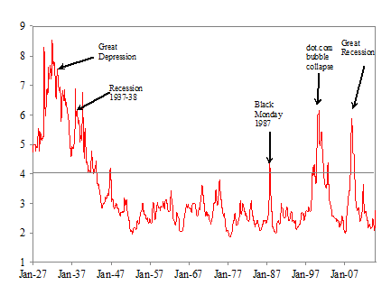
Project Context and Motivation
Title: Bayesian Generalized Pareto Modeling of Extreme Stock Market Crashes
Domain: Finance and Risk Analysis
Real-World Context
Extreme stock market crashes occur rarely but cause severe financial losses.
Standard return models often underestimate extreme events.
Financial returns exhibit heavy-tailed behavior.
Why Uncertainty Exists
Market volatility changes over time
Global financial spillovers affect domestic markets
Investor behavior becomes unstable during crises

Slide 3
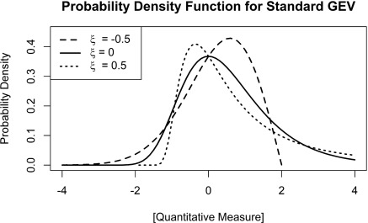

Project Objective and Deterministic Baseline
Project Objective
Model and simulate extreme financial losses in stock markets.
Focus on tail events where returns fall below −2%.
Estimate probability of severe crashes (loss > 5%).
Deterministic Baseline Strategy
Use Maximum Likelihood Estimation (MLE) to estimate parameters.
Estimate: regression coefficients β, GPD shape parameter ξ
Scale parameter modeled as:
Why MLE Baseline is Reasonable
Widely used in financial risk modeling
Provides consistent parameter estimates
Establishes a deterministic benchmark before probabilistic inference

Slide 4
System Pipeline Overview
End-to-End Simulation Pipeline
Market Data
Compute Returns and Volatility
Threshold Exceedance Detection
Tail Dataset Construction
GPD Regression Model
Parameter Estimation using MLE
Crash Risk Estimation
Where Uncertainty Enters
Financial return fluctuations
Volatility changes
Rare extreme observations
Data Flow
Returns
Extreme Losses
Volatility Covariates
GPD Model
Risk Prediction

Slide 5
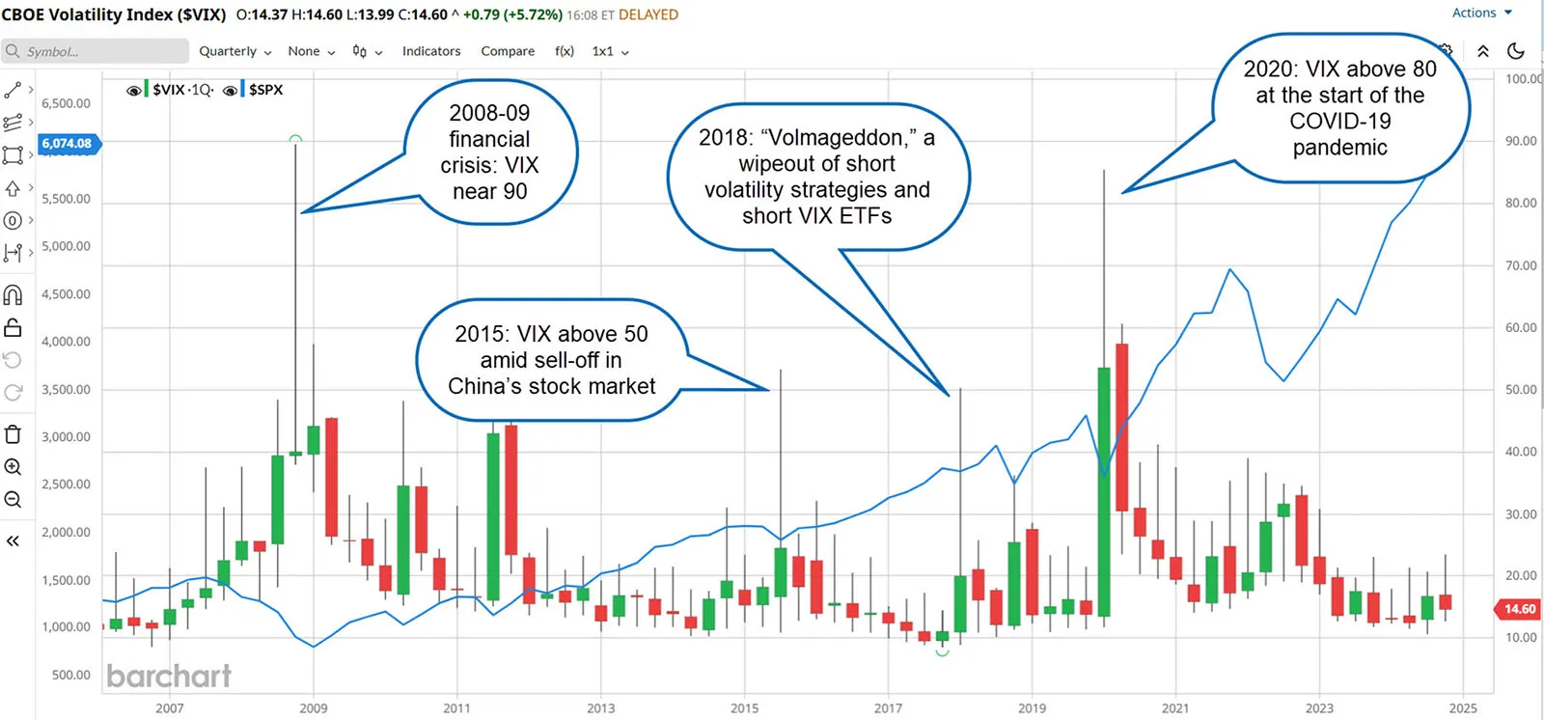
Sources of Uncertainty
Measurement Noise
Imperfect return calculation
Volatility estimation errors
Environmental Variability
Global market shocks
Policy changes and economic events
Model and Data Uncertainty
Limited extreme crash observations
Threshold selection sensitivity
Changing market conditions over time

Slide 6



Key Random Variables
1. Tail Loss Magnitude: primary variable used to estimate crash risk
r = daily return
Represents magnitude of extreme losses
Distribution:
2. Market Volatility Covariates: determine the scale of the loss distribution
Examples: NIFTY volatility, S&P 500 volatility, Gold volatility
Assumed distribution:
3. Crash Event Indicator: used to estimate crash probability

Slide 7


Probabilistic Modeling with Deterministic Decisions
Extreme losses modeled using Generalized Pareto Distribution (GPD).
Scale parameter:
Probabilistic Assumptions
Extreme losses follow heavy-tailed distribution
Exceedances are conditionally independent
Volatility influences loss magnitude

Slide 8
Deterministic Baseline Logic
Step-by-Step Process
Identify extreme losses where return < −2%.
Construct exceedance dataset.
Model exceedances using GPD regression.
Estimate parameters using Maximum Likelihood Estimation.
Compute crash probability using fitted distribution.
Important
No randomized decision rules are used.
Same dataset always produces the same parameter estimates.

Slide 9
Simulation Implementation
Algorithm Components
Data preprocessing and return computation
Volatility estimation (EWMA, Garman-Klass)
Threshold filtering (Peaks-Over-Threshold method)
GPD regression model fitting
Parameter Estimation
Shape parameter ξ
Regression coefficients β
Estimated using MLE optimization.
Outputs Generated
crash probability estimates
tail distribution visualizations

Slide 10
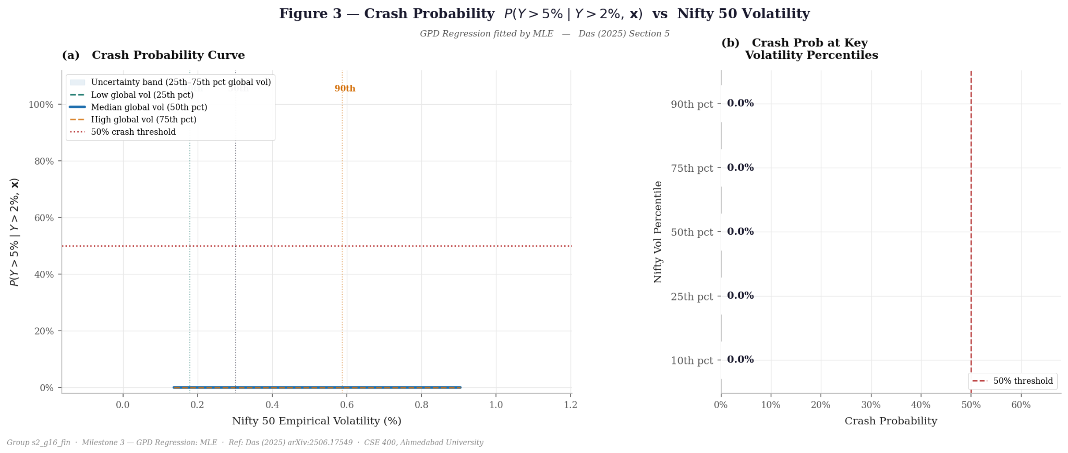
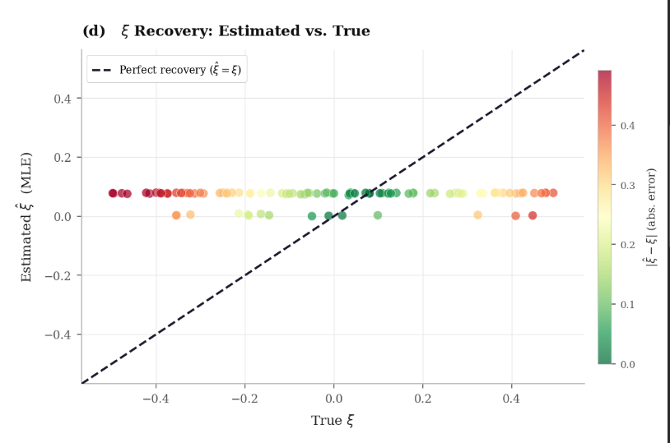
Results and Performance Analysis
Higher volatility increases extreme loss magnitude
Crash probability rises during volatile market periods
Model predictions align with observed extreme losses

Slide 11
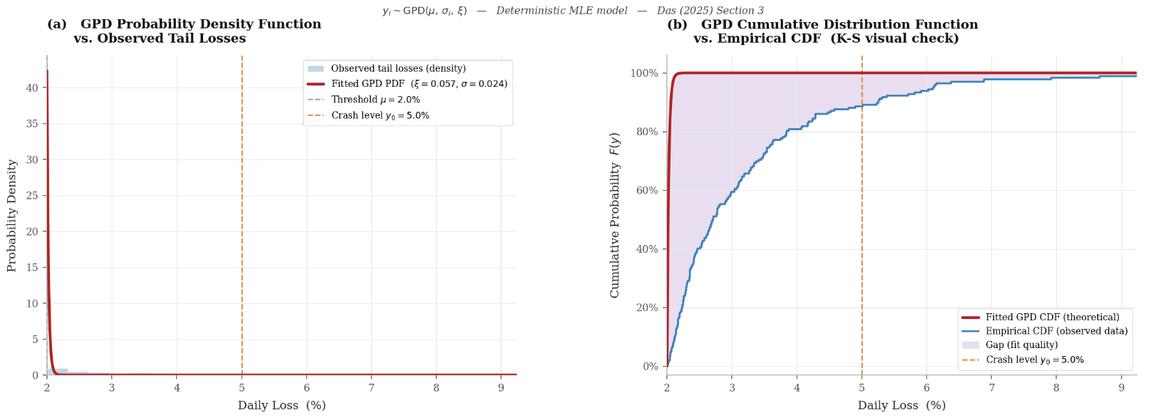
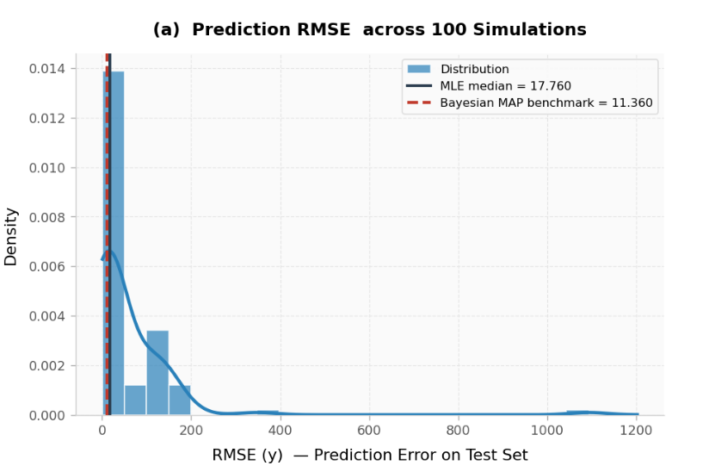
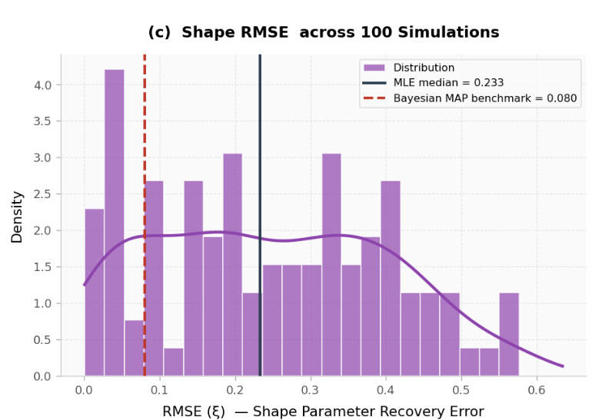
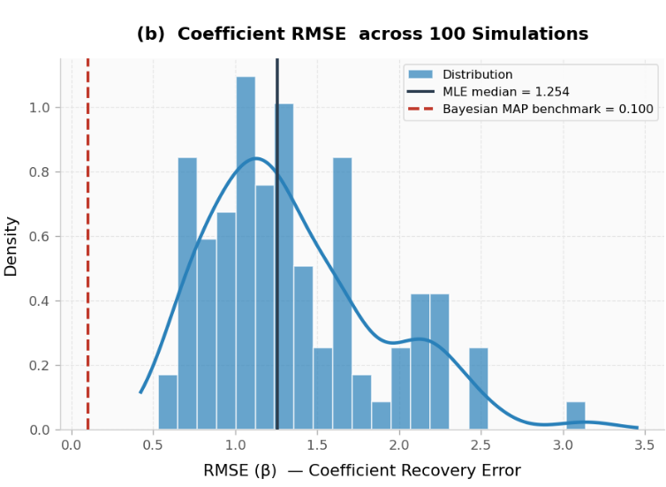
Results and Performance Analysis
RMSE values indicate stable parameter estimation across simulations.
GPD effectively captures heavy-tailed behavior of market loss

Slide 12
Limitations of Deterministic Strategy
Current Weaknesses
MLE provides only point estimates.
Parameter uncertainty is not modeled.
Limited number of extreme crash observations.
Simplified Assumptions
Constant shape parameter
Limited explanatory variables
Stationary market behavior

Slide 13
Summary and Transition to Randomized Strategies
Key Insights
Extreme market crashes follow heavy-tailed distributions.
Market volatility strongly influences crash severity.
GPD regression provides a useful framework for modeling extreme losses.
Milestone 3 - Implemented deterministic MLE baseline model.
Milestone 4 - Introduce probabilistic inference methods, such as:
Bayesian parameter estimation
stochastic volatility modeling
Monte Carlo simulations

Slide 14
Thank You
Section 2 - Group 16
Sakshi Patel
Dhruvika Mehta
Hitaksh Thaker
Hirva Vekariya
Tirth Khunt

