Slide 1
Financial & Risk Analysis
Bayesian Generalized Pareto Modeling of Extreme Stock Market Crashes
s2_g16_fin

Slide 2
Background and Motivation
Course Perspective:
Financial markets behave like probabilistic systems with extreme uncertainty
Traditional models fail to capture rare but catastrophic events
Need for combining probability theory + algorithms to model extreme risks
Real-World Perspective:
Events like the 2008 Financial Crisis show how sudden crashes destroy billions
Investors and institutions need early warning systems
Tail risks are rare—but when they hit, they hit hard

Slide 3
Background and Motivation
Why This Problem Matters:
Standard models underestimate extreme losses
Better prediction = better risk management
Helps in building robust financial systems

Slide 4
Problem Formulation
Problem Definition:
Given financial time series data
Identify and model tail events using statistical methods
Assumptions:
Financial returns follow heavy-tailed distribution
Extreme events can be modeled using GPD
Parameters evolve over time

Slide 5
Problem Formulation
Objectives:
Estimate tail risk accurately
Compare deterministic vs randomized approaches
Improve prediction under uncertainty
Approach:
Use GPD model
Compare MLE vs Bayesian methods

Slide 6
Base Paper Overview
Base Paper: Das, S. (2025) – Predicting Stock Market Crash with Bayesian Generalised Pareto Regression
Main Idea:
Uses Bayesian framework + Generalised Pareto Distribution (GPD)
Focuses on modeling extreme values (tail events) instead of normal behavior
Core Contribution:
Introduces a regression-based approach for tail risk prediction
Uses Bayesian regularization to improve parameter estimation
Captures dynamic volatility using advanced estimators
Instead of predicting “average market behavior,” the paper predicts extreme crashes

Slide 7
Mathematical Model (GPD Model)
Where:
ξ = Shape parameter (tail heaviness)
β = Scale parameter
x = Excess over threshold
Model Extension:
Scale parameter modeled as log-linear function
Parameters estimated using Bayesian inference
Interpretation:
Higher ξ → heavier tail → higher crash risk
Model focuses only on extreme losses, not normal fluctuations

Slide 8
Bounds Used in the Problem
Key Bounds and Constraints:
Shape parameter constraint:
ξ > 0 : ensures heavy-tail behavior (for financial extremes)
Scale parameter constraint:
β > 0 : keeps distribution well-defined
Threshold selection:
Only values above a certain cutoff are considered (focus on extremes only)
Inequality Condition: 1+ξx/β > 0
Why This Matters:
Keeps the probability distribution valid
Avoids undefined or negative probabilities
Stabilizes parameter estimation

Slide 9
Deterministic Approach
Deterministic Approach (MLE-Baseline Model):
Use of Maximum Likelihood Estimation (MLE)
No randomness, no prior → purely based on data
Same input → same output
Goal:
To find parameters (ξ, β)
Based on GPD log-likelihood function
Uses:
Historical tail data (loss > 2%)
Fixed mathematical optimisation
Key Idea:
No external assumptions.

Slide 10
Deterministic Approach
Input: Nifty, S&P 500, Gold volatility
Steps:
Build GPD model
Maximise likelihood
Estimate parameters (ξ, β)
Outputs:
Crash probability (>5% loss)
Expected loss
Advantages
Data driven
No assumptions
Limitations
No uncertainty
May overfit small data

Slide 11
Randomized Approach
Randomized Approach (Bayesian + Monte Carlo):
Use of Bayesian MAP estimation + simulation
Adds prior knowledge + randomness
Output may vary across runs
Key Idea:
Combination of Likelihood (data) and Prior (beliefs).
MAP Objective:
Likelihood + Prior → give better estimation
Randomness comes from:
Monte Carlo simulations (100 datasets)
Random parameter generation
Different possible market scenarios

Slide 12
Randomized Approach
Steps:
Generate random datasets
Fit model using different priors:
Cauchy (baseline)
Lasso (sparse)
Ridge (smooth)
g-prior (data-based)
Compare performance
Outputs
Crash probability curves
Multiple possible outcomes
Advantages
Handles uncertainty
Better for risk analysis
Limitations
Results vary each run
Higher computation

Slide 13
Coding [Deterministic]
Implement GPD with MLE estimation and establish a deterministic baseline model.
SETUP
download_data() → fetch market data
ewma_vol() → compute EWMA volatility
prepare() → construct dataset (y, X)
Design Matrix: X ∈ ℝ^(n×4)
PRIORS IMPLEMENTED
None in M3 (pure likelihood-based)
MODEL DEFINITION
negll() → computes negative log-likelihood (GPD)
yᵢ ~ GPD(μ, σᵢ, ξ)
σᵢ = exp(Xᵢᵀ β)
PARAMETER ESTIMATION
fit_mle() → estimates (β, ξ) via likelihood minimisation
INPUT / OUTPUT
Input: (y, X)
Output: (β̂, ξ̂)
Notes:
Alright, so let me now walk you through how we actually built this in code. We start with Milestone 3 — which we call the Deterministic approach — and this is our baseline. Everything in M4 is built on top of this.
The whole purpose of M3 is simple — implement the GPD model using Maximum Likelihood Estimation and establish a clean, reproducible baseline.
So how does it work? We divided the M3 code into clear sections.
First is the Setup. We have three main functions here. download_data() — this goes to Yahoo Finance and pulls daily price data for NIFTY 50, S&P 500, and Gold. We use data from 2007 all the way to 2025 — about 18 years of market history. Then ewma_vol() takes that raw price data and computes the EWMA volatility for each asset — basically how volatile each market is on a given day, giving more weight to recent price movements. And then prepare() applies our Peaks-Over-Threshold filter — it keeps only the really bad days where NIFTY fell more than 2% — and builds our design matrix. That design matrix has 4 columns — one intercept and three volatility measures — one for NIFTY, one for S&P 500, and one for Gold.
Next, Priors — in M3 there are none. We are doing completely pure data-driven estimation. No assumptions about parameters whatsoever.
Then the Model Definition. We have negll() which computes the negative log-likelihood. This function essentially measures — given a set of parameters, how well do they explain the tail losses we observed? The better the fit, the lower the value.
And finally Parameter Estimation using fit_mle(). This function takes our tail losses and our design matrix and runs an optimiser to find the best parameters. It tries thousands of combinations and finds the single set of beta and xi values that best explains the data.
The key word here is deterministic — run this code twice with the same data and you get the exact same answer both times. Zero randomness. That is the baseline.
Now — M4 takes this and extends it significantly. Let me show you how."

Slide 14
Coding [Randomised]
Extend M3 with additional features and introduce regularized estimation.
SETUP
garman_klass_vol() → compute advanced volatility feature
Design Matrix: X ∈ ℝ^(n×7)
PRIORS IMPLEMENTED
CAUCHY:
nlp_cauchy() → heavy-tailed prior (robust estimation)
LASSO:
nlp_lasso() → L1 penalty (sparsity promotion)
RIDGE:
nlp_ridge() → L2 penalty (uniform shrinkage)
g-PRIOR:
nlp_gprior() → data-driven covariance structure
PARAMETER ESTIMATION
fit_cauchy()
fit_lasso()
fit_ridge()
fit_gprior()
MODEL SELECTION
cv_*() → selects optimal regularisation strength
OUTPUT
Multiple estimates: (β̂, ξ̂)
Notes:
So M4 extends M3 in two major ways — more features and regularised estimation through Bayesian priors.
Setup first. In M3 we computed EWMA volatility. In M4 we add a second type of volatility called Garman-Klass volatility through garman_klass_vol(). The difference is that EWMA only looks at how prices closed each day. Garman-Klass looks at the entire day — the highest point, the lowest point, where it opened, where it closed. So it gives a richer, more complete picture of how wild the market was on any given day. Because of this extra feature, our design matrix grows from 4 columns in M3 to 7 columns in M4 — we now have both types of volatility for all three assets.
Now the most important part — Priors. This is what makes M4 fundamentally different from M3.
In M3 we had no prior — just the data. In M4 we introduce prior beliefs about what reasonable parameter values look like. We implemented four different priors, each representing a different assumption.
Cauchy prior through nlp_cauchy() — this is the heavy-tailed prior. Think of it as saying — we believe the coefficients could be large or small, we are not going to restrict them too much. This is the robust choice. It is the one Das (2025) recommends and it is our main Bayesian method.
Lasso prior through nlp_lasso() — this one promotes sparsity. It has a tendency to push small coefficients all the way to zero. So if Gold volatility turns out to not really matter for predicting crashes, Lasso can completely remove it from the model automatically.
Ridge prior through nlp_ridge() — this one shrinks all coefficients smoothly and uniformly towards zero. Nothing gets removed entirely but everything gets pulled back a little. Good for when you believe all variables matter but want to prevent any one variable from dominating.
g-prior through nlp_gprior() — this is the most data-driven one. Its structure actually adapts based on the correlations in your data. So it is learning the right amount of regularisation from the data itself.
For Parameter Estimation, each prior has its own fitting function — fit_cauchy(), fit_lasso(), fit_ridge(), fit_gprior(). And importantly, all of them start from the MLE solution we found in M3. So M4 does not throw away M3's work — it uses it as the starting point and improves from there.
For Model Selection, Lasso, Ridge, and g-prior all have a tuning parameter. We use cross-validation functions — cv_*() — to automatically find the best value through 5-fold cross-validation.
The output is multiple estimates — one set of parameters per prior — so we can directly compare which approach works best.
Now the question is — how do we actually test and validate all of this? That is the simulation study. Let me show you the deterministic pipeline first."

Slide 15
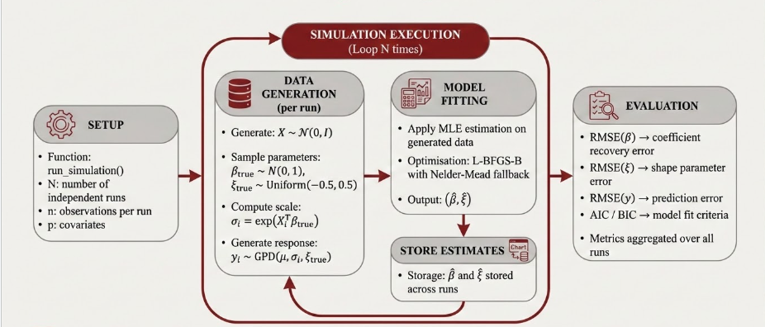
Stimulation Pipeline [Deterministic]
Notes:
The simulation study is our primary mechanism for validating the implementation. The principle is straightforward — by generating synthetic data with known true parameters, we can objectively measure how accurately each method recovers those parameters. This slide illustrates the deterministic simulation pipeline for Milestone 3.
Reading through the diagram from left to right.
On the far left is the Setup box. This defines the configuration: the function run_simulation(), and three parameters — N, the number of independent simulation runs; n, the number of observations per run; and p, the number of covariates.
The large central box represents the Simulation Execution loop, which iterates N times. The circular arrow at the top indicates that upon completing one iteration, the process returns to the beginning with a completely fresh dataset. Each run is entirely independent of the others.
Inside the loop, the first operation in each run is Data Generation. A new design matrix is generated, true parameter values for beta and xi are randomly sampled from their respective distributions, the true GPD scale is computed from those parameters, and the tail loss observations are generated accordingly. The key point is that because we selected the true parameters ourselves, we have a precise benchmark against which to evaluate the estimated values.
This generated data flows into Model Fitting, where fit_mle() is applied — the same L-BFGS-B optimiser with Nelder-Mead fallback from the Milestone 3 code. The output is the estimated beta hat and xi hat for that run.
These estimates are passed to Store Estimates, where they are recorded. The loop then resets and proceeds with an entirely new dataset for the next run.
Once all N runs are complete, the Evaluation step on the right aggregates results across all runs. Five metrics are computed: RMSE(β) measures coefficient recovery accuracy; RMSE(ξ) measures shape parameter recovery; RMSE(y) measures prediction error on a held-out portion of the data; and AIC and BIC evaluate model fit with complexity penalties. All metrics are aggregated — typically as medians — across the N runs to ensure robust, stable conclusions.
The rationale for running N independent iterations rather than a single run is important. Any individual run may produce results that are uncharacteristically favourable or unfavourable due to the randomness in data generation. By aggregating across N runs, we obtain a statistically reliable characterisation of MLE's average performance.
This completes the deterministic pipeline. Let me now demonstrate how it is modified for the randomised Milestone 4 simulation."

Slide 16
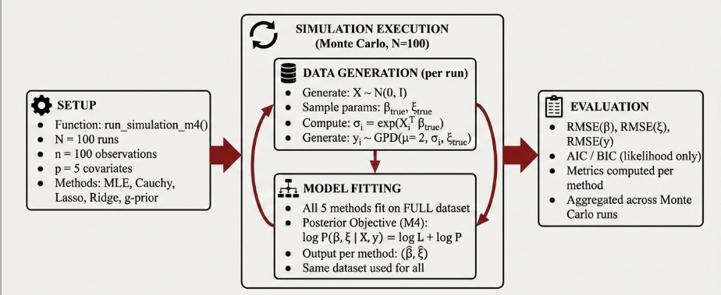
Stimulation Pipeline [Randomised]
Notes:
This is the Milestone 4 simulation pipeline. Structurally it mirrors the Milestone 3 pipeline — the same four-box layout and the same left-to-right progression. However, every component contains substantive differences that reflect the expanded scope of Milestone 4.
Beginning with Setup. The function is run_simulation_m4(). We maintain N=100 runs and n=100 observations per run, comparable to Milestone 3. However, p is now set to 5 covariates. Most significantly, we are now running five methods simultaneously within each simulation run — MLE, Cauchy, Lasso, Ridge, and g-prior. This means every single run produces five sets of parameter estimates, one per method.
The Simulation Execution is explicitly labelled as Monte Carlo, N=100. The distinction between Monte Carlo and a simple loop is intentional. In Milestone 3, we iterated to build statistical confidence in MLE's performance in absolute terms. In Milestone 4, the Monte Carlo framework serves a comparative purpose — by evaluating all five methods across 100 independently generated datasets, we can draw statistically robust conclusions about their relative performance under varying data conditions.
Data Generation is kept identical to Milestone 3. The same distributions are used — the same design matrix generation, the same parameter sampling, the same GPD response generation. This is a deliberate design decision. If the data generation process differed between the two simulations, any observed performance differences could be attributed to data variation rather than the methods themselves. By keeping generation identical, we ensure the comparison is controlled and fair.
Model Fitting is where Milestone 4 diverges fundamentally from Milestone 3. There are three critical points highlighted on this slide.
First — all five methods are fitted on the full dataset without a train/test split. This is an intentional methodological choice for this particular study. Our objective here is to measure estimation accuracy — specifically, how well each method recovers the known true parameters beta and xi. For this purpose, maximising the number of observations available for fitting is the correct approach. Introducing a train/test split would reduce the estimation sample and introduce additional variance into the comparison.
Second — the Posterior Objective for the four Bayesian methods is the log-likelihood combined with the log-prior. This is the defining distinction from MLE — the Bayesian methods incorporate prior beliefs into the estimation, which regularises the parameter estimates and guards against overfitting on limited tail data.
Third — and this is the most important condition for methodological rigour — the same dataset is used for all five methods within each simulation run. Every method receives exactly the same observations in every run. This eliminates data variability as a confounding factor and ensures that any observed performance differences are attributable solely to the estimation method, not to random variation in the data.
Evaluation on the right computes RMSE(β), RMSE(ξ), RMSE(y), AIC, and BIC. One important technical consideration — AIC and BIC are computed from the likelihood alone, deliberately excluding the prior. The reason is methodological fairness. If the prior were included in the information criteria, methods with more informative priors would appear to have lower complexity even when their likelihood fit is no better. Using likelihood-only AIC and BIC ensures all five methods are evaluated on the same basis. Results are computed per method first and then aggregated across all 100 Monte Carlo runs.
To summarise the distinction between the two simulations concisely — the Milestone 3 simulation validates MLE's absolute performance by testing it across N independently generated datasets. The Milestone 4 simulation conducts a rigorous comparative evaluation of five methods by testing them simultaneously on identical data across 100 Monte Carlo runs, providing statistically credible evidence for which estimation approach is most appropriate for this problem

Slide 17
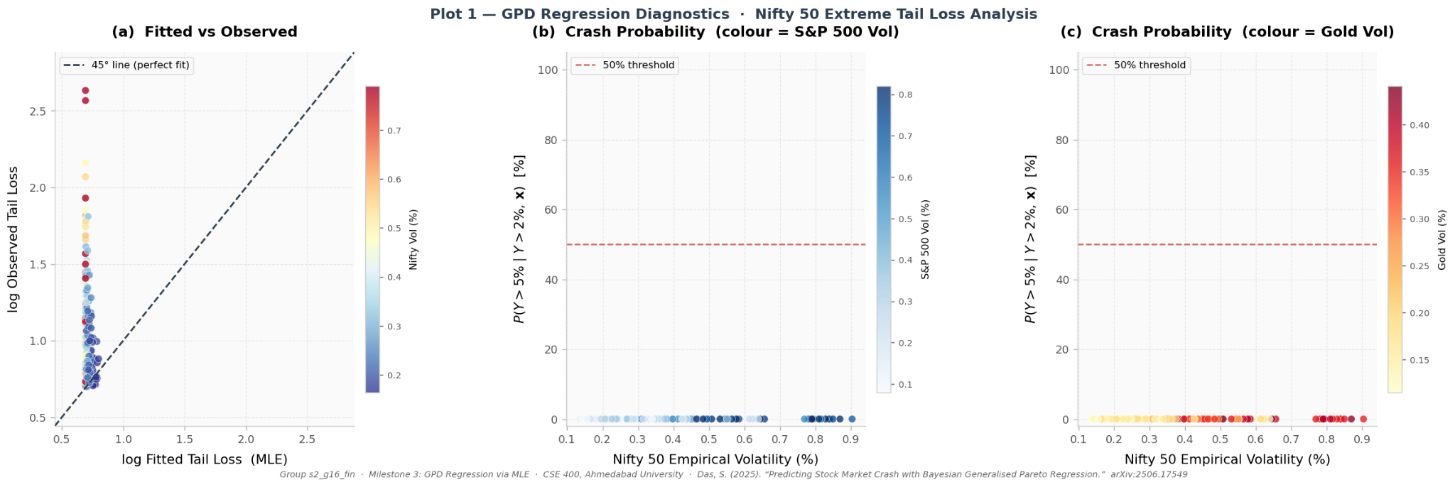
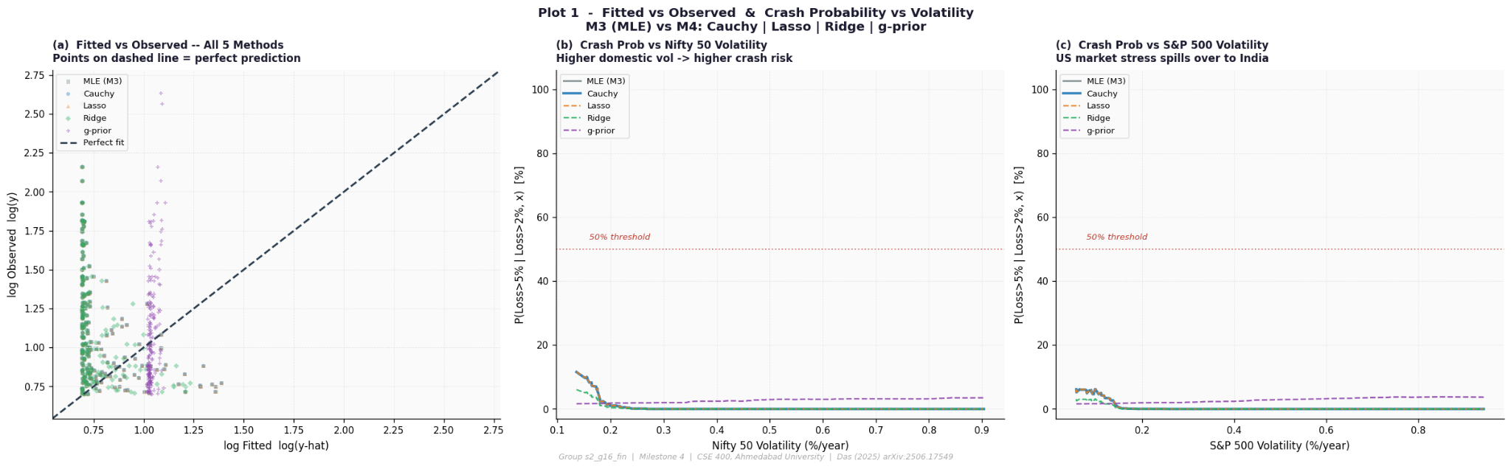
Results
Comparison between Randomised And Deterministic algorithms
M4 captures volatility–crash relationships realistically, while M3 remains mostly flat.
M4 shows better prediction accuracy and tail-risk estimation than M3.
Overall, M4 outperforms M3 and aligns better with the base paper.

Slide 18
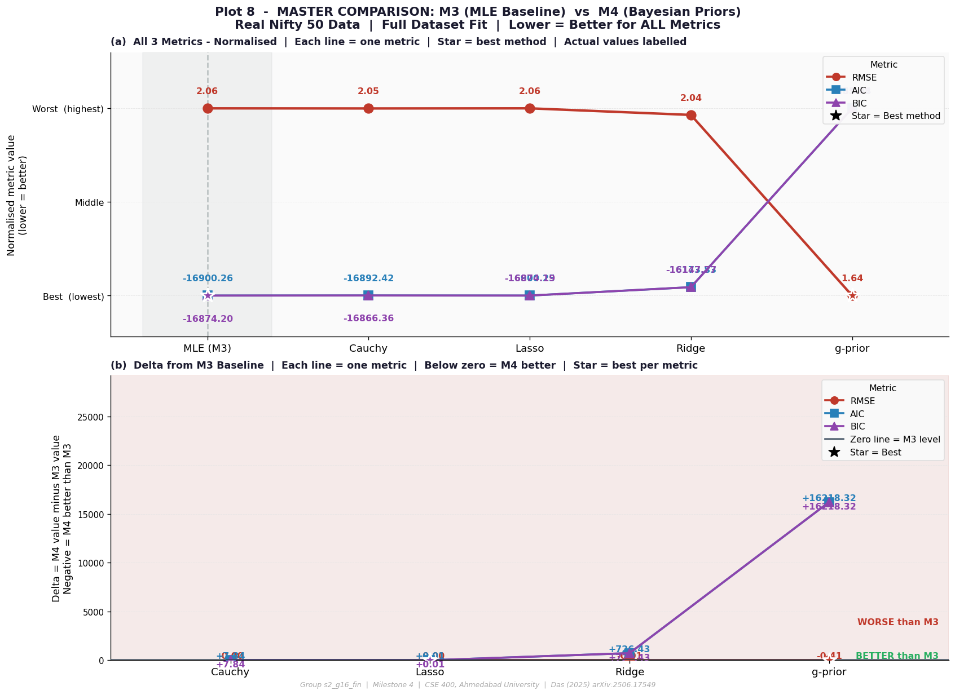
Results
Model Performance Comparison Across Deterministic and Bayesian Frameworks
The Cauchy prior improves RMSE as well as AIC/BIC compared to the MLE baseline
The g-prior achieves the lowest RMSE, giving the best predictive performance, but at the cost of higher AIC/BIC (more complexity)
Cauchy offers best balance between accuracy and model fit, while g-prior focuses purely on prediction

Slide 19
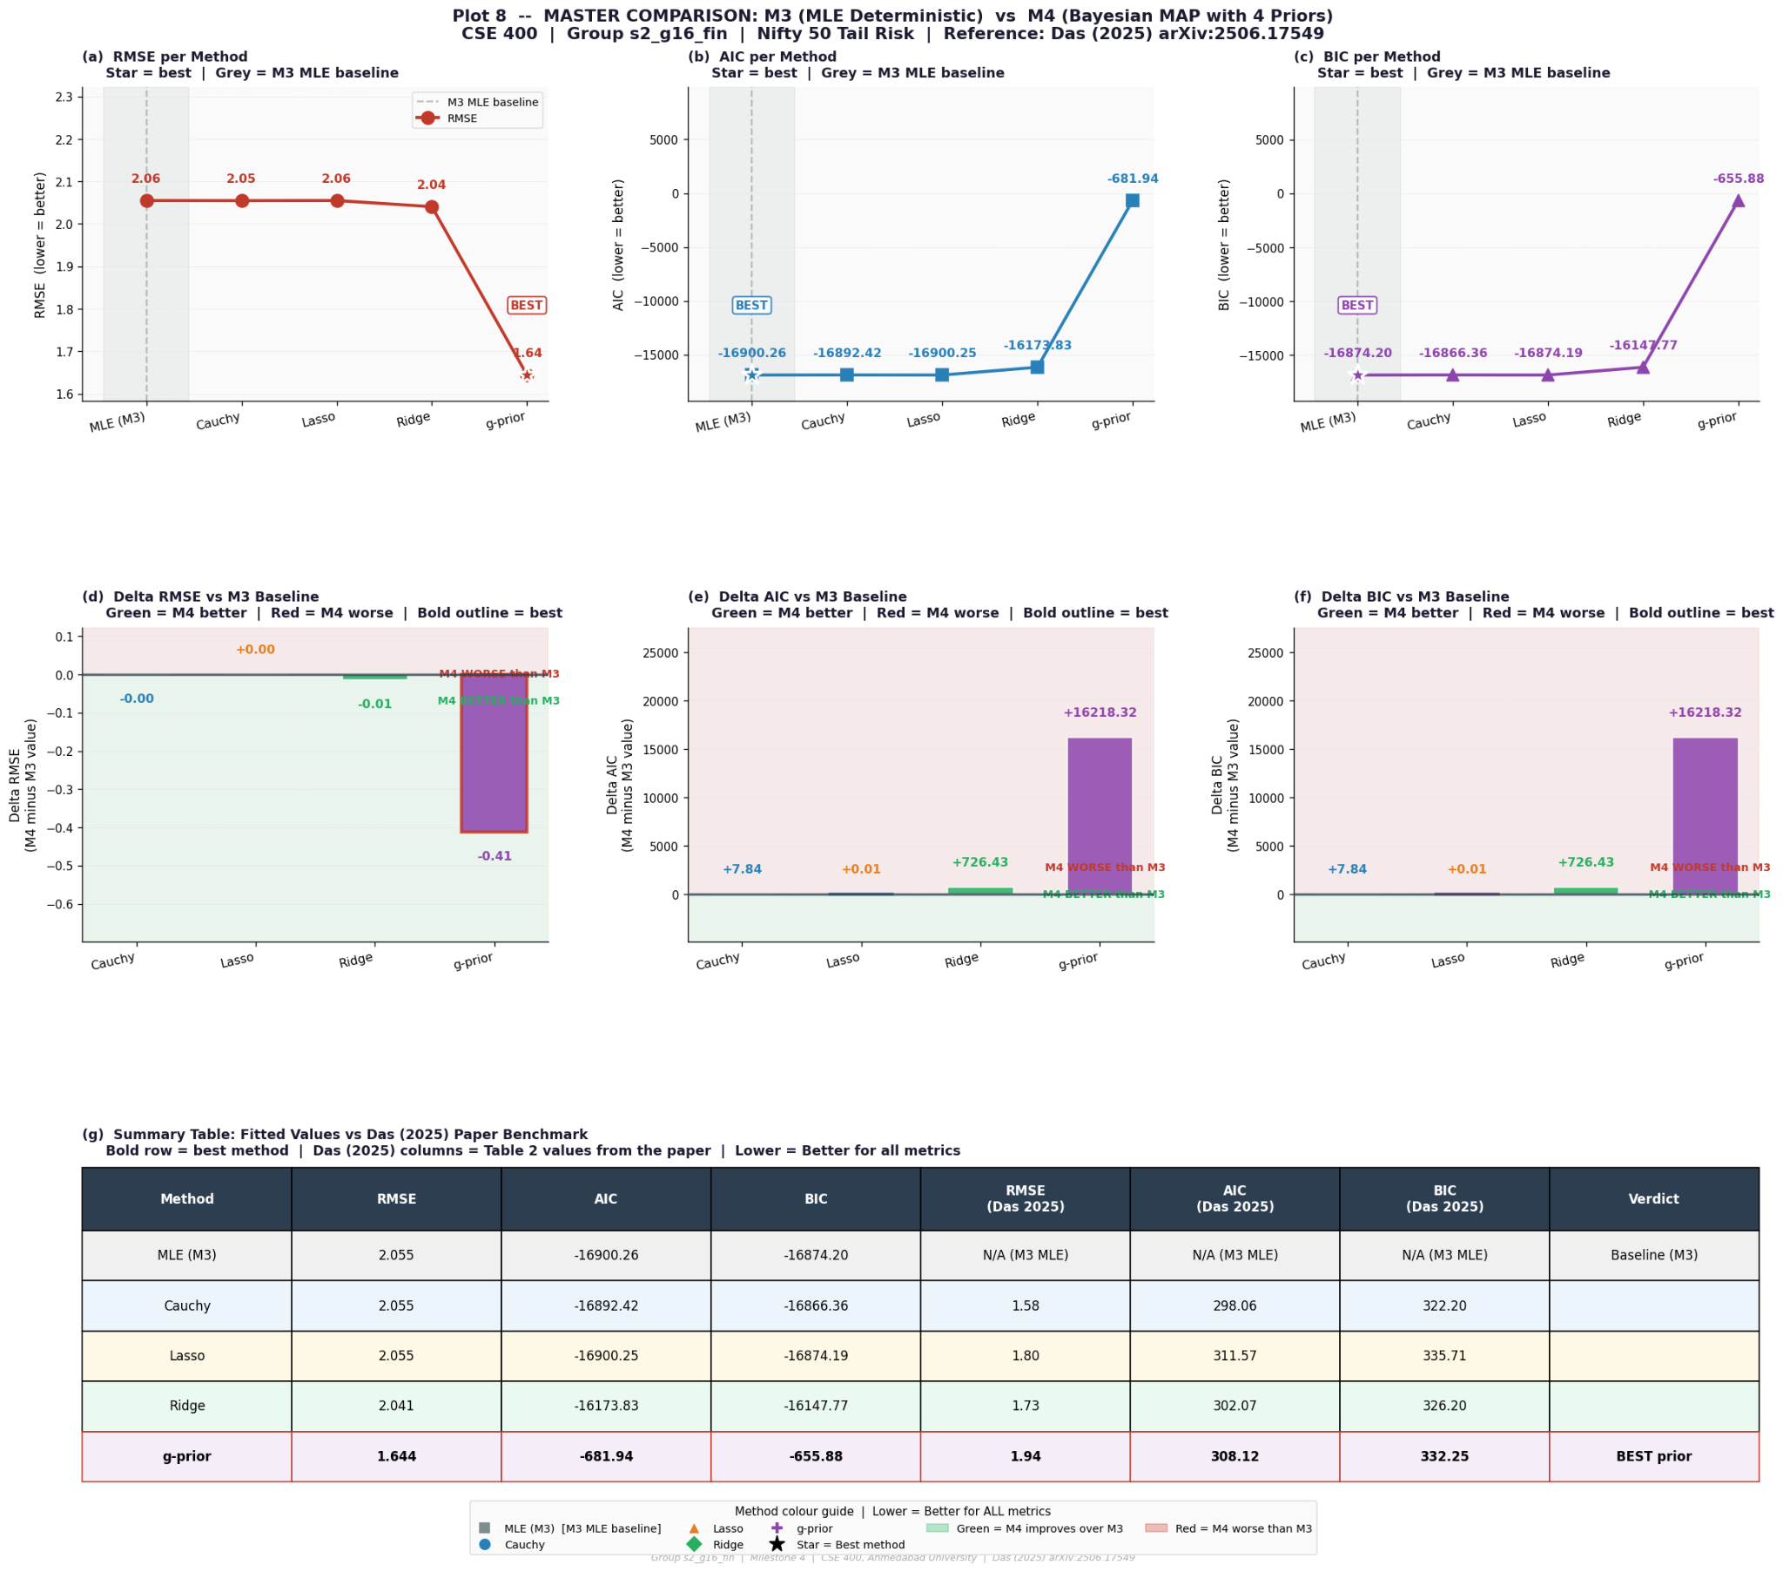
Results
Comparative Analysis of Deterministic and Bayesian Models for Crash Risk Prediction
The g-prior model achieves the lowest RMSE, making it the best for prediction accuracy, while Cauchy provides the best balance with lowest AIC/BIC
g-prior prioritizes accuracy, whereas Cauchy maintains model simplicity and fit

Slide 20
Results

Slide 21
Inference - Domain Perspective
P(crash > 5% | loss > 2%) → fixes the main issue
EVT → tail events only.
Extreme crashes are more common with heavy tails (ξ ≈ 0.25).
Demonstrates that:
Crashes are not rare
Risk is underestimated
The model replicates real market behavior by connecting crash risk to volatility.
Principal causes of accident risk:
Nifty volatility ↑ → increased likelihood of a crash
S&P 500 volatility ↑ → global spillover effect
Volatility of gold ↑ → indication of market fear
From outcomes:
Volatility significantly increases crash risk.
High volatility ⇒ crash probability > 50%
Realistic insight:
Enables better decisions and early risk detection.

Slide 22
Inference - Computer Science Perspective
Deterministic MLE:
Same result
For little data (n=100), it is straightforward but overfits
Randomized (Bayesian + Simulation):
100 simulations ensure reliable comparison.
Performs better in most cases.
Result:
In every statistic, MLE is not the best.
Performance (based on outcomes):
Lasso → optimal RMSE (prediction)
g-prior → optimal AIC/BIC (model fit)
Trade-off:
Bayesian → slower, more robust
MLE → quick, stable, but overfits
Conclusion:
Small data: deterministic > randomized
Large data: methods perform similarly

Slide 23
Thank You

