Slide 1
Financial & Risk Analysis
Bayesian Generalized Pareto Modeling of Extreme Stock Market Crashes

Slide 2
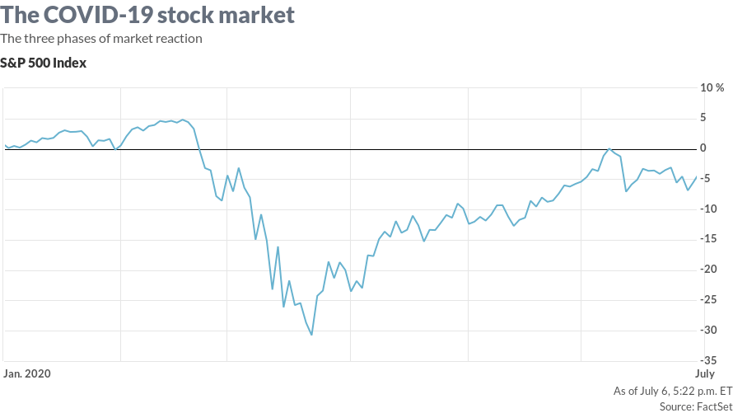
Project Context and Motivation
Title : Bayesian Generalized Pareto Modeling of Extreme Stock Market Crashes
Domain : Finance and Risk Analysis
Real World Context :
Normal-return models underestimate extreme crashes
Rare events cause major financial damage
Heavy-tailed behavior observed in markets
Why Uncertainty Is Intrinsic :
Crashes are rare and unpredictable
Volatility changes over time
Global spillovers influence domestic markets
Investor behavior is unstable

Slide 3
Project Objective and Scope
Project Objective :
Estimate probability of extreme NIFTY 50 crashes
Quantify severity of crash losses
Crash Definition:
Crash event: Rt<−2%R_t < -2\%Rt​<−2%
Loss magnitude: Y=∣Rt∣Y = |R_t|Y=∣Rt​∣ when crash occurs
Project Scope :
Model extreme tail risk only
Bayesian GPD regression framework
Volatility-driven crash severity
Out of scope :
Daily price prediction
Normal market modeling

Slide 4
Project System Overview
End to End Pipeline :
Market Data:
Volatility Computation
Threshold Exceedance Detection
Bayesian GPD Regression
Crash Risk Estimates
Major Components :
Volatility module
Exceedance filtering
Bayesian inference (MAP)
PDF/CDF tail visualization
Data Flow :
Returns → Extreme Losses → Covariates → GPD Model → Risk Output

Slide 5
Sources of Uncertainty
Measurement Noise :
Imperfect return estimation
Volatility calculation variability
Environmental Variability :
Global shocks
policy changes
Financial contagion
Modeling / Data Uncertainty:
Limited crash observations
Threshold sensitivity
Time-varying volatility

Slide 6
Key Random Variables and Their Roles
Response Variable (Y):
Extreme loss magnitude [Exceedances beyond −2% or −5%]
Represents crash severity
Covariates (Time-Varying):
NIFTY 50 volatility: Domestic risk
S&P 500 volatility: Global influence
Gold volatility: Fear indicator

Slide 7
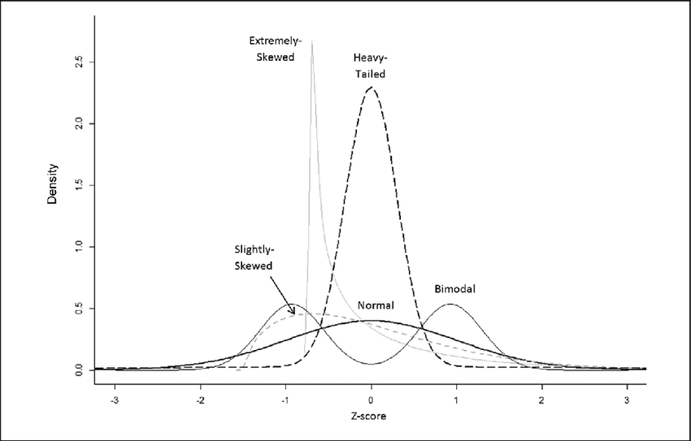


Probabilistic Models and Assumptions
Model : Generalized Pareto Distribution (GPD) for extreme losses
Volatility-Dependent Scale
Jensen’s Inequality Insight Since exponential is convex:
Implication:
Volatility fluctuations increase expected crash severity
Using average volatility underestimates tail risk
Key Assumptions :
Extreme losses are heavy-tailed
Exceedances are conditionally independent
Volatility affects loss magnitude non-linearly

Slide 8
Probabilistic Reasoning and Inference Logic
Propagation of Uncertainty:
Volatility → affects scale parameter → alters tail heaviness → changes crash probability.
Reasoning Pathway:
Observe market volatility, update the scale parameter, construct the conditional GPD, estimate the crash severity distribution, and compute the crash probability.

Slide 9
Operationalizing Probabilistic Reasoning in the Project
Implementation of Reasoning:
Likelihood from exceedance data
Cauchy priors on parameters
MAP estimation
Jensen Operationalization
Volatility treated as time-varying
Nonlinear scale modeling applied
Evaluation Metric:
RMSE
PDF/CDF visualization
Regime comparison
Simplifying Assumptions:
Constant shape parameter
Short-term market stability

Slide 10
Current Limitations and Conceptual Gaps
Known Weaknesses:
Less observations are done for extreme crash.
Questionable Assumptions:
Constant shape parameter
Independent extreme events
Conceptual Ambiguities:
Threshold selection
Delayed global effects

Slide 11
Planned Refinements and Role Coordination
Next Milestone:
Time-varying shape parameter
Dynamic volatility models
Improved threshold selection
Role Coordination:
Model role refine system
Data role enhance volatility estimation
Scribe role maintain probabilistic consistency
Reviewer ensures consistency

Slide 12
Summary of Group Level Understanding
Probabilistic Understanding:
Market crashes are very rare, major and heavy-tailed.
Crash risk is being modeled as probability instead of predicting it.
Volatility drives crash severity nonlinearly
Key Insight:
Volatility variability amplifies extreme risk.
Average volatility is misleading.
Jensen’s inequality mathematically explains why tail risk is underestimated when volatility fluctuates.
Overall Conclusion:
We use Bayesian modeling in order to capture crash risk.
Global effects and time variation will be evolved by the model.

Slide 13
Thank You
Section 2 - Group 16
Sakshi Patel
Hitaksh Thaker
Dhruvika Mehta
Tirth Khunt
Hirva Vekariya

