Slide 1
skin diseases identification using large vision model
IBM AICTE PROJECT
Presented By:
Student Name-Sakshi Shivaji Kamble
College Name-DKTE Textile & Engineering College
Department-Computer Science & Engineering

Slide 2
OUTLINE
Problem Statement
Proposed System/Solution
System Development Approach
Algorithm & Deployment
Result (Output Image)
Conclusion
Future Scope
References

Slide 3
Problem Statement
Diagnosing skin diseases requires expertise and timely access to healthcare, which many people around the world lack. Many conditions, like acne, eczema, or melanoma, can look similar in early stages, making early and accurate diagnosis difficult. There’s a need for an intelligent, accessible tool that can support dermatological screening using just images

Slide 4
Proposed Solution
The solution leverages the Pixtral 12B multimodal AI model to analyze medical images and answer diagnostic queries. By combining advanced vision encoding with natural language understanding, the system can accurately identify skin diseases from images.
Key components include:
Image Encoding: Convert skin images into a format understandable by the AI model.
Multimodal Query Processing: Input images along with user questions (e.g., "What disease is this?") to the model.
AI-powered Diagnosis: Generate concise, accurate textual responses identifying the disease.
Cloud Deployment: Utilize IBM watsonx.ai for scalable, accessible model hosting and API interaction.
This approach ensures efficient, scalable, and accurate skin disease identification through multimodal AI.

Slide 5
System Approach
Data Acquisition: Collect high-quality skin disease images from reliable medical sources.
Image Preprocessing: Encode images into base64 format to feed into the multimodal model.
Model Integration: Use the Pixtral 12B multimodal model deployed on IBM watsonx.ai for image and text input processing.
Query Handling: Combine user queries with encoded images to form multimodal input for the AI model.
Inference & Response: Generate accurate disease identification responses based on image analysis and user questions.
Result Presentation: Display diagnostic results clearly for users or medical professionals.
Deployment: Host the solution on cloud infrastructure ensuring scalability, availability, and easy access via APIs.

Slide 6
Algorithm & Deployment
Algorithm
The system uses Pixtral 12B, a large multimodal transformer model with 12 billion parameters, designed to handle both image and text inputs. It consists of:
Vision Encoder: Converts input images into tokenized visual embeddings.
Multimodal Transformer Decoder: Processes combined image embeddings and text prompts to generate relevant text outputs.
The model is trained to understand complex visual content (e.g., medical images) and generate accurate textual responses, excelling at tasks like image captioning and visual question answering.

Slide 7
Algorithm & Deployment
Deployment
The model is deployed on IBM watsonx.ai cloud platform, accessible via API calls from a Jupyter Notebook environment. Deployment steps include:
Setting up a watsonx.ai project and runtime service.
Generating API keys for authentication.
Encoding input images into base64 format for transmission.
Sending multimodal queries combining images and user text prompts.
Receiving and processing model-generated textual responses in real time.
This cloud deployment ensures scalable, reliable access to Pixtral 12B without requiring local computational resources.

Slide 8
Result
The Pixtral 12B model successfully analyzed the input images of skin conditions and generated accurate, concise answers describing the type of disease depicted (e.g., acne type). The model demonstrated a strong understanding of visual content combined with contextual user queries, outperforming other vision-language models like the llama 11b vision-instruct in clarity and detail.
Sample output for an acne image: “This person appears to have Type IV acne characterized by severe inflammation and nodules.”
The model’s ability to integrate image data with text input showcases its effectiveness in visual question answering tasks, particularly in medical image understanding.

Slide 9
Conclusion
Pixtral 12B is a powerful multimodal AI model capable of accurately interpreting complex images and providing relevant textual answers. Leveraging the model through IBM’s watsonx platform allows for easy deployment and integration into real-world applications such as medical diagnosis support, image captioning, and document analysis. The model’s high parameter count and advanced architecture contribute to superior performance in vision-and-language tasks, making it a valuable tool for enhancing AI-driven multimodal understanding.

Slide 10
Future scope
Future Scope
Enhanced Medical Diagnostics: Extend to more skin diseases and other medical imaging areas for wider diagnostic support.
Real-time Mobile Integration: Deploy the model in mobile apps for instant disease detection from photos.
Multilingual Support: Improve language understanding to support global users in multiple languages.
Continuous Learning: Implement online learning to update the model with new data for improved accuracy.
Explainability Features: Add interpretable AI outputs to help medical professionals understand model predictions.
Integration with EHR Systems: Seamlessly connect with electronic health records for comprehensive patient management.

Slide 11
References
Mistral AI. (2024). Pixtral 12B: A 12 Billion Parameter Multimodal Model. Retrieved from https://mistral.ai/news/pixtral-12b/
IBM. (2024). watsonx.ai Documentation. Retrieved from https://www.ibm.com/products/watsonx-ai
IBM GitHub Repository. (2024). Pixtral Multimodal AI Tutorial. Retrieved from https://github.com/IBM/ibmdotcom-tutorials/blob/main/generative-ai/pixtral-multimodal-ai.ipynb
IBM Cloud Docs. (2024). Using IBM watsonx Runtime and API Keys. Retrieved from https://dataplatform.cloud.ibm.com/docs/content/wsj/analyze-data/ml-authentication.html

Slide 12
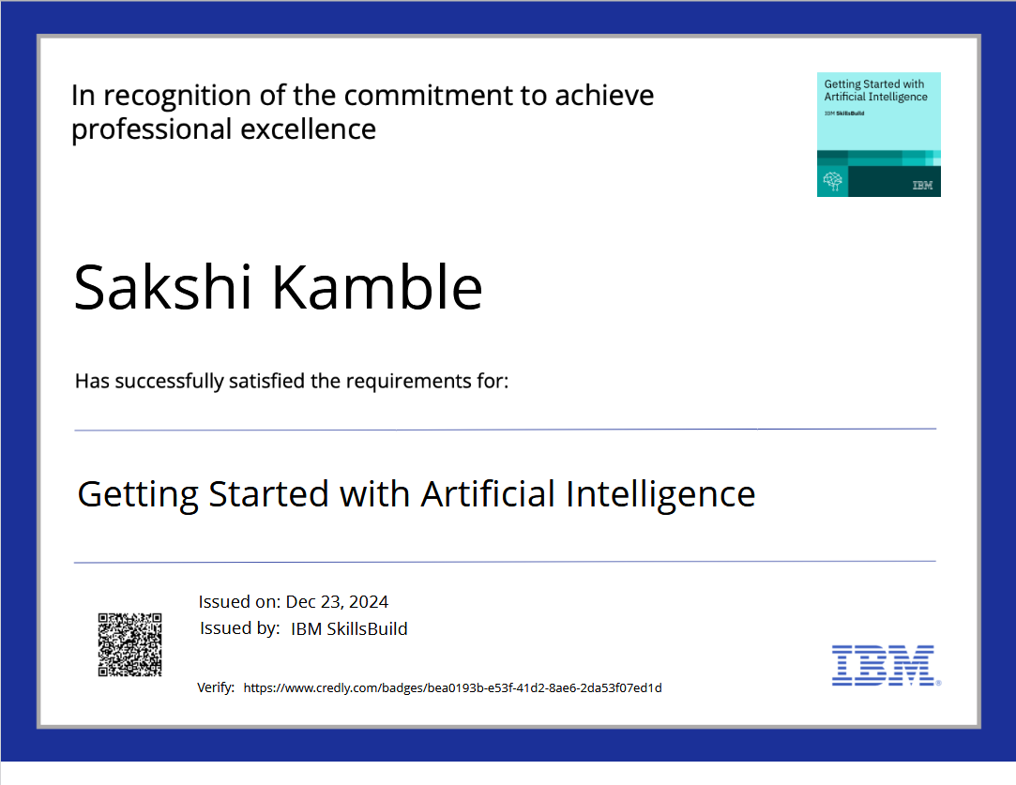
IBM Certifications

Slide 13
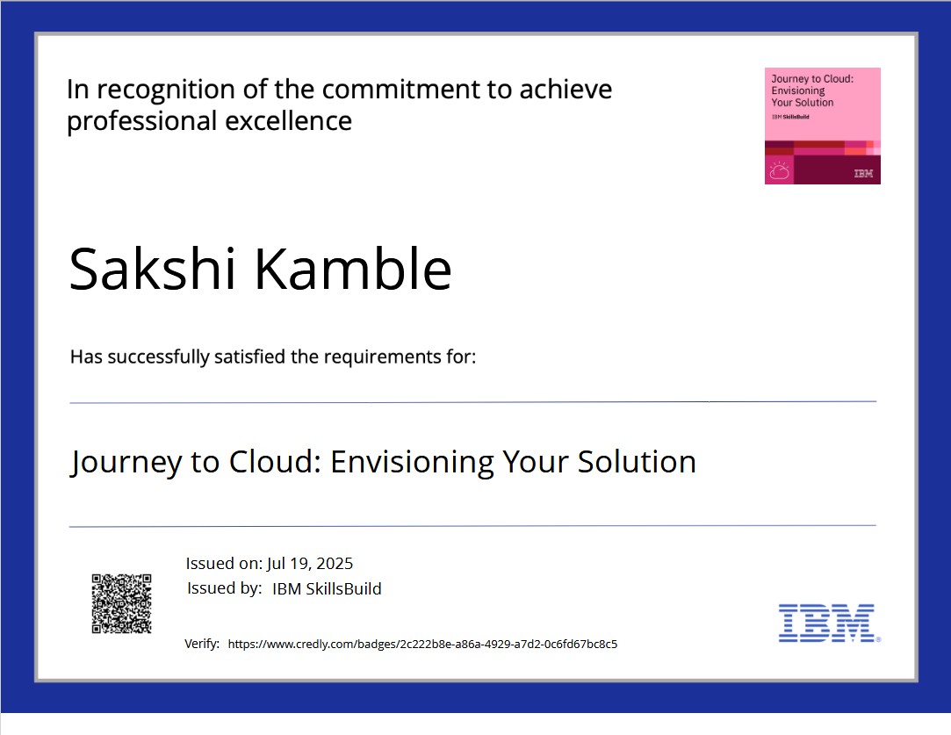
IBM Certifications

Slide 14
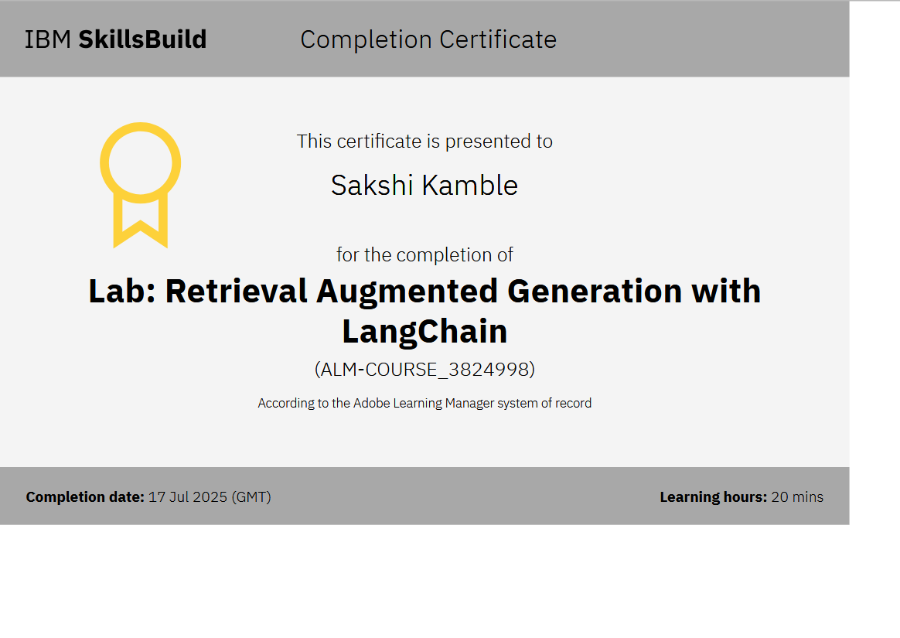
IBM Certifications

Slide 15
THANK YOU

