Slide 1
INTERNSHIP REPORT
Data Analytics Internship at Link In Blink
Data Analyst Intern • HM ESCAN Pvt. Ltd. • April 18 – May 20, 2025
Submitted by Sakshi Kumari | Roll No. CS-23411589
School of Computer Science and Engineering
IILM University, Greater Noida, U.P. | B.Tech CSE, Batch 2026-27

Slide 2
OVERVIEW
What This Report Covers
1
Organization Profile
2
Internship Overview
About Link In Blink and HM ESCAN Pvt. Ltd.
Role, duration, and mode of engagement
3
Problem Statement & Objectives
4
Scope, Tools & Methodology
Why the work mattered and its goals
How the work was approached
5
Key Contributions & Outcomes
6
Certificate of Completion
What was delivered and learned
Verification of successful completion
Internship Report – Link In Blink | Sakshi Kumari (CS-23411589)
2

Slide 3
CHAPTER 4.2
Organization Profile
Link In Blink – “One Tap to Trusted Entry”
Link In Blink, operated by HM ESCAN Pvt. Ltd., is a technology company building secure, tap-based visitor and entry-management solutions. The platform helps organizations manage trusted access with speed, accuracy, and reliability.
LINK IN
BLINK
COMPANY
HM ESCAN Pvt. Ltd.
HEADQUARTERS
Bikaner, Rajasthan
WEBSITE
Security technology & visitor management
www.linkinblink.com
Internship Report – Link In Blink | Sakshi Kumari (CS-23411589)
3

Slide 4
CHAPTER 4.1
Internship at a Glance
7
Apr 18 – May 20
Data Analyst
Unpaid
Weeks Duration
2025
Intern Role
Engagement Type
The internship was completed as part of the Data Analyst Intern role at Link In Blink, focused on applying data collection, cleaning, analysis, and dashboarding skills to real organizational needs — working closely with cross-functional teams throughout.
Internship Report – Link In Blink | Sakshi Kumari (CS-23411589)
4

Slide 5
CHAPTER 4.3
Problem Statement
Organizations relying on manual or fragmented processes to track visitor entry and operational data struggle with accuracy, consistency, and timely insight.
THE CORE CHALLENGE
Raw data → Reliable insight
There was a clear need to collect, clean, and analyze data from multiple sources — and translate it into clear dashboards and reports that support faster, better-informed business decisions.
Turning scattered, unvalidated records into a single source of truth that teams can act on with confidence.
Internship Report – Link In Blink | Sakshi Kumari (CS-23411589)
5

Slide 6
CHAPTER 4.4
Project Objectives
1
Collect, clean, and validate data from various sources
2
Perform exploratory data analysis (EDA) to identify trends and insights
3
Create dashboards and reports using Excel and visualization tools
4
Assist in data modeling and analysis to support business decisions
5
Collaborate with cross-functional teams to deliver data-driven solutions
Internship Report – Link In Blink | Sakshi Kumari (CS-23411589)
6

Slide 7
CHAPTERS 4.5 & 4.6
Scope of Work & Tools Used
SCOPE OF THE PROJECT
TECHNOLOGIES & TOOLS
The internship covered end-to-end handling of business data: sourcing and validating raw records, performing exploratory analysis, and presenting findings through dashboards and summary reports used by internal stakeholders to support operational decision-making.
Microsoft Excel
Data cleaning, analysis, and dashboard creation
Visualization Tools
Presenting trends and insights clearly
Validation Techniques
Ensuring accuracy and data quality
Internship Report – Link In Blink | Sakshi Kumari (CS-23411589)
7

Slide 8
CHAPTERS 4.7 & 4.8
System Workflow & Methodology
1
2
3
4
5
Collect Data
Clean & Validate
Explore & Analyze
Build Dashboards
Share & Review
The internship followed an iterative approach — data collection and validation, exploratory analysis, dashboard and report creation, and review with the team — with regular feedback from the HR Manager and team members incorporated at each stage to keep outputs aligned with business needs.
Internship Report – Link In Blink | Sakshi Kumari (CS-23411589)
8

Slide 9
RECOGNIZED CONTRIBUTIONS
What I Contributed During the Internship
As noted in the internship completion certificate issued by Link In Blink:
Collected, cleaned, and validated data from various sources
Performed exploratory data analysis to identify trends and insights
Created dashboards and reports using Excel and visualization tools
Assisted in data modeling and analysis to support business decisions
Collaborated with cross-functional teams to deliver data-driven solutions
Internship Report – Link In Blink | Sakshi Kumari (CS-23411589)
9

Slide 10
CHAPTER 4.9
Expected Outcomes & Learnings
Practical Data Skills
Analytical Thinking
Hands-on experience in data collection, cleaning, and validation
Ability to perform exploratory analysis and surface meaningful trends
Business Dashboards
Team Collaboration
Skill in building dashboards and reports that inform decisions
Experience working with cross-functional teams in a real organization
Internship Report – Link In Blink | Sakshi Kumari (CS-23411589)
10

Slide 11
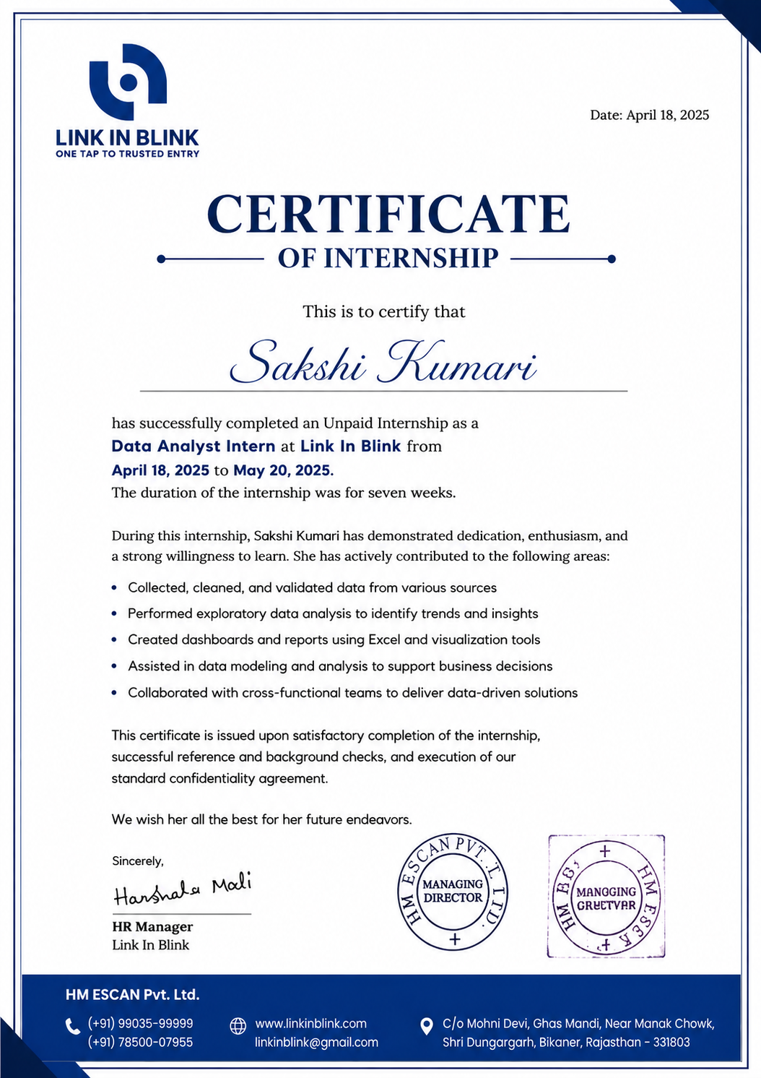
VERIFICATION
Internship Completion Certificate
Internship Report – Link In Blink | Sakshi Kumari (CS-23411589)
11

Slide 12
Thank You
Gratitude to Link In Blink (HM ESCAN Pvt. Ltd.) and the School of Computer Science and Engineering, IILM University, for their guidance and support.
Sakshi Kumari | Roll No. CS-23411589 | B.Tech CSE, Batch 2026-27

