Slide 1
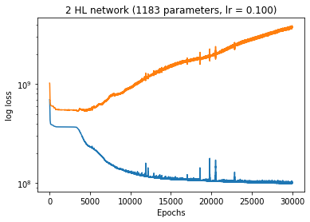
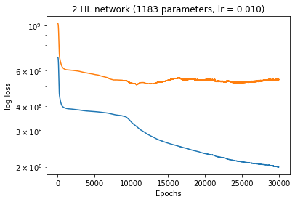
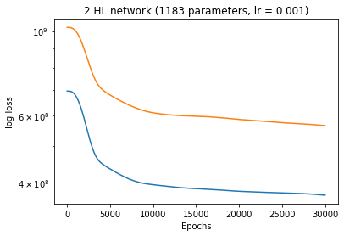
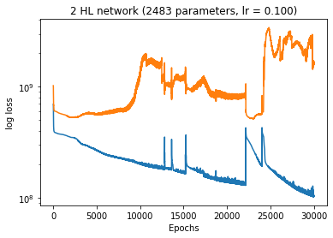
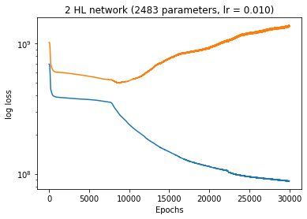
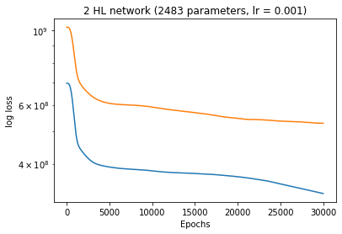
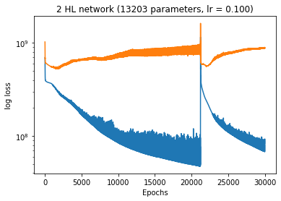
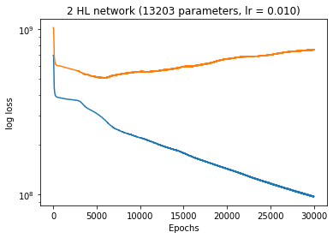
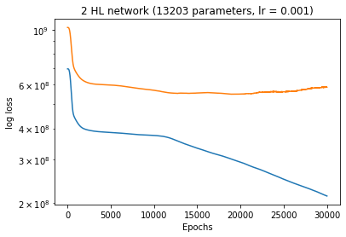
Baseline experiments

Slide 2
R2-score
{((30, 10), 0.1): {0: tensor(-2.7286), 1: tensor(-2.4183), 2: tensor(-1.4610)},
((30, 10), 0.01): {0: tensor(0.2681), 1: tensor(-0.5576), 2: tensor(-0.2449)},
((30, 10), 0.001): {0: tensor(0.2625), 1: tensor(0.2227), 2: tensor(0.3894)},
((50, 20), 0.1): {0: tensor(-729.9717), 1: tensor(-126.8024), 2: tensor(-97.5322)},
((50, 20), 0.01): {0: tensor(-52.0549), 1: tensor(-2879.7458), 2: tensor(-2671.4656)},
((50, 20), 0.001): {0: tensor(0.4427), 1: tensor(-0.5064), 2: tensor(0.0587)},
((100, 100), 0.1): {0: tensor(-10.3420),1: tensor(-7.3590),2: tensor(-2.2001)},
((100, 100), 0.01): {0: tensor(0.2834), 1: tensor(-3.1010), 2: tensor(-2.2946)},
((100, 100), 0.001): {0: tensor(-0.2262),1: tensor(-18.1115),2: tensor(-10.4676)}}
TEST_LOSS
{((30, 10), 0.1): 1280474752.0,
((30, 10), 0.01): 647760384.0,
((30, 10), 0.001): 317696736.0,
((50, 20), 0.1): 51267399680.0,
((50, 20), 0.01): 1390513225728.0,
((50, 20), 0.001): 489750240.0,
((100, 100), 0.1): 1665068672.0,
((100, 100), 0.01): 1714227200.0,
((100, 100), 0.001): 5966696960.0}

Slide 3
Final results for the report
a)
b)
Training
Validation
Training
Validation
c)
d)
Training
Validation
Training
Validation

Slide 4
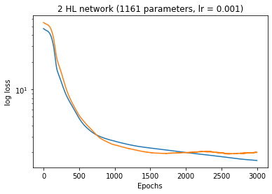
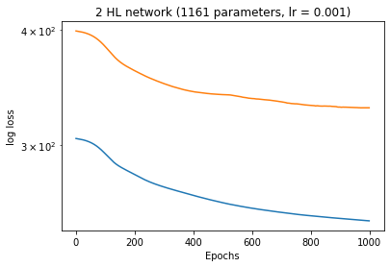
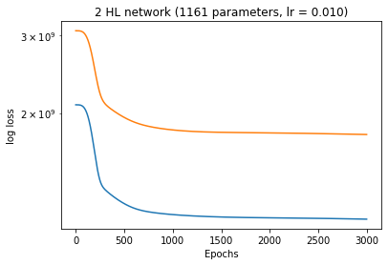
3 different NNs for each target
Target 1
Target 2
Target 3
Training
Validation
Training
Validation
Training
Validation
Target 1
R2-SCORE = tensor(0.6994)
Target 2
R2-SCORE = tensor(0.0274)
Target 3
R2-SCORE = tensor(0.0933)
Average Test Loss: 12.197778701782227
Average Test Loss: 207.908447265625
Average Test Loss: 961243520.0

