Slide 1
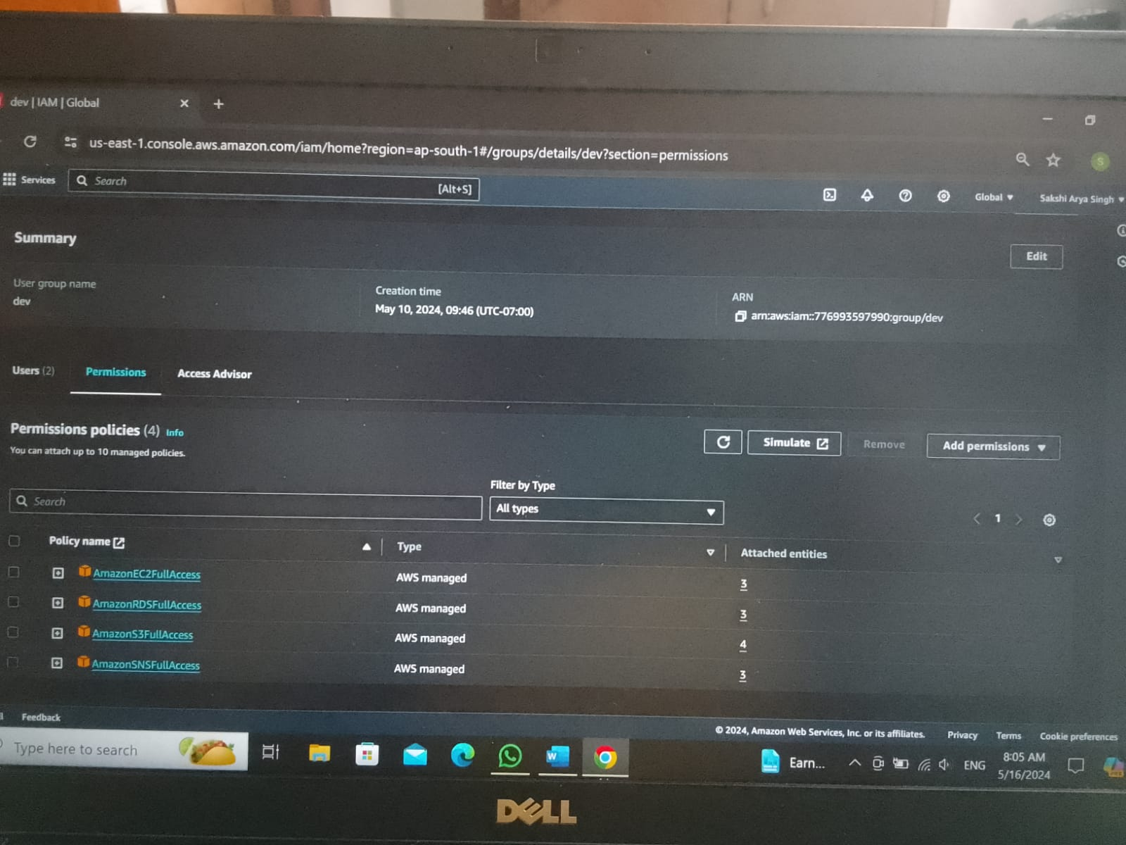
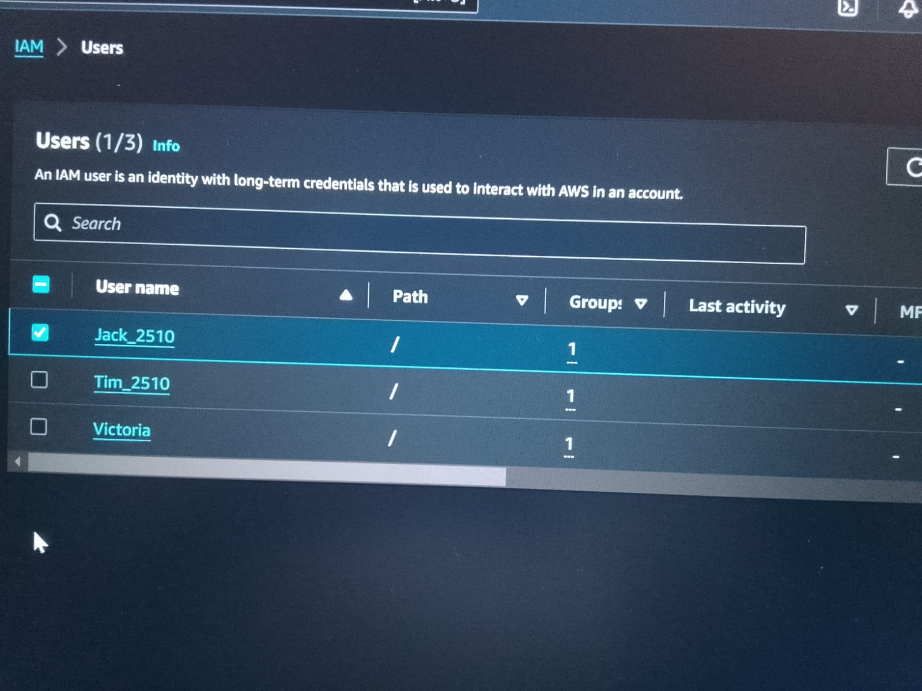
Create an IAM user Jack and provide him full access for ec2, S3, SNS and RDS.

Slide 2
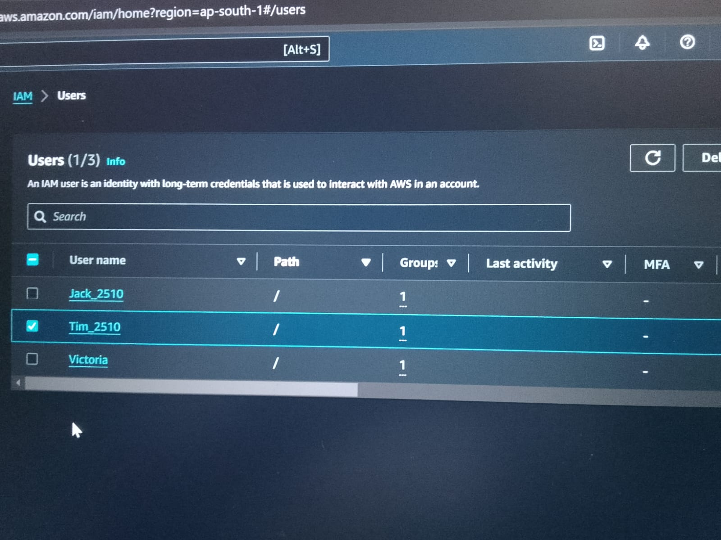
Create another user Tim by copying all policies from Jack.

Slide 3
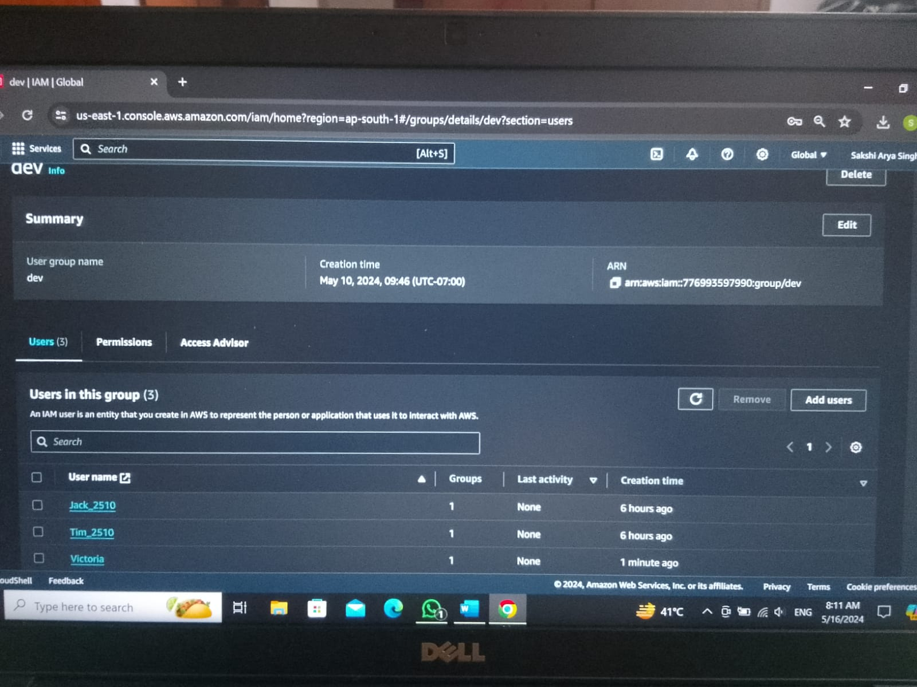
Create a group called Dev and add Jack & Tim to it. Along with that create and add Victoria to the group.

Slide 4
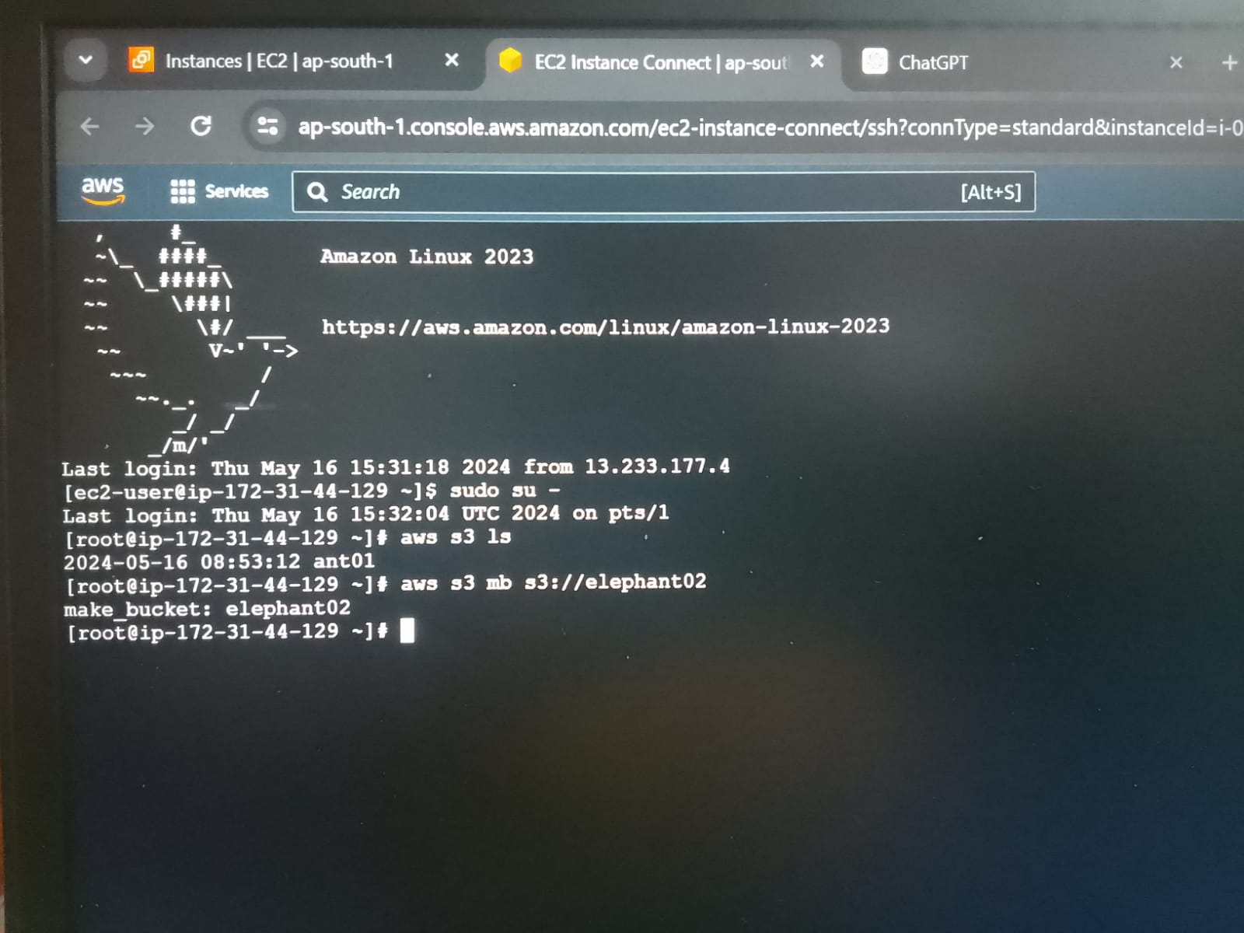
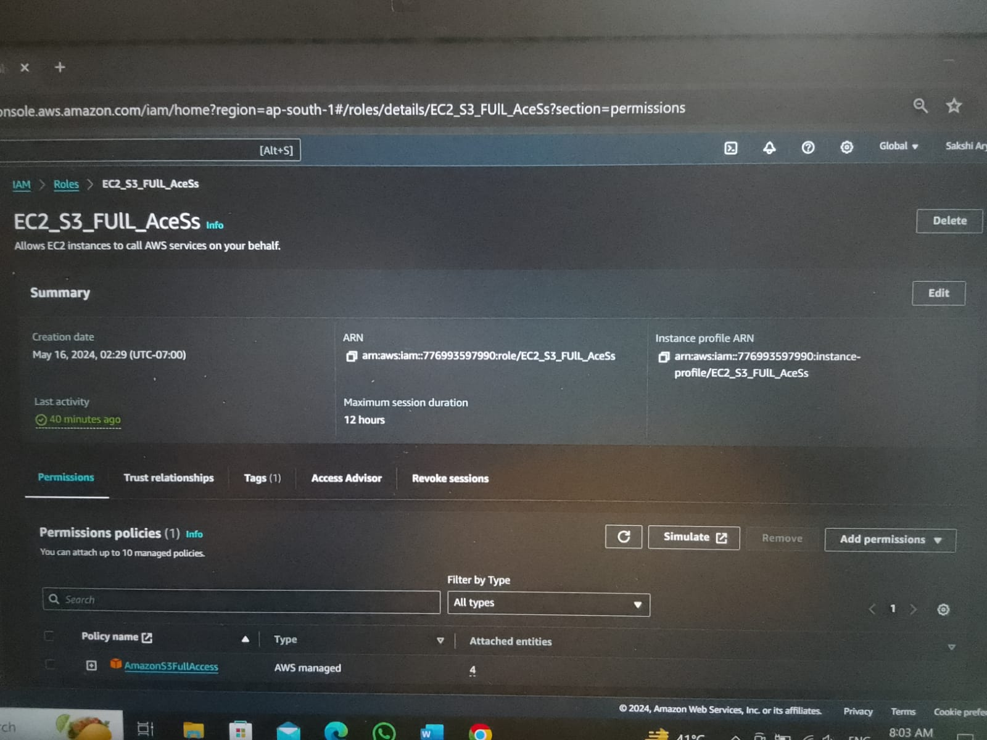
Connect S3 bucket with EC2 using IAM Role.

Slide 5
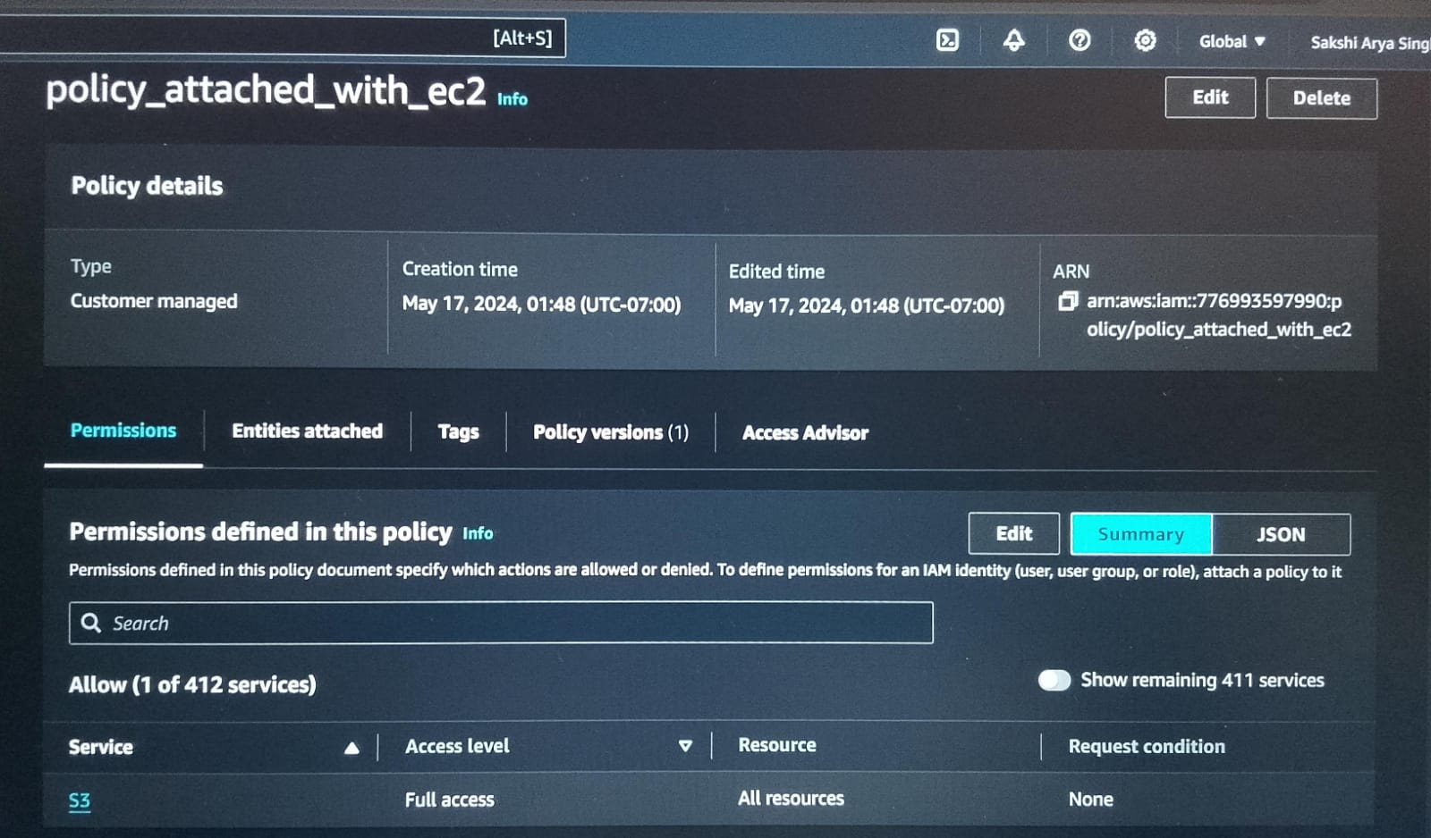
Create and attach any custom-made policy to an ec2 instance and test.

Slide 6
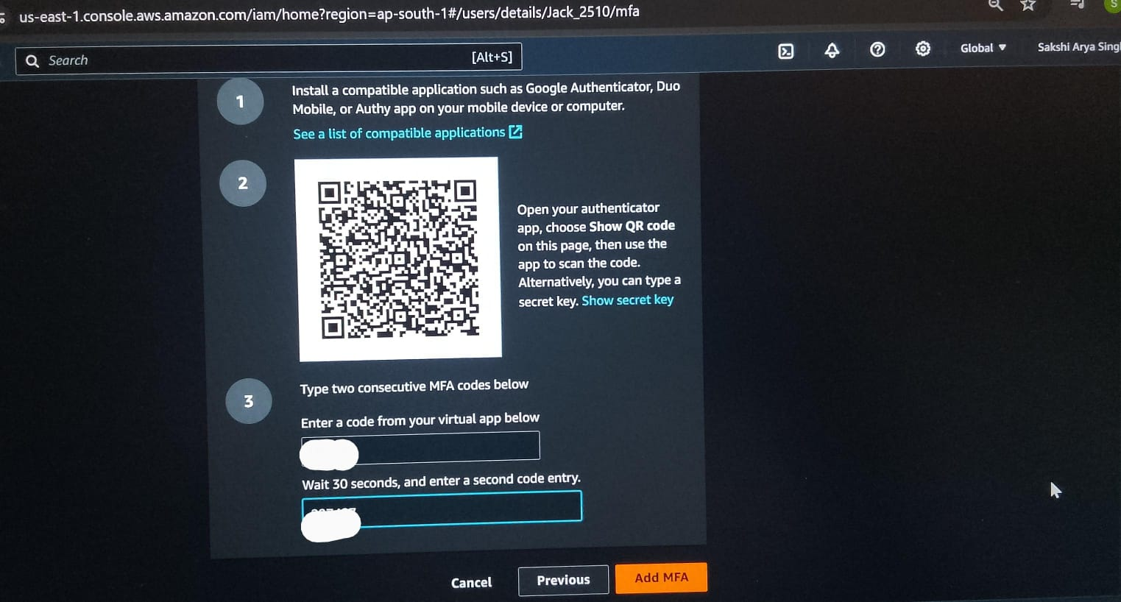
Add Multifactor Authentication to your account.

Slide 7
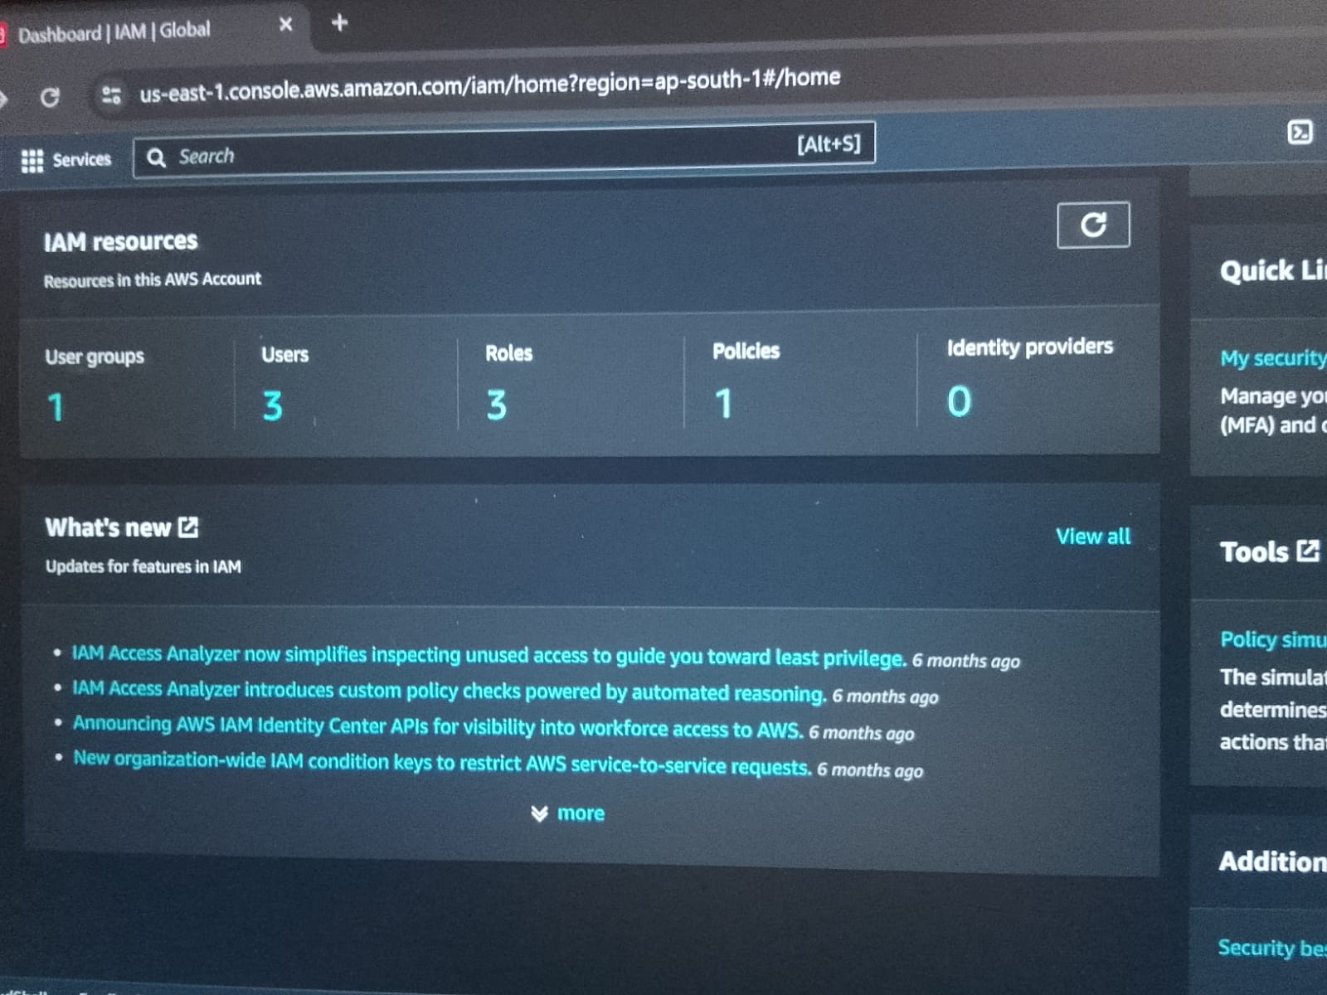
IAM RESOURCES:-

