Slide 1
ANTARDHWANI
Catching Crises Before They Catch Us…..
By: Sakshi Sheogekar

Slide 2
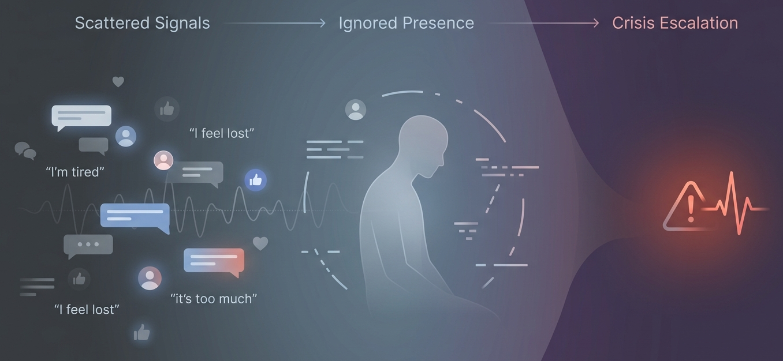

Slide 3
KEY FEATURES & INSIGHTS
Real-Time Monitoring: Tracks health & social signals continuously
Behavior Detection: Spots early signs of stress or mood changes
Language Analysis: Understands speech & text for mental health insights
Predictive AI: Anticipates risks before crises happen
Actionable Support: Suggests timely interventions & care
Visual Dashboards: Heatmaps & charts for quick insights
Unique Edge: Predictive, community-focused, multi-layer intelligence

Slide 4
WHAT MAKES ANTARDHWANI UNIQUE ??
Spots mental health risks before crises occur
Combines behavior, language, and data for smarter insights
Understands community and individual trends while respecting privacy
Provides actionable interventions, not just reports
Continuously tracks signals in real time

Slide 5
FUTURE VISION
Expand to monitor broader public health trends globally
Integrate more AI-driven predictive models for early interventions
Enable personalized mental health support at scale
Foster community well-being with proactive, data-driven insights
Continuously evolve with ethical, human-centered AI principles

Slide 6
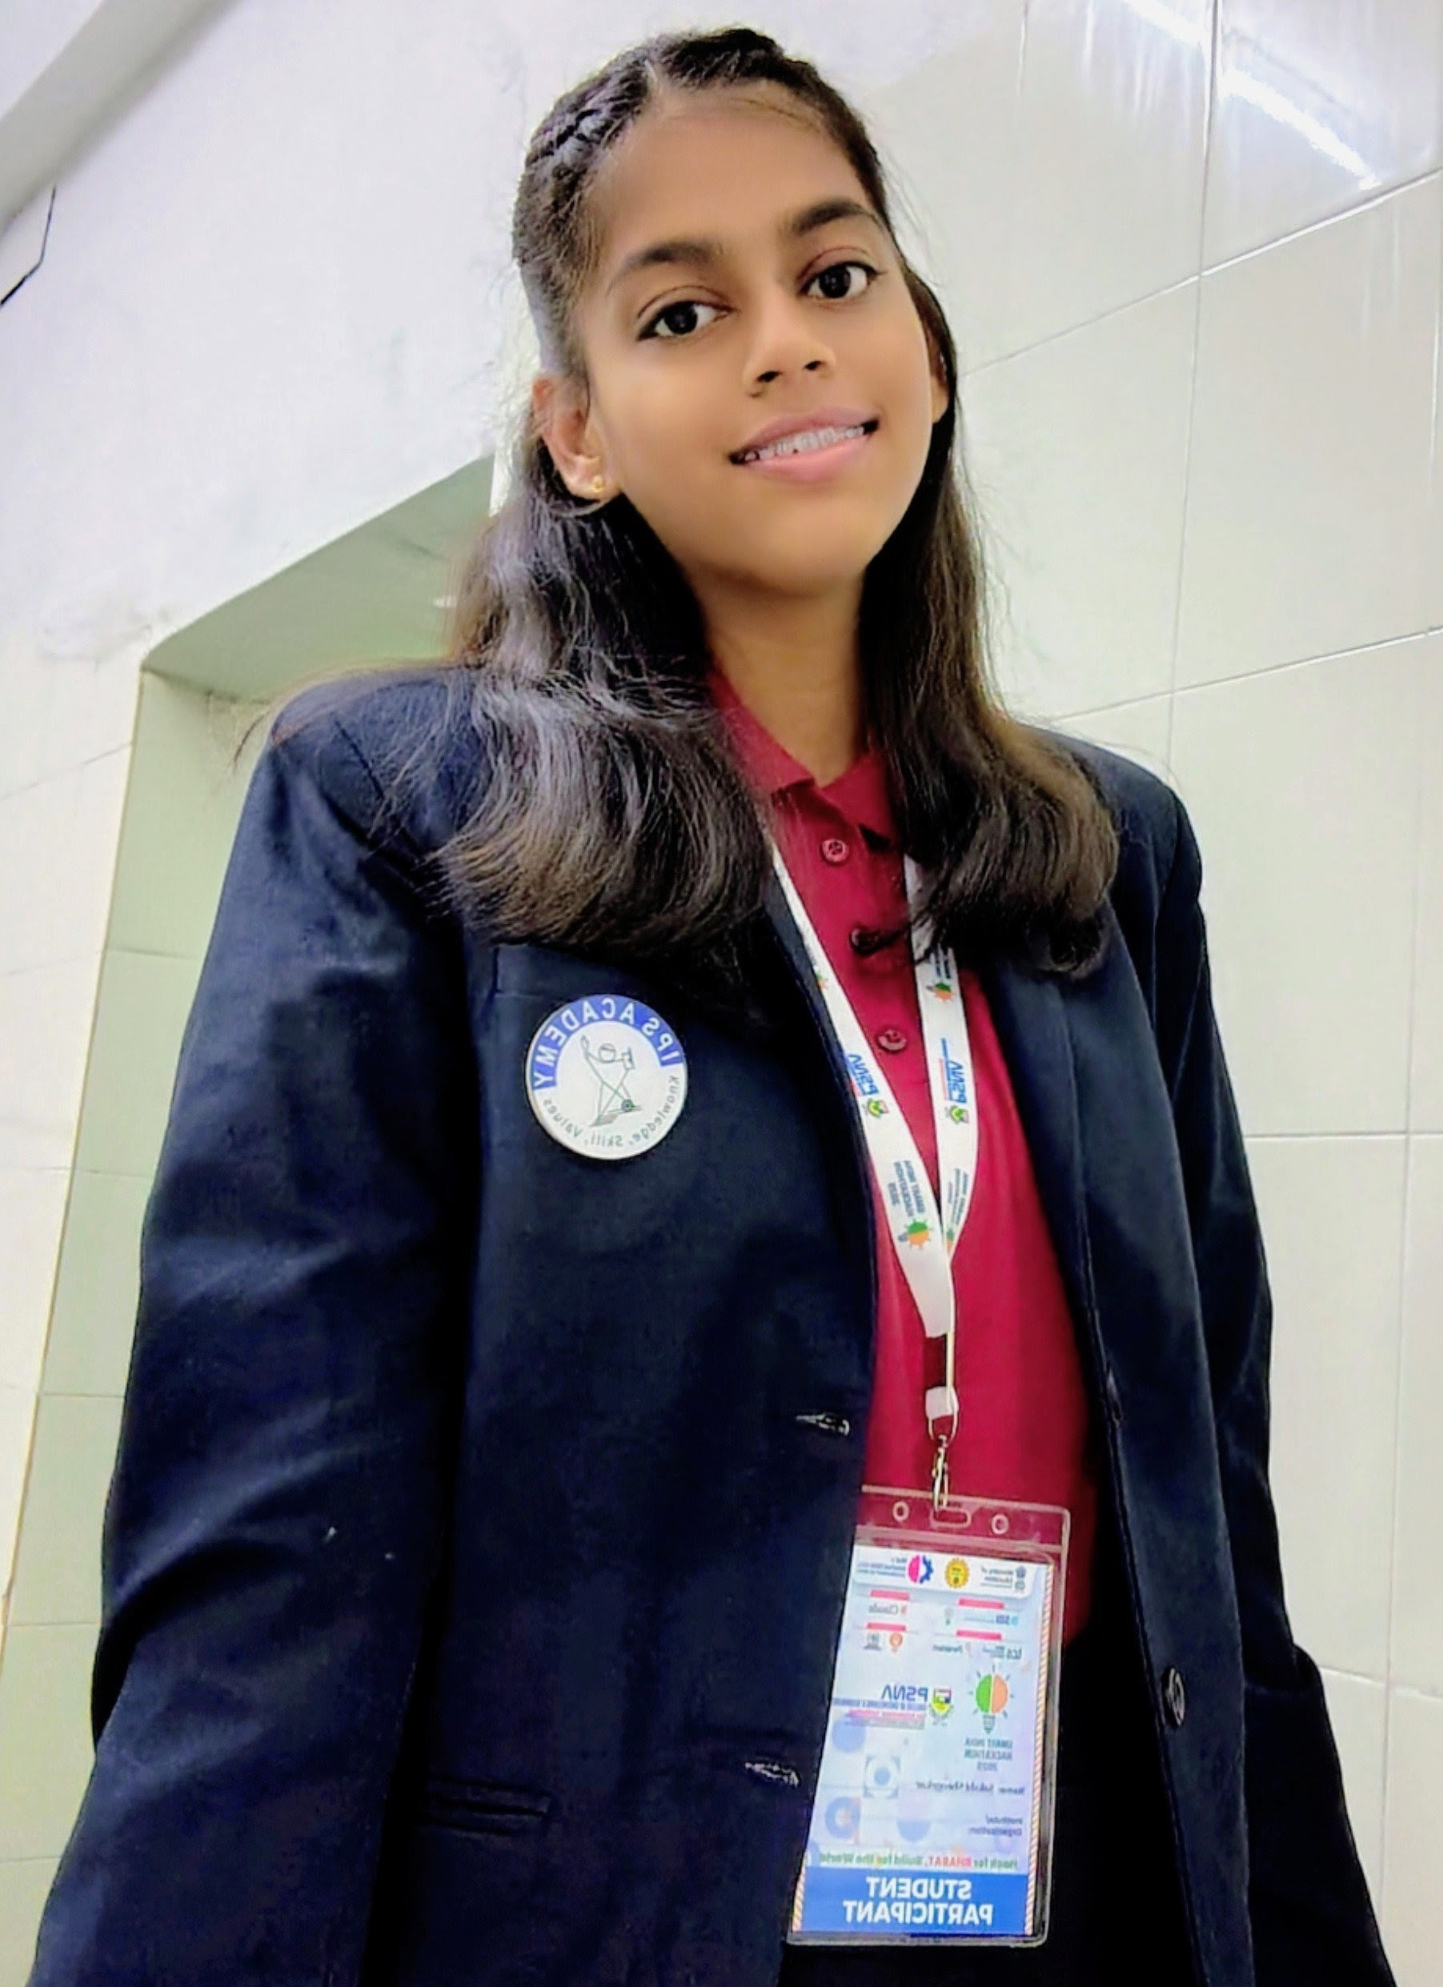




THANK YOU !!!!
PESENTED BY :
CONTACT DETAILS :
+91 9109887298
sheogekarsakshi3@gmail.com
https://www.linkedin.com/in/sakshisheogekar-b1a239322/
Indore, India
Sakshi Sheogekar

