Slide 1

IOT BASED SMART PARKING
SYSTEM
TEAM NAME : IOTech
Sanjivani College of Engineering, Kopargaon

Slide 2
GROUP MEMBERS :-
Gavade Vishal
Jape Shraddha
Jejurkar Shraddha
Modhave Shravani
Guided By:-
Mr. Umesh Sangule

Slide 3
IOT BASED SMART PARKING SYSTEM
Abstract :
Real-time Slot Availability Notification is to address the challenges associated with urban parking by providing users with up-to-the minute information on parking slot availability.
This project uses Internet of Things (IoT) technology to monitor and manage parking spaces efficiently.
Parking area is equipped with sensors and connected to a centralized system, creating a network that continuously monitors the occupancy status of individual parking spaces.
Real-time data collection from sensors processed and made accessible to users through a LED display

Slide 4
IOT BASED SMART PARKING SYSTEM
Components :
Smart IR Sensors – Data transmission using wireless network
Arduino Uno – Processing Instructions
Servo Motor – Access control
Bread Board – Circuit board
LED Display 16 X 2 – Available slot details
Rainbow Cables – Connection

Slide 5
IOT BASED SMART PARKING SYSTEM
Working Principle :
Parking area with smart sensors, infrared sensors, capable of detecting the presence or absence of a vehicle.
Sensors collected data is sent to the Arduino Uno which manages the centralized system and then relevant information about slot availability is visible on LED display.
9V battery a portable and compact power source for Arduino boards.
The 16x2 LED display a user interface to visualize slot status. Displays messages, symbols, or numeric information about available and occupied parking slots.
Servo motor integrated into an access control system, allowing the gate to open automatically when criteria is met, as detecting a valid parking permit or when a user has reserved a parking space.

Slide 6
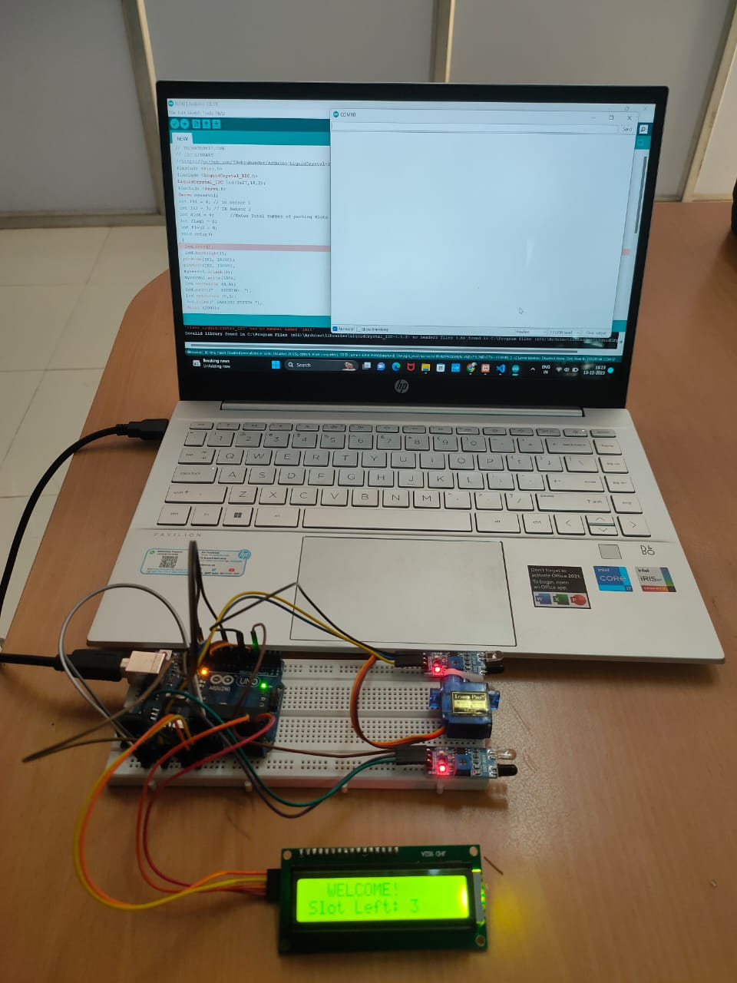
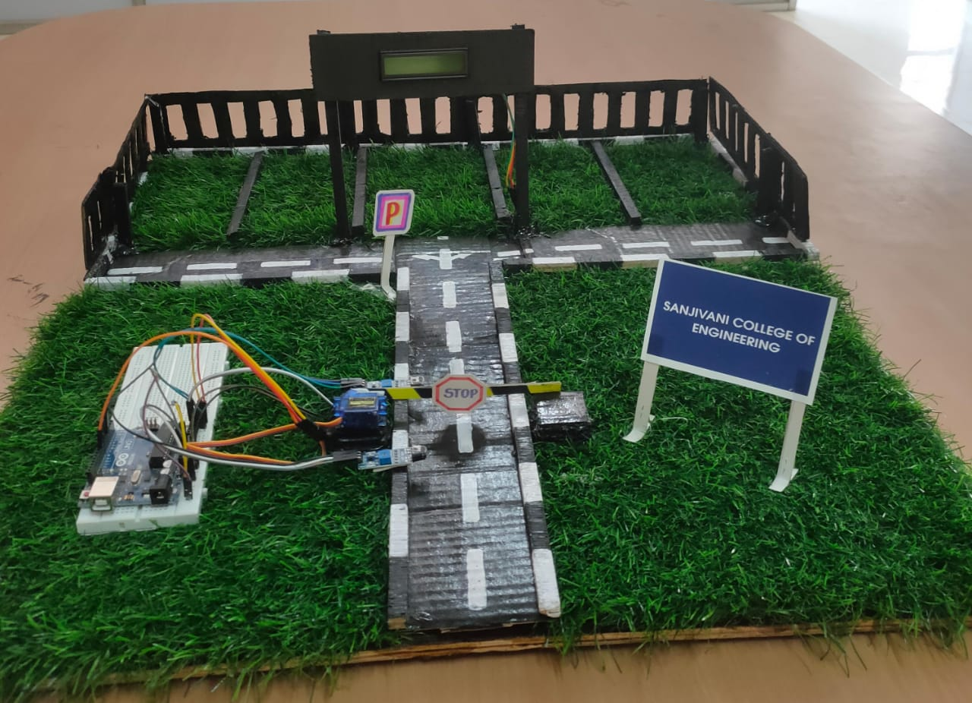
IOT BASED SMART PARKING SYSTEM
Prototype :

Slide 7
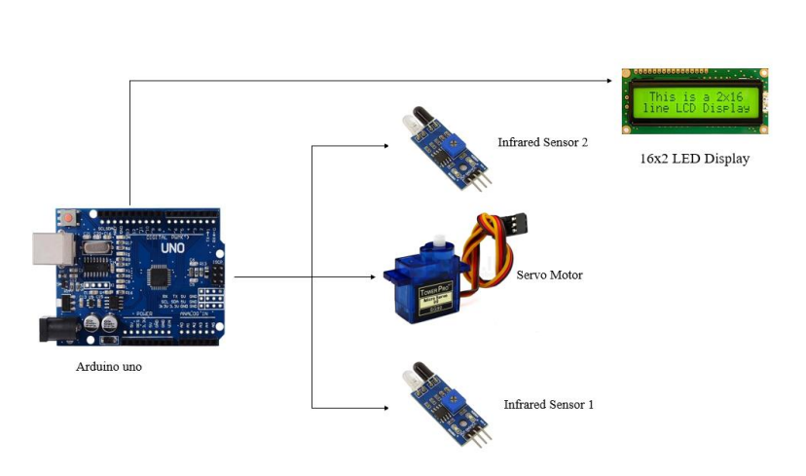

Slide 8
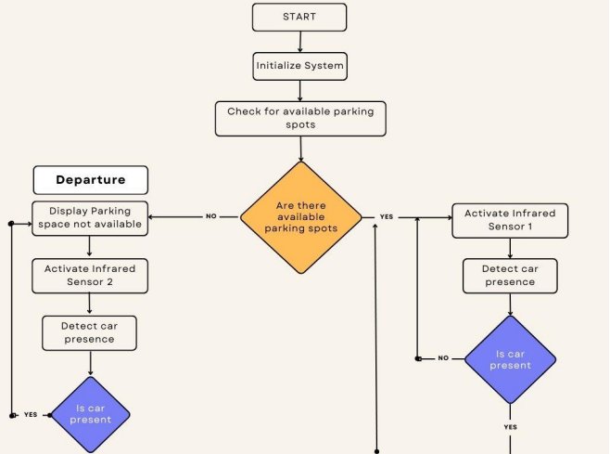

Slide 9
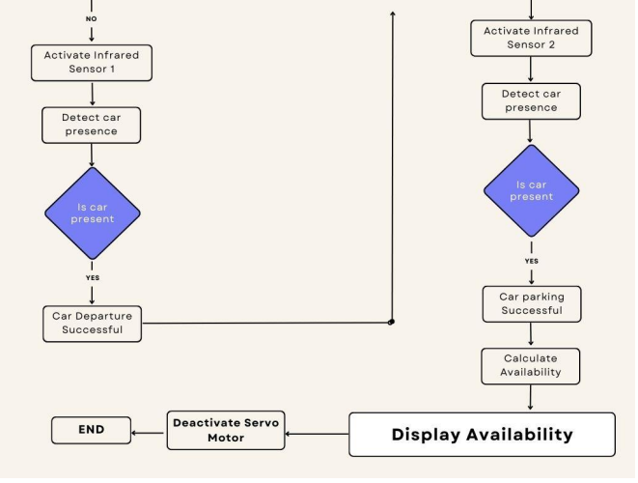

Slide 10
IOT BASED SMART PARKING SYSTEM
Advantages :
Efficient Parking Management – Slot availability display – Dual Sensors
Multilevel Parking Compatibility
Reduces slots search time
Easy expansion of parking area
Reducing traffic congestion
Integrated with Smart Cities
Cost Effectiveness
Applications over existing models :
Enhances Accuracy – Dual sensors
Minimizes Human Intervention
Cost Effectiveness

Slide 11
IOT BASED SMART PARKING SYSTEM
Applications :
Real-time Parking Availability
Guidance System
Environmental Impact

Slide 12
THANK YOU..

