Slide 1
TMDB Movie Data
Learner : Sakshi Laxman Waghmare
Guide : Shruti Gode

Slide 2
Business Objectives
Even if a movie costs over $100 million to make, it can still flop because people have different interests. A production company wants to study a dataset of movies to figure out if a movie will make a lot of money and if people will like it. This way, they can predict if a movie will be a hit or get good ratings
Identify the most popular movies and determine their genres.
Understanding the relation between budget and revenue.
Identify the movies with the lowest budget as well as the movies with the highest revenue.
1
2
3

Slide 3
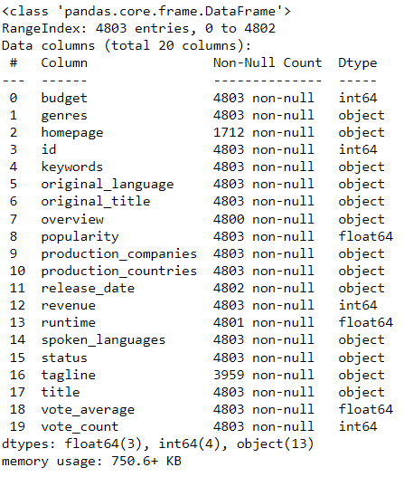
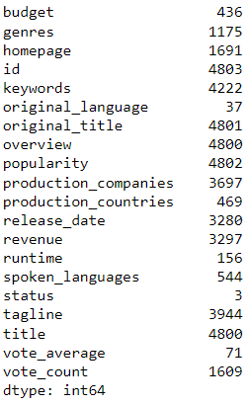

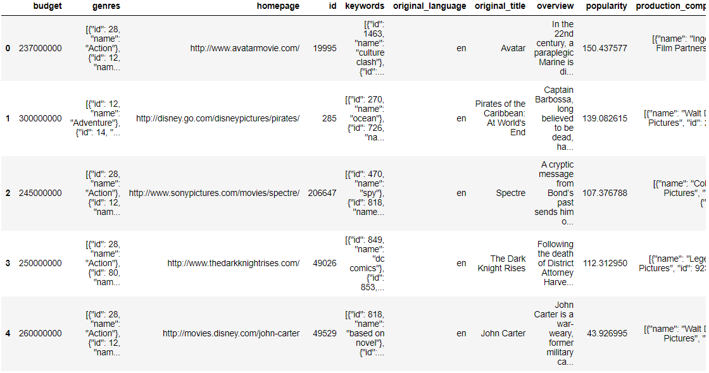
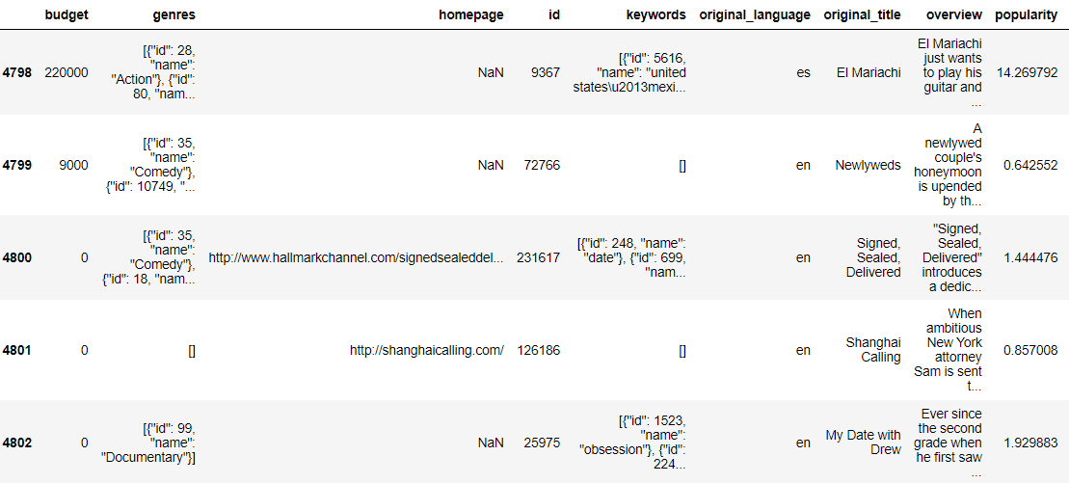
Data understanding
Data Information
Number of unique records
Number of rows and columns in Dataset
First five rows
Last five rows

Slide 4
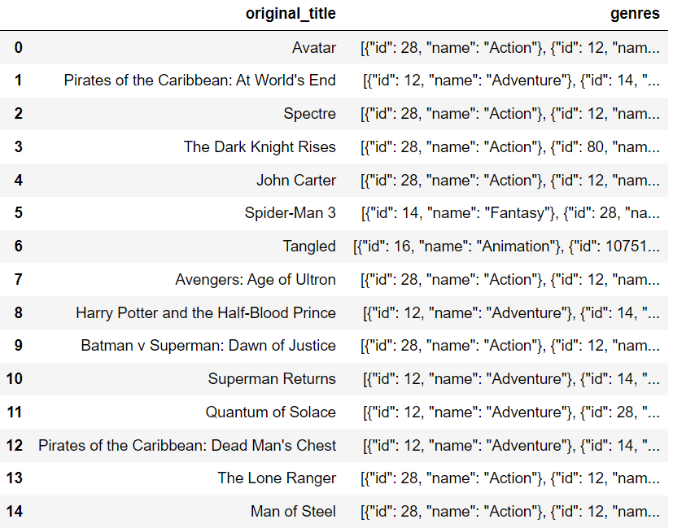
Task - 1 Load the movies dataset into python notebook. Display the number of rows and columns in dataset. Display the title and genres of the first 50 movies from dataset.
Interpretation:
To load dataset into python notebook we have used pandas built-in function “read_csv”.
We have used the "shape" method to find the number of rows and columns in the dataset. It turns out there are 4803 rows and 20 columns. To show the genres of the first 50 movies in the dataset, we filtered the data using the "loc" method and extracted the first 50 rows using the "head" method.

Slide 5
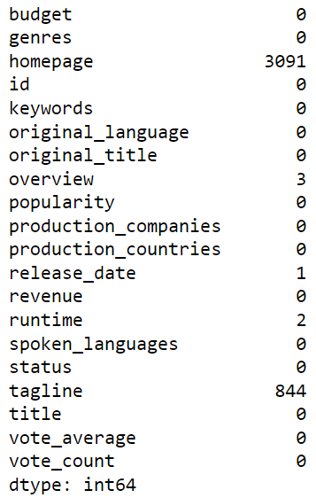
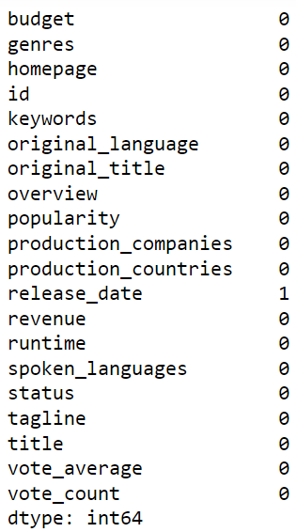
Task - 2 Identify the columns that have null values and perform the null value treatment. (Choose the imputation method based on the type of data in the columns of interest)
Null records in dataset
After
Interpretation:
We have used the "isnull" and "sum" methods to identify and count the missing values in the dataset.
We have used the "fillna" method to replace missing values in the dataset with the mode of the respective column.
Initially, there were missing values in 5 columns of the dataset. After imputation, there are no any missing values in the dataset.

Slide 6
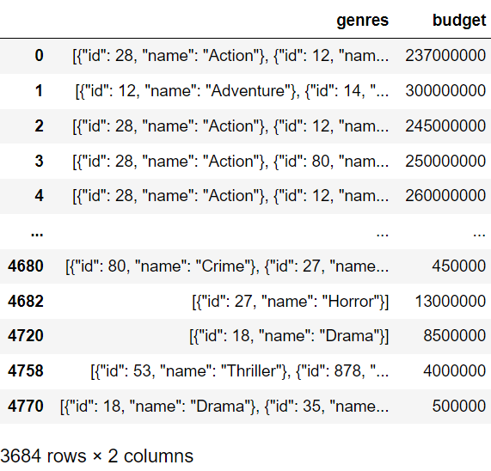
Task - 3 Display the movies category that have budget greater than 220000.
Interpretation:
We have filtered data to get movie categories which has budget greater than 220000.
In dataset there are 3684 movies which has budget greater than 220000.

Slide 7
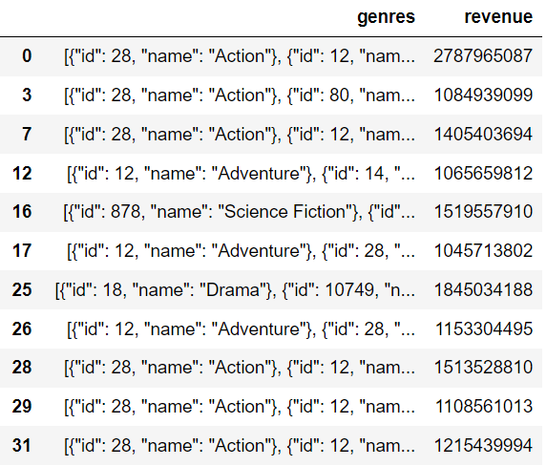
Task - 4 Display the movie categories where the revenue is greater than 961000000.
Interpretation:
We have filtered data to get movie categories which has revenue greater than 9661000000
In dataset there are 24 movies which has revenue greater than 961000000.

Slide 8
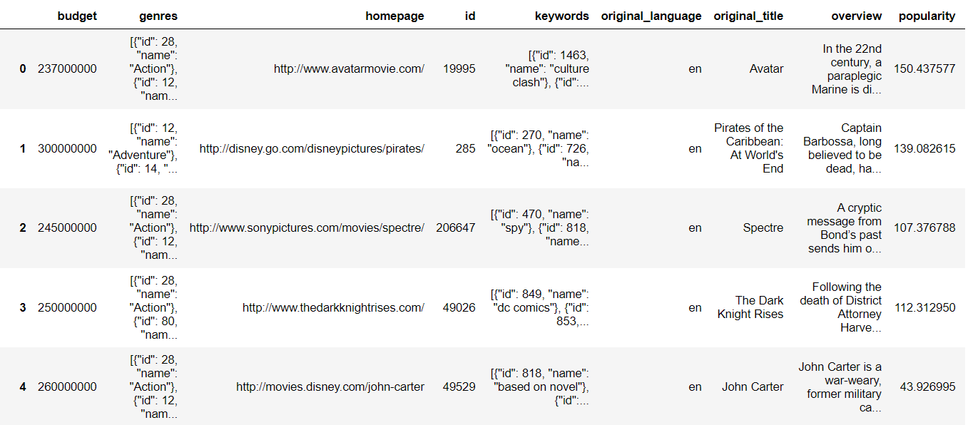
Task - 5 In the dataset there are some movies which the budget and revenue column have the value 0, which mean unknown values remove the rows with value 0 from the both budget and revenue column.
Interpretation:
We have filtered the data based on the given criteria and stored the resulting data in a variable.
There are 3229 movies in which both the budget and revenue columns do not have a value of 0.

Slide 9
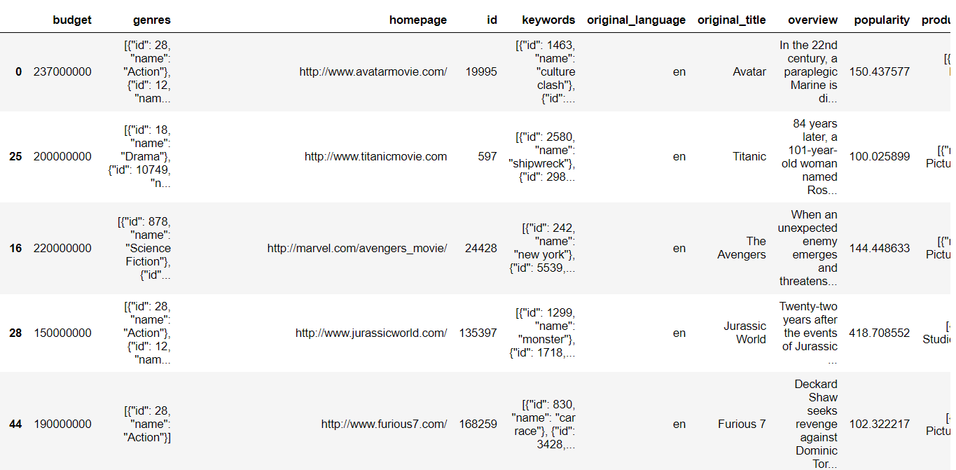
Task – 6 - A List the top 10 movies with highest revenue and top 10 and the movies with least 10 budget. Top 10 movies with highest revenue.
Interpretation:
We sorted the data in descending order based on revenue and selected the top 10 entries using the "head" method

Slide 10
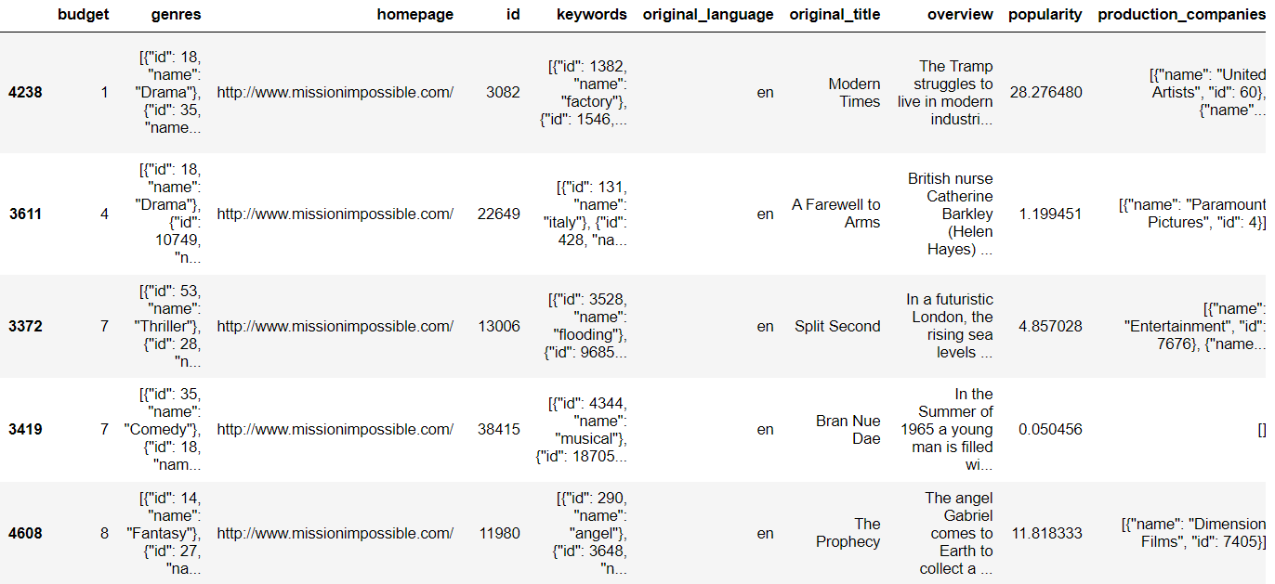
Task – 6 - B List the top 10 movies with highest revenue and top 10 and the movies with least 10 budget. Top 10 movies with least budget.
Interpretation:
We sorted the data in ascending order based on budget and selected the top 10 entries using the "head" method

Slide 11
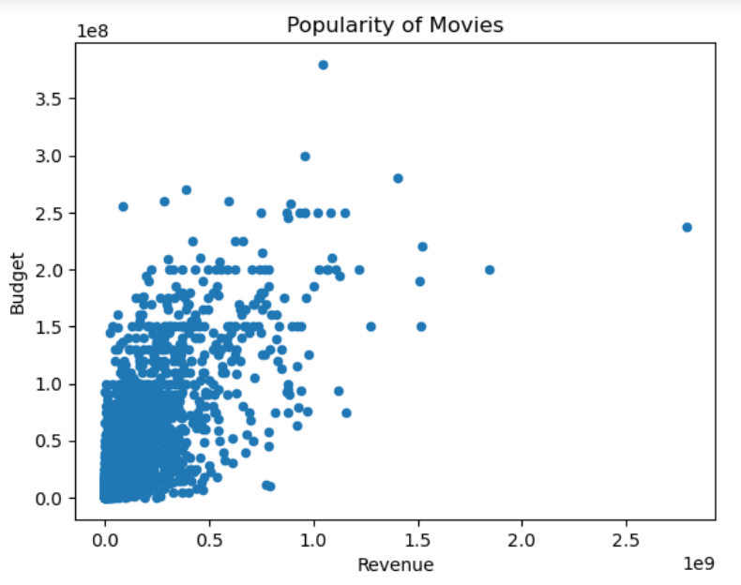
Task – 7 How are popularities of movies related with the movies budgets ? are they correlated or total uncorrelated with each other ? Write the interpretation of your analysis.
Interpretation:
We have used plot method and scatter plot to see the correlation between revenue and budget.
As the budget increases, revenue also increases, indicating a positive correlation between budget and revenue.

Slide 12
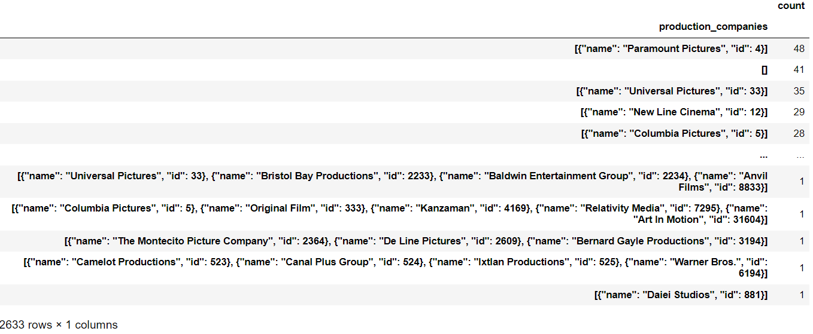
Task – 8 Identify and display the name of all production companies along with the number of time they appears in the dataset.
Interpretation:
To show the appearance of company along with number of times they appear in dataset we used “value_counts” method.
There are 2633 companies in dataset.

Slide 13
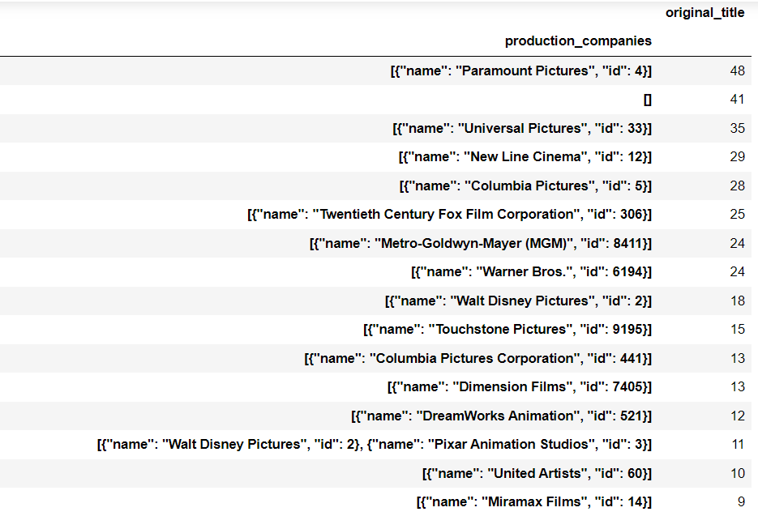
Task – 9 Display the names of top 25 production companies based on the number of movies they produced in descending order of the number of movies produced.
Interpretation:
To display the top 25 production companies along with the frequency of their appearance in the dataset, we grouped the data by production company, used the "count" method to determine their occurrences, and then sorted the data in descending order before using the "head" method.

Slide 14
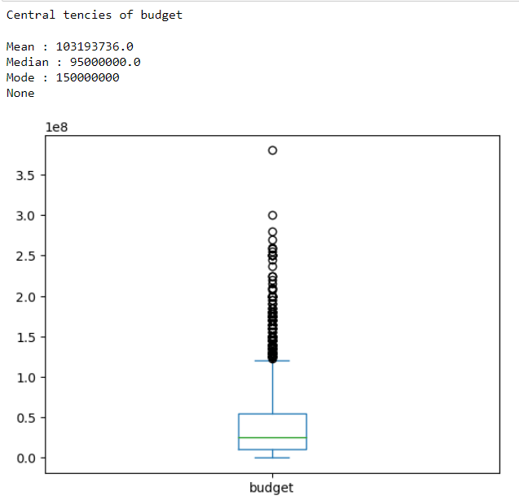
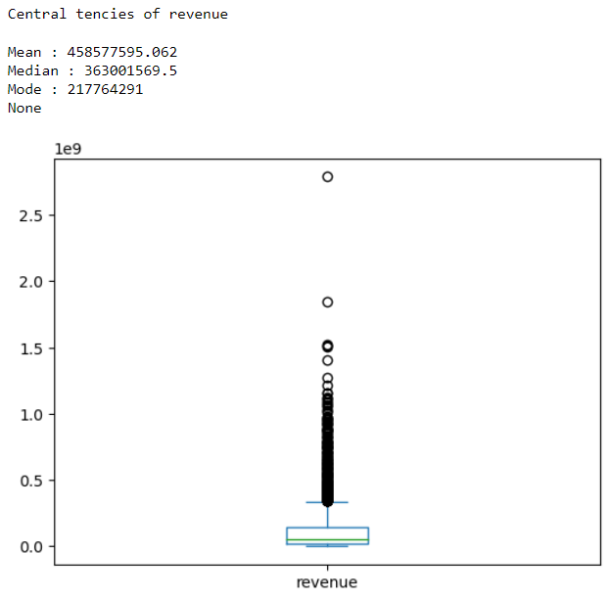
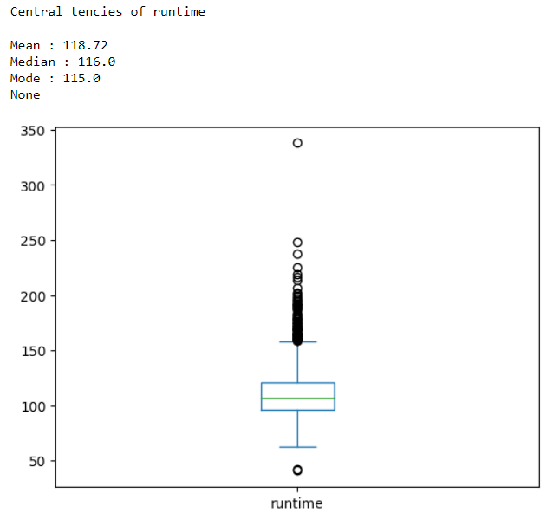
Task – 10- A Sort the data in descending value based on revenue and filtered top 500 companies, Find the measures of central tendency for the following columns using the filtered data. Outliers analysis using box plot.
Budget
Revenue
Runtime
Interpretation:
We have defined a function called "central_tendencies" to obtain the central tendencies of each column. Additionally, we used a box plot to visually represent and identify outliers in the data.

Slide 15
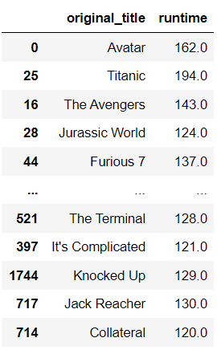
Task – 11 Identify and Display the names of movies along with their runtimes for those movies that have above average runtime using the data from previous task.
Interpretation:
We have used the "concat" method to create a DataFrame with two columns, namely "original title" and "runtime." Following that, I applied a condition to filter movies with a runtime above the average runtime.
There are 234 movies with a runtime greater than the average runtime.

Slide 16
interpretation
The most popular movies, Movies with the highest revenue belong to genres such as Action, Adventure, Science Fiction, and Drama.
"Avatar" is the movie with the highest revenue, while "Modern Times" is the movie with the lowest budget.
As the budget increases, revenue also increases, indicating a positive correlation between budget and revenue.
"Paramount Pictures" is the production company with the highest number of movies, that is 48.

Slide 17


