Slide 1
Customer churn analysis
Learner : Sakshi Laxman Waghmare
Guide :Shruti Gode

Slide 2
Business objectives
A bank in North America wants to perform customer churn analysis as a credit card business of the bank is not performing very well.
Analyse the percentage of customer attrition and retention
Examine the gender and region-wise distribution of attrition and retention percentages among customers.
Identify customers who have stopped purchasing credit cards.
Determine the income categories in which customer attrition is more prevalent

Slide 3
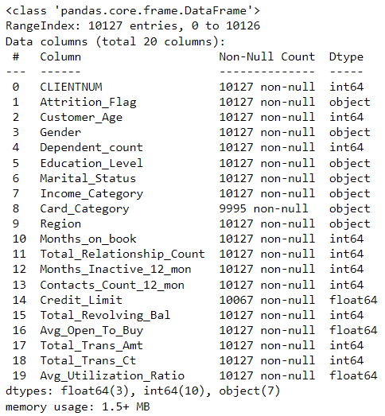
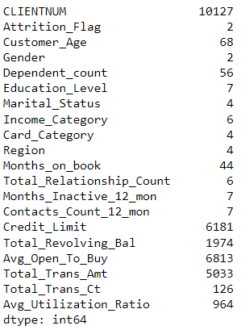
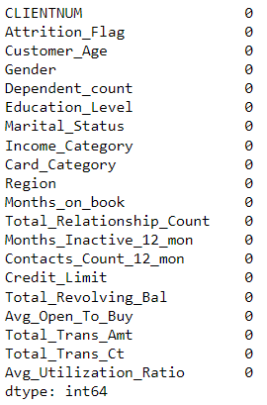

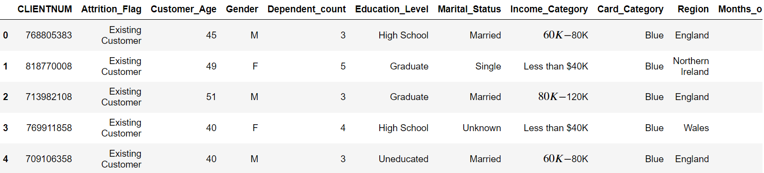
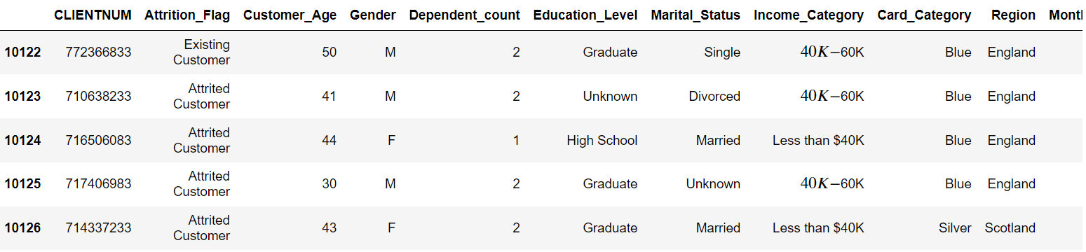
Data understanding
Data Information
Number of unique values
Number of missing values
Number of rows and columns in dataset
First five rows
Last five rows

Slide 4
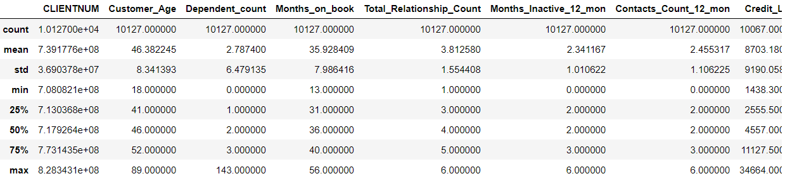
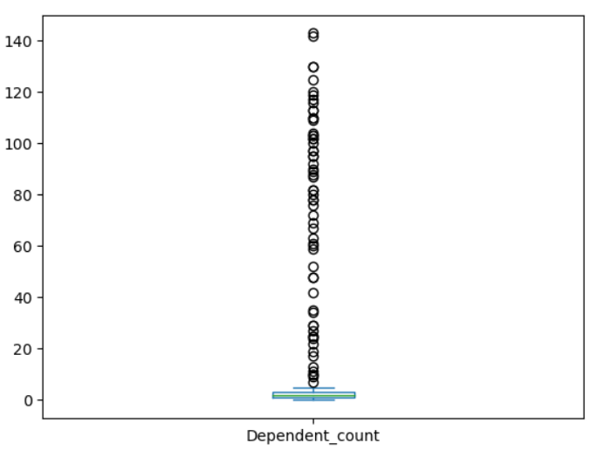
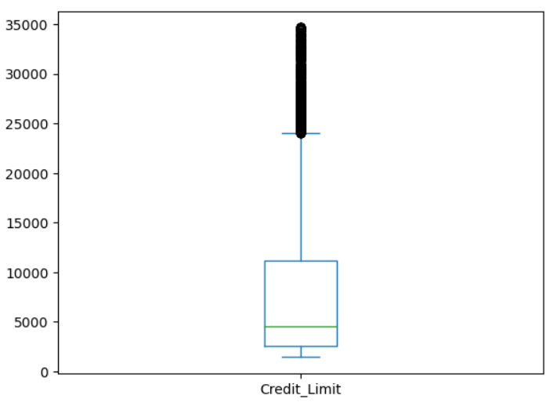
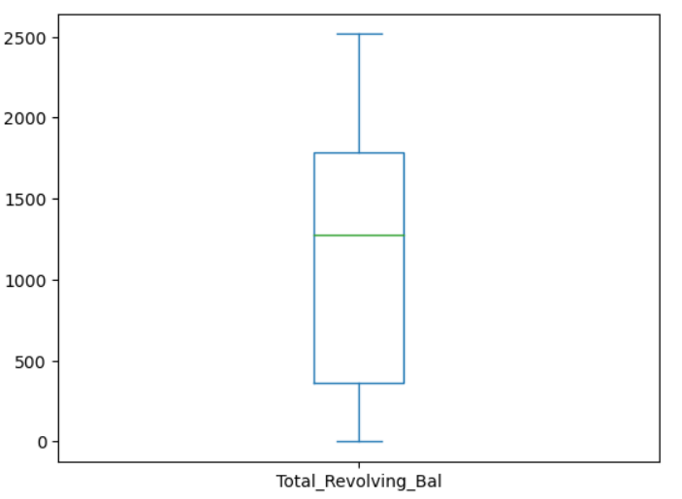
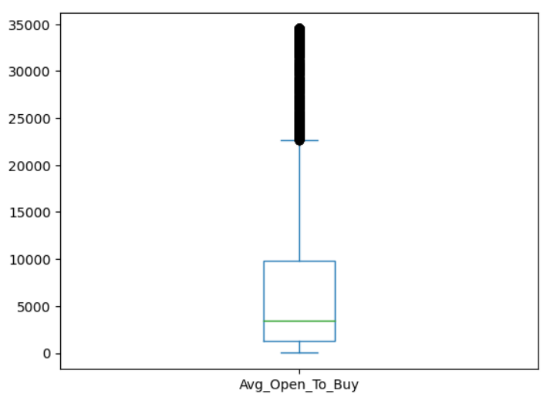
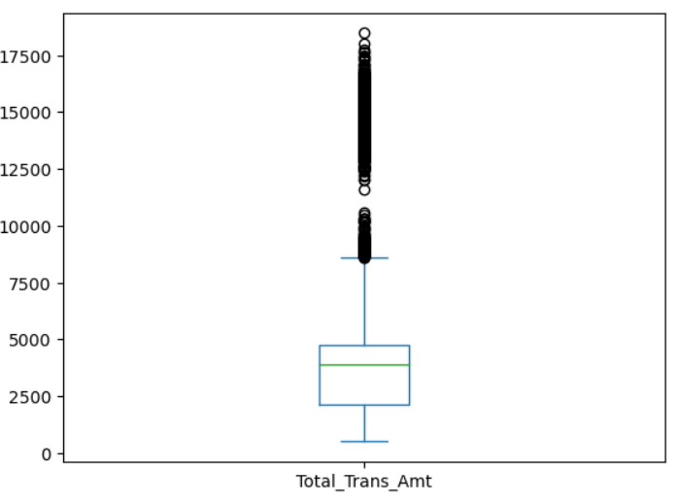
Data Pre-processing using Python
Summary Statistics
Dependent Count
Credit Limit
Total Revolving Amt.
Avg Open to Buy
Total Transaction Amt

Slide 5
VISUALIZATION

Slide 6
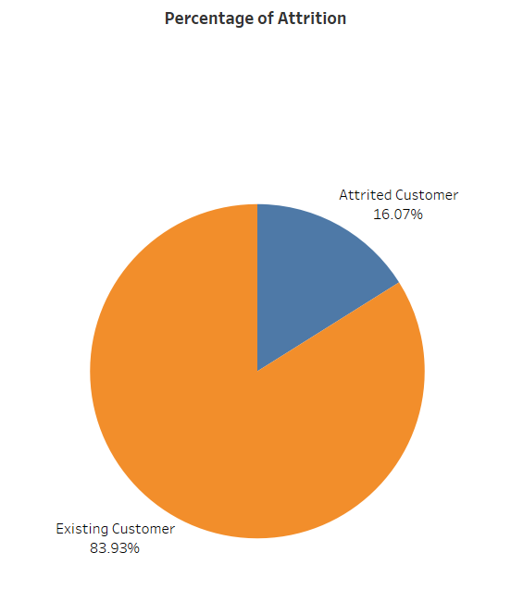
TASK – 1
Display the percentage of attrited and Existing customers.
Interpretation:
Among the customers, 16% have attrited from the firm, while the remaining 84% are existing.

Slide 7
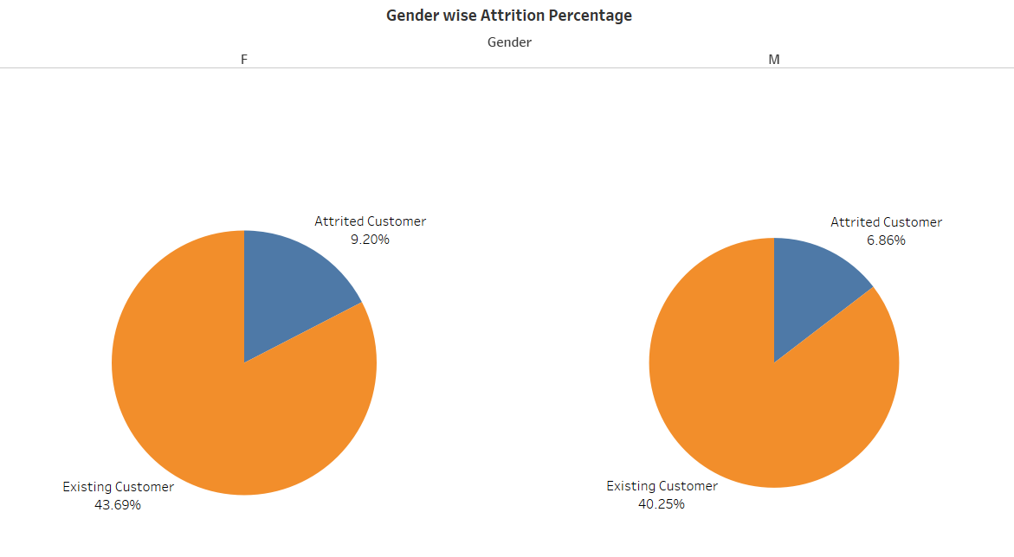
TASK – 2
Display the gender-wise percentage of attrited and Existing customers.
Interpretation
Female customers have a higher attrition rate compared to male customers.

Slide 8
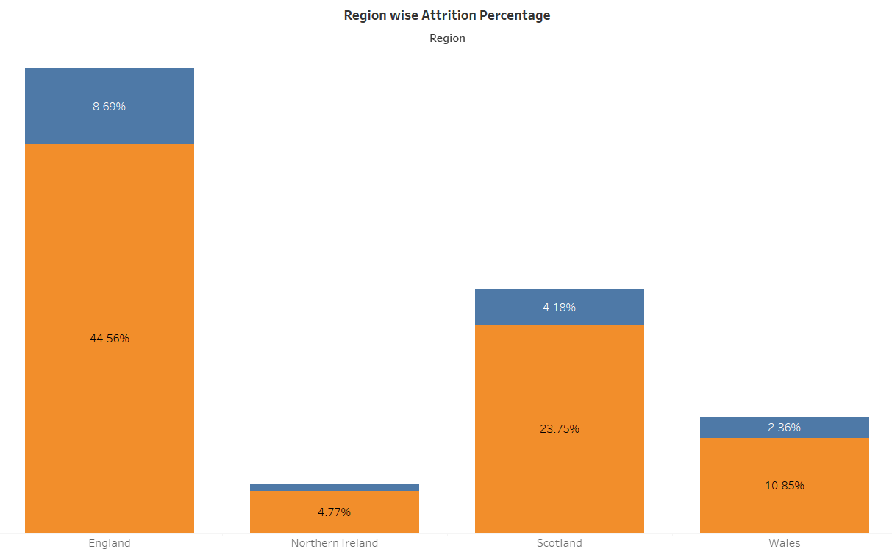
TASK – 3
Display the Region-wise percentage of attrited and Existing customers.
Interpretation
The majority of customers are from the England region, and the attrition rate is also notably high in that area.

Slide 9
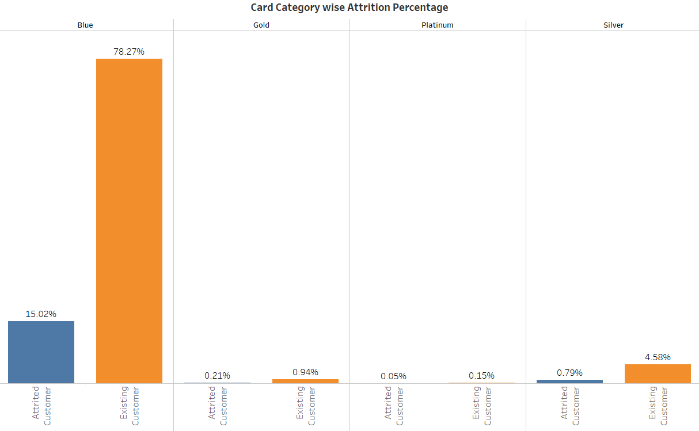
TASK – 4
Display the percentage of attrited and Existing customers for each card category.
Interpretation
The majority of customers belong to the “blue” card category, and the attrition percentage is also high among blue card holders

Slide 10
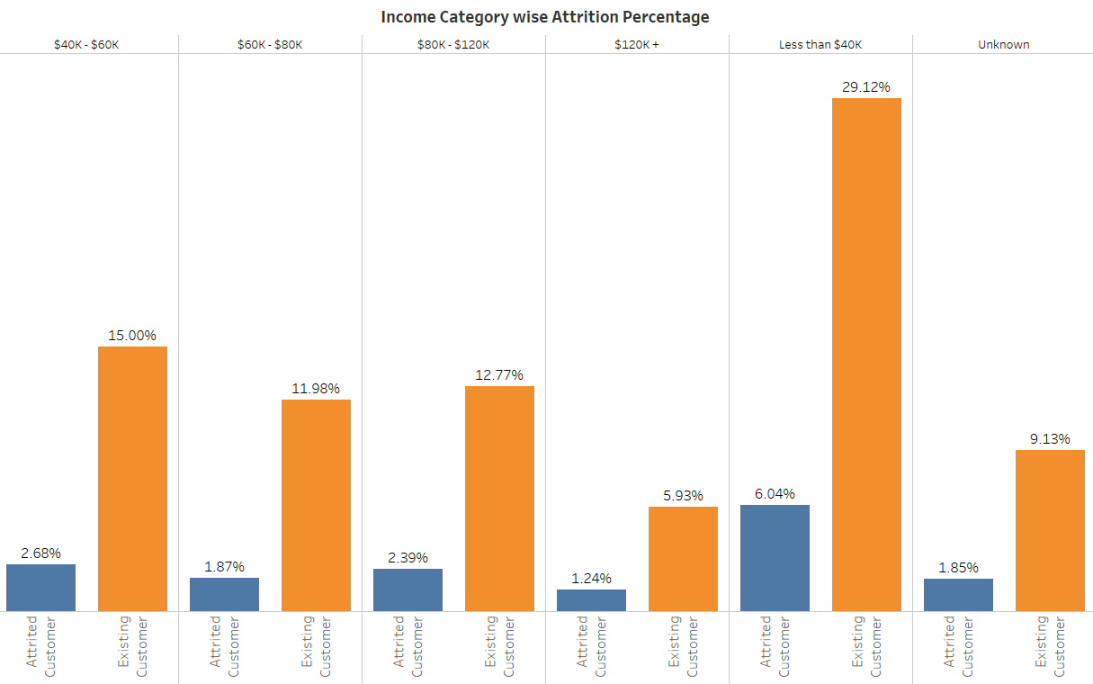
TASK – 5
Display the percentage of attrited and Existing customers for each income category.
Interpretation
The majority of customers fall under the income category of “less than $40K”, and the attrition percentage is also highest in that category.

Slide 11
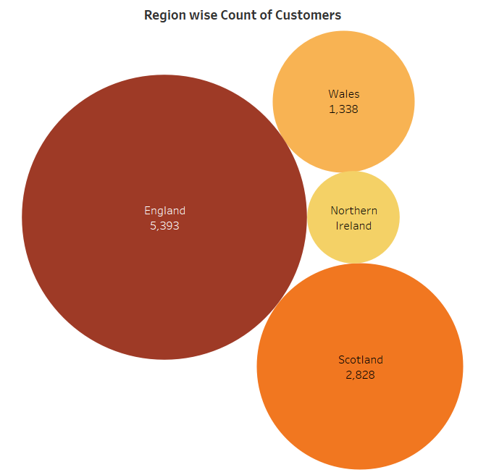
TASK – 6
Display region-wise count of customers. Identify the region that has the maximum number of customers.
Interpretation
Maximum number of customers are from England region.

Slide 12
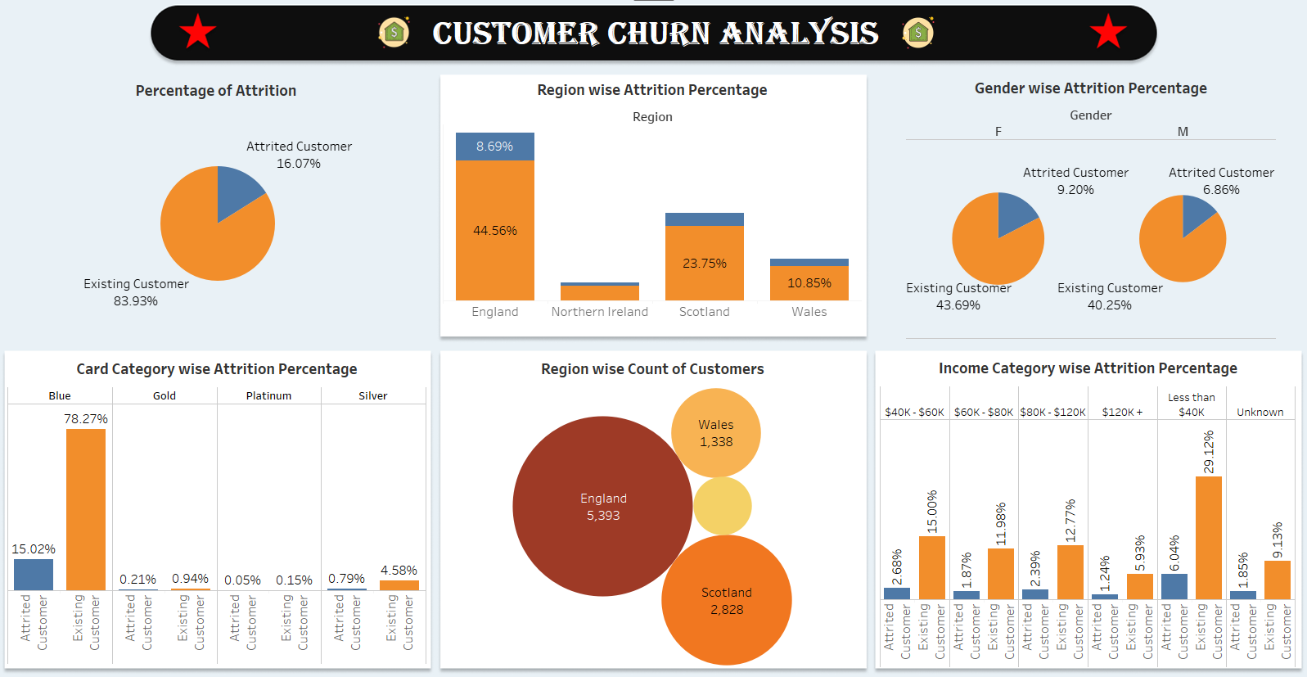

Slide 13
INTERPRETATION
Among all customers, 16% have left, while 84% remain with the firm.
Attrition is higher among female customers compared to male customers, and the total count of female customers is also high.
Customers with blue cards experience more attrition, and those with an income less than $40K are most affected.
The majority of customers are from the England region, where the attrition percentage is also high

Slide 14


