Slide 1
Bat Landing Risk and Reward in Relation to Rat Activity
Assessment 2: Group Project Presentation
Analysis of Event and Window Data
Student Name:
Student ID:

Slide 2
Introduction
Context: Bats forage in environments with rat presence
Aim: Explore risk/reward determinants of bat landings
Methods:
Clean & merge datasets
Descriptive statistics
Logistic regression models
Notes:
Give background on why studying risk and reward in bat foraging is important. Emphasize the ecological setting — rats are competitors and risks for bats. State research aims: do rat pressure, food, season, or time after sunset affect outcomes? Outline methods: data cleaning, descriptive exploratory analysis, and inferential logistic regression.

Slide 3
Data Overview
Dataset1 (n=907): Bat landing events
Risk, reward, landing time, habit
Dataset2 (n=2123): 30-min windows
Rat arrivals, rat minutes, food availability
Joined via as-of merge with 30-min tolerance
Notes:
Describe the datasets. Dataset1 has individual bat landings, while Dataset2 summarizes rat activity and food availability in windows. Stress the importance of merging correctly: used as-of merge with tolerance 30 minutes to align events with context. Mention full coverage achieved — all 907 landings matched to a window.

Slide 4
Data Cleaning and Features
Habit categories standardized
Derived features:
landing_after_rat
rat_presence_window
sec_after_rat_bin
Temporal mapping: Month → Season (Turhan, 2020)
Notes:
Explain preprocessing. Habits were inconsistent (e.g., “rat_pick” vs “rat and pick”), so categories were cleaned. New features created to capture ecological context — whether landing occurred after rat arrival, during rat presence, and how long after. Months were mapped to two seasons for seasonal comparisons.

Slide 5
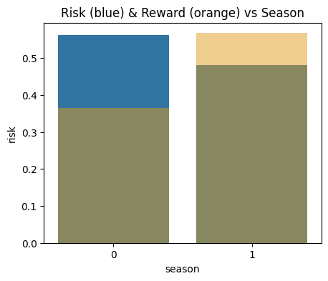
Exploratory Analysis (Rat Minutes)
Risk higher in short & very long rat activity
Reward improves with sustained rat presence
Quartile trend:
Q1 Risk 54%, Reward 47%
Q2–Q4 Risk ~47–51%, Reward ~55%
Notes:
Discuss descriptive statistics for rat minutes. Bats landing in very short rat activity windows face high risk and low reward. But sustained rat presence slightly improves reward chances. Suggest possible ecological mechanism: bats might time foraging to when rats are distracted.

Slide 6
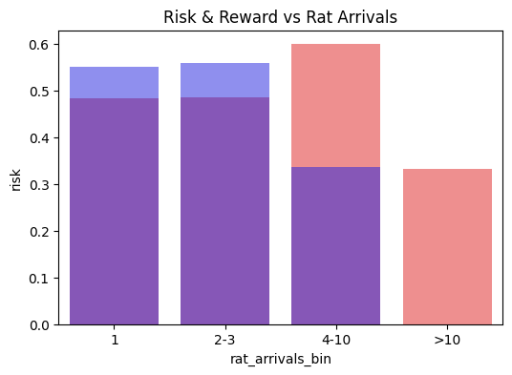
Exploratory Analysis (Rat Arrivals)
Risk increases with more arrivals
Reward decreases with more arrivals
Key stats:
1–3 arrivals → Risk ~48%, Reward ~55%
4–10 arrivals → Risk 60%, Reward 34% (Hariri, Fredericks, and Bowers, 2019)
Notes:
Highlight the strong pattern: many rat arrivals create competitive pressure. Bats face higher risk and lower chance of reward. This variable shows the clearest relationship with outcomes.

Slide 7
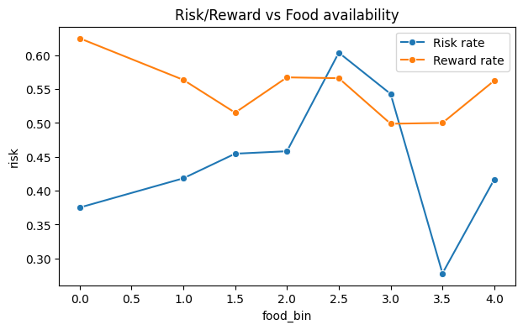
Exploratory Analysis (Other Factors)
Food availability: noisy, no clear trend
Hours after sunset:
Early (0–2h): High risk (59%), Low reward (42%)
Later (6–8h): Lower risk (44%), Higher reward (58%)
Season:
Season 0: Risk 56%, Reward 36%
Season 1: Risk 48%, Reward 57%
Notes:
Summarize additional predictors. Food availability inconsistent. Strong patterns with time and season: later hours and Season 1 provide safer, more rewarding opportunities. Suggest ecological explanations like predator activity or seasonal food abundance.

Slide 8
Logistic Regression (Main Effects)
Risk model: No significant predictors
McFadden R² = 0.006, AUC = 0.56
Reward model:
Rat arrivals ↓ reward (OR=0.79, p=0.001)
Season ↑ reward (OR=1.94, p=0.001)
McFadden R² = 0.028, AUC = 0.57
Notes:
Present inferential results. Risk poorly explained by predictors. Reward model shows significant effects: more rat arrivals reduce reward odds, while Season 1 nearly doubles odds of reward. Note model metrics are modest — weak overall predictive power.

Slide 9
Logistic Regression (Interactions)
Risk model still weak
Reward model improved:
Rat minutes × Season significant (p=0.018)
Rat arrivals × Season borderline (p=0.050)
McFadden R² = 0.036 (Boateng and Abaye, 2019)
Notes:
Explain interaction findings. Season moderates the effect of rat pressure. In Season 1, more rat minutes actually reduce reward odds, while rat arrivals sometimes increase them. Shows ecological complexity that simple main-effect models missed.

Slide 10
Discussion
Rat arrivals consistently predict outcomes
Season strongly shapes reward chances
Hours after sunset shows consistent patterns
Risk outcomes not well explained
Food availability appears noisy
Notes:
Interpret findings in ecological context. Rat arrivals are the most reliable driver. Seasonality plays a major role in reward. Time of night matters too. But risk outcomes remain unexplained — suggesting unmeasured factors like predators, moonlight, or weather. Food availability unreliable.

Slide 11
Conclusion
Integration of two datasets successful
Key drivers of reward: rat arrivals & season
Risk models remain weak
Limitations: low R², small bin counts, missing covariates
Future: more ecological data, non-linear/mixed models
Notes:
The project demonstrates how combining datasets provides ecological insight. Rat arrivals and seasonality matter for bat foraging success. But risk remains elusive, pointing to data limitations. Recommend future work collecting more contextual variables and testing advanced models.

Slide 12
References
Turhan, N.S., (2020) ‘Karl Pearson's Chi-Square Tests’, Educational Research and Reviews, 16(9), pp.575-580. https://files.eric.ed.gov/fulltext/EJ1267545.pdf
Hariri, R.H., Fredericks, E.M. and Bowers, K.M., (2019) ‘Uncertainty in big data analytics: survey, opportunities, and challenges’, Journal of Big data, 6(1), pp.1-16. https://pmc.ncbi.nlm.nih.gov/articles/PMC8114187/pdf/f1000research-10-56004.pdf
Boateng, E.Y. and Abaye, D.A., (2019) ‘A review of the logistic regression model with emphasis on medical research’, Journal of data analysis and information processing, 7(04), p.190. https://www.scirp.org/html/4-2870278_95655.htm

