Slide 1
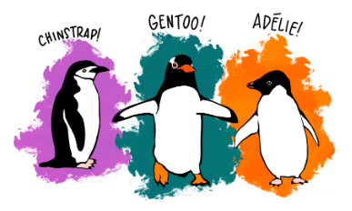
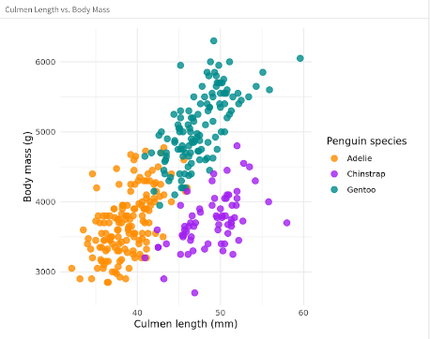

Palmer Penguins
SAKSHI BAJPAI
UID – 21BCS6938

Slide 2
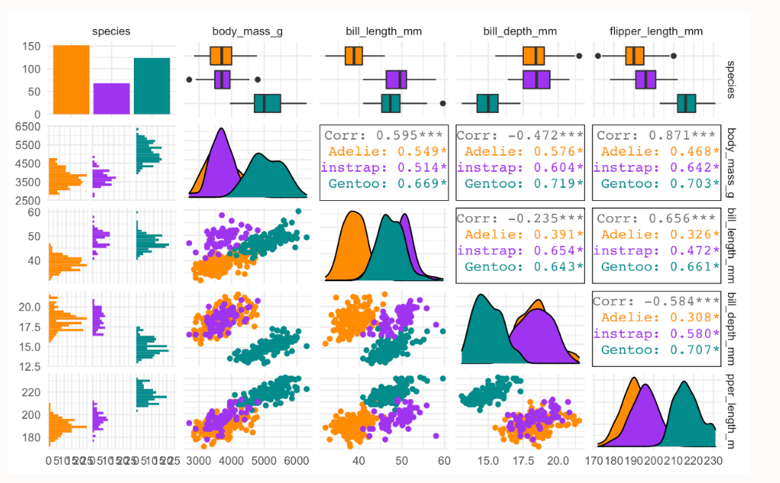
INTRO
The goal of Palmer Penguins is to provide a great dataset for data exploration and visualization.

Slide 3
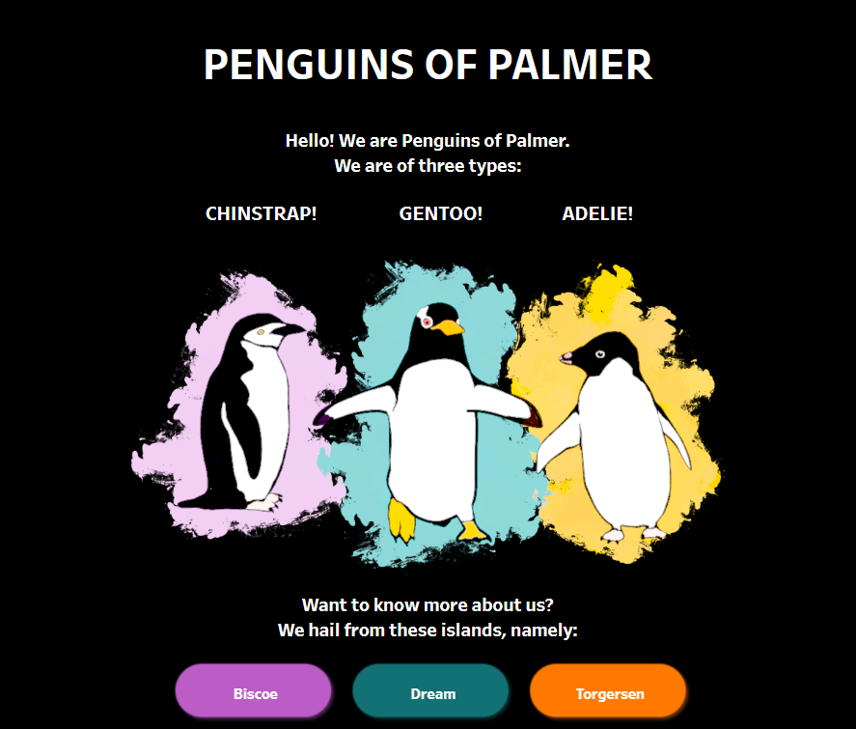
Meet the Penguins of Palmer
The Palmerpenguins data contains size measurements for three penguin species observed on three island in the Palmer Archipelago, Antarctica.

Slide 4
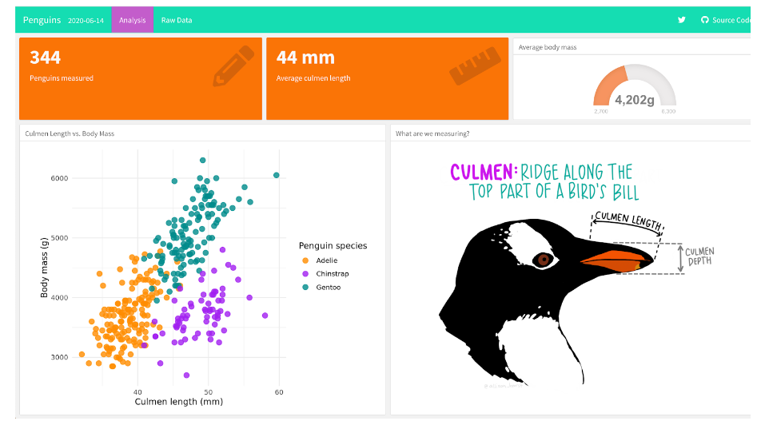
Visualization with R
R offers a broad collection of visualization libraries along with extensive online guidance on their usage.

Slide 5
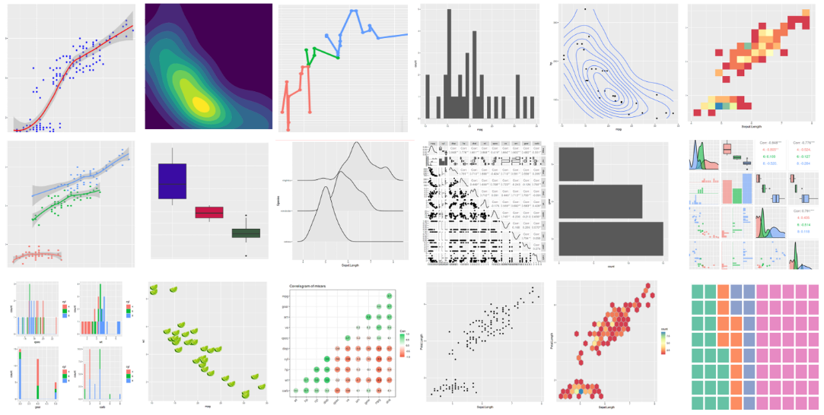
Ggplot2()
R’s most popular visualization package.

Slide 6
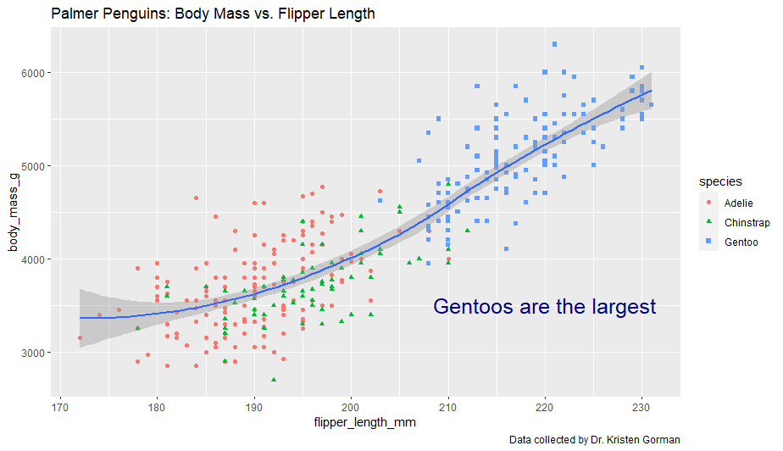
Scatter plot of Body Mass vs. Flipper Length

Slide 7
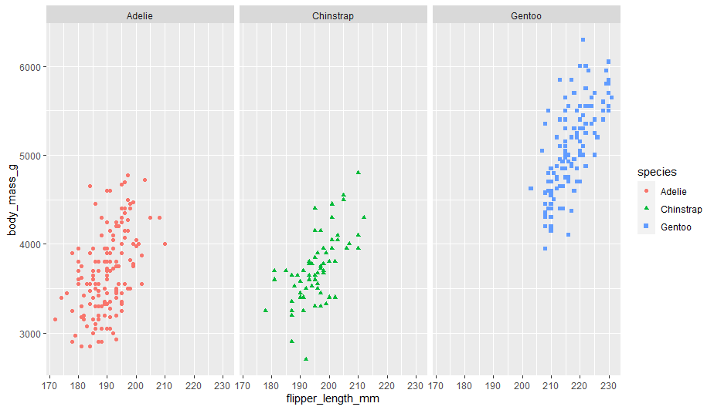
Scatter plot of each species

Slide 8
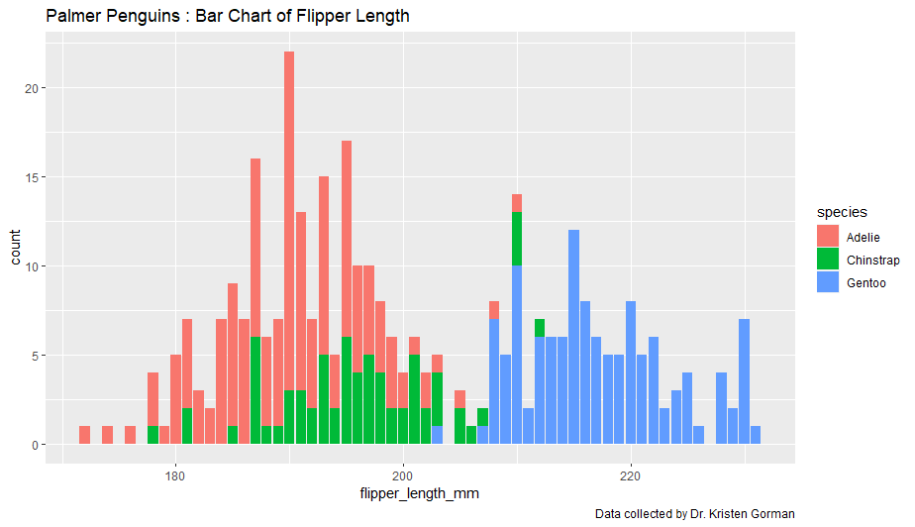
Bar Chart of Flipper Length

Slide 9
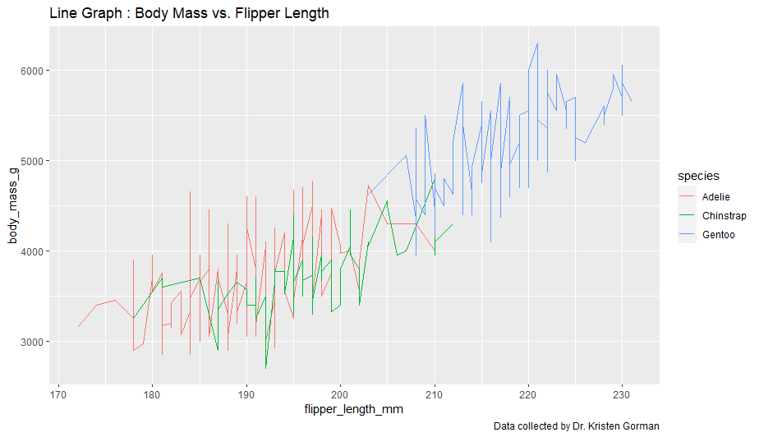
Line Graph of Body Mass vs. Flipper Length

Slide 10
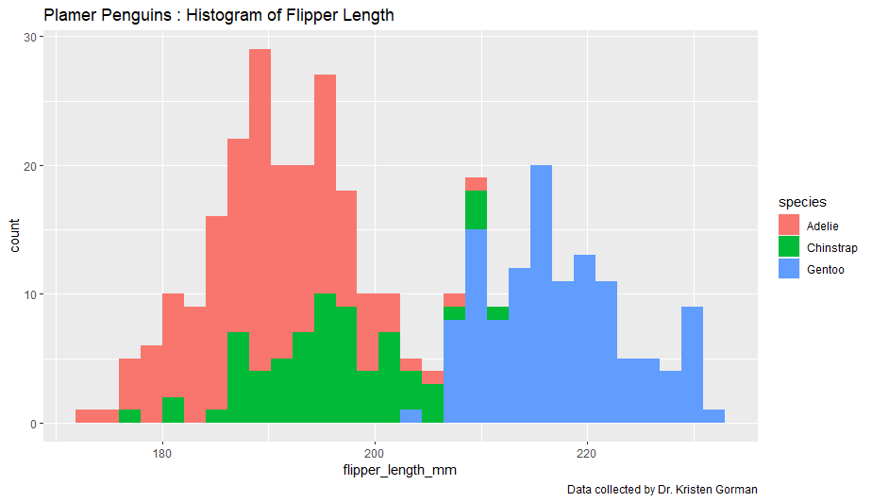
Histogram of Flipper Length

Slide 11
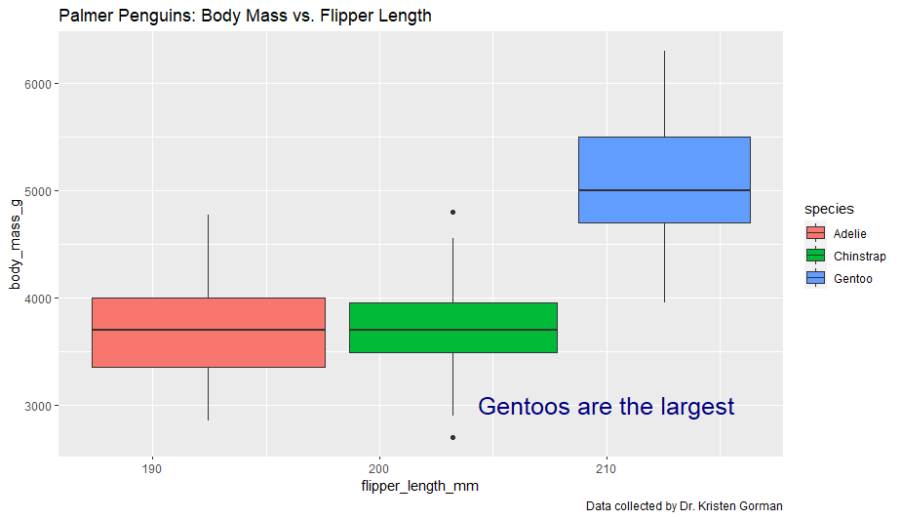
Boxplot of Body Mass vs. Flipper Length

Slide 12
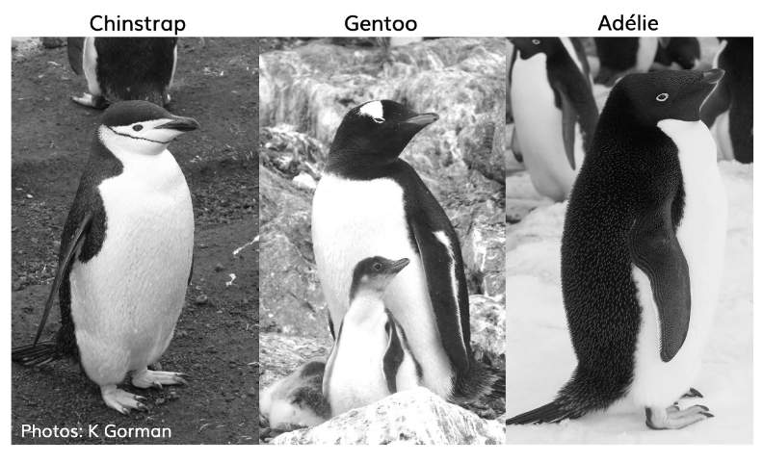
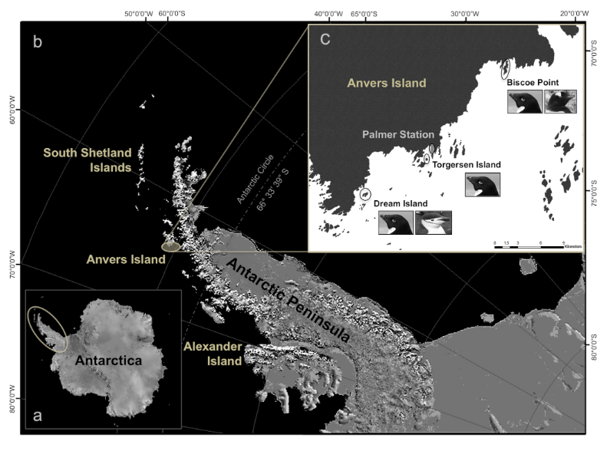
Advantages
Open source
Supports various Data Types
Powerful Graphics
Doesn’t need a Compiler
Very flexible

Slide 13
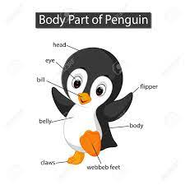
Conclusion
Data visualization in R and RStudio makes it possible to easily use basic plotting functions, or apply more advanced functions through packages.
You can easily ensure reproducibility of your output, simply by writing your commands in a script.
Already installed datasets, and packages to work with.
helps in intuitive and easy understanding of the large quantities of data.

Slide 14

THANKS!

