Slide 1

End-to-End E-Commerce Sales Analytics Platform
A production-ready data engineering pipeline using Azure Data Factory, Azure Databricks, Delta Lake, dbt, and Power BI — from raw CSV ingestion to executive dashboards.
DATA ENGINEERING
AZURE CLOUD
PORTFOLIO PROJECT

Slide 2
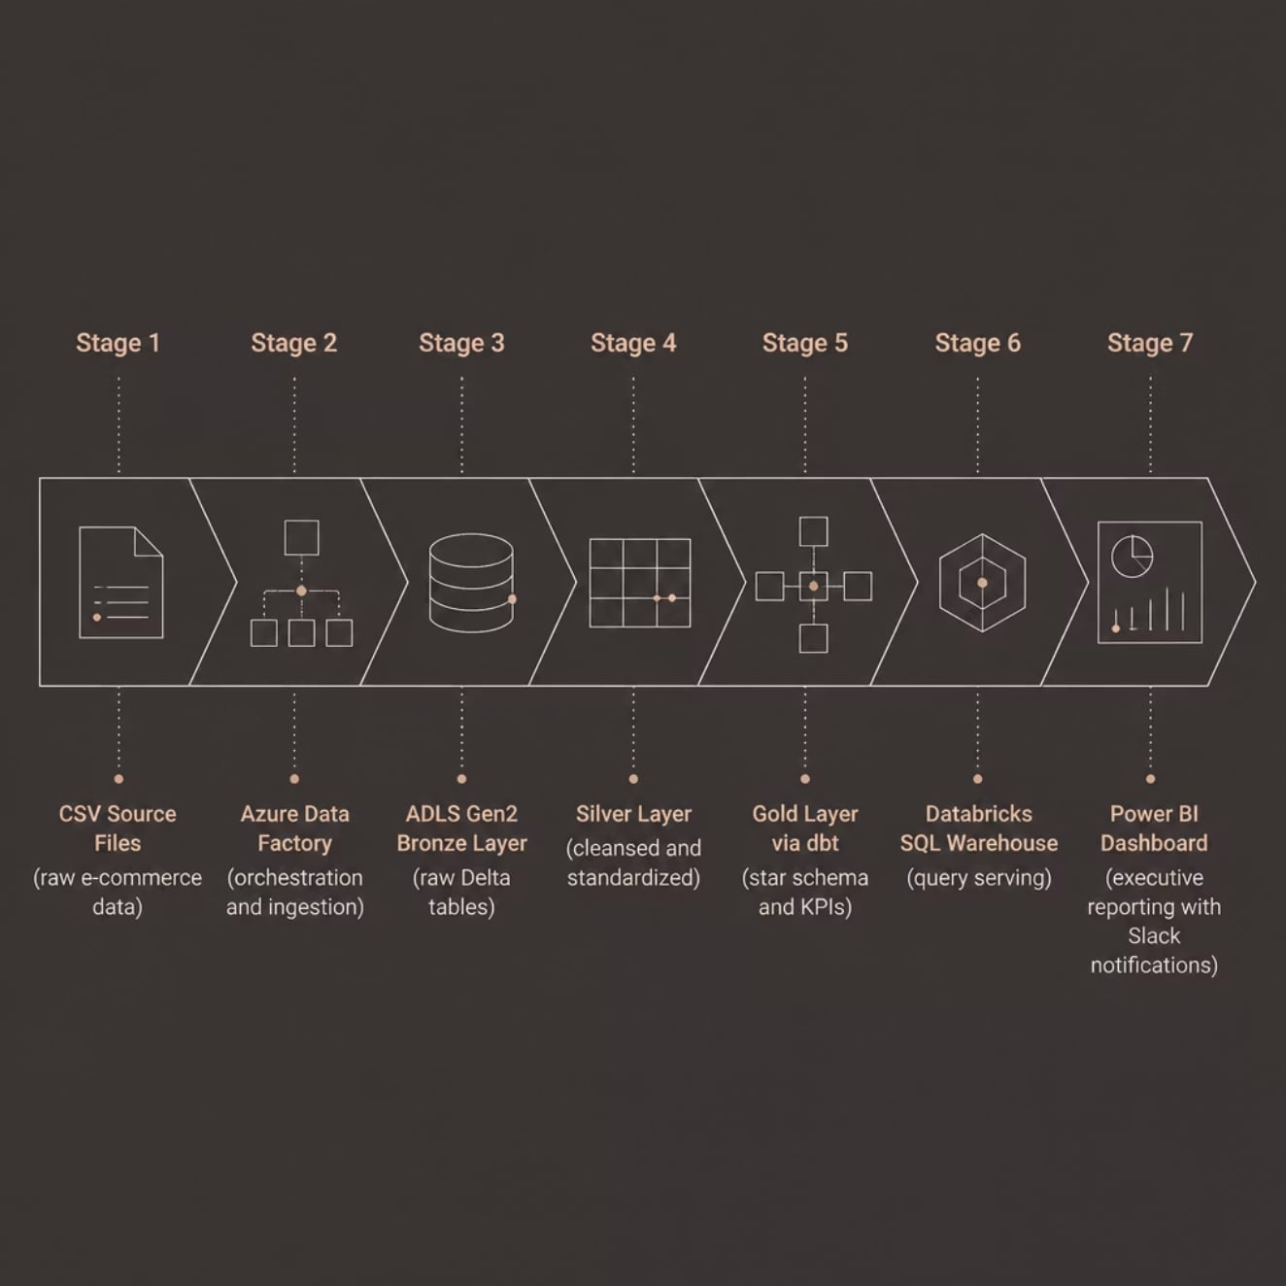
Architecture Overview
A fully automated pipeline moving data through the Medallion Architecture — from raw CSV files to polished Power BI dashboards with Slack alerts at every stage.
Pipeline Flow
Each stage builds on the last — raw ingestion, cleansing, transformation, and finally curated analytics-ready datasets served to Power BI.
Automated ingestion via Azure Data Factory
Medallion Architecture with Bronze → Silver → Gold
dbt for Gold layer modeling and testing
Slack alerts on success and failure at each stage

Slide 3








Technology Stack
Eight integrated Azure and open-source tools form the backbone of this pipeline.
Azure Data Factory
Azure Databricks
Orchestrates ingestion and pipeline execution
PySpark processing on a collaborative notebook platform
ADLS Gen2
Delta Lake
Scalable storage for all pipeline layers
ACID transactions with schema enforcement
dbt
Databricks SQL Warehouse
SQL transformations, tests, and model lineage
Serverless SQL endpoint for BI queries
Power BI
Slack & GitHub
Interactive KPI dashboards and reports
Pipeline alerts and version-controlled source code

Slide 4
Bronze Layer — Raw Ingestion
The Bronze layer captures immutable raw data exactly as it arrives — the single source of truth for all downstream processing.
Incremental Loading
Audit Logging
Only new or changed records are ingested per run, minimizing cost and latency
Every load operation is logged with timestamps, record counts, and status
Delta Tables
Schema Enforcement
Data stored as Delta format for ACID compliance and time-travel queries
Expected schema validated at ingestion to catch upstream issues early

Slide 5



PySpark Transformations for the Silver Layer
The Silver layer leverages PySpark on Azure Databricks to perform advanced transformations, ensuring data is clean, consistent, and structured for reliable analysis.
Deduplication & SCD Handling
Null Handling Strategies
Utilize window functions like row_number() to identify and remove duplicate records, keeping the most recent or relevant entry for Slowly Changing Dimensions (SCD).
Employ F.coalesce() to replace nulls with meaningful defaults across multiple columns, and F.when().otherwise() for conditional null assignments based on business logic.
Data Type Conversions
Business Rule Application
Standardize data types using .cast() to enforce schema consistency, converting string-based values to their appropriate numeric (e.g., DecimalType()) or temporal (DateType()) formats.
Apply specific business rules such as calculating derived metrics, creating flags (e.g., is_active), or enriching data by joining with master datasets to create a unified view.

Slide 6
Gold Layer — dbt Models & Star Schema
The Gold layer uses dbt to build a star schema — staging, dimensions, facts, marts, and KPI models ready for Power BI.
dbt Model Layers
dbt Folder Structure
01
models/
├── staging/
├── dimensions/
├── facts/
├── marts/
├── kpi/
├── macros/
├── tests/
├── snapshots/
└── seeds/
Staging
Light transforms, column renaming, source exposure
02
Dimensions & Facts
Conformed entities and transactional fact tables
03
Marts & KPIs
Business-facing aggregates and executive metrics

Slide 7

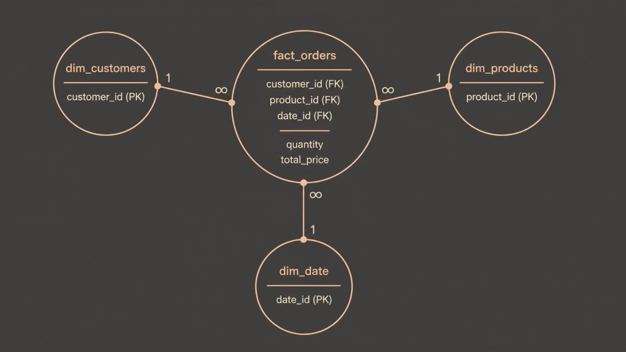
Star Schema Design
The star schema is a foundational design pattern for data warehousing, optimizing for query performance and intuitive understanding of business data. It organizes data into fact tables (containing measures) and dimension tables (containing descriptive attributes).
Conformed Dimensions
SCD Type 1 (Overwrite)
SCD Type 2 (New Row)
Dimensions used across multiple fact tables or data marts, ensuring consistent reporting and integration of data across different business processes. For example, a "Product" dimension should mean the same thing whether analyzing sales or returns.
Slowly Changing Dimension Type 1 handles changes by overwriting the existing dimension record. This method is simple but loses historical data for the changed attribute. Only the current state is preserved.
SCD Type 2 preserves historical data by creating a new record for each change in a dimension attribute. The old record is marked as inactive, and the new record becomes active, often with start and end dates.
Fact Table Grain
Surrogate Keys
The lowest level of detail in a fact table. It defines what a single row in the fact table represents (e.g., a single line item on an order, a single daily temperature reading). This determines the level at which analysis can be performed.
System-generated, simple integer keys assigned to dimension tables. They are independent of the source system's natural keys, allowing for efficient joins, managing SCD Type 2 changes, and isolating the warehouse from source system changes.
Core Star Schema Model
Our star schema centers on the fact_orders table, linking key dimensions for customers, products, and date to enable powerful analytical queries.

Slide 8

Data Quality & Slack Notifications
Every pipeline stage includes automated quality checks and Slack alerts — failures caught before they reach the dashboard.
Data Quality Tests
Slack Pipeline Alerts
Null Checks
✅ Bronze Success
✅ Silver Success
Key columns validated for unexpected nulls
Records loaded, file count, timestamp
Cleansing complete, duplicates removed
Duplicate Checks
Primary keys verified unique across tables
✅ Gold Success
🚨 Failure Alert
Relationship Tests
dbt models built, tests passed
Error details, stage, and timestamp
Foreign key integrity between facts and dimensions
Schema & Row Count
Column types and volumes validated per run

Slide 9




Incremental Models & Snapshot Strategy
Optimize warehouse performance and manage historical data with dbt's intelligent materialization strategies.
Incremental Models
Use is_incremental() logic with a unique_key to process only new or changed records, significantly reducing daily compute time.
Merge vs. Insert-Only
Choose merge (update/insert) for data requiring updates, or insert_overwrite (truncate and reload partitions) for append-only or full partition refreshes.
dbt Snapshots (SCD Type 2)
Automatically track changes to source tables, capturing new versions of records with valid_from and valid_to timestamps for full historical context.
Cost & Performance
These strategies drastically lower warehouse costs by minimizing data processed and improve pipeline speed by only handling relevant data each run.

Slide 10







Power BI Dashboard — Key KPIs
Seven KPIs give stakeholders a real-time view of e-commerce performance, connected directly to the Gold layer via Databricks SQL Warehouse.
Total Revenue
Total Orders
Total Customers
Top Products
Monthly Sales
Category Analysis
Seller Performance

Slide 11
Key Learnings & Best Practices
Reflecting on the development process, several critical lessons emerged, guiding our approach to robust and scalable data solutions, alongside recommendations for future growth.
Key Learnings
Recommendations & Future Growth
Streaming Ingestion: Explore Azure Event Hubs or Kafka for real-time analytics and event-driven processing.
Advanced ML Models: Integrate Databricks Machine Learning for demand forecasting, customer segmentation, or product recommendation engines.
Expand Data Sources: Incorporate marketing, inventory, and customer service data for a 360-degree business view.
Team Scaling: Establish clear dbt best practices and cross-functional training to support team expansion and collaboration.
Data Quality Early
Prioritizing data validation at the Bronze layer is crucial to prevent cascading errors and ensure downstream reliability.
dbt for Maintainability
Leveraging dbt's modularity and testing capabilities dramatically improves model consistency, maintainability, and documentation.
Scalable Medallion
The Medallion architecture proved to be an effective framework for structured data governance and scalable processing.
Monitoring First-Class
Integrating automated monitoring and Slack alerts from the outset ensures operational visibility and rapid incident response.

Slide 12



Data Ingestion Strategy — CSV to Bronze
Safely and efficiently move raw CSV files into the Bronze layer, ensuring data integrity and pipeline resilience.
Key Ingestion Principles
Azure Data Factory Automation
Load Types
Source Monitoring
Incremental: Only new or changed records. Full: All data for initial loads or periodic snapshots.
1
ADF continuously monitors defined cloud storage directories for new CSV files.
File & Schema Validation
Pre-ingestion checks for file format, delimiter consistency, and schema detection/enforcement.
Trigger Pipelines
2
Detection of new files automatically triggers the ingestion pipeline to the Bronze layer.
Error Handling & Retry
Corrupt records quarantined to a separate zone; transient errors trigger configurable retry logic.
Audit & Logging
3
Comprehensive logging captures ingestion status, record counts, and error details for each run.
Notes:
Explain the importance of a robust ingestion layer as the foundation. Discuss how incremental loads save compute, and full loads ensure data completeness for historical analysis. Detail the file validation step, including checks for delimiters, column counts, and basic data type inference. Emphasize the separation of good and bad records, and how retry mechanisms handle temporary network issues or resource unavailability. Highlight ADF's role in orchestrating this process, from detecting new files to triggering the Spark jobs that write to Delta tables in Bronze.

Slide 13



Cost Optimization & Scaling
Implementing strategies to maximize efficiency and minimize cloud expenditures without compromising performance.
Azure Databricks Auto-Scaling
Dynamically adjusts cluster resources based on workload demand, preventing over-provisioning and idle costs.
Reserved Capacity
Committing to compute usage plans for significant discounts on Azure resources, ideal for predictable workloads.
Delta Lake Z-Order
Optimizes data layout for faster, more efficient query execution by co-locating related data in storage.
Cost Per Query Metrics
Monitors and analyzes query performance against cost, identifying areas for further optimization.
Incremental Processing
Only processes new or changed data using dbt models, drastically reducing compute time and associated costs.
Data Partitioning
Divides large datasets into smaller, manageable parts, enabling efficient data skipping and faster query responses.

Slide 14







CI/CD & Version Control
Robust processes ensure code quality, seamless deployments, and a reliable data pipeline from development to production.
GitHub Integration
Automated Testing
Environment Promotion
All dbt models and SQL transformations are version-controlled in GitHub, enabling collaborative development and a clear history of changes.
Every pull request triggers a suite of dbt tests, validating data quality, schema integrity, and model logic before merging to main.
A structured workflow promotes validated changes from development to staging, and then to the production environment, ensuring stability.
Rollback Procedures
dbt Cloud Scheduler
In case of issues, the version-controlled nature of dbt models allows for quick and safe rollbacks to previous stable versions.
Production deployments are managed and scheduled via dbt Cloud, providing reliable execution and monitoring for critical data transformations.

Slide 15
Conclusion & Next Steps
This project has successfully established a robust, scalable, and cost-effective data pipeline, transforming raw e-commerce data into actionable insights for strategic decision-making.
Key Achievements & Impact
Future Enhancements & Call to Action
Stakeholder Feedback: Provide input on current dashboards to refine and enhance analytical capabilities.
Data Expansion: Identify new external data sources for integration, enriching the 360-degree customer view.
Advanced Analytics: Explore machine learning applications for demand forecasting and personalized recommendations.
Continuous Improvement: Collaborate on ongoing pipeline optimizations and feature development roadmap.
End-to-End Visibility
Empowering real-time monitoring of e-commerce performance and customer behavior.
Reliable Data Foundation
Utilizing a Medallion architecture for structured, governed, and high-quality data assets.
Optimized Operations
Implementing cost-efficient processes with Azure Databricks and dbt, ensuring future scalability.

