Slide 1
Vcoders
Shers
GROUP MEMBERS:
Akanksha – Be Cse (Chitkara University, hp)
Sakshi Bhalla- BE CSE (Chitkara university, hp)

Slide 2

Problem Statement
Create Solutions for women health, safety and upliftment
of vulnerable section

Slide 3
Proposed Solution:
A website that covers all the major expectations:
Women’s health- An online way to calculate BMI and then corresponding exercises and diet chart to improve health and maintain a healthy lifestyle. Yoga and Motivational thoughts and videos to improve emotional and mental health.
Women Safety- All the security numbers saved at a particular place, and live location will be sent to those numbers in case of emergency and various self-defence techniques along with their rights and women’s rights NGO.
Upliftment of vulnerable section- The website will be in their local language so that they can learn various skills to earn money via learning from our website and then selling their services throughout the website itself.
These features are elaborated in the upcoming slides.

Slide 4
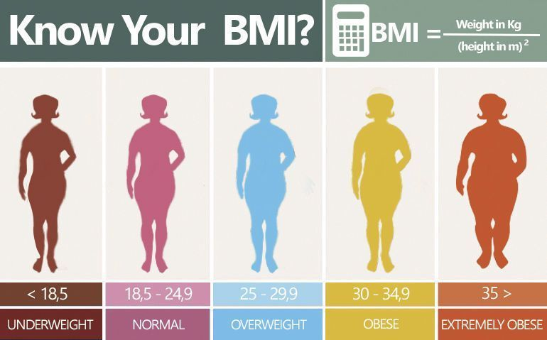
Women Health (Physical Health)
A BMI calculator will divide the person into the following 5 categories based on their BMI.
After the person’s category is classified and corresponding to their category, a diet chart and timetable are issued, which will help them gain a normal weight category and maintain a healthy lifestyle.

Slide 5
Women Health (Emotional and mental Health)
Videos to boost confidence, random quotes, and stories of female fighters who broke the stereotype to achieve their dreams.
Stories can be read by the person or they can listen to them using our audio feature.

Slide 6
WOMEN SAFETY
All the emergency numbers will be available on the site, security tab.
NGOs working for women’s welfare will be accessible through their contact numbers and their sole responsibility.
Videos of self-defense techniques will be available.
In case of emergency live location will be sent to the trusted people.
Videos for fundamental rules and rights for women to protect their dignity and self-respect, where various laws made for women will be available in both audio and texual format.

Slide 7
UPLIFTMENT OF VULNERABLE SECTION
Online workshops to teach basic skills such as embroidery, and crafts to make rural women financially independent.
A platform to sell their products on our website.
Videos to learn different languages.
Other skills such as boutique, cooking, stitching will also be taught.

Slide 8
UNIQUENESS
With each sale and purchase points will be added to the account and according to the points gifts will be given to the user.
Anonymous chatting or voice notes application so that people could share their problems freely and anonymously and get solutions.
It uses BMI to maintain healthy lifestyle.
Various audiobooks will be available in the local language.
A website where people can learn and then sell their products too.

Slide 9
TECH STACK:
React
Html
Css
Bootstrap
Js
Jquery
Api's(if available)

Slide 10
SCALABILITY
We'll start by using our website at the regional level, then within passage of time, we'll make it accessible all over India and then all over the world so that every woman become financially independent and lead a happy and healthy life.
Our motto is ‘Every woman is unique’ so as their needs and requirements. We aim at helping every women, be she belongs to vulnerable society or even in urban societies to stand for herself, develop confidence and live the best life

