Slide 1
VSpeak
IMAGE TO TEXT TO SPEECH CONVERTER
Sakshi Biyani (22BLC1385)
Vidushi Agnihotri (22BLC1387)

Slide 2
PROBLEM STATEMENT
Create a system for accurately converting various types of images to machine-readable text. The solution should efficiently handle factors like image quality, text orientation, and language diversity.The goal is to produce accurate and contextually meaningful text output, with potential applications in digitizing documents, aiding visually impaired individuals, and enabling efficient text extraction and audio visualization for image analysis.

Slide 3
PROCEDURE WE ADOPTED
01
04
02
05
03
06
Idea and Conceptualization
App Development
Define the pupose and goals of our project and finalise a target audience
Writing code in Java to implement the functionality of our app considering optimal performance
Feature prioritization
Debugging and Testing
Preplanning like designing a logo and finalizing the app name
Testing on different Android Virtual and Real Devices
UI-UX Design
Deployment
Designing the Layout of the app by creating wireframes to visualize layout.
Distributing the app through apk

Slide 4
Idea and Conceptualization
We clearly decided the target audience for the app, which includes individuals with visual impairments, reading disabilities, or anyone who requires assistance in accessing text-based information. Then we brainstormed and listed down the essential features that the app should include to fulfill its purpose. This included image selection , text processing, text editing, text-to-speech conversion ,offline mode, and integration with other apps
01

Slide 5
Feature prioritization
We decided our app name to be "VSpeak" as an amalgamation of "Vidushi" and "Sakshi,"and together it sounds like “We speak ” meaning our app serves as a voice for the visually impaired and those with reading disabilities.
The logo of our app is meticulously crafted to symbolize conversion, reflecting our commitment to transforming text into audible speech, thus bridging communication barriers and fostering inclusivity.
02

Slide 6
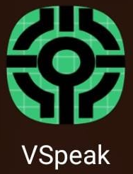
APP LOGO

Slide 7
UI-UX Design
Android Studio's Layout Editor provides a visual interface for designing app layouts using XML or drag-and-drop components.Utilize ConstraintLayout, a flexible layout manager, to create responsive UIs that adapt to different screen sizes and orientations.
03

Slide 8
App Development
We used Android Studio to write, debug, and test their code. It is the official integrated development environment (IDE) for Android app development for creating mobile applications for Android devices using the Java and the Android SDK (Software Development Kit). They start by creating a new Android project. Then, we implemented the app's functionality by writing Java code. This included handling user interactions, accessing device features like the camera, making network requests, and storing data remotely. Then we used Android's set of APIs and libraries to build components of the app.
04

Slide 9
Debugging and Testing
Android Studio provides robust debugging tools, including breakpoints, watches, and variable inspection, to identify and resolve issues in your code.We tested our app on virtual devices with different Android versions and screen resolutions to ensure compatibility and responsiveness.We also enabled USB debugging on physical devices to deploy and debug directly from Android Studio, facilitating real-world testing scenarios.
05

Slide 10
Deployment
Finally, once the app was completed, we packaged it into an APK (Android Package) file using BuildAPK from the Toolbar.
06

Slide 11
APP UI/UX

Slide 12
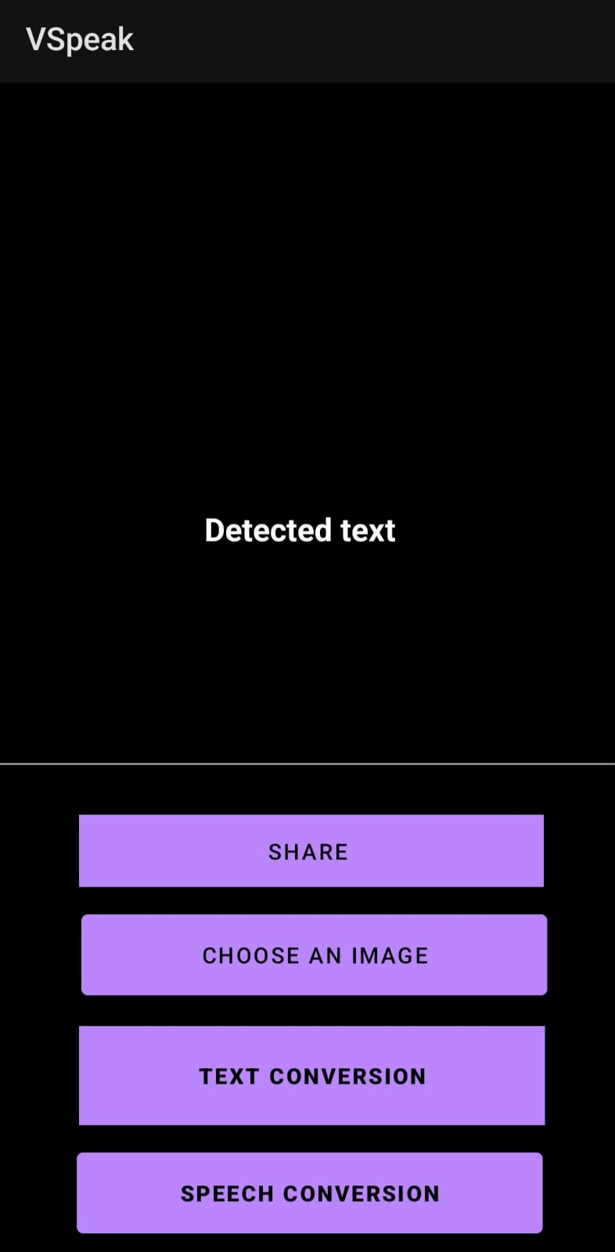
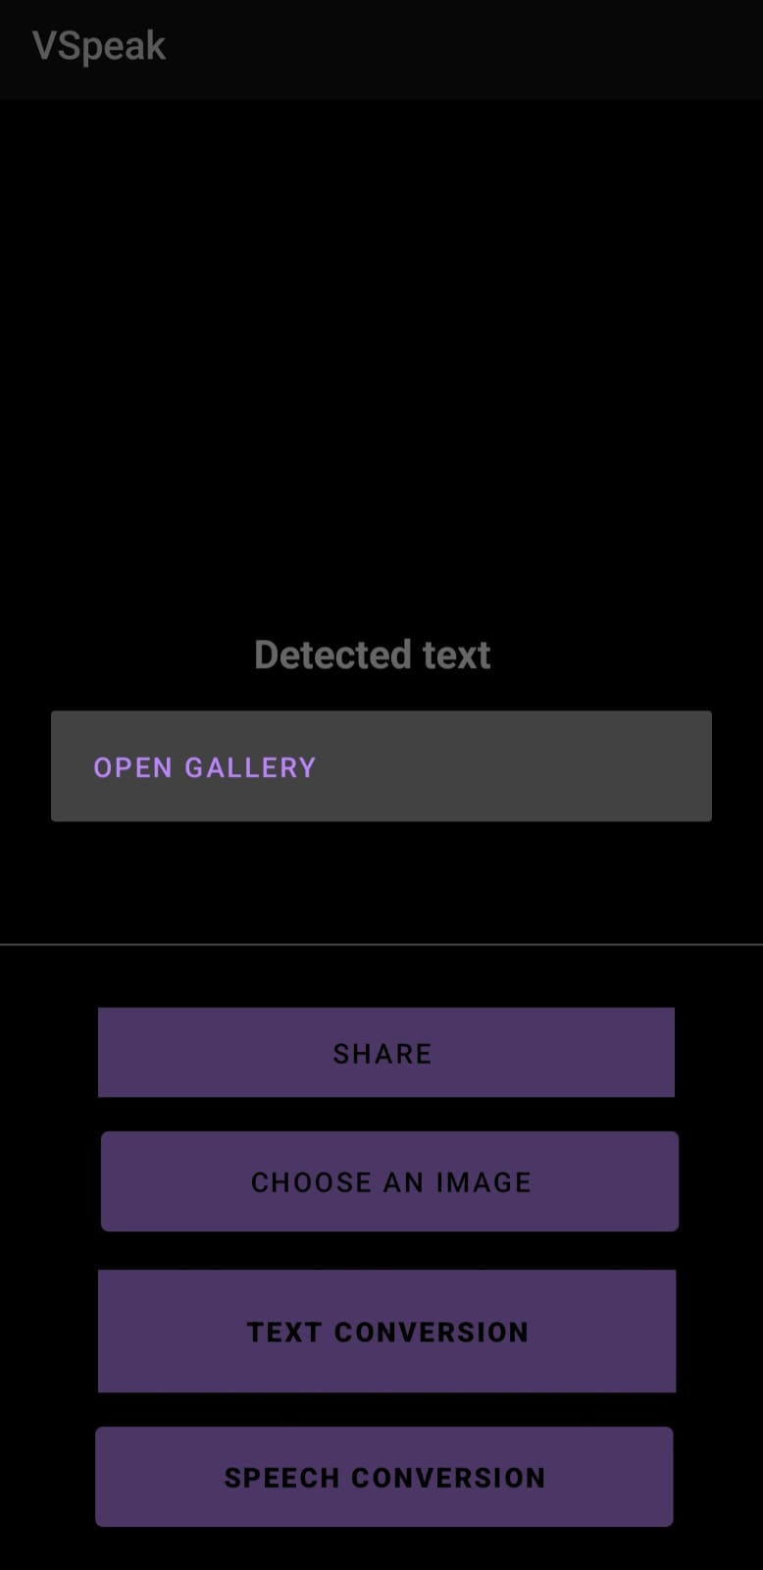
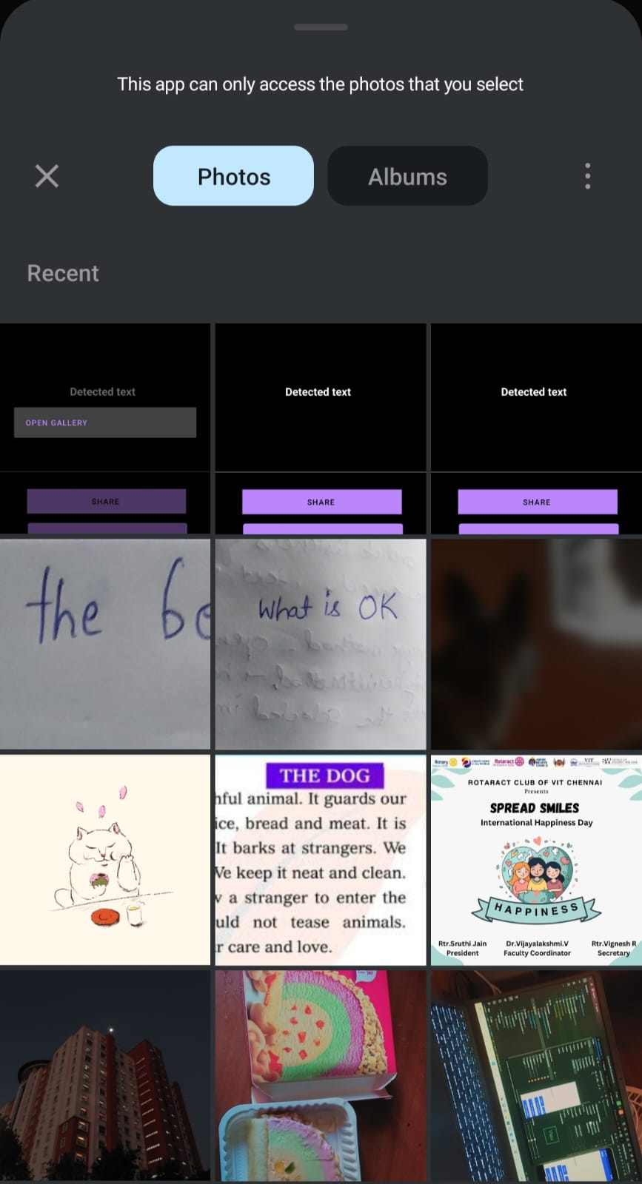

Slide 13
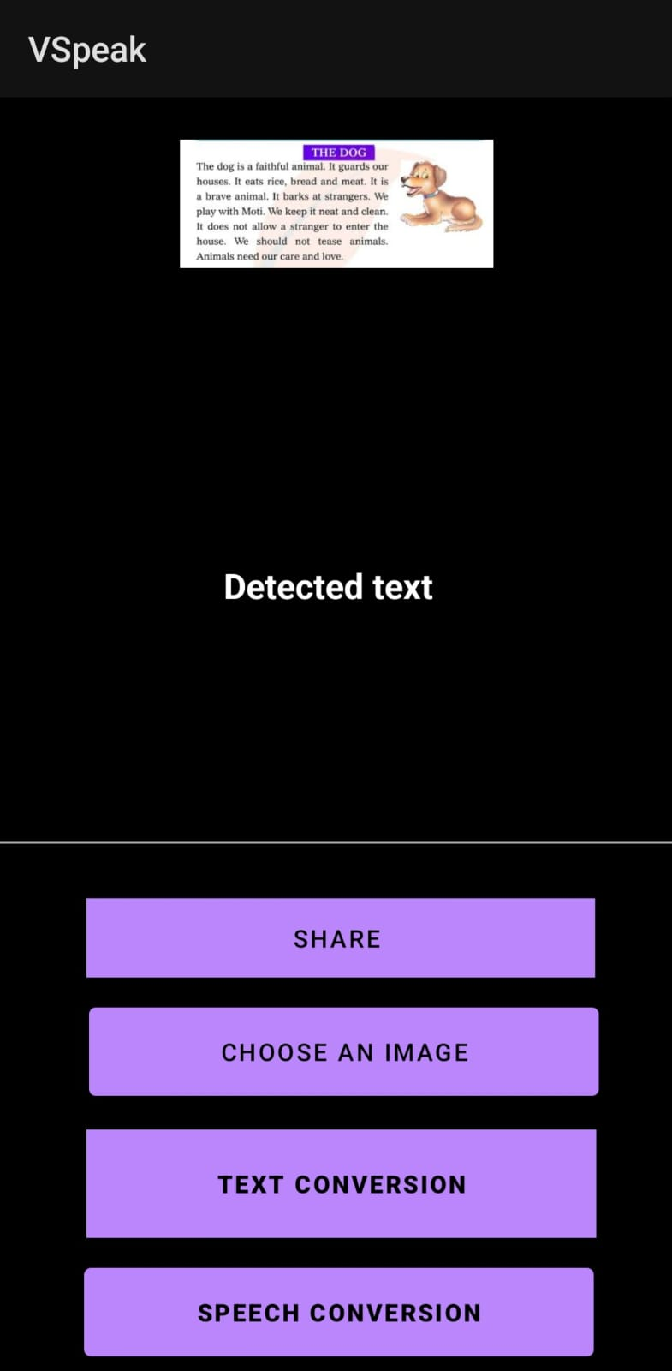
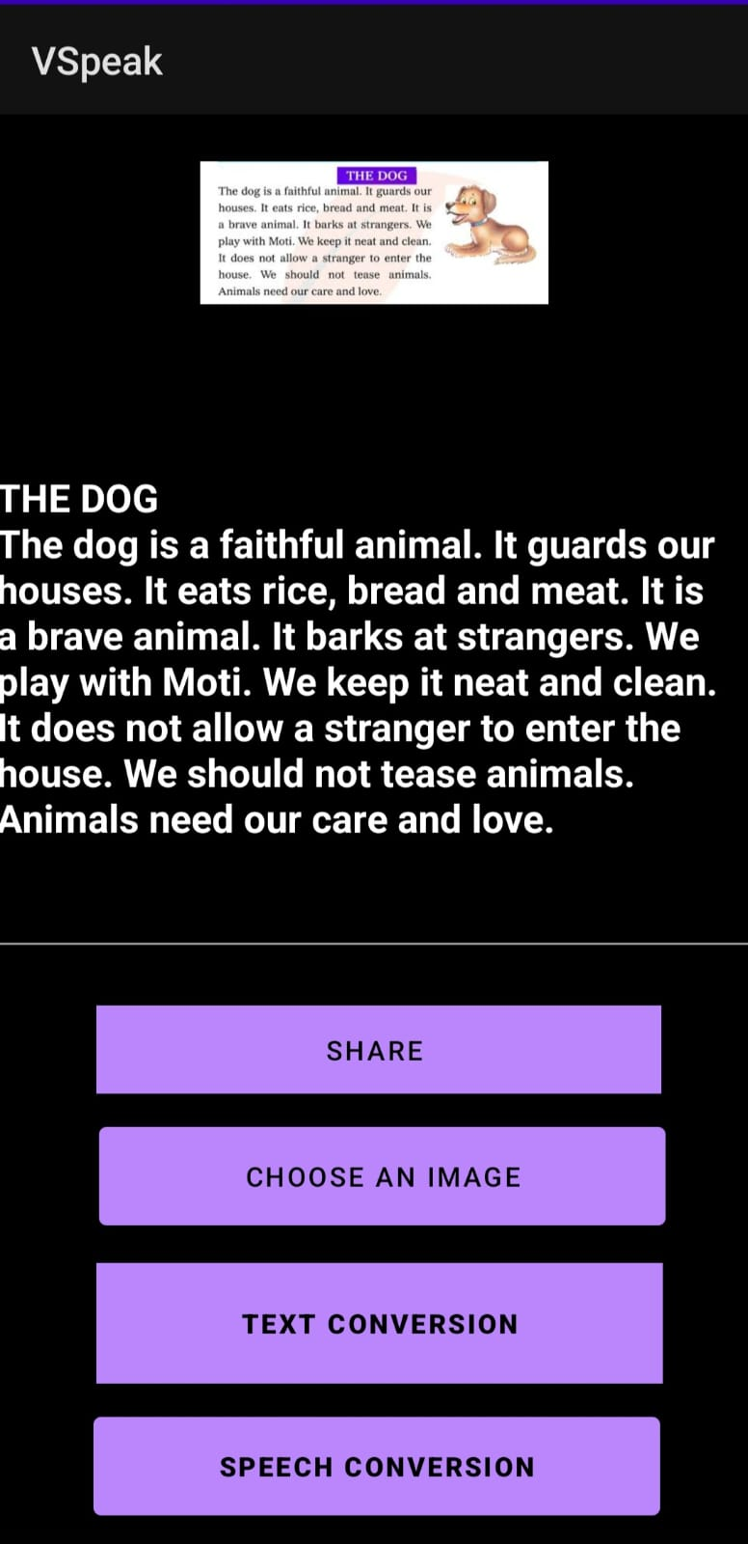

Slide 14
BASIC OVERVIEW OF OUR CODE FOR MOBILE APPLICATION
We have coded MainActivity file in java.
This code exhibits a seamless interaction between UI elements, permissions handling, image selection/capture, text detection, and additional features like text-to-speech conversion and text sharing. It combines various Android SDK components and Firebase ML Vision to provide a comprehensive text processing and interaction experience for the user.

Slide 15
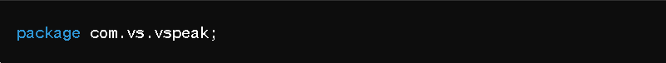
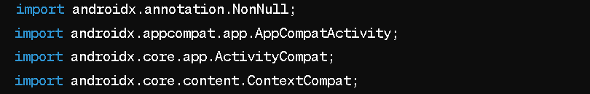
Import Statements
1.Define the package name for the Java file. It organizes the Java classes into a namespace, allowing them to be grouped logically.
2.Imports classes from the androidx library. These classes provide support for various Android features and compatibility across different versions of Android.

Slide 16
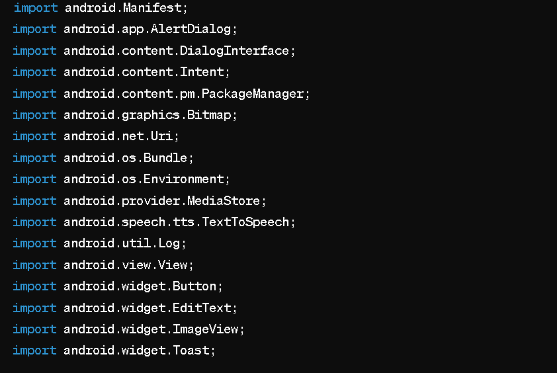
Imports classes from the Android framework. These classes provide functionalities related to UI components, permissions, intents, image handling, speech synthesis, logging, and notifications.

Slide 17
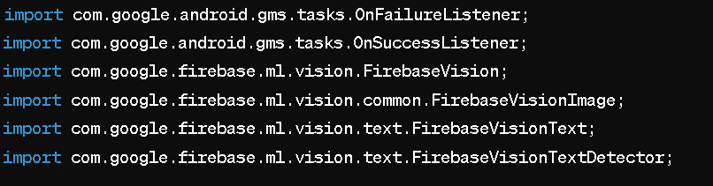
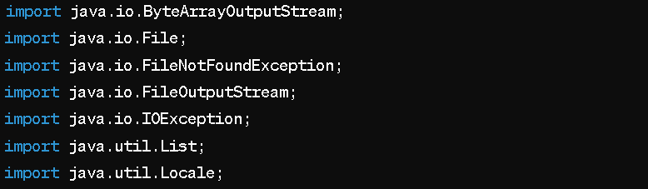
Imports classes from the Firebase ML Vision library. These classes provide functionality for text recognition from images using machine learning models.
Imports standard Java classes for file handling, IO operations, collections, and localization

Slide 18
Declares a class named MainActivity that extends AppCompatActivity. This class represents the main activity of the Android application.
Declares private member variables to hold references to UI elements (EditText, Button, ImageView), TextToSpeech object, and other variables used within the MainActivity class.
1.onCreate Method:
•This method is overridden to initialize the activity when it is first created.
•It sets the layout of the activity and initializes references to UI elements.
•It checks and requests necessary permissions for accessing the camera and external storage.

Slide 19
2.Text-to-Speech Initialization:
•Initializes the TextToSpeech object to convert text to speech. Sets the language to English if the initialization is successful.
3.Speech Button Click Listener:
•Sets an OnClickListener for the "speech" button. When clicked, it converts the text entered in the EditText to speech using the TextToSpeech object.
4.Share Text Button Click Listener:
•Sets an OnClickListener for the "sharetext" button. When clicked, it shares the text entered in the EditText with other apps using an Intent.

Slide 20
5.Camera Button Click Listener:
•Sets an OnClickListener for the "camera" button. When clicked, it opens the gallery to select an image.
6.Detect Text Button Click Listener:
•Sets an OnClickListener for the "Detecttext" button. When clicked, it initiates text detection from the selected image.

Slide 21
•Selectimage(): Opens the gallery for image selection.
•onActivityResult(): Handles the result of image selection or capture.
•detectextfromimage(): Initiates text detection from the selected image using Firebase ML Vision.
•displaytextfromimage(): Displays the detected text from the image in the Display EditText.

Slide 22
WEB APP UI/UX

Slide 23
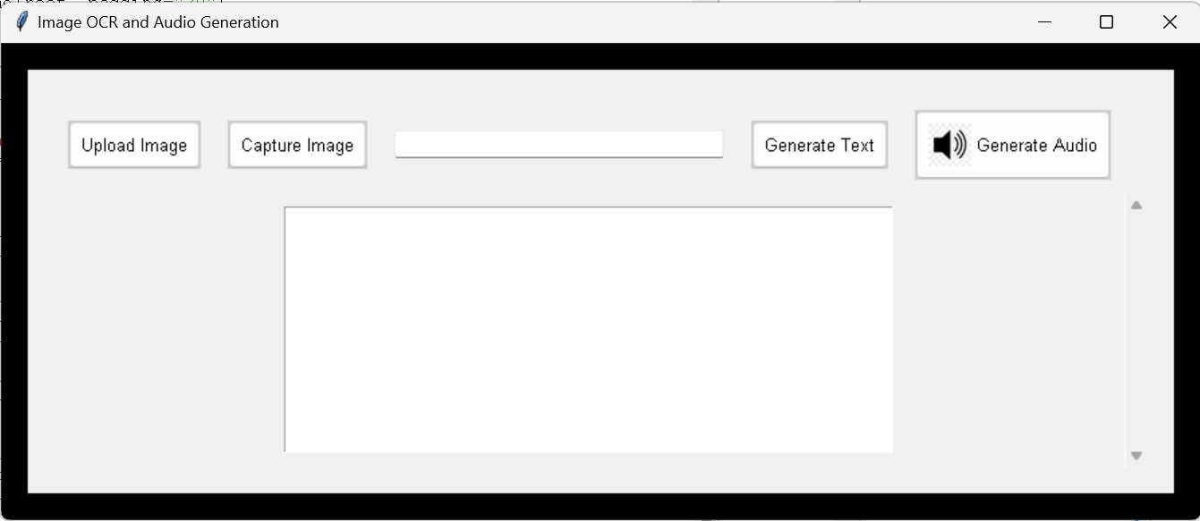
SCREENSHOT OF GENERATED GUI:

Slide 24
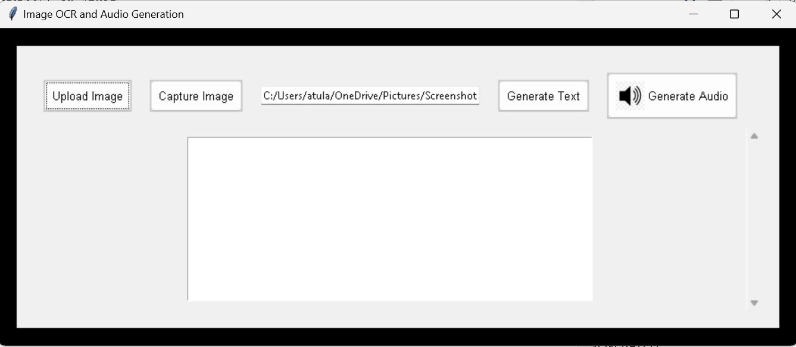
SCREENSHOT AFTER THE IMAGE IS UPLOADED:

Slide 25
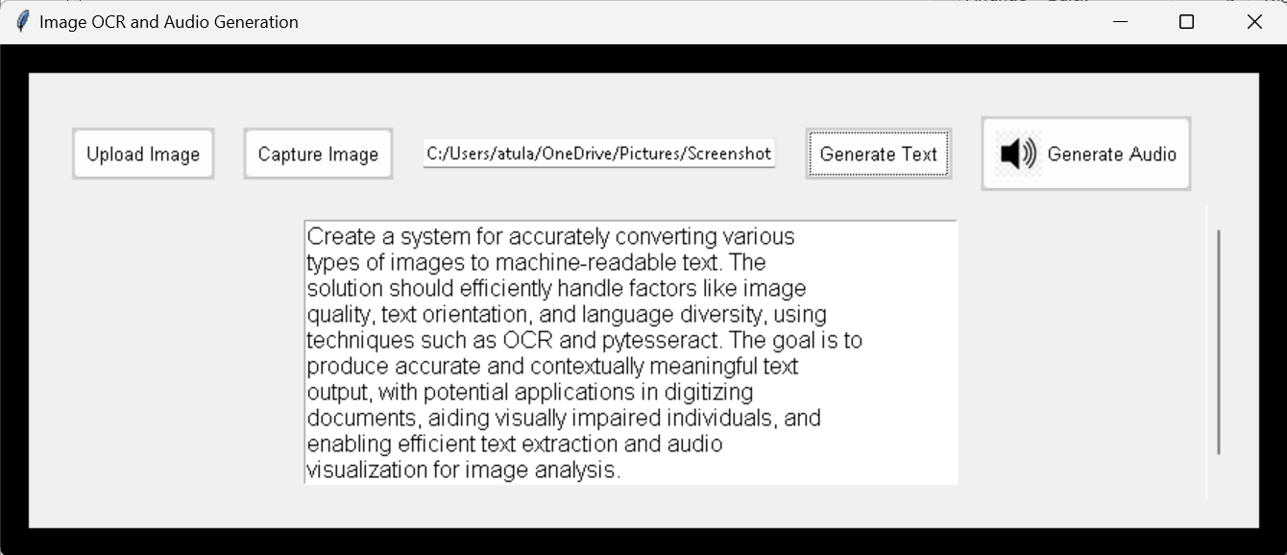
SCREENSHOT AFTER THE TEXT HAS BEEN GENERATED:

Slide 26
BASIC OVERVIEW OF OUR CODE FOR WEB APPLICATION
We have made a Python application built with the Tkinter library, enabling users to convert images to text and generate audio from the extracted text
Import Statements:
tkinter: Import the Tkinter library for building the GUI.
ttk, filedialog, messagebox: Additional Tkinter modules for specific functionalities like themed widgets, file dialogs, and message boxes.
PIL.Image, PIL.ImageEnhance, ImageTk: Imports from the Python Imaging Library (PIL) for image processing and displaying images in Tkinter.
pytesseract: Import the pytesseract library for Optical Character Recognition (OCR).
gtts: Import the gTTS library for text-to-speech conversion.
os, subprocess, cv2: Standard Python libraries for OS operations, subprocess management, and OpenCV for capturing images.
Tesseract Path Configuration:
Set the path to the Tesseract OCR executable.

Slide 27
Image Processing Functions: enhance_image: Enhance image contrast. image_to_text: Convert image to text using OCR. Text-to-Speech Functions: text_to_audio: Convert text to audio using gTTS. play_audio: Play generated audio. GUI Functions: open_image: Open file dialog to select an image. capture_image: Capture image from webcam. generate_text: Generate text from the selected/captured image. generate_audio: Generate audio from the extracted text. Main Window Setup: Create a Tkinter root window. Set the window title and background color. Configure a style for buttons. Load and resize an audio icon.

Slide 28
Frame and Widgets: Create a frame within the root window. Add buttons for uploading/capturing images and generating text/audio. Add an entry widget for displaying the image path. Add a text box for displaying OCR results. Add a scrollbar for the text box. Run the GUI: Start the Tkinter event loop to display the GUI and handle user interactions.

Slide 29
THANK YOU

