Slide 1
SPOTIFY’S HIT ANALYSIS
Probability and Statistics
Lab Project
Team members
01
Vidushi Agnihotri
22BLC1387
02
Sakshi Biyani
22BLC1385
Exploring the data behind the most streamed songs
03
Utkarsh Rounak
22BLC1392
04
Akshat Verma
22BLC1318

Slide 2
Introduction
In the digital era, music streaming platforms like Spotify have revolutionized how people access and engage with music. By examining Spotify's most-streamed songs, we can uncover trends and factors that drive a song's popularity. This analysis focuses on:
Exploring relationships between musical features such as streams, danceability, energy, and mode.
Building predictive models to estimate stream counts based on song characteristics.
Conducting statistical tests to understand differences and patterns within the data.
Through these insights, we aim to help artists, producers, and marketers understand what contributes to a song’s success on streaming platforms.

Slide 3
Methodology
Data Preparation: Imported data, handled missing values, and converted columns (e.g., streams, playlist counts) to numeric for accurate analysis.
Exploratory Data Analysis (EDA): Used summary statistics and visualizations (histograms, bar plots, scatter plots) to understand data distributions and relationships.
Correlation & Regression Analysis:
Calculated correlations among features like danceability, energy, and streams.
Built simple and multiple linear regression models to predict stream counts based on song characteristics.
Statistical Tests:
Conducted t-tests and ANOVA to explore differences in streams across song modes.
Performed chi-square tests to check relationships between song mode and release year.
Distribution Fitting: Modeled data using binomial, normal, and Poisson distributions for additional insights into data patterns.

Slide 4
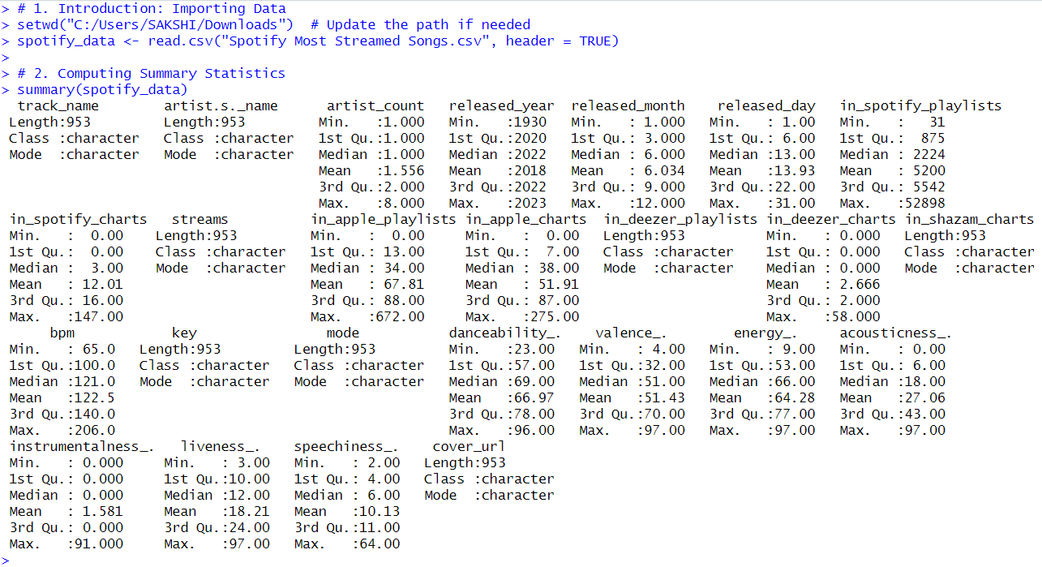
Code Analysis and results

Slide 5
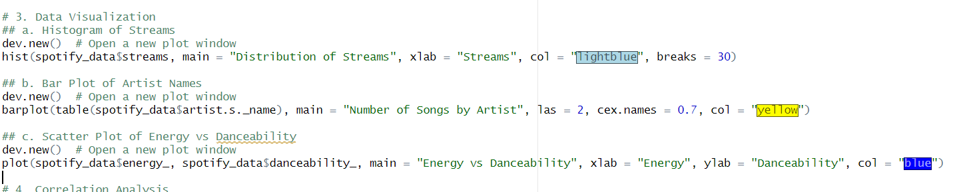
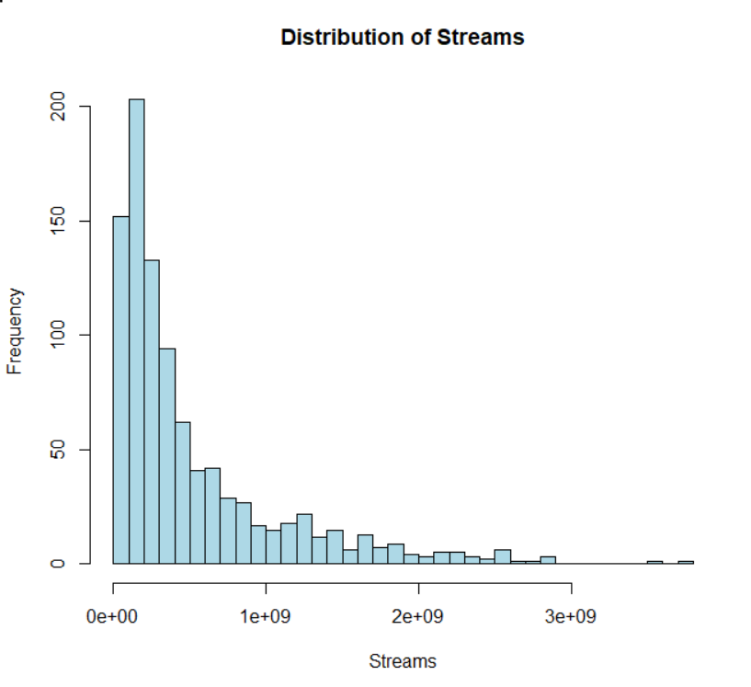
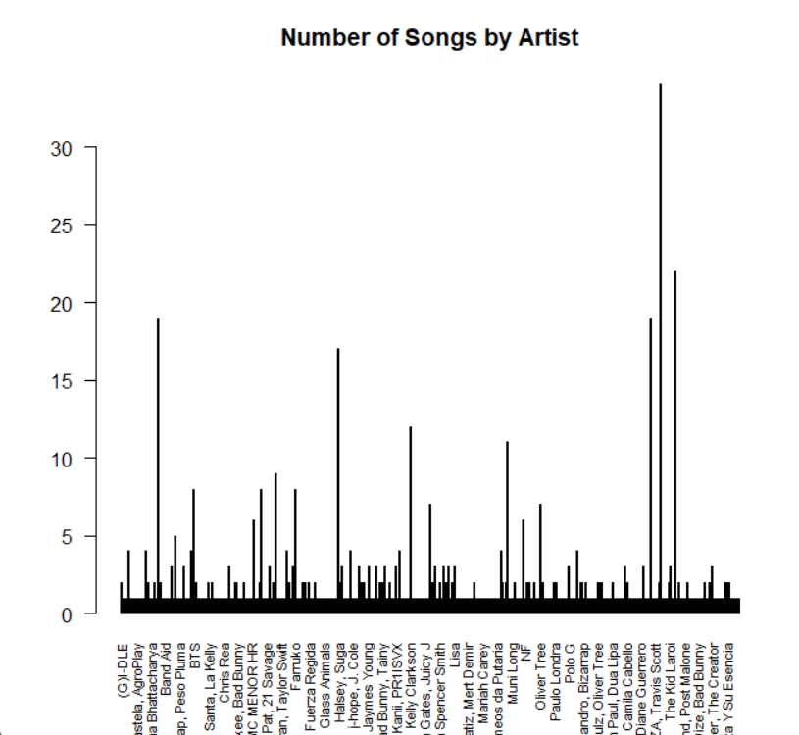
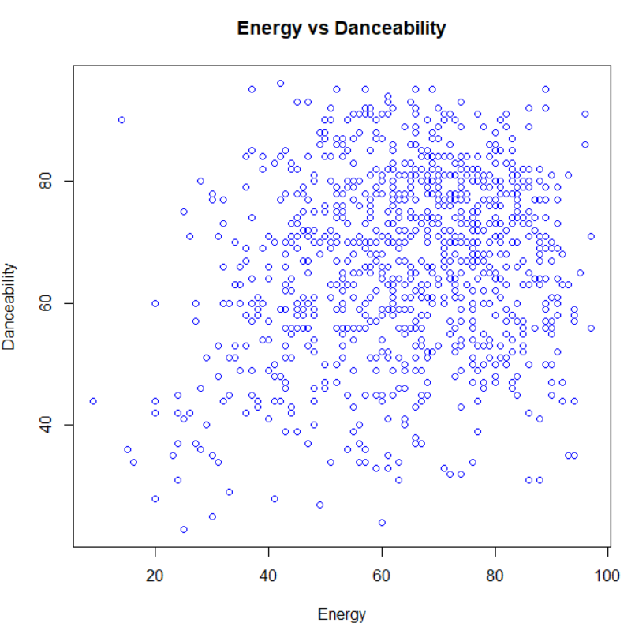
Data visualisation

Slide 6
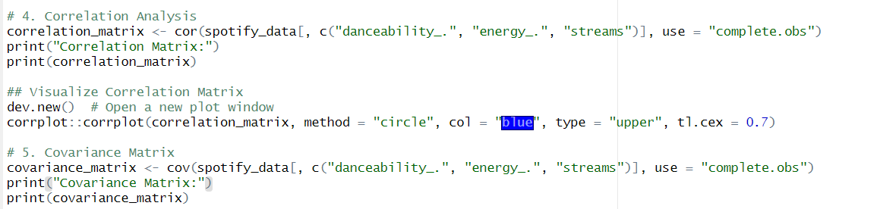
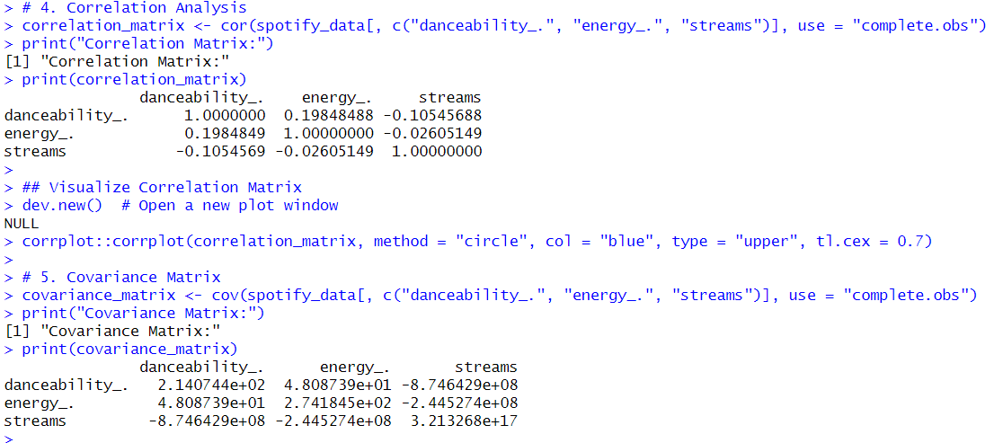
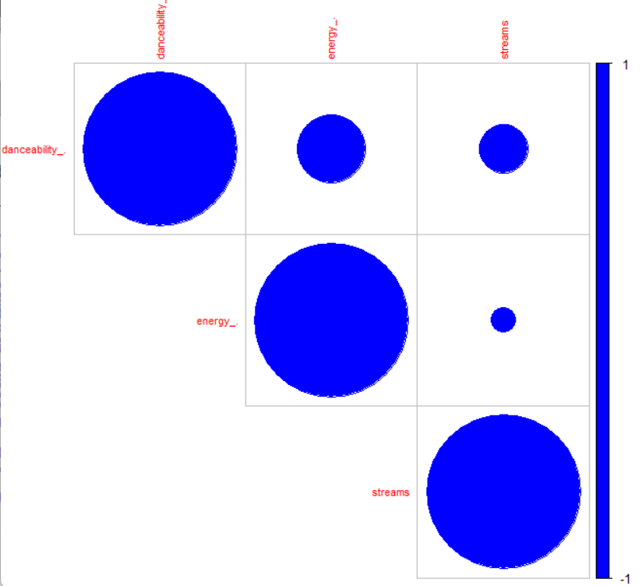
Correlation analysis, correlation matrix and covariance matrix

Slide 7
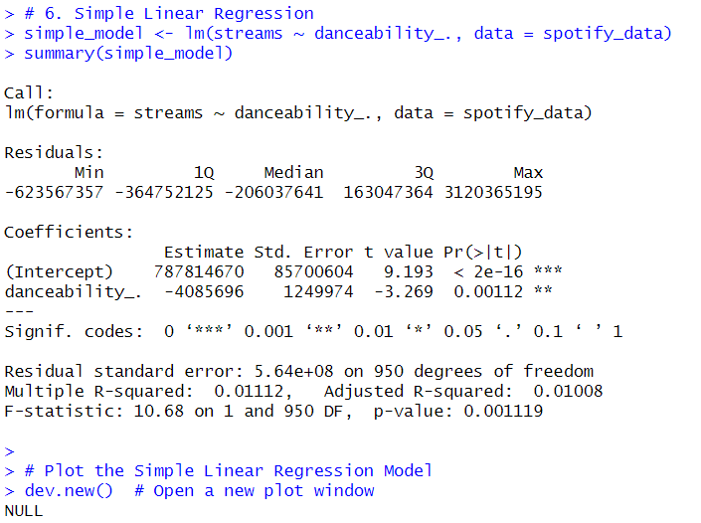
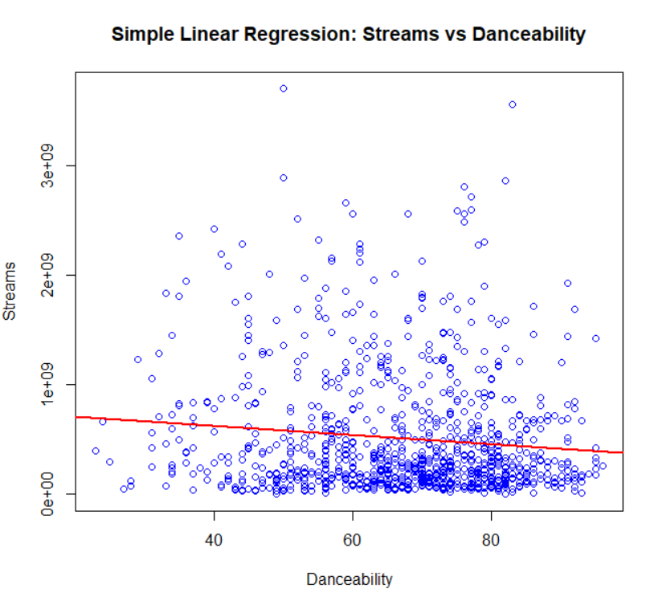
Simple Linear Regression

Slide 8
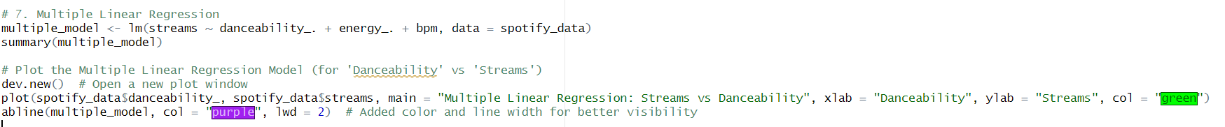
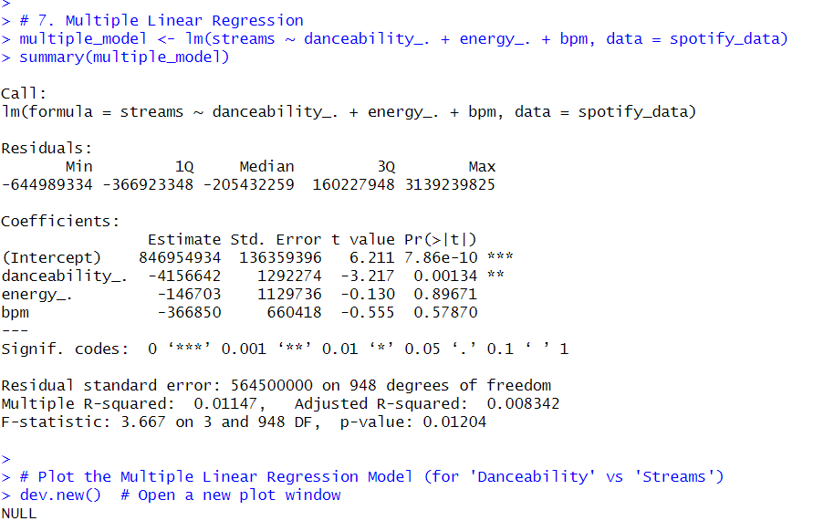
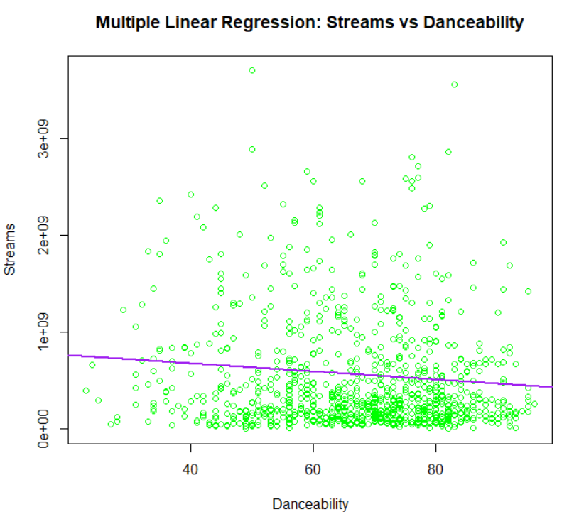
Multiple linear regression

Slide 9
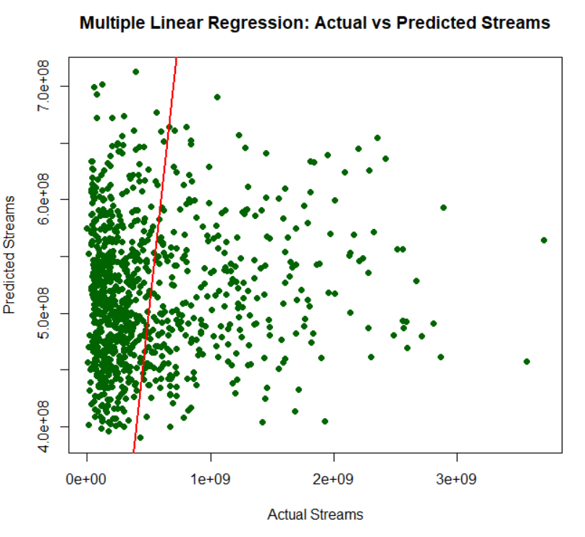
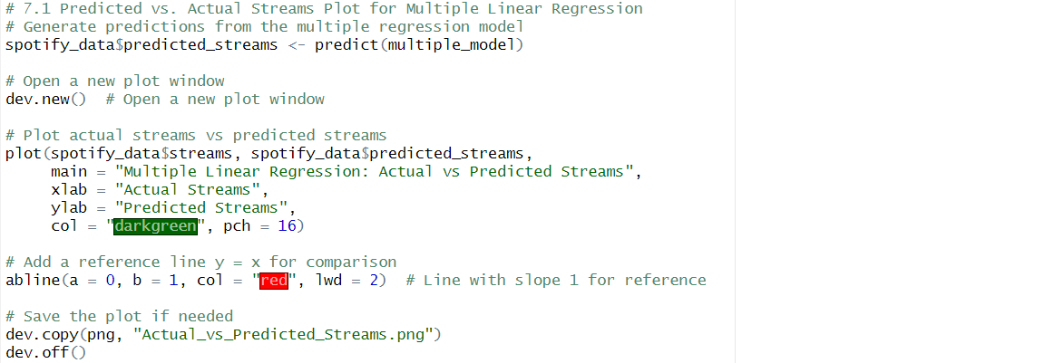
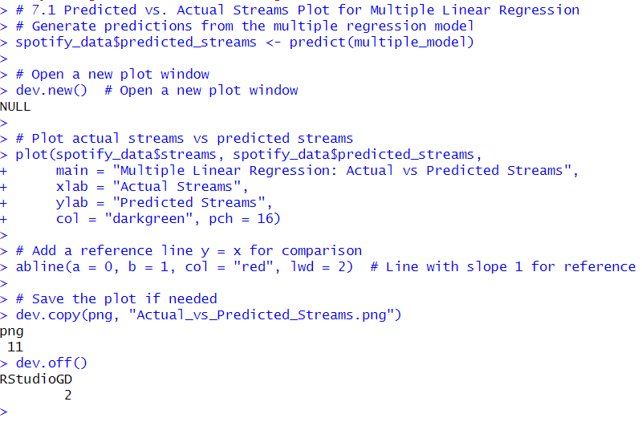
Actual vs predicted streams

Slide 10
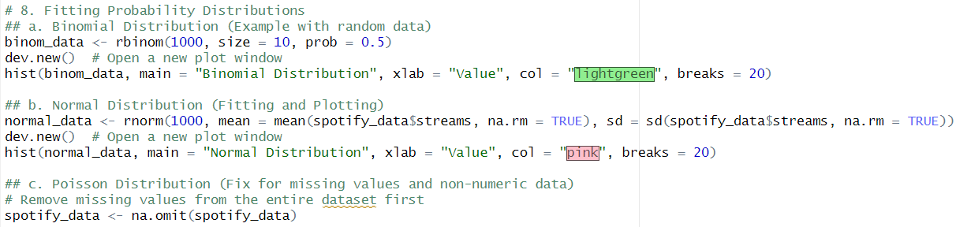
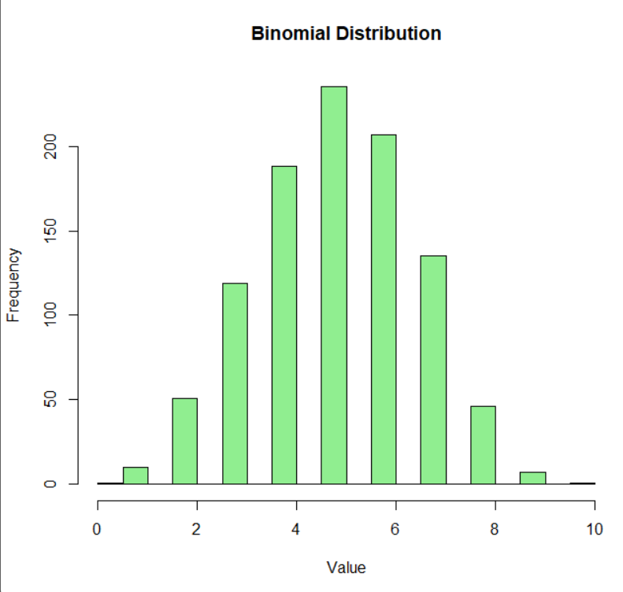
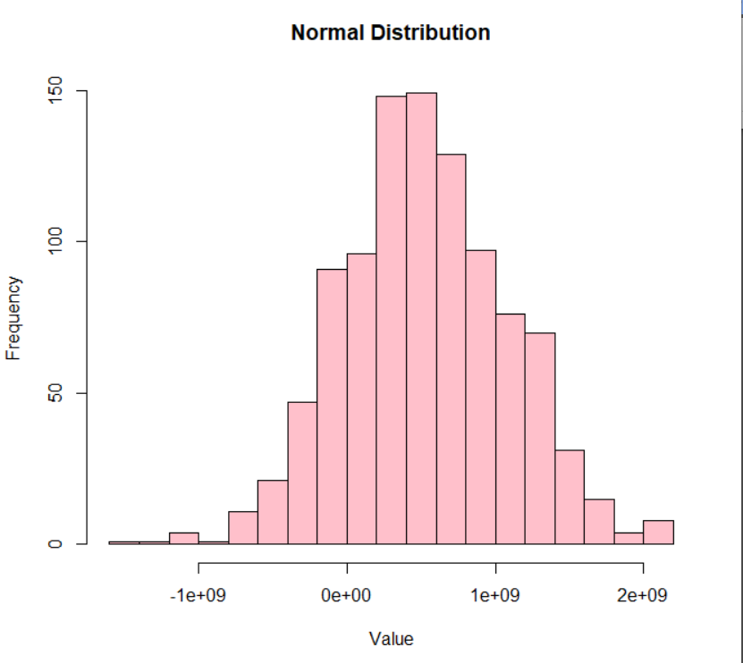
Fitting Probability distributions

Slide 11
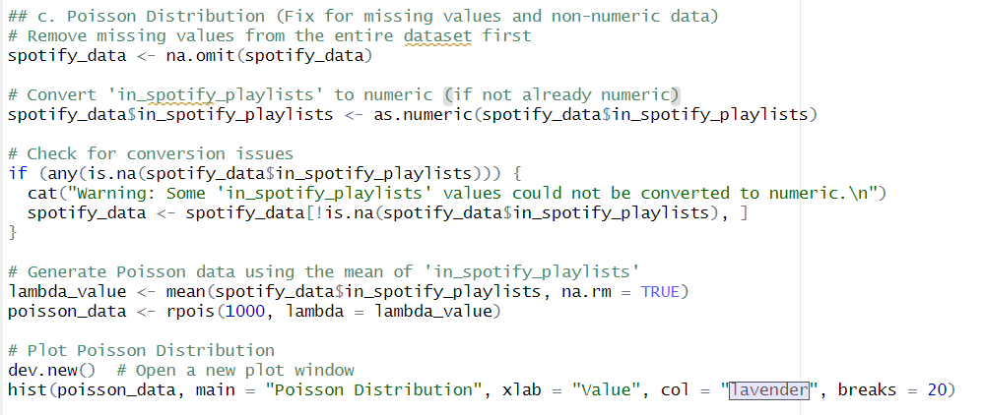
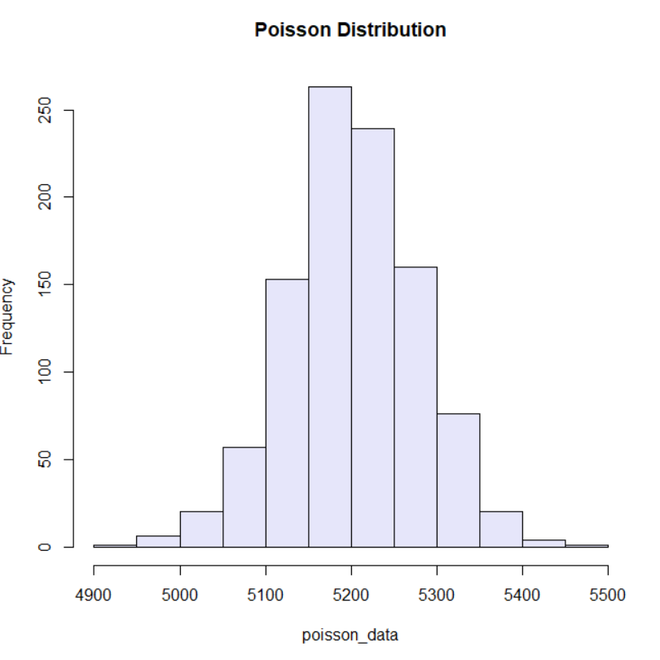
Fitting probability distributions
Poisson distribution
Note:
Missing values were removed to ensure clean data.
Non-numeric values were converted to numeric, with any problematic rows excluded to prevent errors during analysis.

Slide 12
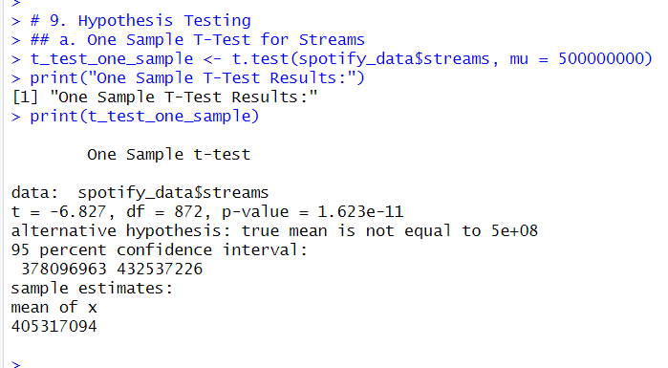
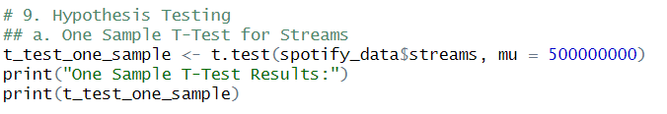
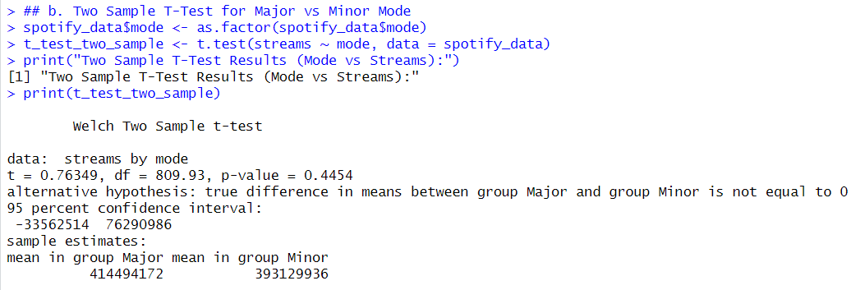
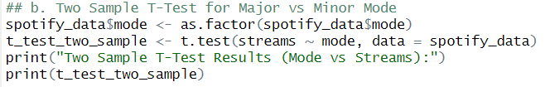
Hypothesis Testing

Slide 13
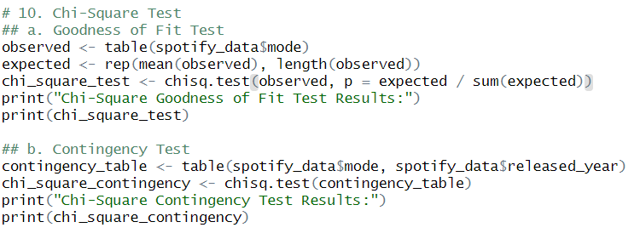
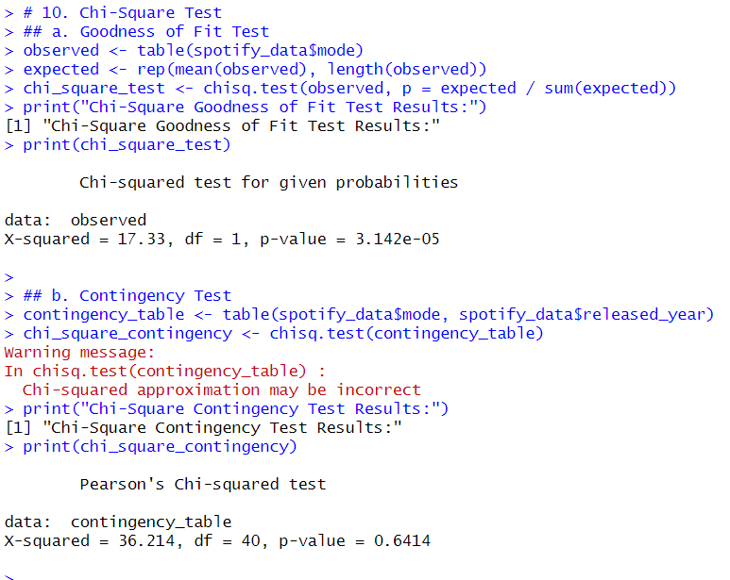
Chi-square test
Goodness of Fit Test: This test checks if the distribution of songs by mode (major vs. minor) aligns with an expected even distribution, helping identify if one mode is more common.
Contingency Test: This test assesses if there’s an association between song mode and release year, revealing any trends in mode preference over time.

Slide 14
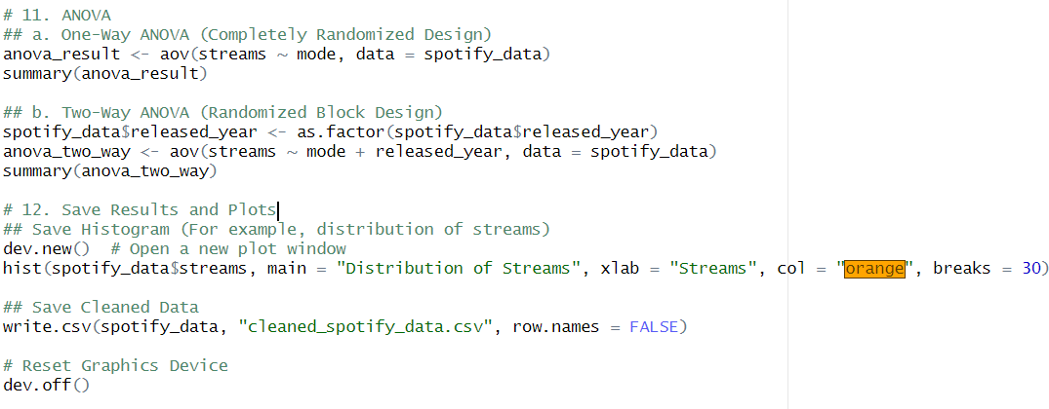
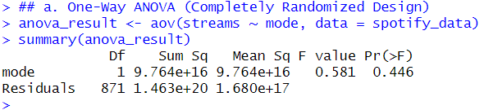
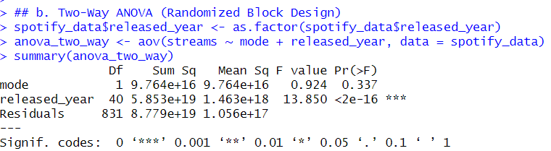
ANOVA
One-Way ANOVA: This test checks if there are significant differences in streams across different song modes (e.g., major vs. minor). It helps determine if mode affects stream counts.
Two-Way ANOVA: This test examines the impact of both mode and release year on streams and identifies any interaction effects. It helps us understand how both factors individually and together influence stream counts.

Slide 15
Conclusion
This analysis provided valuable insights into factors affecting song popularity on Spotify. Key findings include significant relationships between musical attributes (like danceability, energy) and stream counts, as well as trends in song mode preferences over time. Regression models and statistical tests revealed how features impact streaming success, offering a data-driven approach to understanding listener preferences and aiding strategic decisions for artists and marketers in the music industry.
In summary, the analysis underscores the importance of song attributes in determining a song's popularity on Spotify, providing practical insights for artists and producers. Future work could explore more granular musical features and employ machine learning techniques for enhanced prediction accuracy. Additionally, testing with data from multiple streaming platforms would offer a more holistic view of listener preferences across the music industry.

Slide 16
Thankyou
Drive link
https://drive.google.com/drive/folders/15kMLRc9aJO07hTY_RezfCQYLuFD0ORWc?usp=drive_link

