Slide 1
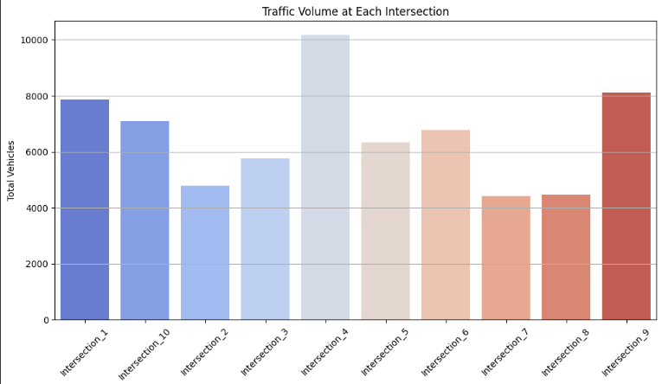
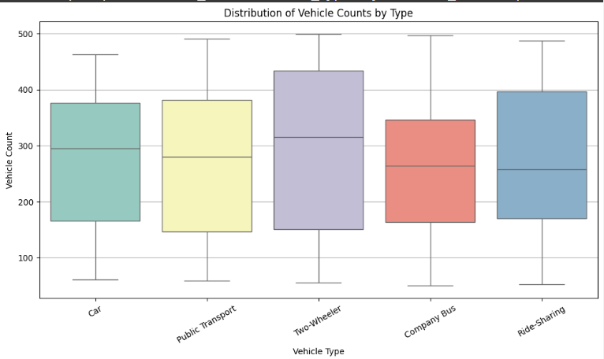
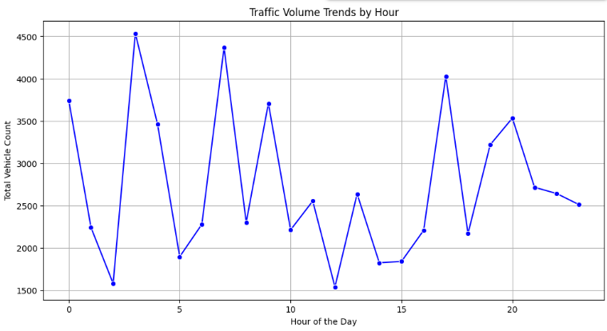
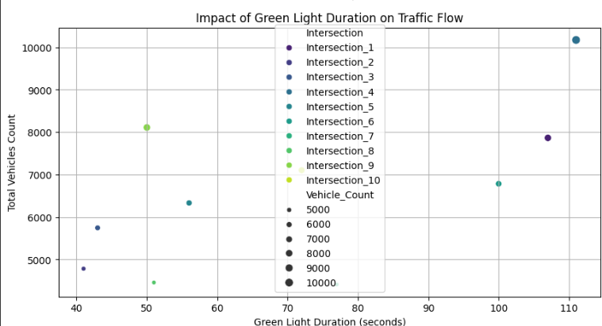
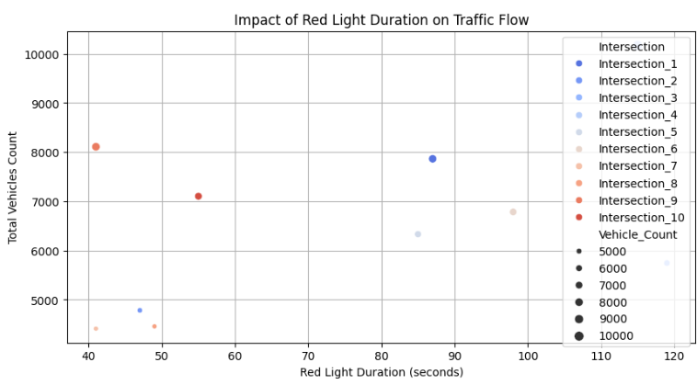
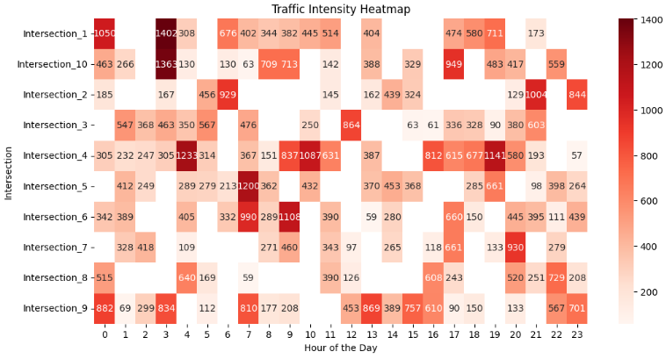
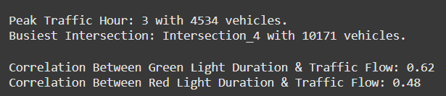
Unlocking Hidden Patterns: A Deep Dive into Data Analysis
Key Data Analysis Insights
Peak Traffic Hours: 7-10 AM and 5-8 PM experience the highest congestion due to IT commuter flow.
Signal Timing Impact: Long red lights cause bottlenecks, while longer green lights improve traffic movement.
Intersection Congestion: Certain intersections handle significantly higher traffic, requiring adaptive signal control.

Slide 2
Recommendations for Traffic Optimization
1. Solar-Powered Smart Roads : Roads embedded with solar panels could generate electricity to power traffic lights, streetlights, and EV charging stations, reducing dependence on traditional power grids while promoting sustainabiliy.
2. AI-Guided Smart Traffic Signals : Traffic lights should adjust dynamically based on real-time congestion, weather, and pedestrian activity. AI-driven signals can sync multiple intersections to create “green corridors” for smoother travel, reducing stop-and-go delays. Example: Singapore’s AI traffic system reduced congestion by 30%.
3. AI-Powered Traffic Waves : Rather than stopping at every red light, AI could coordinate platoons of vehicles that move together at optimal speeds, reducing unnecessary braking and acceleration, leading to better fuel efficiency and traffic flow.
4. Silent Zones with Noise-Absorbing Roads : Traffic congestion often leads to noise pollution. Introducing noise-absorbing road materials and barriers can help reduce urban noise levels while making travel more comfortable in high-traffic zones.
5. Floating Express Lanes : For IT hubs and commercial districts, temporary elevated express lanes can be installed during peak hours and removed during off-peak times. This creates additional road space when needed without permanent infrastructure expansion. Example: Some Asian cities use elevated BRT (Bus Rapid Transit) lanes to ease congestion.
6. Shape-Shifting Roads : Instead of fixed lanes, modular lane dividers can shift throughout the day to accommodate traffic patterns. In the morning, more lanes can be dedicated to inbound traffic, and in the evening, they can switch for outbound commuters. Example: Some highways in Canada use reversible lanes to reduce peak-hour congestion.

Slide 3
Additional Forward Thinking Insights & Strategies
1. AI-Controlled Traffic Swarm Management : Instead of traditional stop-and-go traffic signals, AI can synchronize the movement of multiple vehicles like a coordinated swarm. This system would allow groups of cars to pass through intersections simultaneously without stopping, reducing idle time and congestion.
2. Self-Charging Roads for Electric Vehicles : Roads embedded with wireless charging strips can charge electric vehicles while they are moving, eliminating the need for long stops at charging stations. This would encourage EV adoption and reduce unnecessary congestion caused by parked vehicles.
3. Augmented Reality (AR) Navigation for Traffic Flow : Instead of relying on traditional road signs and navigation apps, AR-enabled windshields and smart glasses could provide real-time traffic updates, rerouting suggestions, and speed limit adjustments directly on the driver’s field of view, reducing distractions and improving response time.
4. Floating Traffic Corridors : Modular elevated roads that can be installed temporarily over congested streets can be deployed when needed and removed once traffic stabilizes. These floating corridors can expand capacity during peak hours without requiring permanent road expansion.
5. Underground Cargo Transport Tunnels : To reduce congestion caused by delivery trucks and cargo vehicles, cities could develop automated underground tunnels for logistics transport. Drones, conveyor belts, or autonomous delivery vehicles could transport goods without impacting main roads.
6. Personalized Traffic Routing Based on Individual Schedules : Navigation apps could integrate personalized traffic data to optimize each driver’s commute based on their daily routines, preferred routes, and past travel patterns. AI would provide customized traffic recommendations to spread out peak congestion naturally.

