Slide 1
More than two groups: ANOVA and Chi-square

Slide 2
ANOVA example
Mean micronutrient intake from the school lunch by school
S1ª, n=28
S2^{b}, n=25
S3^{c}, n=21
P-value^{d}
Calcium (mg)
Mean
117.8
158.7
206.5
0.000
SDe
62.4
70.5
86.2
Iron (mg)
Mean
2.0
2.0
2.0
0.854
SD
0.6
0.6
0.6
Folate (μg)
Mean
26.6
38.7
42.6
0.000
SD
13.1
14.5
15.1
Zinc (mg)
Mean
1.9
1.5
1.3
0.055
SD
1.0
1.2
0.4
ª School 1 (most deprived; 40% subsidized lunches).
^{b} School 2 (medium deprived; <10% subsidized).
^{c} School 3 (least deprived; no subsidization, private school).
^{d} ANOVA; significant differences are highlighted in bold (P<0.05).
FROM: Gould R, Russell J, Barker ME. School lunch menus and 11 to 12 year old children's food choice in three secondary schools in England-are the nutritional standards being met? Appetite. 2006 Jan;46(1):86-92.

Slide 3
ANOVA
(ANalysis Of VAriance)
Idea: For two or more groups, test difference between means, for quantitative normally distributed variables.
Just an extension of the t-test (an ANOVA with only two groups is mathematically equivalent to a t-test).

Slide 4
One-Way Analysis of Variance
Assumptions, same as ttest
  Normally distributed outcome
  Equal variances between the groups
  Groups are independent

Slide 5
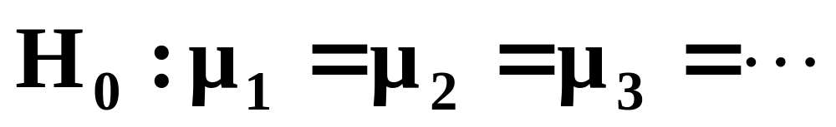
Hypotheses of One-Way ANOVA

Slide 6
ANOVA
It’s like this: If I have three groups to compare:
  I could do three pair-wise ttests, but this would increase my type I error
  So, instead I want to look at the pairwise differences “all at once.”
  To do this, I can recognize that variance is a statistic that let’s me look at more than one difference at a time…

Slide 7
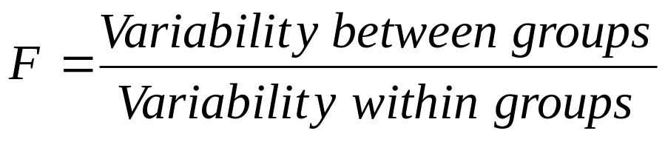
The “F-test”
Is the difference in the means of the groups more
than background noise (=variability within groups)?
Summarizes the mean differences between all groups at once.
Analogous to pooled variance from a ttest.
Recall, we have already used an “F-test” to check for equality of variances→ If F>>1 (indicating unequal variances), use unpooled variance in a t-test.

Slide 8
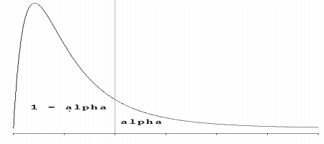
The F-distribution
The F-distribution is a continuous probability distribution that depends on two parameters n and m (numerator and denominator degrees of freedom, respectively):
http://www.econtools.com/jevons/java/Graphics2D/FDist.html

Slide 9
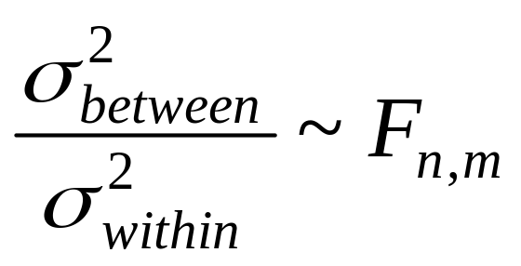
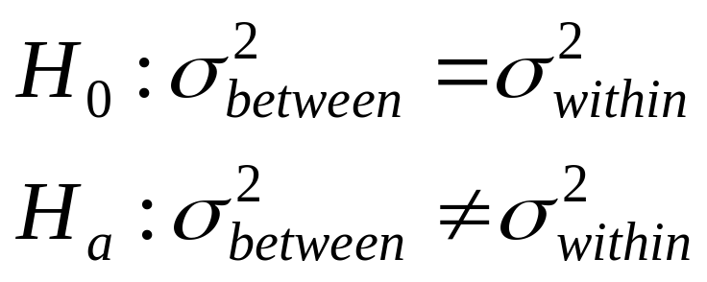
The F-distribution
A ratio of variances follows an F-distribution:
The F-test tests the hypothesis that two variances are equal.
F will be close to 1 if sample variances are equal.

Slide 10
Answer
Step 1) calculate the sum of squares between groups:
Mean for School 1 = 117.8
Mean for School 2 = 158.7
Mean for School 3 = 206.5
Grand mean: 161
SSB = [(117.8-161)² + (158.7-161)² + (206.5-161)²] x25 per group= 98,113

Slide 11
Answer
Step 2) calculate the sum of squares within groups:
S.D. for S1 = 62.4
S.D. for S2 = 70.5
S.D. for S3 = 86.2
Therefore, sum of squares within is:
(24)[ 62.4² + 70.5 ²+ 86.2²]=391,066

Slide 12
Answer
Step 3) Fill in your ANOVA table
Source of variation
d.f.
Sum of squares
Mean Sum of Squares
F-statistic
p-value
Between
2
98,113
49056
9
<.05
Within
72
391,066
5431
Total
74
489,179
**R²=98113/489179=20%
School explains 20% of the variance in lunchtime calcium intake in these kids.

Slide 13
ANOVA summary
A statistically significant ANOVA (F-test) only tells you that at least two of the groups differ, but not which ones differ.
Determining which groups differ (when it’s unclear) requires more sophisticated analyses to correct for the problem of multiple comparisons…

Slide 14
Chi-square test for comparing proportions
(of a categorical variable) between >2 groups
I. Chi-Square Test of Independence
When both your predictor and outcome variables are categorical, they may be cross-classified in a contingency table and compared using a chi-square test of independence.
A contingency table with R rows and C columns is an R x C contingency table.

Slide 15
Calculating the expected, in general
Null hypothesis: variables are independent
Recall that under independence:
P(A)*P(B)=P(A&B)
Therefore, calculate the marginal probability of B and the marginal probability of A. Multiply P(A)*P(B)*N to get the expected cell count.

Slide 16
Expected frequencies if no association between group size and conformity…
Conformed?
Number of group members?
2
4
6
8
10
Yes
47
47
47
47
47
No
53
53
53
53
53

Slide 17
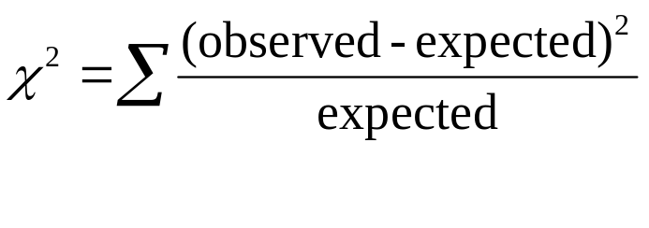
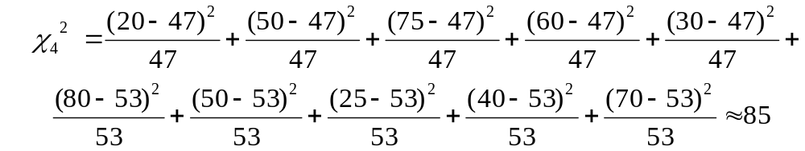
Chi-Square test
Degrees of freedom = (rows-1)*(columns-1)=(2-1)*(5-1)=4

Slide 18
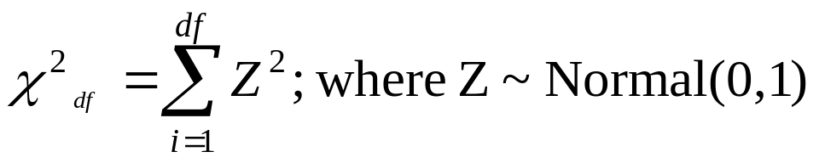
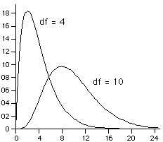
The Chi-Square distribution: is sum of squared normal deviates
The expected value and variance of a chi-square:
E(x)=df
Var(x)=2(df)

Slide 19
Chi-Square test
Degrees of freedom = (rows-1)*(columns-1)=(2-1)*(5-1)=4
Rule of thumb: if the chi-square statistic is much greater than it’s degrees of freedom, indicates statistical significance. Here 85>>4.

