Slide 1
PUZZLES

Slide 2
Rama and Mohan are a married couple having two daughters named Smita and Devika. Devika is married to Aman who is the son of Madhu and Jeewan. Romila is the daughter of Aman. Krishna who is Aman’s sister is married to Sunil and has two sons Anuj and Ankur. Ankur is the grandson of Madhu and Jeewan.
31. How is Krishna related to Devika ?
(a) Sister-in-law (b) Sister (c) Aunt (d) None of these
32. What is the relationship between Anuj and Romila?
(a) Uncle – Niece (b) Father – Daughter
(c) Husband – Wife (d) Cousins
33. Which of the following is true ?
Anuj is the son of Smita.
(b) Romila is the cousin of Krishna.
(c) Madhu is Sunil’s mother-in-law.
(d) Jeewan is Devika’s maternal uncle.

Slide 3
A, B, C, D and E are members of the same family. There are two fathers, two sons, two wives, three males and two females. The teacher was the wife of a lawyer who was the son of a doctor. E is not a male, neither also a wife of a professional. C is the youngest person in the family and D is the eldest. B is a male.
41. How is D related to E ?
(a) Husband (b) Son (c) Father (d) Wife
42. Who are the females in the group ?
(a) C and E (b) C and D (c) E and A (d) D and E
43. Whose wife is the teacher ?
(a) C (b) D (c) A (d) B

Slide 4
5 students Anubhav, Bipin, Charu, Dheeraj and Eklavya were seated in a row to take a Mock Test. Each person belonged to a different branch of Engineering from CS, ME, EC, EE and CE. Further conditions are as follows :
1. Charu’s branch is EC and she is not seated at either ends.
2. The person with CE specialization is 2nd to the right of Dheeraj.
3. Bipin’s branch is neither ME nor CS.
4. Ekalvya is at the extreme left of the arrangement.
5. The person with ME specialization is at the middle position.
6. The Electrical Engineer is to the immediate left of Bipin.

Slide 5
Q17 : Who is the person with EE specialization?
a. Bipin b. Eklavya c. Anubhav d. CBD
Q18 : What is the specialization of the person sitting 4th from the left of the arrangement?
a. EE b. EC c. CS d. CBD
Q19 : Which of the following is true about the position of Ekalvya?
a. To the immediate right of Dheeraj.
b. 2nd to the left of Anubhav.
c. To the immediate left of Charu.
d. 2nd to the left of Bipin.
Q20 : Who is the person specializing in ME?
Dheeraj b. Bipin c. Ekalvya d. Anubhav

Slide 6
A, B, C, D, E, F, G and H are sitting around a circle facing the centre but not necessarily in the same order. Each of them has a relationship with A.
G is sitting second to the left of father of A.
F is immediate neighbor of A.
D, mother of A is sitting opposite to the sister of A.
B who is the son of A is sitting to the immediate right of wife of A.
E who is a male is sitting second to the right of mother of C.
Brother of A is sitting third to right of B.
Daughter of A is sitting to third to right of sister of A.
A is sitting second to the right of daughter of E.
E is sitting to the immediate left of sister of A.

Slide 7
1. Who is the mother of H?
A) F B) G C) C D) D E) None of these
2. Who is the grand-daughter of E?
A) B B) C C) D D) G E) None of these
3. Who is sitting second to the right of F’ sister?
A) wife of A B) brother of C C) daughter of A D) father of B
4. How many persons are sitting between A’s wife and D’s husband when counted from right of A’s wife?
A) None B) One C) Two D) Three E) More than three
5. What is the position of G’s daughter with respect to D’s daughter?
A) third to left B) second to left C) third to right
D) second to right E) fourth to right

Slide 8
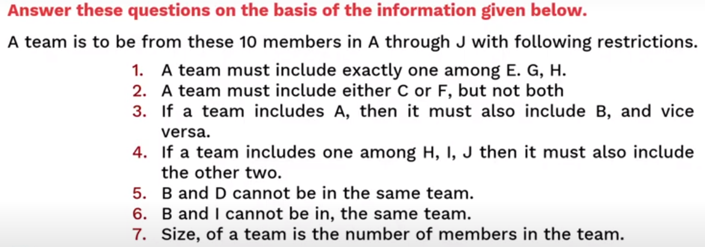

Slide 9
Question 1: What would be the size of the largest possible team? (a) 8 (b) 7 (c) 6 (d) 5 (e) Cannot be determined

Slide 10
Question 2: What could be the size of a team that includes A? (a) 2 or 3 (b) 2 or 4 (c) 3 or 4 (d) Only 2 (e) Only 4

Slide 11
Question 3: In how many ways a team can be constituted so that the team includes D? (a) 2 (b) 3 (c) 4 (d) 5 (e) 6

Slide 12
Question 4: Who cannot be a member of a team of size 3? (a) B (b) C (c) D (d) E (e) F

Slide 13
Question 5: Who can be a member of a team of size 5? (a) A (b) B (c) C (d) E (e) G

