Slide 1

Department of Electronics and Communication Engineering
MINOR PROJECT
Global IoT Smart Home Controller with ESP32 and Cloud API
SL.NO. | NAME | USN | ROLL NO.
01 | Sachin Sidnal | 02FE22BEC073 | 06
02 | Sakshi Dodawad | 02FE22BEC074 | 07
03 | Shreya Kadkol | 02FE22BEC098 | 29
04 | Vinod Yallur | 02FE22BEC117 | 48
Under the Guidance of
Prof. Shivanand Upari

Slide 2
Content
i. Problem Statement
ii.Gantt Chart
iii.Work Breakdown Structure
iv.Input Specifications
v.Output Specifications
vi.Functional Block Diagram
vii.Circuit daigram

Slide 3
Problem Statement
A person away from home wants to control appliances like lights, fans, and door locks remotely. Existing systems are costly or limited. This project uses ESP32 and a cloud API to enable global, affordable smart home control.

Slide 4
Gantt Chart
Phases | Week1 | Week2 | Week3 | Week4 | Week5 | Week6 | Week7 | Week8 | Week9 | Week10
Project Design
Component Selection
Complete Software Implementation
Simulation Design
Complete Hardware Model
Test and debug

Slide 5
WBS(Work Breakdown Structure)
Global IoT Smart Home Controller with ESP32 and Cloud API
Fan,LEDbulb, waterpump, washing machine
Servomotor for doorlock, IRmodule for TV control
ESP32,powersupply
Arduino IDE for coding,Cloud API (Firebase),Web or mobile app for control
Software simulation of the Total design using wowki
Project Design
Component Selection
Software Implementation
Simulation Design
Complete Hardware model
User sends command from phone or computer.
Command goes to a cloud API.
ESP32 reads the command from the cloud.
ESP32 controls the home device (like light or fan).
ESP32 can send back status or sensor data.
Write ESP32 code to connect Wi-Fi and read commands
Create cloud API to send and receive device commands
Host the API online (Firebase, Vercel, etc.)
Build a simple app to control devices via the API
ESP32 connects to Wi-Fi and controls devices like fan, LED bulb, water pump, motor (for washing), and door lock using a mobile app. An IR module can control the TV. All components are wired on a breadboard using jumper wires and powered by a 5V or 12V adapter
Notes:
v

Slide 6
Input Specification
Power Supply: 5V (for ESP32), 12V (for some devices)
Wi-Fi Network: 2.4 GHz Wi-Fi required for ESP32 internet connection
User Input: Web or mobile app sending ON/OFF commands
API Input Format: HTTP requests (usually JSON format)

Slide 7
Output specification
Devices like fan, bulb, pump, motor, TV, and door lock turn ON/OFF
ESP32 sends control signals to the relay module (3.3V logic)
Relays switch connected appliances (AC or DC)
Device status (ON/OFF) can be sent to the cloud API
App or web interface shows current device status

Slide 8
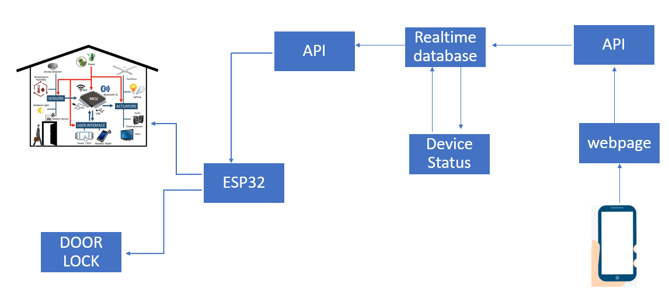
Functional Block Diagram

Slide 9
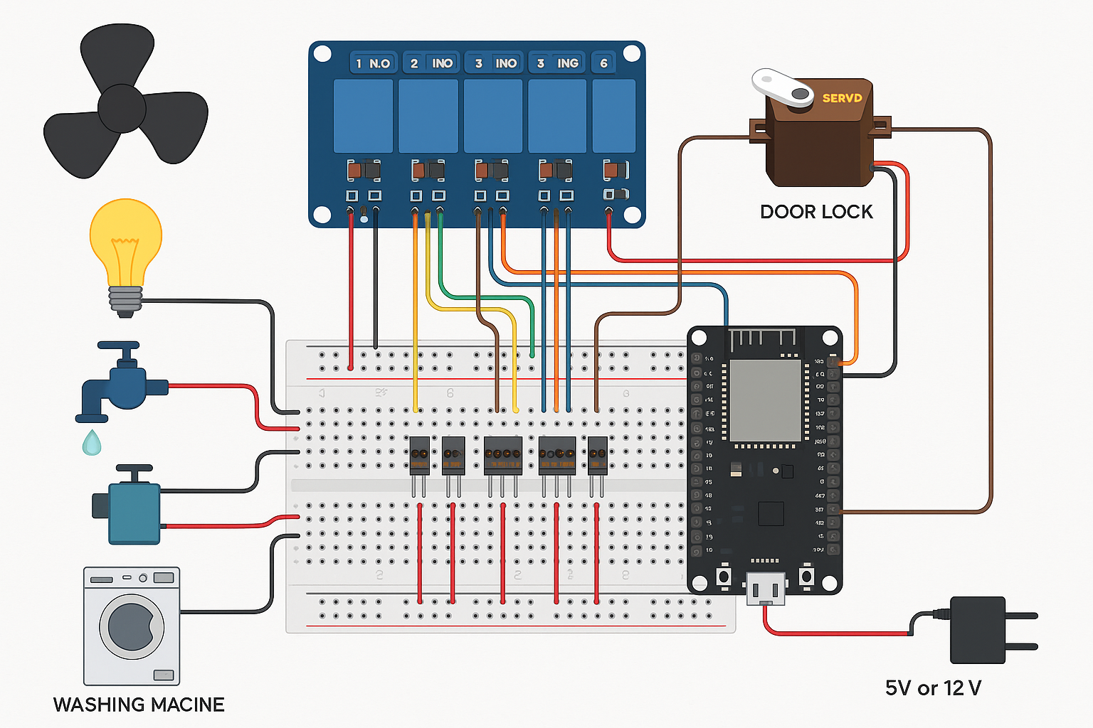
Circuit Diagram

Slide 10
Debugging Details
Wi-Fi Connectivity: Ensure the ESP32 is connecting to the correct Wi-Fi network using the right credentials. A failed connection stops all functions.
API and Database Configuration: Make sure the cloud API or Firebase URL and credentials are correctly set up in your code so that commands can be sent and received reliably.
GPIO Pin Mapping: Double-check that the ESP32 pins used in your code match the actual hardware connections for the motor driver and servo.
Motor Driver Testing: If appliances don't respond, manually trigger outputs from the ESP32 to test the motor driver and ensure it's switching properly.
Servo Motor Signals: Ensure the servo receives clean, accurate PWM signals from the ESP32. Use a proper power source if it jitters or doesn’t move correctly.
Realtime Database Sync: Ensure data from the cloud is updating in real time. Lag or sync issues can cause control delays or missed commands.
Serial Monitor Debugging: Use the serial monitor to log the ESP32’s behavior. It helps identify where the process is failing (e.g., connection, API call, or pin control).
App/Webpage Control: Make sure the interface (web/app) is correctly writing commands to the database and reflecting device status properly.

Slide 11
Plan For Optimization
Connect ESP32 to Wi-Fi and cloud API (e.g., Firebase).
Use motor driver to control appliances like fan, bulb, and pump.
Interface servo motor for door lock automation.
Build a webpage/app to send commands to the cloud.
Sync device status via real time database.
Test system for remote control and reliability

Slide 12
Need For Optimization
Power Efficiency: Reduce energy use by sleeping ESP32 when idle.
Faster Response Time: Optimize cloud communication to minimize delay.
Security: Add authentication to Firebase or use encrypted APIs.
Scalability: Design system to add more devices easily.
NetworkCode Optimization: Use efficient libraries and avoid blocking functions.
Reliability: Handle Wi-Fi disconnections with auto-reconnect

Slide 13
Thank you

