Slide 1

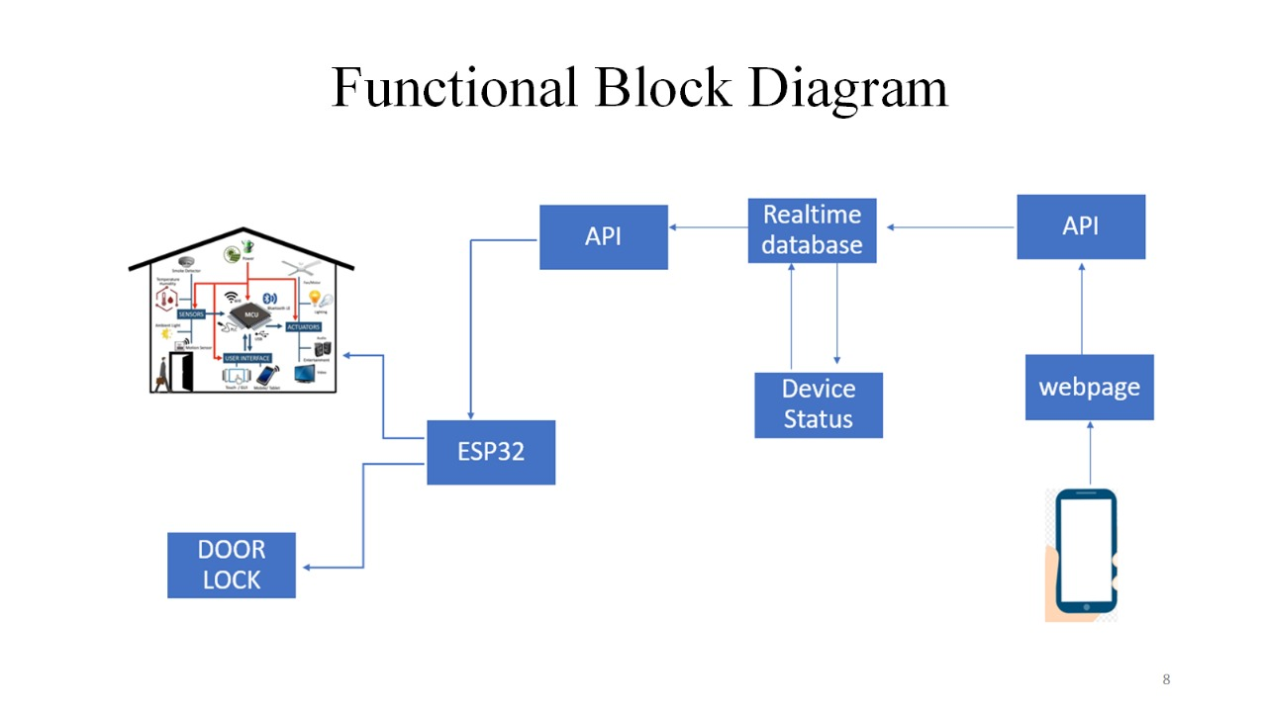
Title
Names of students:
Under guidance of :
Department of Electronics and Communication Engineering
Sleep ESP32 to save power
Optimize cloud for speed
Add secure authentication
Make system scalable
Use efficient, non-blocking code
Auto-reconnect Wi-Fi
Problem statement
METHODOLOGY
Results
Global IoT Smart Home Controller with ESP32 and Cloud API
The project was developed using the ESP32 microcontroller for its Wi-Fi capabilities and GPIO support to control home appliances via relays and sensors like DHT11. Code was written in the Arduino IDE to handle device control and real-time data transmission. Cloud communication was established using Firebase or MQTT protocols, enabling remote monitoring and control through a custom mobile app or web dashboard. Security was ensured with HTTPS and API authentication. The system was tested for stability, responsiveness, and global access, with provisions made for future scalability and integration with other smart systems.
Global IoT Smart Home Controller uses ESP32 and Cloud APIs to let users remotely control and monitor home appliances via the internet. It offers real-time updates, smartphone access, and energy-efficient automation, making it a scalable and modern smart home solution.
Objectives
Build a smart home system using ESP32 and cloud API.
Enable remote control of appliances via app/web.
Use Firebase for real-time monitoring and commands.
Optimize power with ESP32 sleep mode.
Optimization details
.
Sleep ESP32 to save power
Optimize cloud for speed
Add secure authentication
Make system scalable
Use efficient, non-blocking code
Auto-reconnect Wi-Fi
Contributions
Affordable smart home tech
Remote appliance control
Enhances safety & convenience
Saves energy
Helps elderly, travelers, rural users
Conclusions
Literature survey
This project successfully demonstrates a low-cost, scalable, and globally accessible smart home automation system using the ESP32 microcontroller and a cloud-based API like Firebase. By integrating hardware components such as a motor driver and servo motor, the system enables remote control of household appliances like fans, bulbs, pumps, and door locks. The use of cloud communication allows users to monitor and manage their devices from anywhere with an internet connection, enhancing both convenience and energy efficiency. The system proves that with simple IoT hardware and real-time cloud connectivity, smart living can be made affordable and practical for everyday use.se in modern day technologies in the whole domain of signal processing.
NoIoT enables remote, manual control of home appliances using ESP8266.
deMCU and cloud platforms manage smart home devices with sensors and actuators.
Industrial motors monitored wirelessly via Arduino, sensors, and ESP8266, sending data to cloud.
Home comfort (temperature, light, air) monitored and controlled remotely using NodeMCU and cloud services.
Minor Project-2024-25

