Slide 1

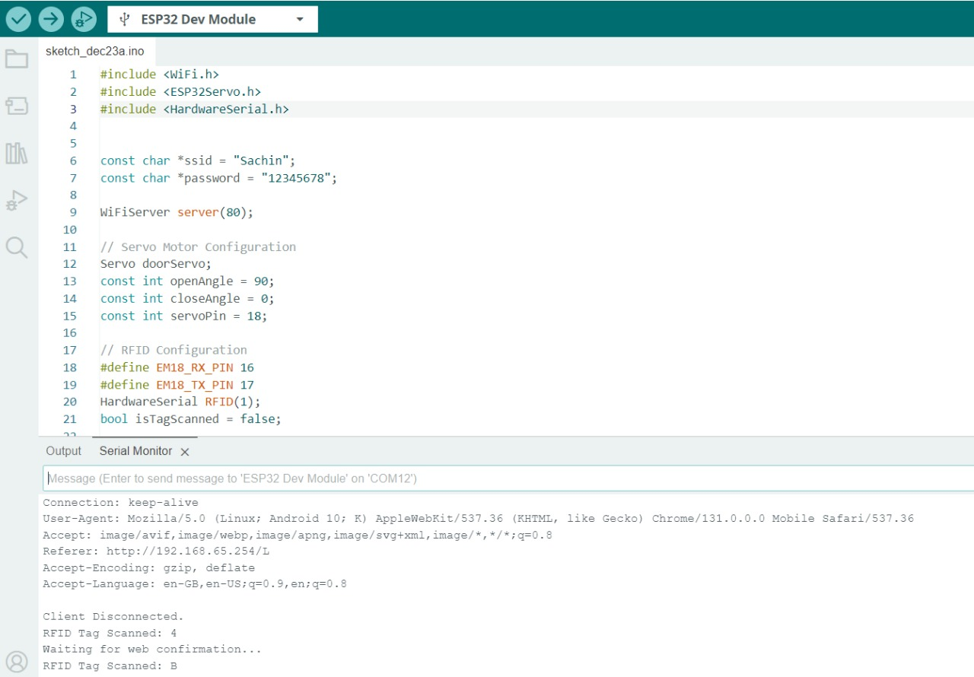
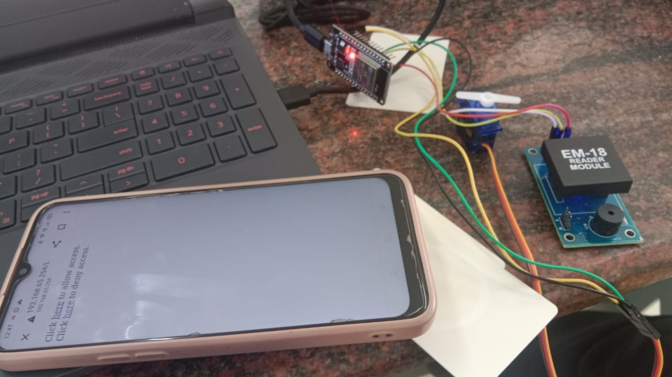
RFID Multifactor Authentication in IOT
Names of students: Sakshi.D, Sachin.S, Shreya.K, Vinod.Y
Under guidance of :Prof.Shivanand Upari
Department of Electronics and Communication Engineering
Problem statement
The campus security system integrates RFID and IoT technologies for real-time access control. Each student and faculty member uses an RFID tag to request access at entry points. Scans trigger IoT-based notifications to an administrator’s mobile app for instant approval or denial, ensuring multifactor authentication. A backend server manages credentials, logs access, and provides an audit trail. The system undergoes rigorous testing before deployment, ensuring reliability and security, with scheduled maintenance to sustain functionality and protect against threats, offering a robust security solution.
Results
Enable secure campus access using RFID tags and IoT-based administrator approvals for multifactor authentication.
Methodology
Objectives
Strengthen campus security with RFID and IoT.
Enable real-time, controlled access.
Use multifactor authentication for entry.
Centralize credential management.
Keep detailed access logs.
Provide reliable, responsive security.
.
Optimization details
Optimize Wi-Fi management with retries, timeouts, and backoff to prevent delays. Enhance RFID scanning using interrupt-driven processing for faster response. Streamline web-based access control with lightweight protocols like MQTT or REST, and implement caching to reduce latency, ensuring efficient, responsive, and reliable system performance for secure access control.
Contributions
Literature survey
Conclusions
The literature highlights RFID's effectiveness in access control, IoT's role in remote monitoring, and multi-factor authentication's security benefits. Integrating RFID with web-based approval and servo motor control enhances security, while optimizing Wi-Fi and response time improves system efficiency and scalability.
The RFID-based IoT system combines RFID scans with web approval via a Wi-Fi-enabled ESP32 for secure access. It enables remote monitoring, uses a servo motor for door control, and supports biometrics for enhanced, scalable, and multifactor authentication.
Mini Project-2024-25

