Slide 1


Department of Electronics and Communication Engineering
Mini Project
RFID Multifactor Authentication using IOT
SL.NO. | NAME | USN | ROLL NO.
01 | Sachin Somappa Sidnal | 02FE21BEC073 | 06
02 | Sakshi Dodawad | 02FE21BEC074 | 07
03 | Shreya Kadakol | 02FE21BEC098 | 29
04 | Vinod Yallur | 02FE21BEC117 | 47
Under the Guidance of
Prof. Shivanand

Slide 2
CONTENTS
PROBLEM STATEMENT
ABSTRACT
INTRODUCTION
LITERATURE SURVEY.
METHODOLOGY
REFERENCE
RESULTS
CONCLUSION

Slide 3
Problem Statement
"Implement a campus security solution where students and faculty use RFID tags to request access to various facilities, and IoT-enabled notifications allow administrators to approve or deny access through a mobile app, ensuring only authorized individuals can enter . Enabling secure multifactor authentication.

Slide 4
Abstract
This project proposes a campus security solution that leverages Radio Frequency Identification (RFID) technology and Internet of Things (IoT) protocols to control and monitor access to campus facilities. Each authorized student and faculty member is provided with an RFID tag, which is used to request entry at various access points. Upon an access request, the system sends an IoT-enabled notification to a mobile application, allowing campus administrators to remotely approve or deny the request in real time. This method introduces multifactor authentication, combining RFID and administrator approval to ensure that only authorized individuals gain entry. The solution enhances campus security through robust access control, real-time monitoring, and a centralized log of access events for auditing purposes. This approach demonstrates an innovative integration of RFID and IoT for improved safety and security management in educational institutions.

Slide 5
Introduction
Campus security is crucial for ensuring the safety of students, faculty, and staff. Traditional access control methods, like key cards or basic RFID systems, provide limited security, as they typically lack real-time monitoring and are vulnerable to unauthorized use if a tag or card is lost or stolen. As campuses become larger and more complex, there is a growing need for smarter, more flexible security solutions that can adapt to evolving security requirements.
This project aims to enhance campus security by implementing a system that combines RFID technology with Internet of Things (IoT) protocols. Each authorized individual is given an RFID tag to request access at designated entry points. When an access request is made, the system sends a notification to a mobile app used by campus administrators, allowing them to approve or deny access in real time. This approach provides a multifactor authentication layer, increasing security and enabling administrators to monitor and control access remotely. By integrating RFID and IoT, this solution provides a more secure, efficient, and responsive campus security system.
.

Slide 6
Literature Review
Sl No. | Paper Title | Methods/Techniques/Algorithm used | Limitations /Disadvantages/Remarks
1 | RFID Authentication And Monitoring Using IOT | The methodology involves integrating an MFRC522 RFID reader module, a Node MCU board for IoT connectivity, and dynamic RFID sensor tags for real-time asset tracking. The RFID tags send data to the cloud, enabling continuous location tracking. A Python-based Tkinter GUI is used for visualizing asset status and managing system functionalities. This framework supports practical, secure asset monitoring and enhances security management in dynamic nature. | Battery Dependency Wi-Fi Dependency Limited Range | Extended Range High Battery Life Introduce network redundancy with Ethernet or cellular backup for consistent connectivity.
2 | A light weight mutual authentication and key generation scheme for RFID systems used in Medical IoT | The methodology involves using passive RFID tags for secure communication with readers in a medical environment. The tags store a unique ID and a secret password, which are manually enrolled in the cloud server. Upon authentication, the RFID reader initiates a secure session, generating a session key and updating the tag's password after each successful session. | Limited Tag Memory Insecure Wireless Communication | Secure Communication Each time a session concludes, the password (P) in both the RFID tag and cloud server should be updated.

Slide 7
Literature Review
Sl No. | Paper Title | Methods/Techniques/Algorithm used | Limitations /Disadvantages/Remarks
3 | Enhancing Bank Locker Security through Multi-Layered Authentication and IoT Integration | The methodology combines multi-layered authentication for bank locker security, incorporating fingerprint recognition, keypad password entry, OTP verification, and real-time image capture. The Adafruit Fingerprint Sensor interfaces with an Arduino Uno, which processes and compares fingerprint data against stored templates, ensuring secure access. OTPs and real-time images further enhance verification and security. | Cost and Maintenance Fingerprint Sensor Reliability | Keypad Password Entry Using less cost materials

Slide 8
METHODOLOGY
The methodology for this campus security system integrates RFID and IoT technologies to create a secure, real-time access control solution. Authorized students and faculty members are each assigned an RFID tag, which they use to request access at designated entry points. When an RFID tag is scanned, the system sends a real-time notification to an administrator's mobile app via an IoT protocol, allowing the administrator to approve or deny access instantly. This adds an extra layer of security through multifactor authentication, as entry requires both the RFID tag and the administrator’s approval. A backend server manages the database of user credentials, stores access logs, and records each request, providing a comprehensive audit trail for security monitoring. Following development, the system undergoes rigorous testing to ensure reliability and security, after which it is deployed across campus with scheduled maintenance for continued functionality and protection against threats. This methodology offers a streamlined, responsive, and robust approach to campus security management.

Slide 9
Gantt Chart
Planning and requirement analysis
System Design
Hardware Setup
Software Development
Integration and Testing
Development and Documentation
September
October
November
December
Dept. of ECE
9

Slide 10
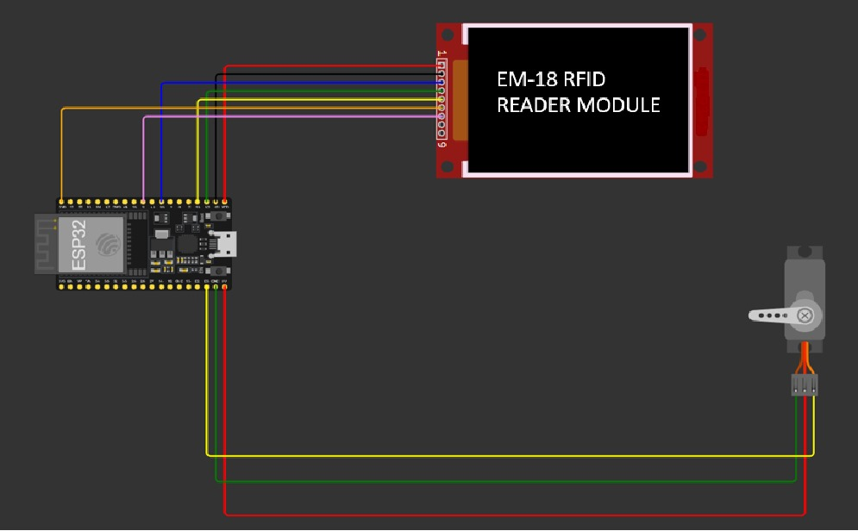
Circuit Simulation

Slide 11
Work Breakdown Structure
Planning and Requirement Analysis
Integration and Testing
Model Development
System Design
Development and Documentation
Data Presentation
Model Design and Development
Hardware Setup
Data Analytics and security
Model Training and Testing
Software Development
Optimization

Slide 12
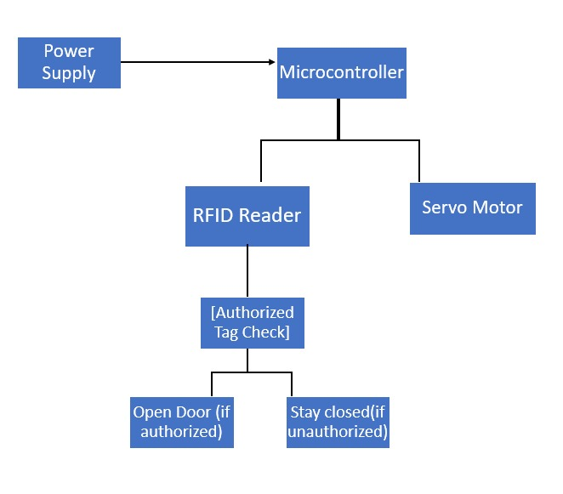
Block Diagram

Slide 13
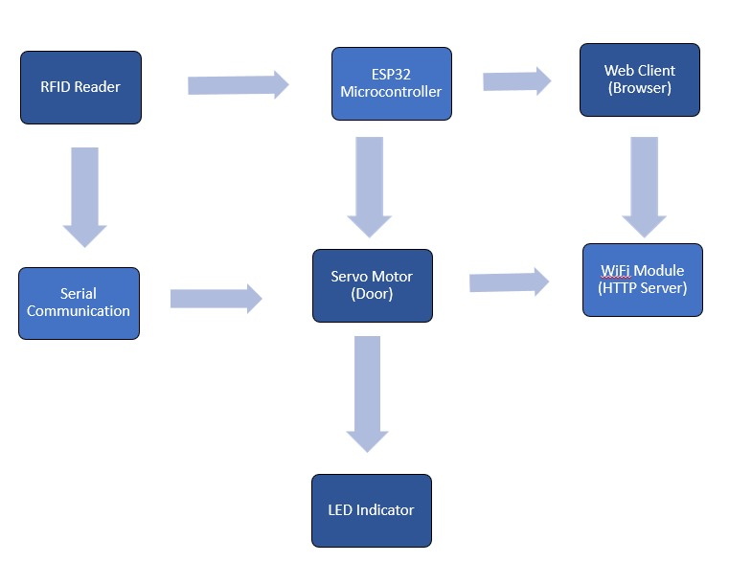
Functional Block Diagram:

Slide 14
Block diagram Explanation:
This block diagram represents an automated access control system using RFID technology. The power supply provides electricity to the system components. The RFID reader scans the RFID tag, and the microcontroller processes the tag's data to check its authorization status. If the tag is authorized, the microcontroller sends a signal to the servo motor to open the door. If the tag is unauthorized, the door remains closed. This system ensures secure and automated access control.

Slide 15
Specification and identification of input and output
Component | Input | Output
Power Supply | 220V AC | 5V DC (Power for components)
Microcontroller | Data from RFID Reader, IoT Server, Sensors | Control signals to Motor, IoT Server updates
Authorized RFID Tag | RFID Tag Presence (Authorization) | UID of tag detected (send to Microcontroller)
IoT Server | Access request data from Reader | Real-time alerts/door control update
Servo Motor | Motor control signal (from Microcontroller) | Door unlocked or locked based on authorization
Unauthorized Detection | Unauthorized RFID Tag detected | Alert to IoT Server, door stays closed
System Communication | Data from Microcontroller | Secure access control, logging updates

Slide 16
PROCEDURE:
WIFI-Based Web Server for Access Control- This algorithm establishes a WIFI connection and runs a web server that serves an interface to allow or deny access remotely. After successfully connecting to a specified WIFI network using the provided credentials, the system acquires an IP address, making it accessible to users via a browser. The server listens for incoming client requests on port 80. Upon receiving a request, it serves a basic HTML page with two options: one to allow access and open the door and the other to deny access and keep the door closed. This interaction ensures that users can control access from any device with a browser, and once the web request is handled, the client connection is closed.
2. RFID Tag Detection and Data Processing- This algorithm handles the detection and processing of RFID tag data. It continuously monitors the RFID reader (EM-18) for any scanned tags. When a tag is detected, the system reads the tag's data byte-by-byte and stores it in a string variable. The data is then cleaned by trimming any unwanted spaces or newlines to ensure the integrity of the tag information. The tag data is printed to the serial monitor for debugging and validation purposes. A flag (isTagScanned) is set to true once a tag is successfully read, signaling that the system is awaiting confirmation via the web interface before granting access.
3. Door Control Mechanism with Servo and LED Feedback- This algorithm controls the operation of the physical door by using a servo motor and provides feedback through an LED indicator. Initially, the servo is set to a closed position (0°), keeping the door shut. When access is granted through the web interface (after RFID tag validation), the LED is turned on to indicate that access has been allowed, and the servo rotates to 90° to open the door. The door stays open for a brief period (2 seconds), after which the servo resets to the closed position. In case of access denial, the LED is turned off, and the door remains closed. This mechanism ensures secure, automated door control with visual feedback for users.

Slide 17
Optimization of Code:
WIFI Connection Management : Manages the connection to the WIFI network, with a timeout to prevent indefinite hanging if the connection fails.
2. RFID Tag Scanning and Authentication :Handles the scanning of RFID tags and authenticates the tag by setting a flag to indicate a valid tag has been read.
3. Web-Based Access Control :Processes the web requests to allow or deny access based on the scanned RFID tag, controlling the servo motor to open or close the door accordingly.

Slide 18
Design specification
Component | Specification
Power Supply | 5V DC regulated PSU, capable of supplying 2A or more for system components.
Microcontroller | Arduino/ESP32/Raspberry Pi for processing RFID data and IoT communication.
RFID Reader | 13.56 MHz RFID Reader (e.g., RC522) to read authorized tags.
Authorized RFID Tag | Passive RFID tags (e.g., ISO 14443A) with unique UIDs for authorized personnel.
IoT Server | Cloud-based platform (AWS/Firebase) for real-time monitoring and access control.
Servo Motor | SG90/MG996R Servo motor to control door lock mechanism (180° rotation).
Unauthorized Access Detection | Log unauthorized access attempts, send IoT alerts, and keep door locked.
System Communication & Security | SSL/TLS encryption for secure IoT communication (e.g., ESP8266/ESP32 Wi-Fi).

Slide 19
Bill Of Materials
Component | Quantity | Amount
ESP-32 | 1 | 500
SERVO MOTOR | 1 | 250
EM 18 MODEL | 1 | 500
RFID CARDS | 1 | 100
CARDBOARD AND OTHER MATERIALS | 1 | 200
- | - | -
- | - | -
- | - | -

Slide 20
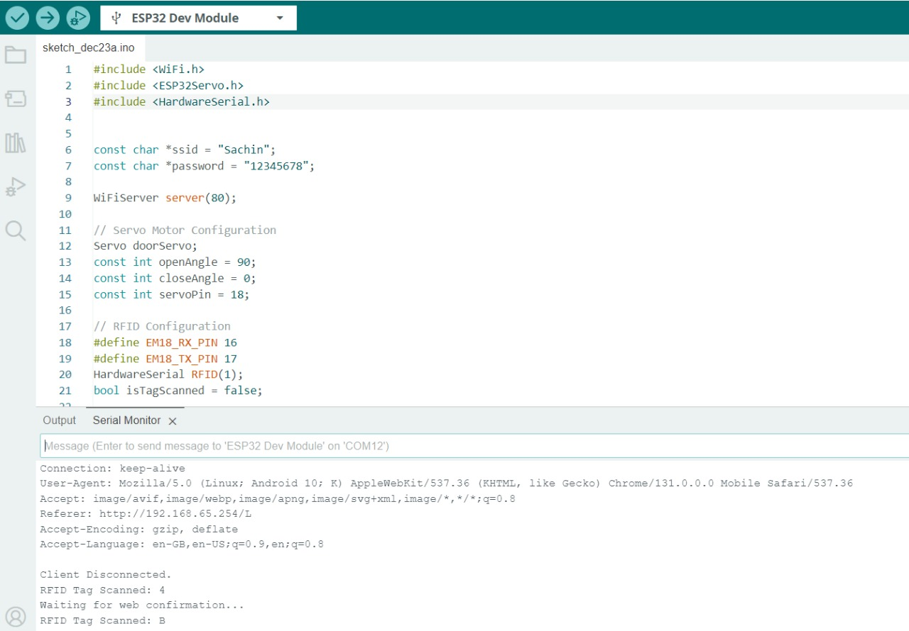
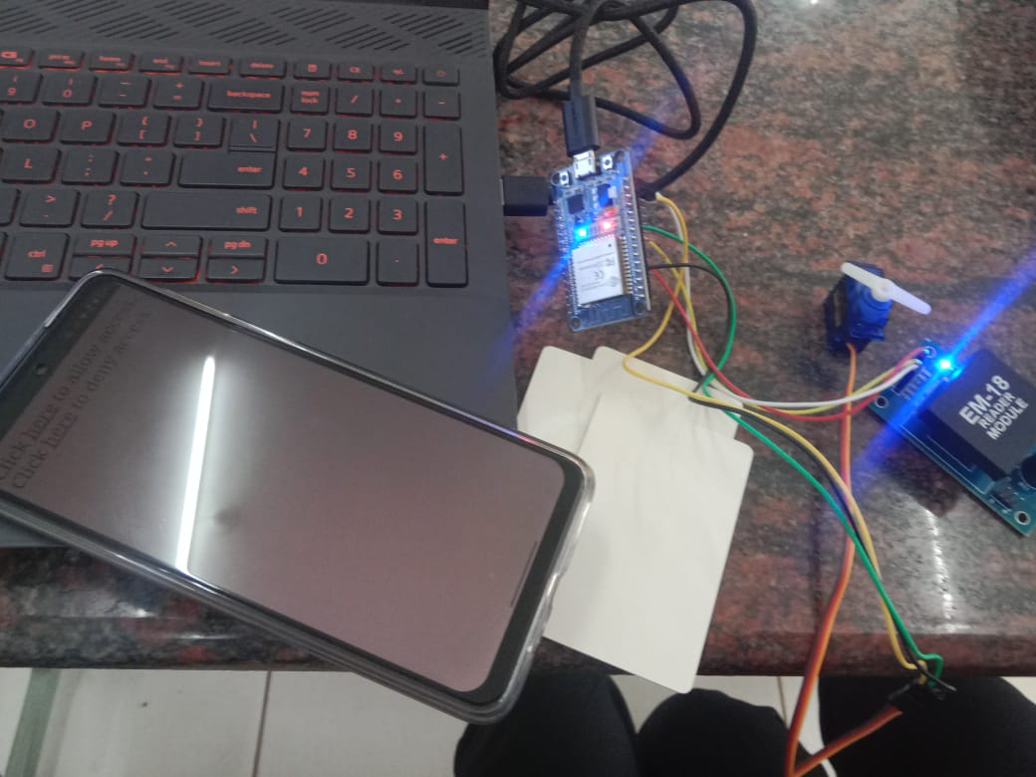
Results

Slide 21
Conclusion
The RFID-based Multi-Factor Authentication Using IoT system combines RFID technology with web-based approval for enhanced security. It requires both an RFID scan and remote web confirmation through a Wi-Fi-enabled ESP32 microcontroller to grant access, reducing unauthorized entry risks. IoT connectivity allows remote monitoring, while a servo motor controls door access. The system can be further strengthened with additional factors like biometrics, offering a secure and scalable solution for access control.

Slide 22
References
Wang, H., & Zhang, X. (2018). RFID-based access control system with multiple authentication factors. IEEE Access, 6, 65847-65855.
Chatterjee, S., & Saha, S. (2020). Secure IoT-based RFID and biometric authentication system. Journal of Computer Security, 28(4), 381-398.
Shaikh, F. K., & Zeadally, S.(2017). IoT-based access control systems and their security mechanisms. Computers & Electrical Engineering, 60, 395-407.
Singh, M., & Nandi, S. (2019). RFID and biometric-based authentication system for IoT security. IEEE Internet of Things Journal, 6(4), 7986-7994.
Bui, T. T., & Zhang, Y.(2016). A survey of RFID-based authentication techniques for IoT security. Journal of Communications and Networks, 18(2), 170-184.
Fazel, M., & Sabahi, F. (2015). Security enhancement of RFID access control system using multi-factor authentication. IJCSIS, 13(10), 140-148.
Zhu, Q., & Wang, D. (2017). Multi-factor authentication schemes for IoT-based access control systems. International Journal of Computer Applications, 165(7), 6-11.
Li, Z., & Zhang, Y. (2020). A review on RFID-based IoT systems and their authentication models. IEEE Access, 8, 160767-160785.
Soni, S., & Gupta, A. (2019). Integrating IoT and RFID for secure campus management systems. Procedia Computer Science, 152, 31-37.
Sood, P., & Manogaran, G. (2018). Integrating IoT and RFID for secure access control using mobile devices. Journal of Information Security and Applications, 43, 112-121.
Farah, S. A., & Iqbal, F.(2021). IoT and RFID-based access control system for secure campus management. IJARCS, 12(3), 193-199.
Mansour, A., & Ahmed, M. (2019). IoT-based RFID system for campus security with multi-factor authentication. Future Generation Computer Systems, 96, 82-91.
Rathore, M. M., & Park, J. H.(2018). A framework for RFID-based multi-factor authentication in IoT networks. Journal of Network and Computer Applications, 106, 100-115.
Sarma, S., & Weis, S. (2019). Designing RFID-based authentication systems for IoT with enhanced security measures. Security and Privacy, 1(3), e35.
Kumar, P., & Jain, A. (2016). Secure and efficient multi-factor authentication system using IoT and RFID. International Journal of Security and Applications, 10(12), 1-10.

Slide 23
Thanking You all

