Slide 1

Project Title- Car Market Trends Analysis with Car Dekho Data
AICTE STU ID :STU698d6919884ad1770875161
Student Name – Gomase Sakshi Sandip

Slide 2

PROBLEM STATEMENT
The used-car market contains a large amount of information about vehicle prices, manufacturing year, kilometres driven, fuel type, seller type, transmission and ownership.
However, raw vehicle data makes it difficult to identify important market trends and understand factors affecting resale prices.
Objectives:
Analyze the Car Dekho vehicle dataset.
Understand vehicle price and market trends.
Analyze depreciation in vehicle prices.
Identify popular vehicle models.
Compare cars and two-wheelers.
Study the effect of vehicle age and kilometres driven on selling price.
Identify unusual or attractive resale deals.

Slide 3
Project Description Car Market Trends Analysis with Car Dekho Data is a Python-based data analytics project that analyzes vehicle market data using Pandas, NumPy and Matplotlib. The project performs data cleaning, exploratory data analysis, statistical analysis and price/depreciation analysis. Key Analysis Performed: Dataset structure and statistical summary Missing-value analysis Vehicle manufacturing year analysis Selling price and present price analysis Fuel-type analysis Seller-type analysis Transmission analysis Ownership analysis Vehicle depreciation analysis Two-wheeler analysis Car-only analysis Relationship between age, kilometres driven and selling price

Slide 4

WHO ARE THE END USERS?
🚗 Used-Car Buyers
Can compare vehicle prices and understand depreciation.
💼 Used-Car Sellers
Can estimate resale-value patterns based on vehicle characteristics.
🏢 Car Dealers
Can use market trends to support pricing and inventory decisions.
📊 Data Analysts
Can use the project as an example of exploratory data analysis.
🎓 Students & Researchers
Can study vehicle-market trends and practice data analytics techniques.

Slide 5

Technology Used
Programming Language
Python
Development Environment
Jupyter Notebook / VS Code
Libraries
Pandas — Data loading, cleaning and analysis
NumPy — Numerical calculations
Matplotlib — Data visualization
Dataset
Car Dekho Dataset (.csv)
Version Control
Git & GitHub

Slide 6
Methodology / Workflow
Dataset Collection
↓
Data Loading
↓
Data Inspection
↓
Data Cleaning
↓
Exploratory Data Analysis
↓
Price & Depreciation Analysis
↓
Car / Two-Wheeler Segmentation
↓
Data Visualization
↓
Insights & Conclusions

Slide 7
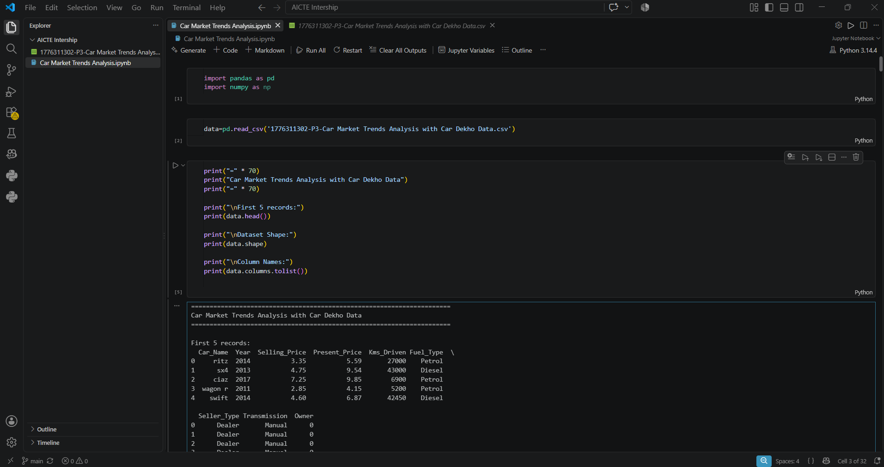
RESULTS
Demo Link
https://github.com/SakshiGomase14/VOIS-DataAnalytics-Internship

Slide 8
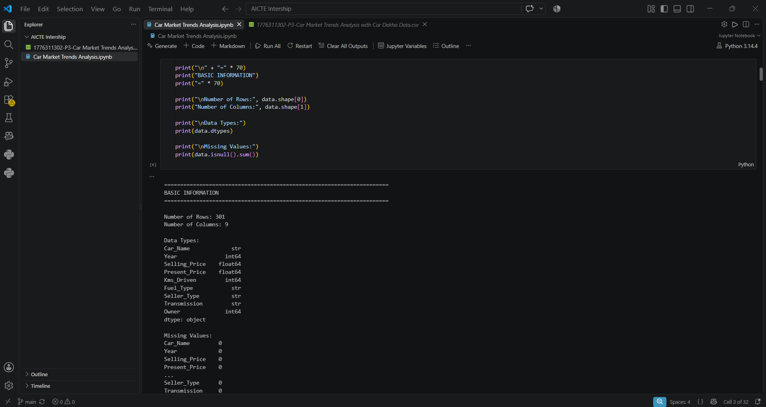
RESULTS
Demo Link
https://github.com/SakshiGomase14/VOIS-DataAnalytics-Internship

Slide 9
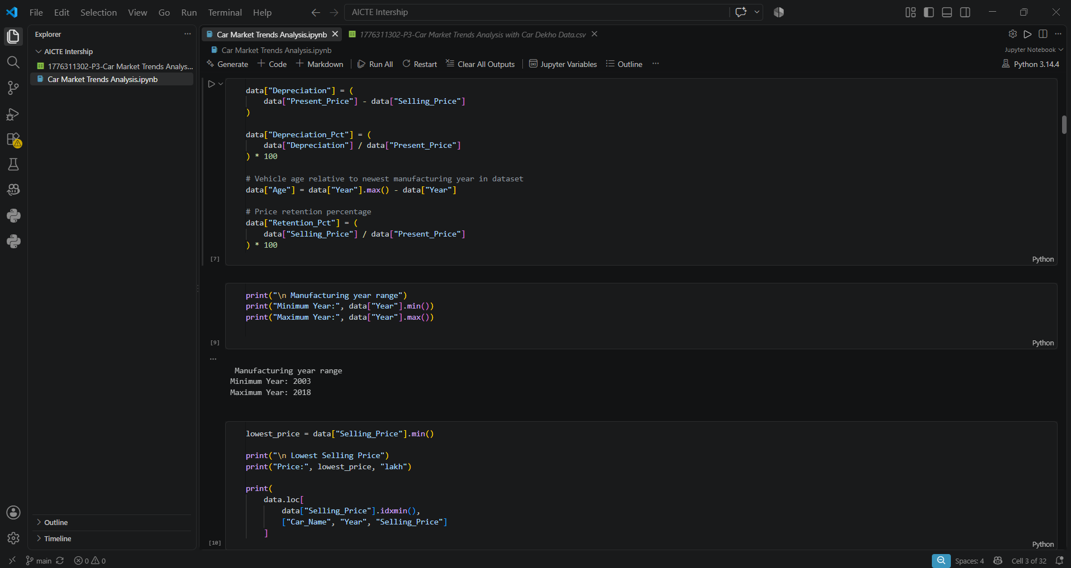
RESULTS
Demo Link
https://github.com/SakshiGomase14/VOIS-DataAnalytics-Internship

Slide 10
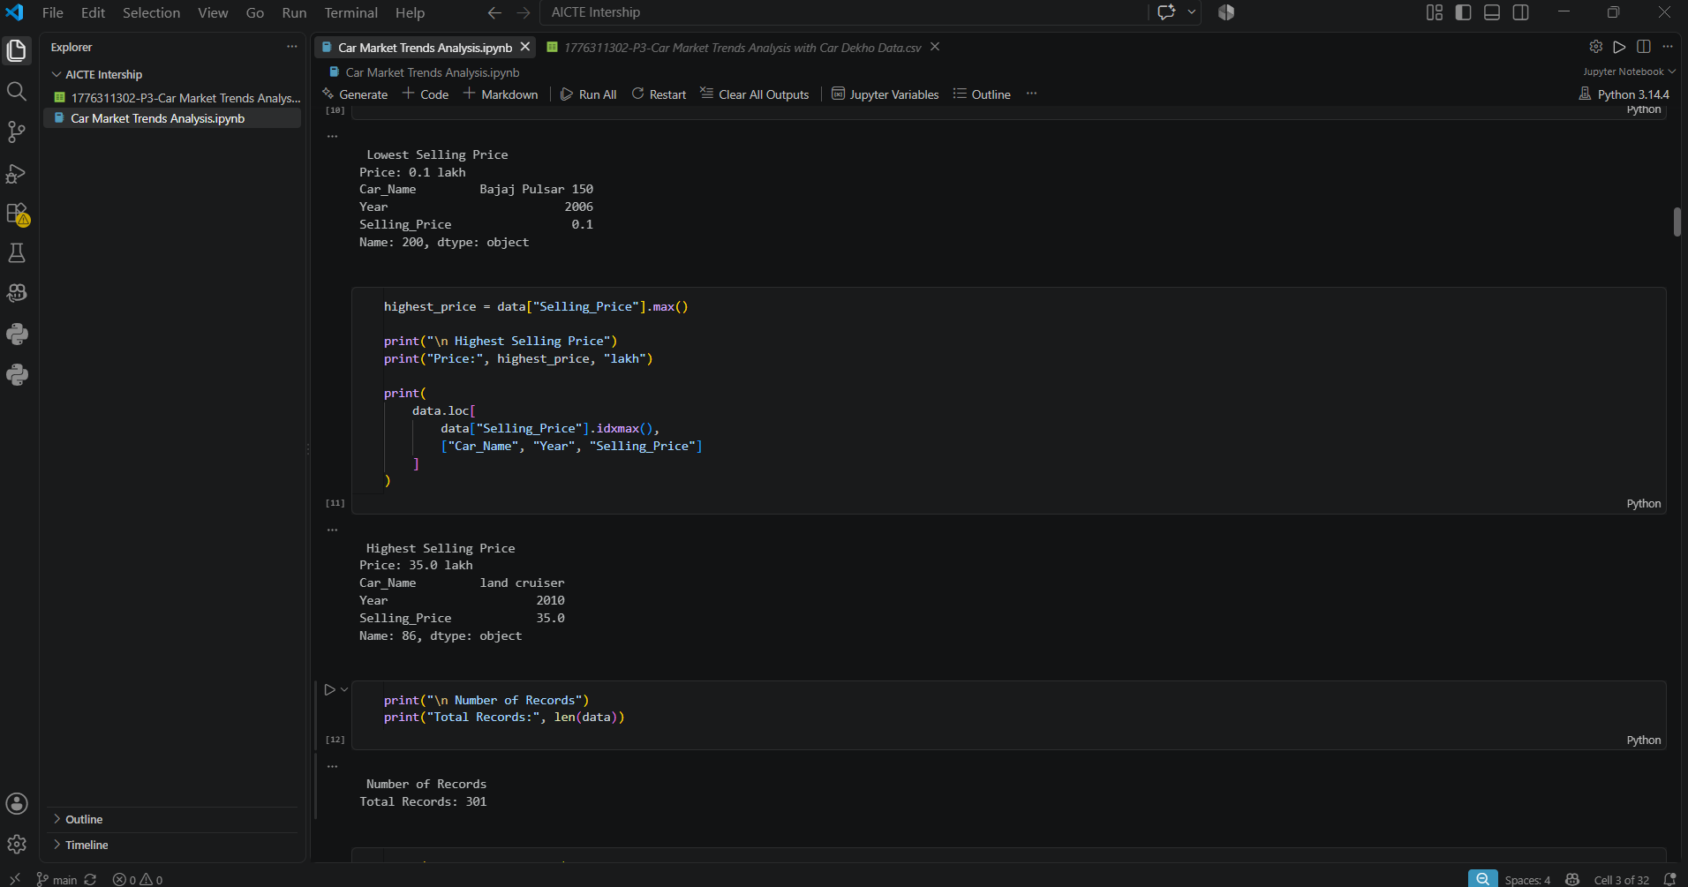
RESULTS
Demo Link
https://github.com/SakshiGomase14/VOIS-DataAnalytics-Internship

Slide 11
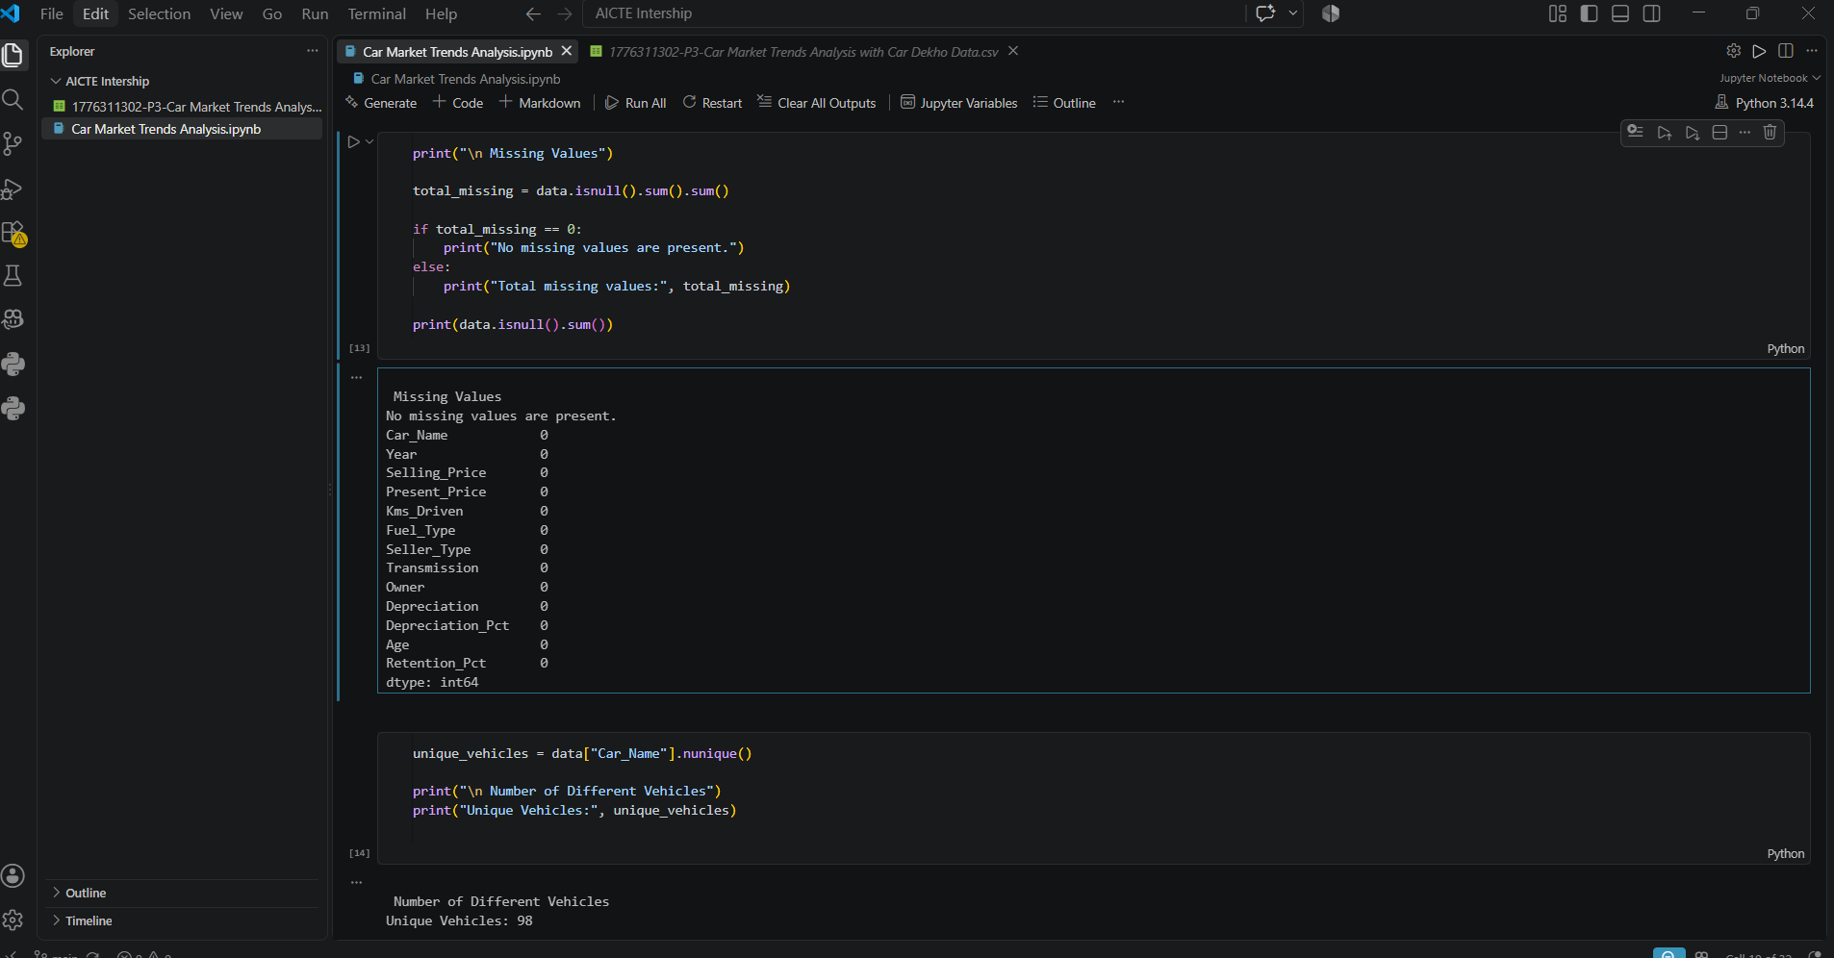
RESULTS
Demo Link
https://github.com/SakshiGomase14/VOIS-DataAnalytics-Internship

Slide 12
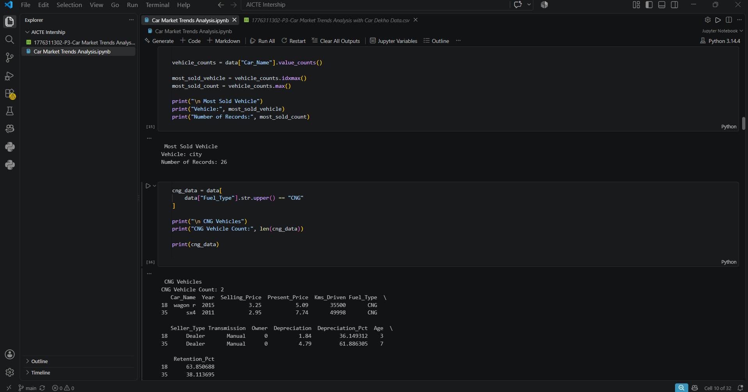
RESULTS
Demo Link
https://github.com/SakshiGomase14/VOIS-DataAnalytics-Internship

