Slide 1
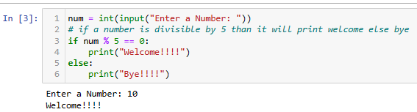
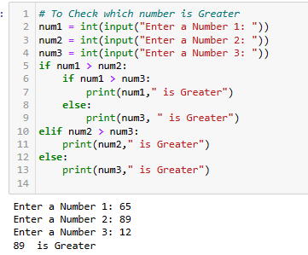
PYTHON CASE - 1
1.Write a program to display "Welcome " if a number entered by user is a multiple of five otherwise print "Bye"
2. Write a program to find the largest number out of three numbers excepted from user

Slide 2
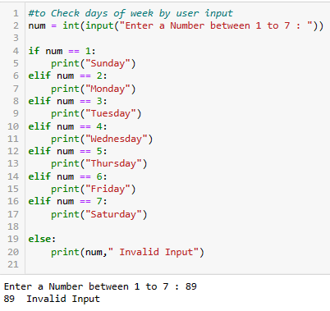
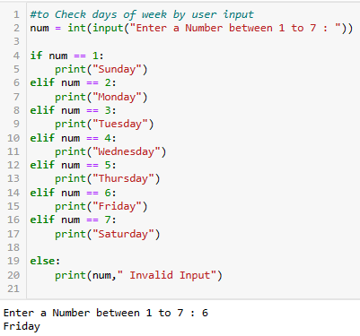
3. Write a program to accept a number from 1 to 7 and display the name of the day like 1 for Sunday , 2 for Monday and so on

Slide 3
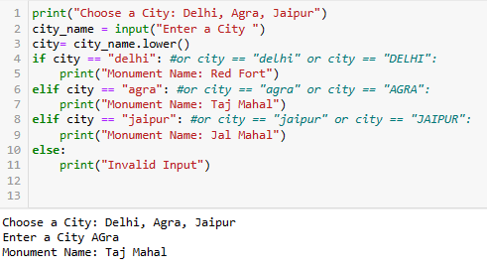
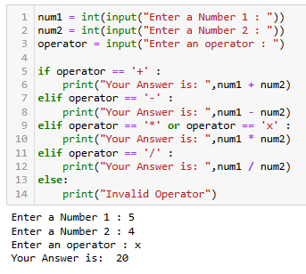
 | 5 . Write a program to accept two numbers and mathematical operators and perform operation accordingly Like: Enter First Number: 7 Enter Second Number : 9 Enter operator : + (you can use different operators as well) Your Answer is : 16
4. Accept any city from the user and display monument of that city
City Monument
Delhi Red Fort
Agra Taj Mahal
Jaipur Jal Mahal

Slide 4
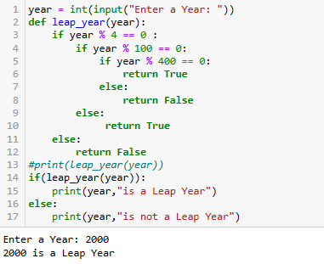
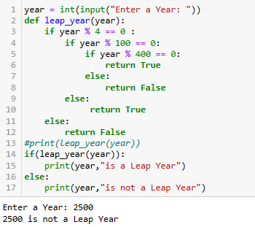
6. Check if the input is Leap Year , write a function We add a Leap Day on February 29, almost every four years. The leap day is an extra, or intercalary day and we add it to the shortest month of the year, February.
In the Gregorian calendar three criteria must be taken into account to identify leap years:
The year can be evenly divided by 4, is a leap year, unless:
2. The year can be evenly divided by 100, it is NOT a leap year, unless:
3. The year is also evenly divisible by 400. Then it is a leap year. Examples : This means that in the Gregorian calendar, the years 2000 and 2400 are leap years, while 1800, 1900, 2100, 2200, 2300 and 2500 are NOT leap years.
What you have to do? You are given the year, and you have to write a function to check if the year is leap or not.
Note that you have to complete the function and remaining code is given as template. You can use a variable as input with a fix value of user input

Slide 5
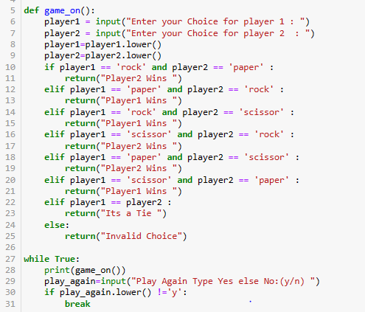
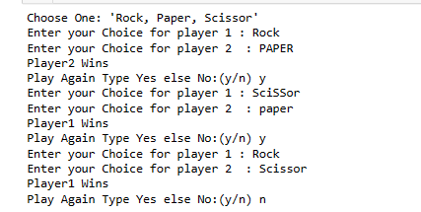
7. Rock Paper Scissors , if else or while ? Make a two-player Rock-Paper-Scissors game.
(Hint: Ask for player plays (using input), compare them, print out a message of congratulations to the winner, and ask if the players want to start a new game)
Remember the rules:
1. Rock beats scissors
2. Scissors beats paper
3. Paper beats rock If you don't know what is this game , go watch it :)

Slide 6
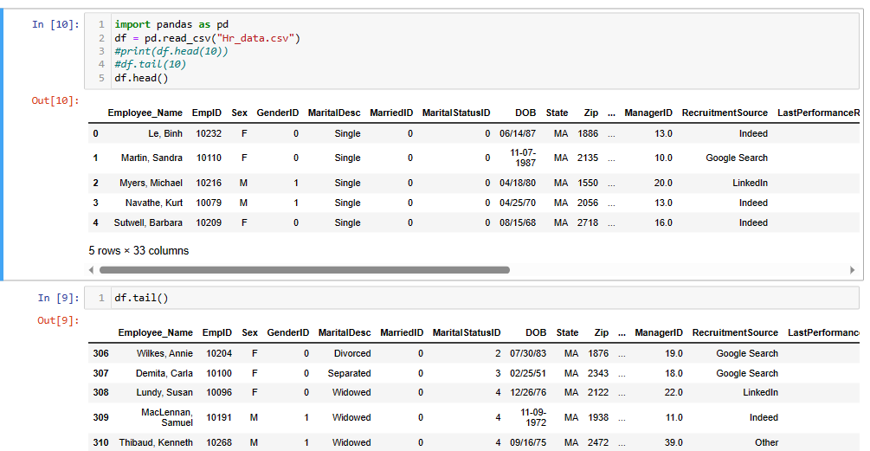
PART 2
Suppose you are a data analyst in a company & You have been provided with the HR dataset, now they want you to find certain insights in the organization.
Now your task is to do data exploration, data preprocessing & find out the necessary insights they are looking for, the questions are as follows:
i) Import the data & check the head, tail for it.

Slide 7
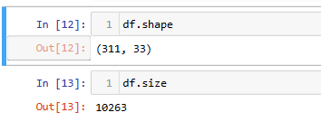
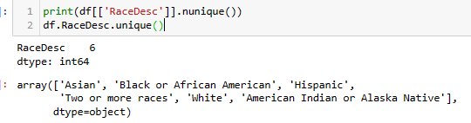
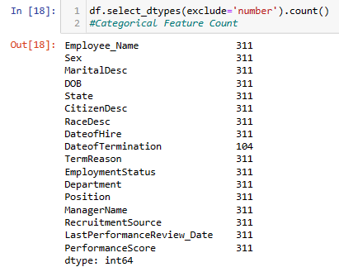
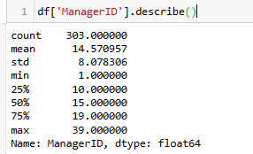
 | iv) How many unique values are present in RaceDesc column?
ii) Check the shape, size of the data.
iii) How many columns have categorical features?
v) Check for mean, max .value, min .value, count, standard deviation of ManagerID column.

Slide 8
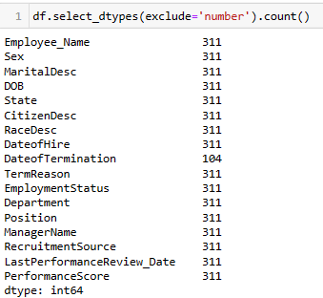
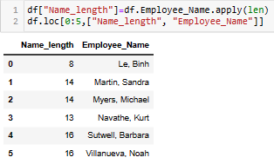
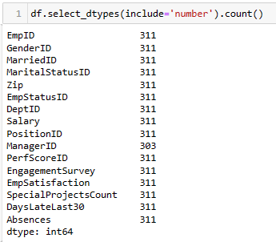
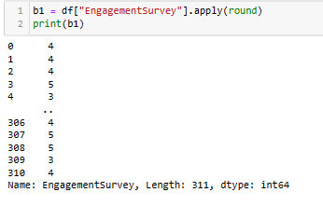
vi) Count the no of categorical , numerical columns .
ix) Add a new column which specifies the number of characters in Employee_Name column.
x) Round up the values in EngagementSurvey column

Slide 9
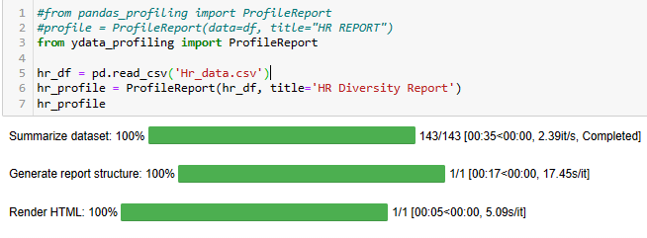
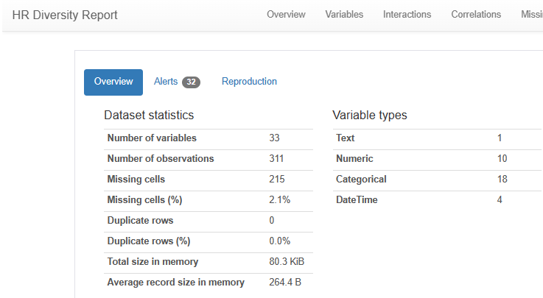
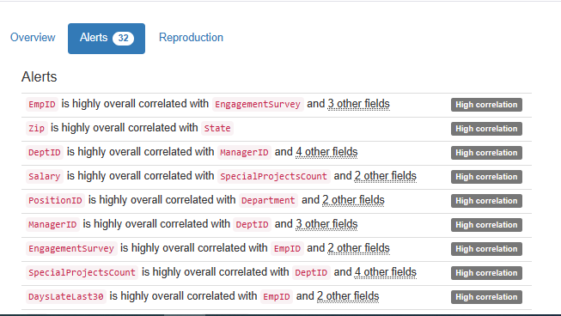
vii) Make a diversity report about the dataset.

Slide 10
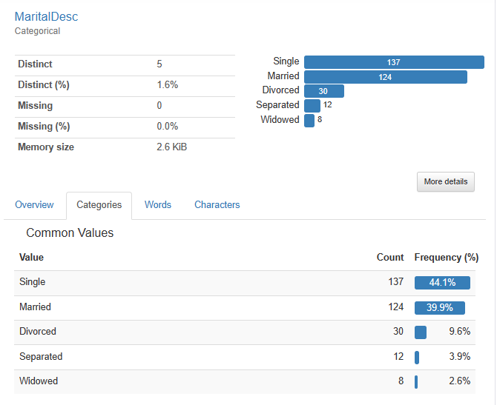
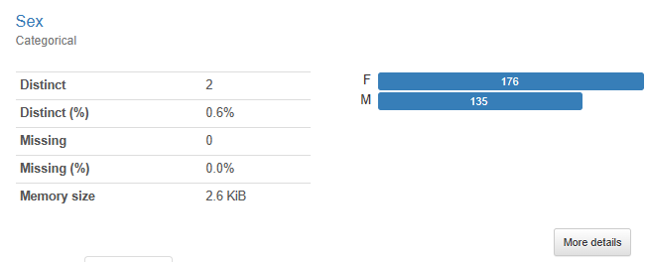
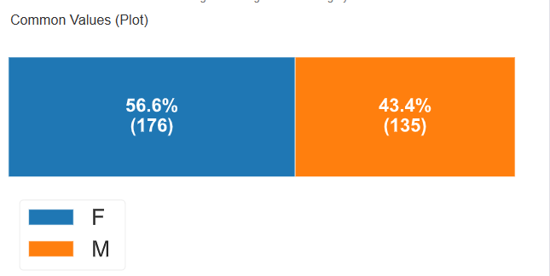
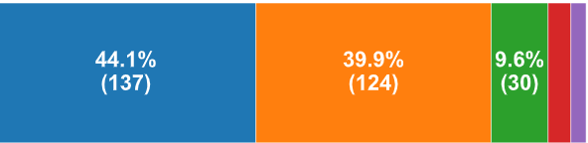
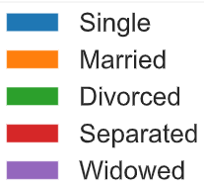

Slide 11
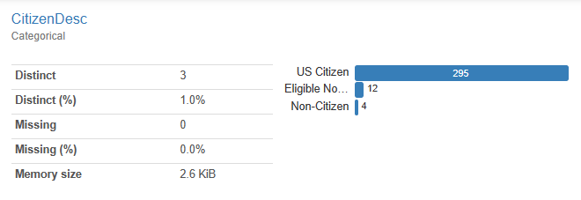
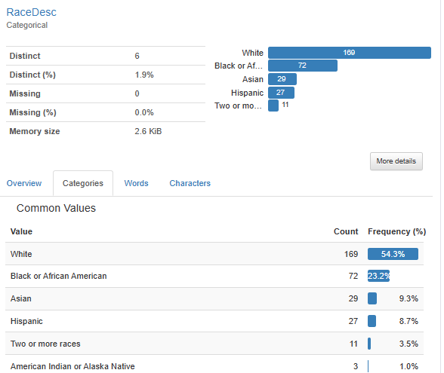
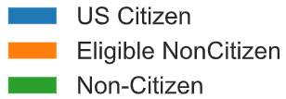

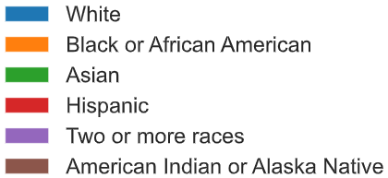
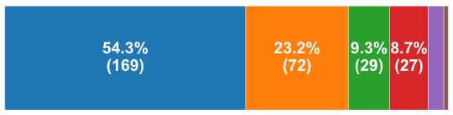

Slide 12
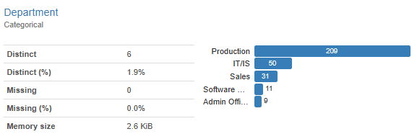
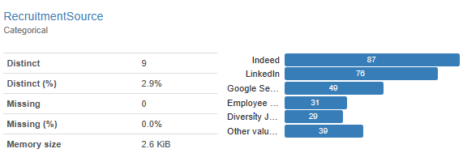
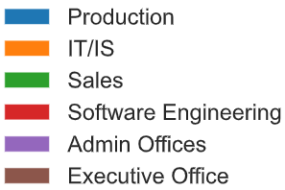
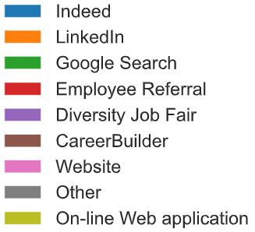
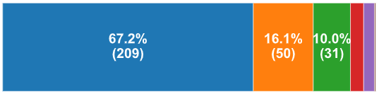
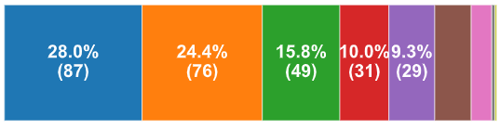

Slide 13
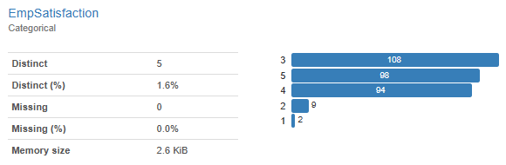
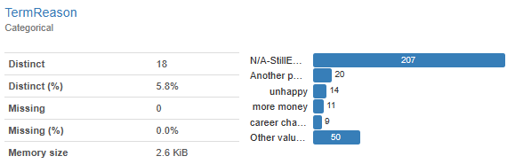


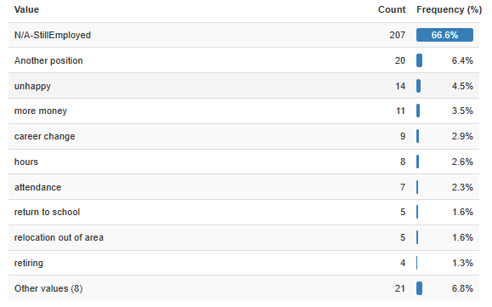
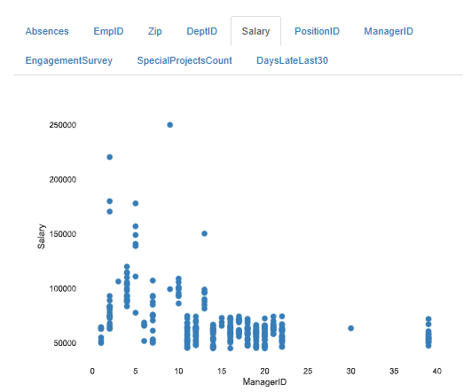

Slide 14
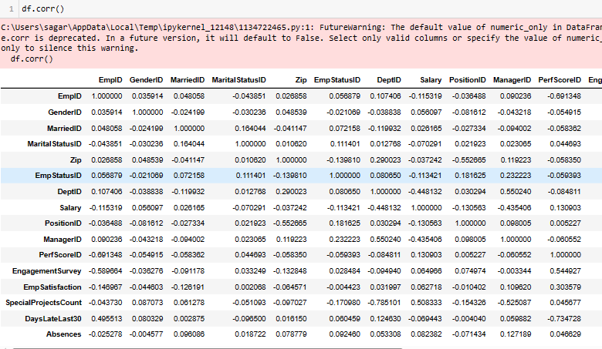
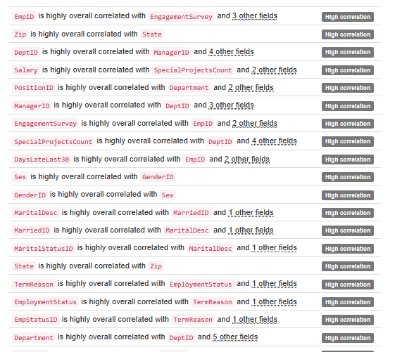
viii) Which columns have correlation with each other, what will you interpret from it.

Slide 15
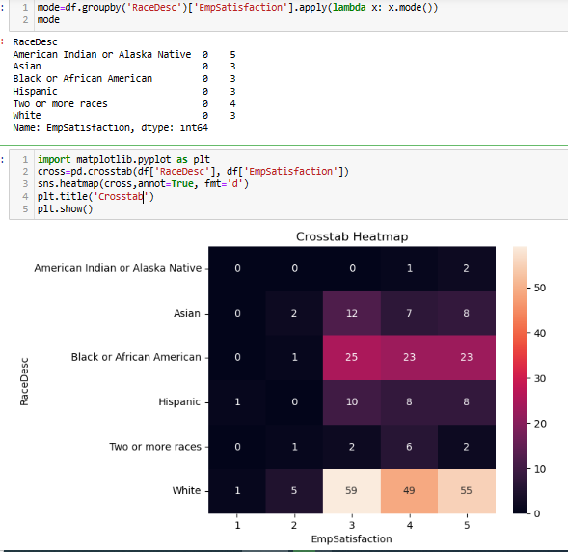
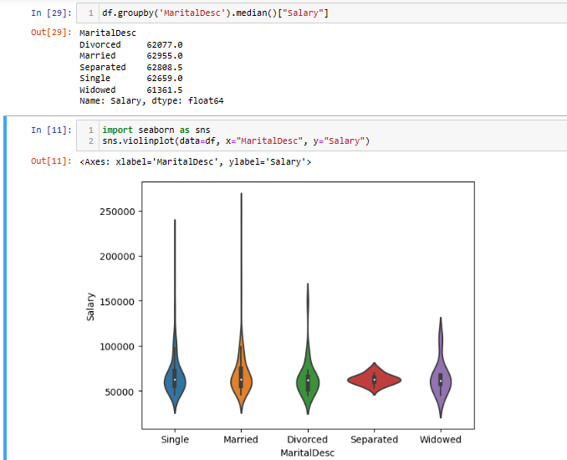

xi) Check for
a. Does marital status have any impact on salary?
b. Does RaceDesc have any impact on EmpSatisfaction?
This suggests that, on average, individuals who are married tend to have higher salaries compared to those who are separated, single, divorced, or widowed.
c. Is there any correlation between EngagementSurvey and EmpSatisfaction
Based on the observation that the mode for Asian, Black or African American, Hispanic, and White is 3, while Two or more races is 4, and American Indian or Alaska Native is 5, it suggests that there may be variations in employee satisfaction ratings across different racial groups.

Slide 16
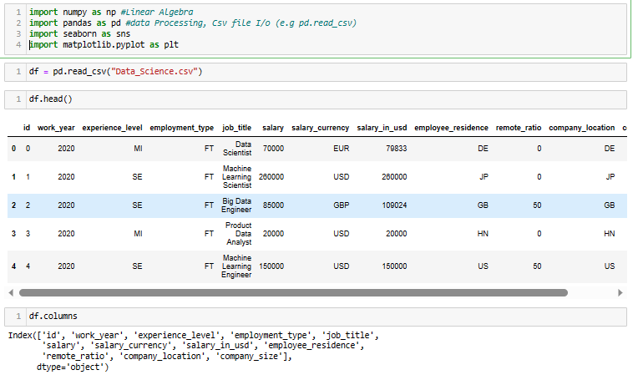
PYTHON CASE - 2
Data science is an interdisciplinary field that uses scientific methods, processes, algorithms, and systems to extract knowledge and insights from noisy, structured, and unstructured data, and apply knowledge from data across a broad range of application domains.

Slide 17
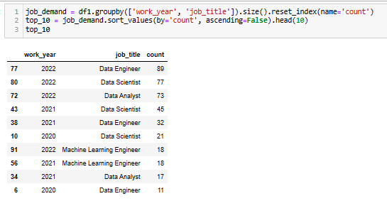
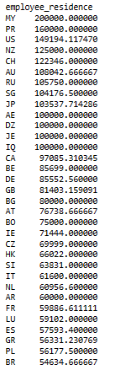
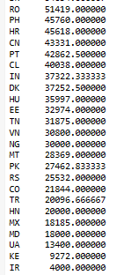
1. How does where you live affect your salary?
2. How has the demand of the jobs been throughout the years?

Slide 18


3. How common is to work remote?
4. What the highest paying jobs with entry level as well as for senior level experienced?

Slide 19




5. What company size hire the most?
7. What are most popular roles in Data Science ?
6. How has average salary changed throughout the years?
8. Which country hire the most people in Data Science?

Slide 20


9. What is the distribution of Salaries?
10. How much can you expect depending on your years of experience?

Slide 21



11. Which year do people prefer to stay at home the most?
12. Which country has the highest pay?
13. Which job title has the highest pay?

Slide 22

14. Is freelancing is worth or not?
In terms of salary, the order from highest to lowest is CT (Contract) > FT (Full-Time) > FL (Freelance) > PT (Part-Time), indicating that freelance work is more financially rewarding compared to a part-time job.

