Slide 1
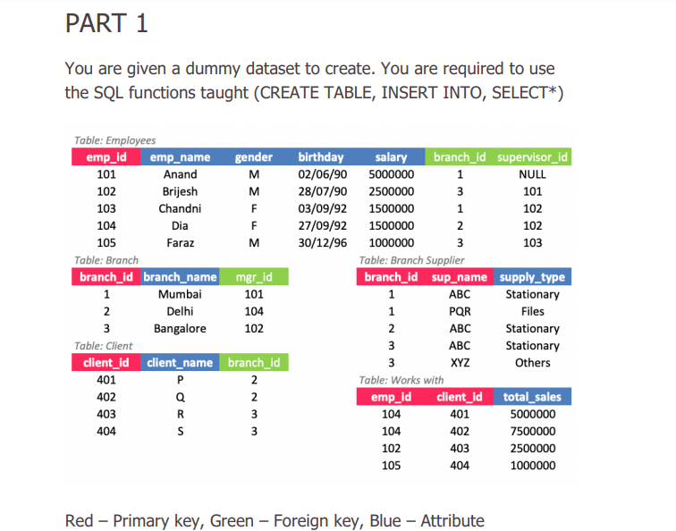
SQL Case Solution
Case 1

Slide 2
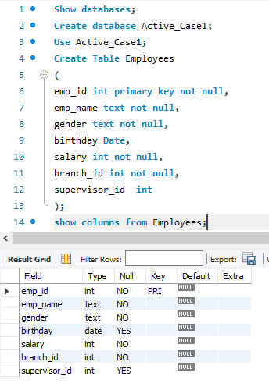
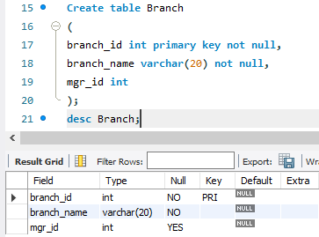
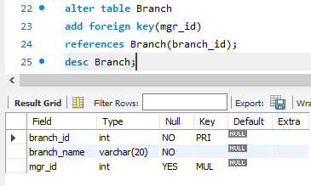

Slide 3
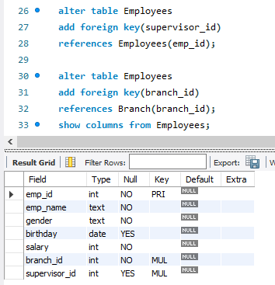
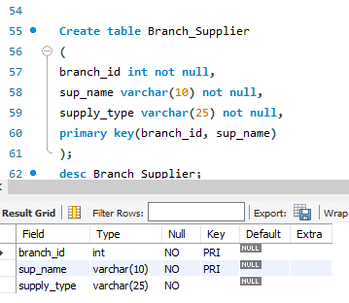

Slide 4
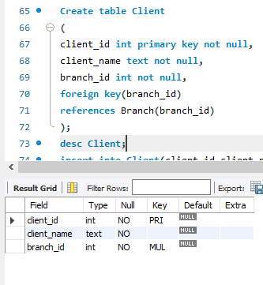
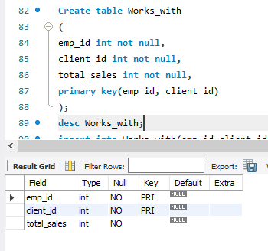

Slide 5
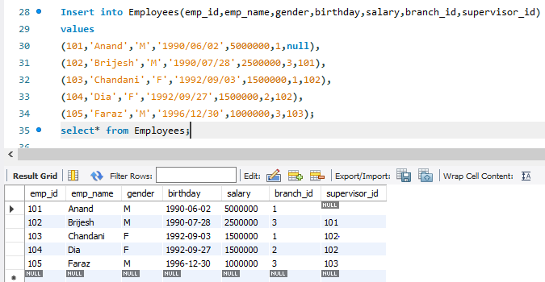

Slide 6
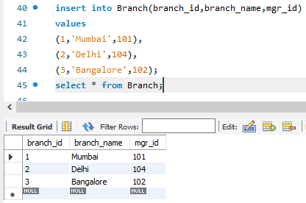
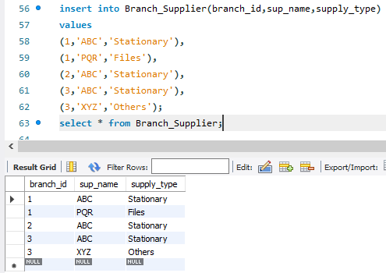

Slide 7
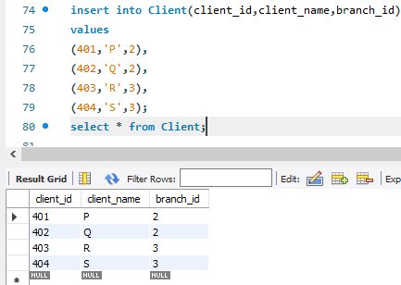
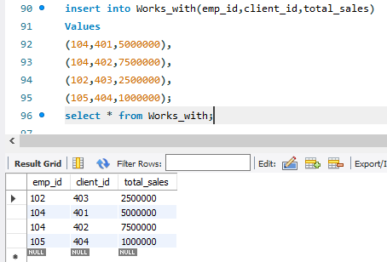

Slide 8
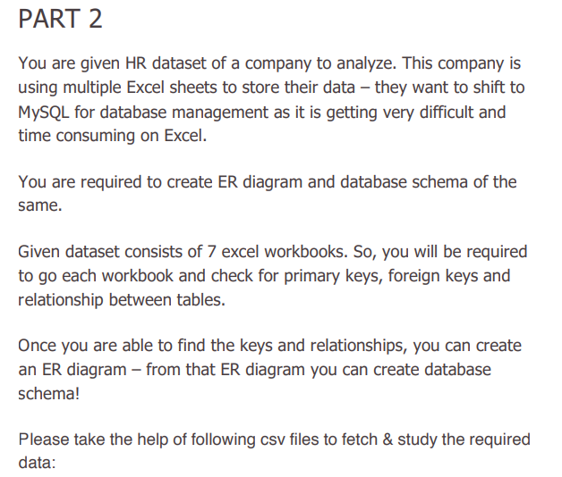
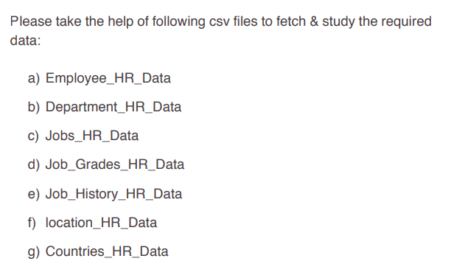

Slide 9
EMPLOYEE_ID
FIRST_NAME
LAST_NAME
EMAIL
PHONE_NUMBER
HIRE_DATE
JOB_ID
SALARY
COMMISSION_PCT
MANAGER_ID
DEPARTMENT_ID
DEPARTMENT_ID
DEPARTMENT_NAME
MANAGER_ID
LOCATION_ID
MANAGES
Manager
1
M
EMPLOYEE
M
1
WORKS FOR
M
1
MANAGES
HAS
HAS
1
M
M
DEPARTMENT
1
JOB
JOB_HISTORY
M
IS IN
EMPLOYEE_ID
START_DATE
END_DATE
JOB_ID
DEPARTMENT_ID
JOB_ID
JOB_TITLE
MIN_SALARY
MAX_SALARY
1
LOCATION
IS AT
COUNTRY
M
1
COUNTRY_ID
COUNTRY_NAME
REGION_ID
LOCATION_ID
STREET_ADDRESS
POSTAL_CODE
CITY
STATE_PROVINCE
ER Diagram

Slide 10
Database Schema
COUNTRY_DATA
COUNTRY_ID | COUNTRY_NAME | REGION_ID
DEPARTMENT_DATA
DEPARTMENT_ID | DEPARTMENT_NAME | MANAGER_ID | LOCATION_ID
EMPLOYEE_DATA
EMPLOYEE_ID | FIRST_NAME | LAST_NAME | EMAIL | PHONE_NUMBER | HIRE_DATE
JOB_ID | SALARY | COMMISSION_PCT | MANAGER_ID | DEPARTMENT_ID
PRIMARY KEY
FOREIGN KEY
ATTRIBUTE

Slide 11
JOB_HISTORY_DATA
EMPLOYEE_ID | START_DATE | END_DATE | JOB_ID | DEPARTMENT_ID
JOB_DATA
JOB_ID | JOB_TITLE | MIN_SALARY | MAX_SALARY
LOCATION_DATA
LOCATION_ID | STREET_ADDRESS | POSTAL_CODE | CITY | STATE_PROVINCE | COUNTRY_ID
PRIMARY KEY
FOREIGN KEY
ATTRIBUTE

Slide 12
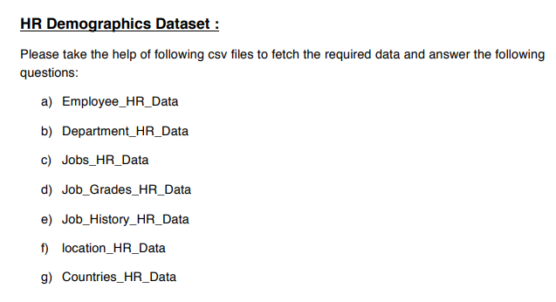
Case 2

Slide 13
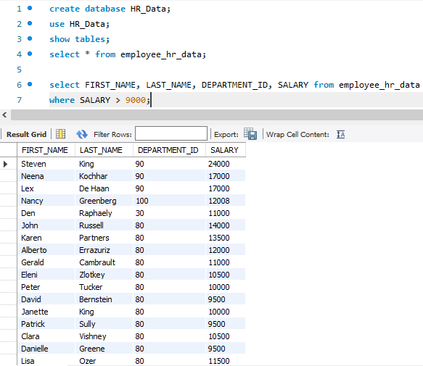
1. Write a SQL query to find those employees whose salary is higher than 9000. Return first name, last name and department number and salary.

Slide 14
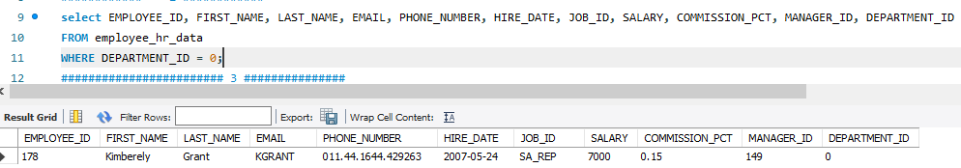
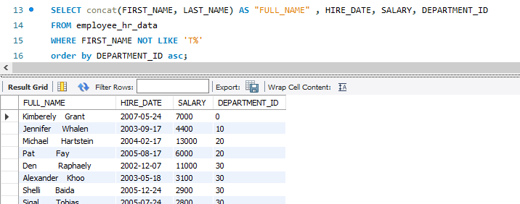
2. Write a SQL query to identify employees who do not have a department number. Return employee_id, first_name, last_name, email, phone_number, hire_date, job_id, salary, commission_pct, manager_id and department_id.
3. Write a SQL query to find those employees whose first name does not contain the letter ‘T’. Sort the result-set in ascending order by department ID. Return full name (first and last name together), hire_date, salary and department_id.

Slide 15
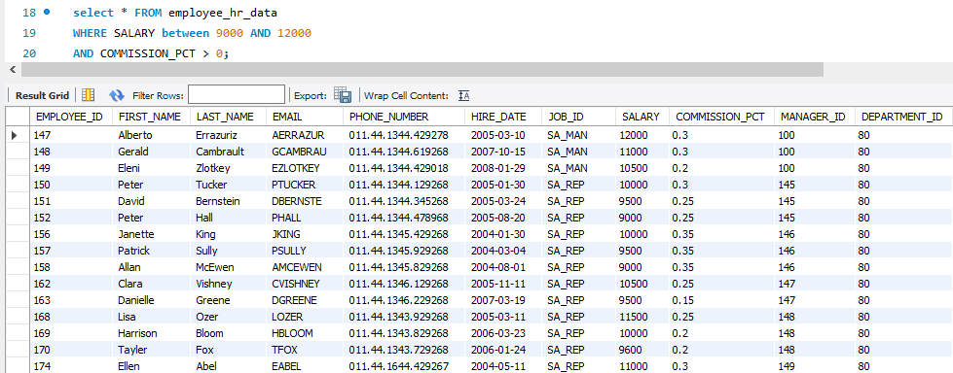
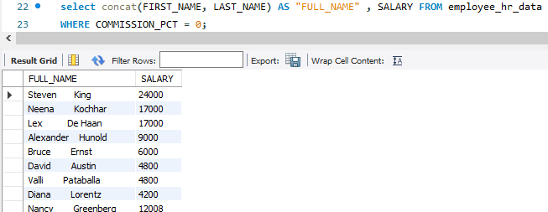
4. Write a SQL query to find those employees who earn between 9000 and 12000 (Begin and end values are included) and get some commission. Return all fields.
5. Write a SQL query to find those employees who do not earn any commission. Return full name (first and last name), and salary.

Slide 16
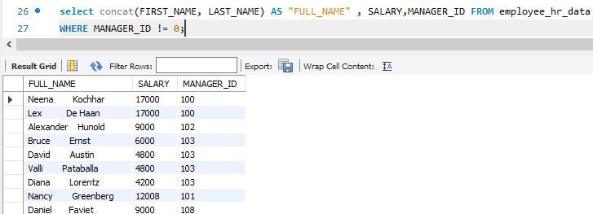
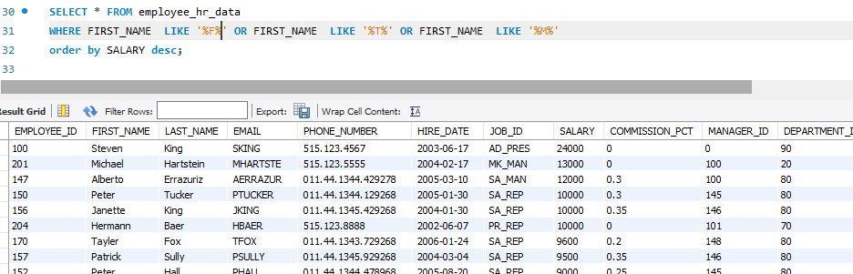
6. Write a SQL query to find those employees who work under a manager. Return full name (first and last name), salary, and manager ID.
7. Write a SQL query to find employees whose first names contain the letters F, T, or M. Sort the result-set in descending order by salary. Return all fields

Slide 17
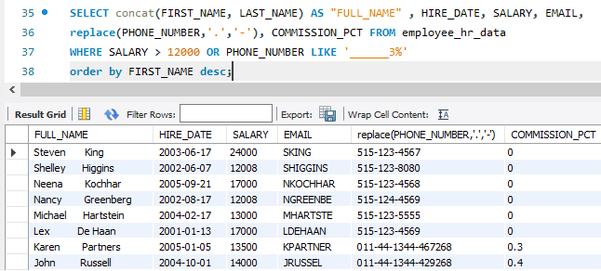
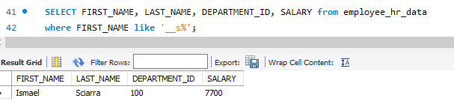
8. Write a SQL query to find those employees who earn above 12000 or the seventh character in their phone number is 3. Sort the result-set in descending order by first name. Return full name (first name and last name), hire date, commission percentage, email, and telephone separated by '-', and salary.
9. Write a SQL query to find those employees whose first name contains a character 's' in the third position. Return first name, last name and department id.

Slide 18
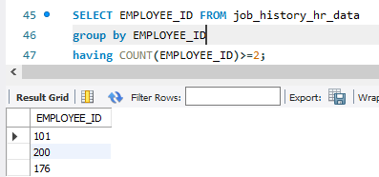
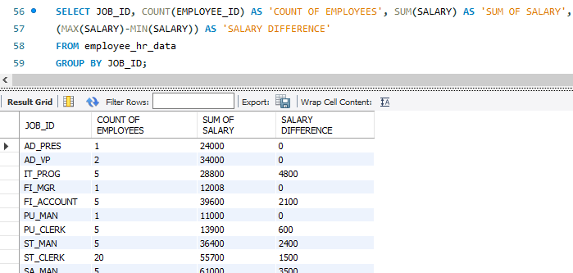
10. Write a SQL query to find those employees who worked more than two jobs in the past. Return employee id.
11. Write a SQL query to count the number of employees, the sum of all salary, and difference between the highest salary and lowest salaries by each job id. Return job_id, count, sum, salary_difference.

Slide 19
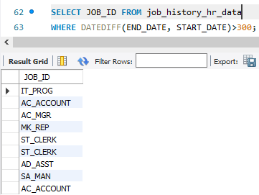
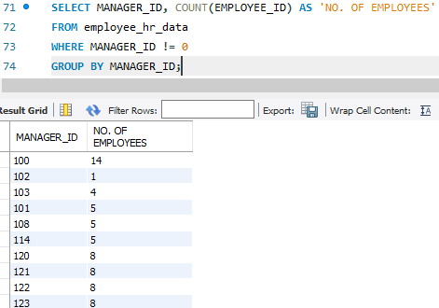
12. Write a SQL query to find each job ids where two or more employees worked for more than 300 days. Return job id.
13. Write a SQL query to count the number of employees worked under each manager. Return manager ID and number of employees.

Slide 20
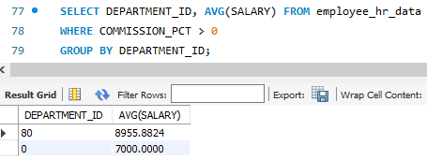
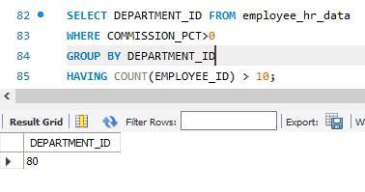
14. Write a SQL query to calculate the average salary of employees who receive a commission percentage for each department. Return department id, average salary.
15. Write a SQL query to find the departments where more than ten employees receive commissions. Return department id.

Slide 21
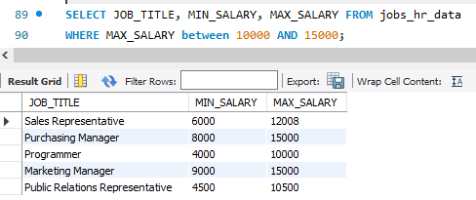
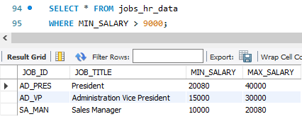
16. Write a SQL query to find those job titles where maximum salary falls between 10000 and 15000 (Begin and end values are included). Return job_title, max_salary, min_salary.
17. Write a SQL query to find details of those jobs where the minimum salary exceeds 9000. Return all the fields of jobs

Slide 22
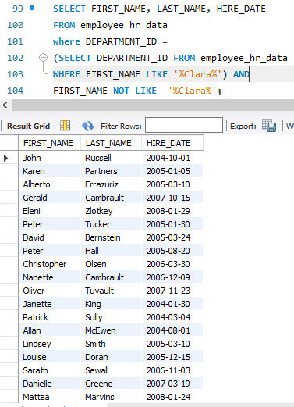
18. Write a SQL query to find those employees who work in the same department as ‘Clara’. Exclude all those records where first name is ‘Clara’. Return first name, last name and hire date

Slide 23
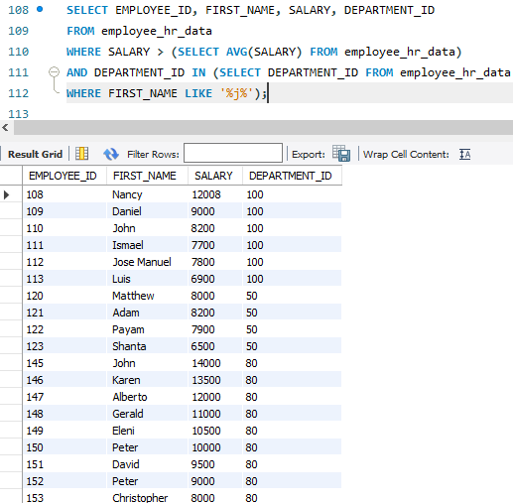
19. Write a SQL query to find those employees who earn more than the average salary and work in the same department as an employee whose first name contains the letter 'J'. Return employee ID, first name and salary.

Slide 24
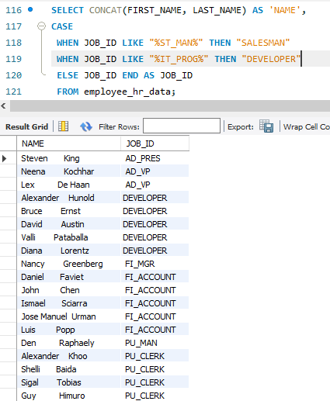
20. Write a query to display the employee id, name ( first name and last name ) and the job id column with a modified title SALESMAN for those employees whose job title is ST_MAN and DEVELOPER for whose job title is IT_PROG.

Slide 25
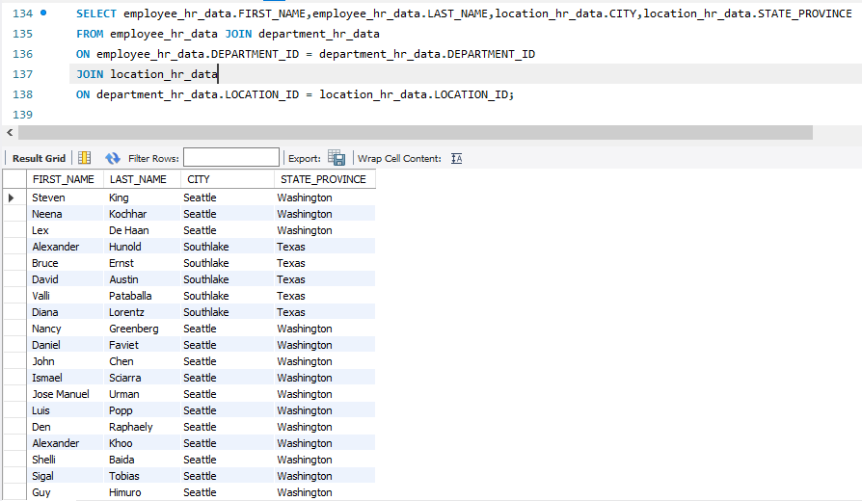
JOINS
1. Write a SQL query to find the first name, last name, department, city, and state province for each employee.

Slide 26
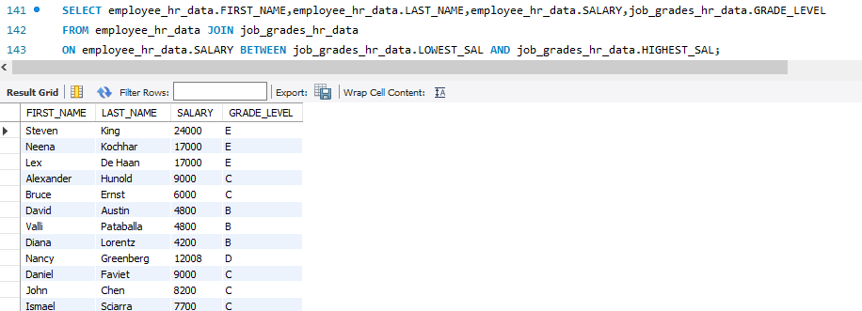
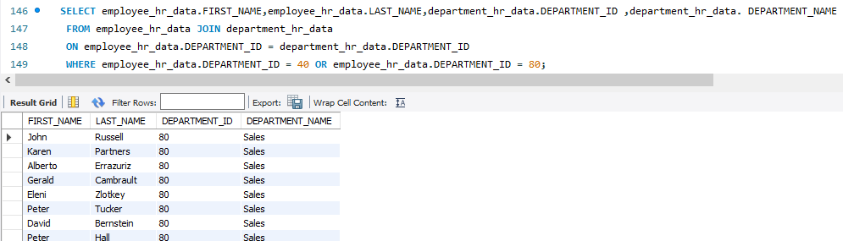
2. Write a SQL query to find the first name, last name, salary, and job grade for all employees
3. Write a SQL query to find all those employees who work in department ID 80 or 40. Return first name, last name, department number and department name

Slide 27
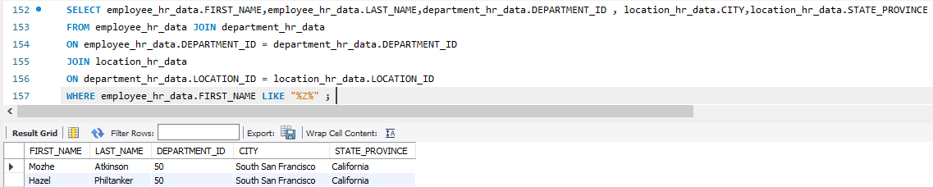
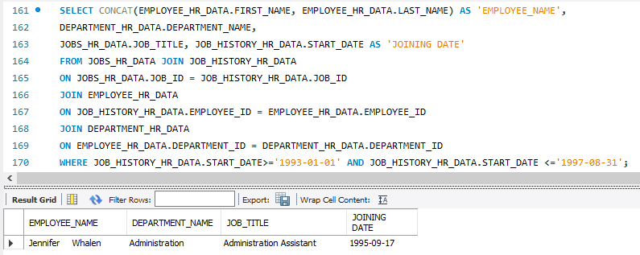
4. Write a SQL query to find those employees whose first name contains the letter ‘z’. Return first name, last name, department, city, and state province.
5. Write a SQL query to find all employees who joined on 1st January 1993 and left on or before 31 August 1997. Return job title, department name, employee name, and joining date of the job.

Slide 28
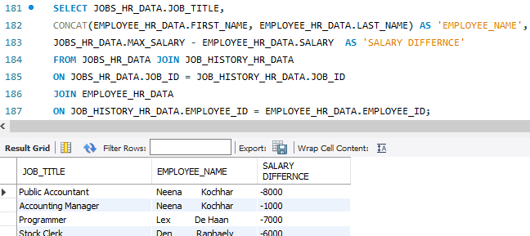
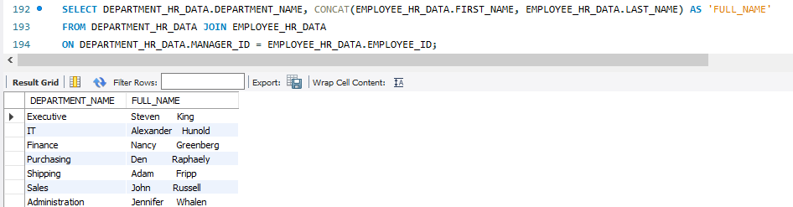
6. Write a SQL query to calculate the difference between the maximum salary of the job and the employee's salary. Return job title, employee name, and salary difference.
7. Write a SQL query to find the department name and the full name (first and last name) of the manager.

Slide 29
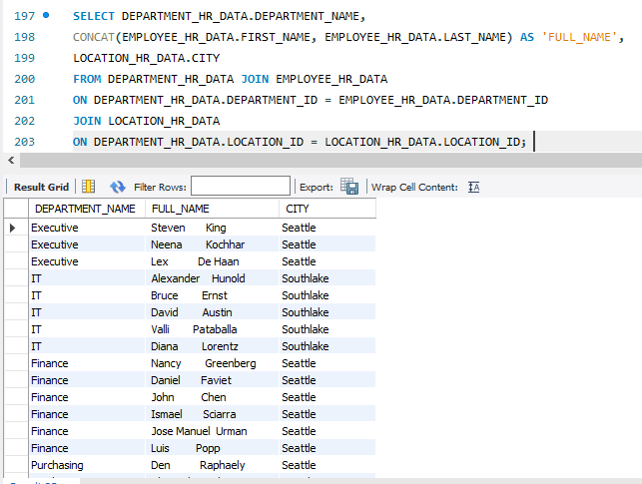
8. Write a SQL query to find the department name, full name (first and last name) of the manager and their city.

Slide 30
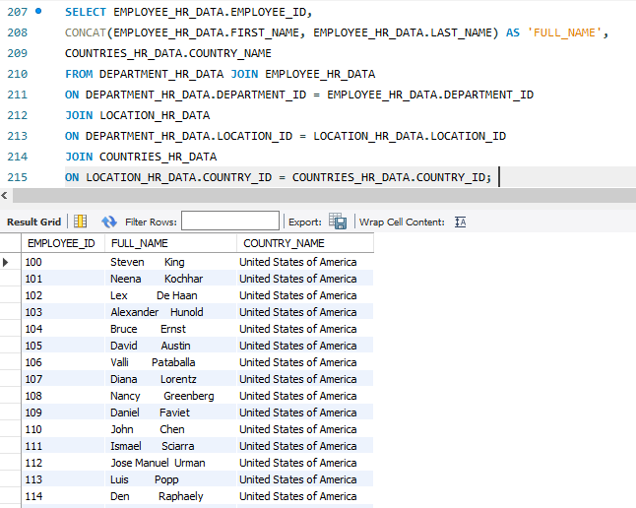
9. Write a SQL query to find out the full name (first and last name) of the employee with an ID and the name of the country where he/she is currently employed.

