Slide 1

WebSec Scan :
A Web Security Scanning Tool
PROJECT TEAM ID: MP24CSE094
GUIDE NAME: Mr.Siddhant Thapliyal
STUDENT DETAILS: NAME : UNI ROLL NO :
STUDENT 1 Sakshi Lingwal 2019064
STUDENT 2 Rabia Bakshi 2019257

Slide 2
INTRODUCTION
This project focuses on building an automated web security scanner that enables users to analyze websites for potential vulnerabilities. Users can input a website URL and choose from different security scan options, including:
Basic Scan,SQL Injection,Cross-Site Scripting (XSS) Testing,DNS Records Analysis ,Full Security Scan, Website Stress Testing,Weak passwords and Defacement Attacks.
The system will then analyze the website and generate a brief report outlining vulnerable sections and detected security flaws. By automating the security assessment process, this project aims to empower developers, security professionals, and businesses to proactively secure their web applications without needing extensive cybersecurity expertise.
This solution will contribute to making web security assessments more accessible, efficient, and actionable, helping organizations protect their online presence against evolving cyber threats.

Slide 3
PROBLEM STATEMENT
With the rise of cyber threats, web applications have become one of the most vulnerable entry points for attackers. Exploits such as SQL injection, cross-site scripting (XSS), and DNS misconfigurations are frequently used to compromise websites, steal sensitive data, or gain unauthorized access. However, many organizations and individual developers struggle to assess their web applications for security flaws due to a lack of accessible and efficient testing tools.
Traditional security testing methods often require specialized knowledge, manual intervention, and expensive resources, making them impractical for many users. As a result, vulnerabilities remain undetected until they are exploited by attackers, leading to data breaches, financial losses, and reputational damage.
To address this challenge, there is a need for an automated and user-friendly web security scanning tool that allows users to test their websites for vulnerabilities efficiently. The tool should support different types of security assessments, provide clear insights into security weaknesses.

Slide 4
Literature Survey
The rise of web applications and their accompanying security challenges, emphasizing how vulnerabilities, such as SQL injections, cross-site scripting, and broken authentication, leave them open to cyber-attacks. It identifies and compares the top ten web application vulnerabilities and their mitigation strategies. Additionally, it reviews open-source vulnerability assessment tools and their effectiveness. [1]
This systematic literature mapping provides an overview of web application security testing techniques, tools, and frameworks, summarizing the state-of-the-art in the field and offering insights beneficial to practitioners and researchers.[2]
The thesis examines vulnerability scanners, key tools in managing application, database, and network security. It provides background on the various types of vulnerability scanners and testing methods, emphasizing application, database, and network-based scanners. Through a survey and comparative analysis, the study aims to guide users in selecting suitable scanners. Additionally, it evaluates the accuracy of two network scanners—OpenVAS and Nessus—by comparing their performance on the same target and discussing the findings and implications.[3]

Slide 5
This study evaluates the performance of different vulnerability scanners, emphasizing the benefits of combining multiple scanners for comprehensive security assessments. It highlights the effectiveness of integrated scanning approaches in detecting vulnerabilities.[4]
The methods for scanning web vulnerabilities and discusses frameworks aimed at improving web security. It serves as a foundation for future research in web vulnerability scanning and security enhancement.[5]
This empirical study compares six web application penetration testing tools, including OWASP ZAP, Burp Suite Professional, and Qualys WAS. It evaluates their effectiveness in detecting common web application vulnerabilities and discusses their strengths and weaknesses.[6]
This paper discusses the implementation and effectiveness of a Web Vulnerability Scanner (WVS) in enhancing web application security. It covers the working principles of vulnerability detection tools and presents the scanning results to verify the research.[7]

Slide 6
Objective
Automate Web Security Assessments
Provide an automated scanning tool that helps users detect vulnerabilities in their websites without manual intervention.
2. Identify Common Web Vulnerabilities
Scan for critical security flaws such as:
SQL Injection (SQLi) – Protect databases from unauthorized queries.
Cross-Site Scripting (XSS) – Prevent JavaScript injection attacks.
Weak Passwords – Identify security risks in authentication mechanisms.
Website Defacement Risks – Detect unauthorized content modifications.
Perform DNS and Network Security Checks
Analyze DNS records for misconfigurations that might expose sensitive information.
Conduct stress testing to evaluate how a website handles high-traffic scenarios.
4.Provide a User-Friendly API for Security Testing
Offer a simple and accessible REST API to allow developers, security analysts, and organizations to easily perform security scans.
5. Generate Actionable Security Reports
Return detailed insights about vulnerabilities, including the affected website components .

Slide 7
Project Work Carried
User Input & API Request Handling
The user provides a website URL and selects the desired scan type (SQLi, XSS, DNS records, etc.).
The frontend sends the request to the Flask backend API.
2. Security Scanning Execution
The backend calls the respective security modules based on the selected scan:
SQL Injection Scanner: Tests for database vulnerabilities.
XSS Scanner: Identifies JavaScript injection flaws.
Weak Password Analysis: Checks for common password vulnerabilities.
DNS Record Checker: Analyzes DNS misconfigurations.
Website Stress Testing: Simulates high-traffic scenarios.
Full Scan: Runs all available security checks.
3. Data Processing & Analysis
The scanner processes the website’s response and detects potential security risks.
If a vulnerability is found, it categorizes the risk level (low, medium, high).

Slide 8
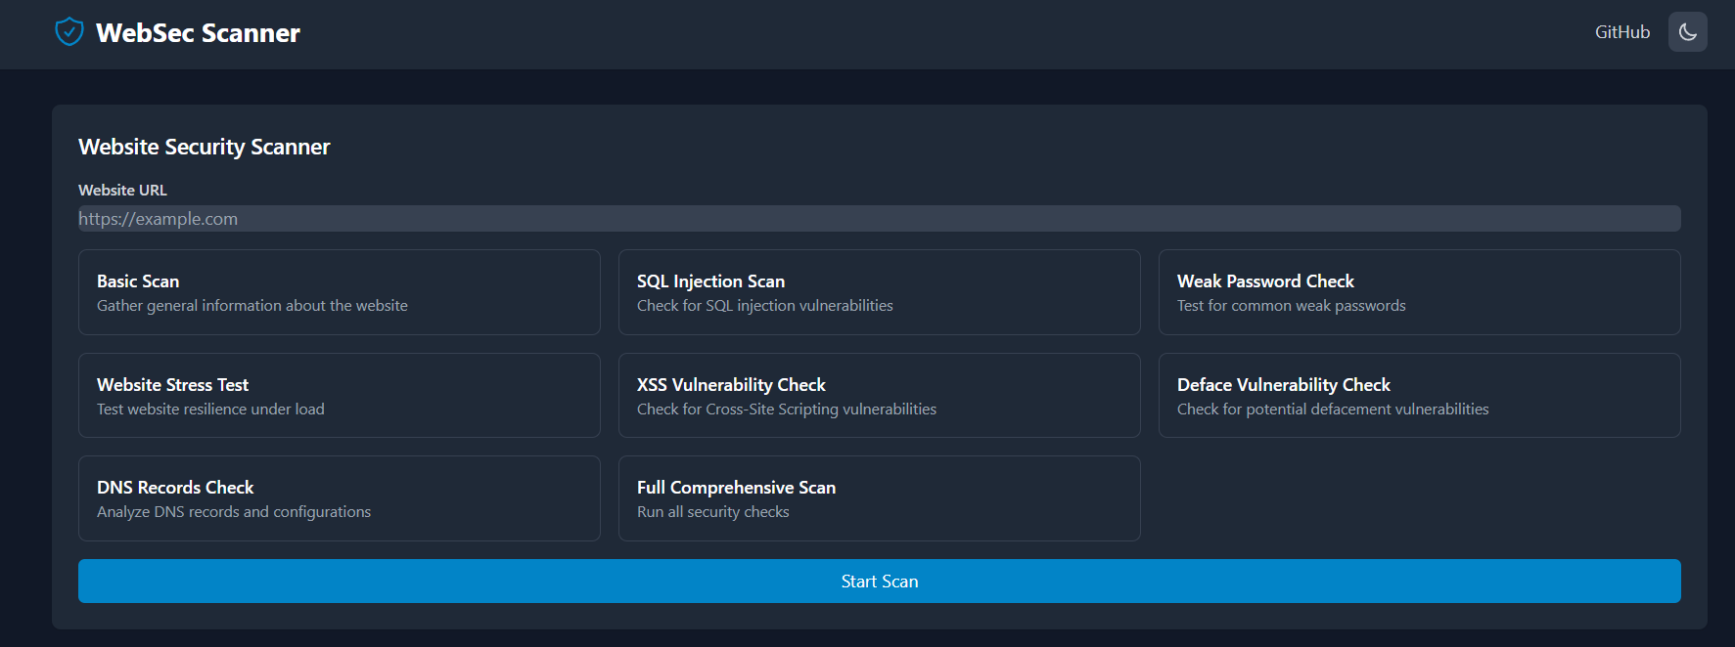
4. User Input
Users provide the target URL. The tool outputs vulnerability findings and open port details.
5. Modular Design
The tool is divided into functions for each task (SQL injection, XSS, parameter extraction, port scanning), making it easy to extend.

Slide 9
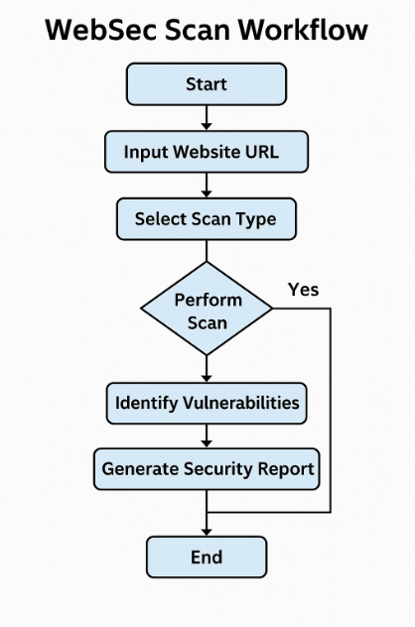
Workflow
of the
WebSec Scan Tool

Slide 10
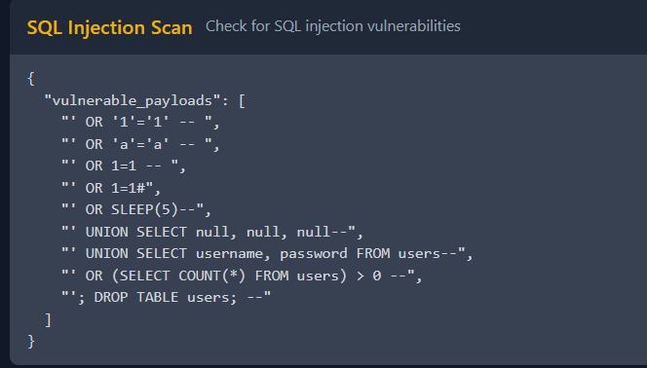
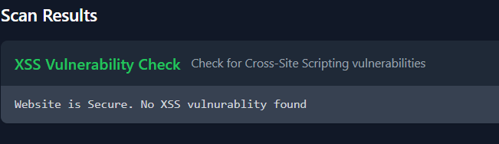
Result of a Vulnerable Website :
Result of a non-vulnerable website :

