Slide 1
Introduction to Database Systems
Notes:
Today we will open the main topic of this class, which is databases. Before we start talking about databases do you have any questions about what we have done so far? Do you have any questions about the homework?
In todays world, databases are used practically in every system. Pretty much any website is built up on top of a database. All organizations (banks, hospitals, universities etc) have their own databases. So we will start with the definition. Anyone want to try? What is the first thing that comes in mind when you hear the word “database”?

Slide 2
Why do we need databases?
Can you think of problems that you might face if you store information in text files?

Slide 3
Databases vs. Text Files
When should you use a database instead of a text file?
Data Consistency: Restrict types of values that can be entered in each column (date vs. age vs. salary vs…)
Being able to sort by column and look for pieces of information
Easier to analyze the data (e.g., a pie chart on how well each book is selling…)
Notes:
Being able to sort by column
Restrict types of values that can be entered in each column (date vs. age vs. salary vs…)
Easier to analyze the data (e.g., a pie chart on how well each book is selling…)
Natural question: Why not Excel then???

Slide 4
Databases vs. Spreadsheets
When should you use a database instead of Excel?
Insertion anomalies
Deletion anomalies
Update anomalies
Notes:
Talk about the anomalies
Then show how to organize in separate tables

Slide 5
Anomalies in un-normalized data
Insertion anomalies
Inability to insert a piece of information about an object without having to insert a (bogus) piece of information about something else
Example: Adding a new customer/book before it is ordered How can you add the book “Harry Potter” in the file below?
Notes:
Go through the table in the previous slide and find the problems encountered when one wants to insert, delete, or update data in it.
Talk about Anomalies
Write down an example of one anomaly (individual then consult pairs).

Slide 6
Anomalies in un-normalized data
Deletion anomalies
The loss of a piece of information about one object when a piece of information about a different object is deleted
Example: Deleting order 2 => deleting customer Lee Sproull
Example: Deleting order 1 => deleting book “Code…”
Notes:
Go through the table in the previous slide and find the problems encountered when one wants to insert, delete, or update data in it.
Talk about Anomalies
Write down an example of one anomaly (individual then consult pairs).

Slide 7
Anomalies in un-normalized data
Update anomalies
Need to change multiple times the same piece of information about an object
Example: Changing Jeff Bezos address in order 1 leaves orders 6 and 8 unchanged…
Notes:
Go through the table in the previous slide and find the problems encountered when one wants to insert, delete, or update data in it.
Talk about Anomalies
Write down an example of one anomaly (individual then consult pairs).

Slide 8
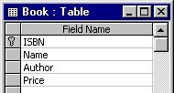
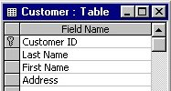
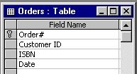
A “normalized” version of the spreadsheet
Normalization
All data stored in “tables” (similar to spreadsheet “worksheets” but more rigid)
Each cell contains a single value (e.g., no list of “orders” in cell)
Prevents insertion, deletion and update anomalies
Notes:
Go through the table in the previous slide and find the problems encountered when one wants to insert, delete, or update data in it.
Talk about Anomalies
Write down an example of one anomaly (individual then consult pairs).

Slide 9
Database schema
Primary, keys, foreign keys, relationships, oh my…
The tables in your database, along with each of their fields, keys
The relationships between the tables
Primary key
Primary key
Primary key
Foreign key
Foreign key

Slide 10
Key Question: How do we design the tables?
The key questions of database design
What tables to create
What fields to put in each table
How to ensure no duplication of data
How to ensure that database has no “multi valued” cells
How to select primary and foreign keys

Slide 11
Entity Relationship Diagrams (ERD)
Notes:
Now we will move forward and discuss the entity relationship diagram, which is a methodology that help us understand what data we have, and what is the best way to structure our database.

Slide 12
Basic Concepts
Entities
Attributes
Primary keys
Relationships
Foreign keys
Cardinalities

Slide 13

Entities
An entity is a collection of objects with the same properties:
Students (student name, student id, age, sex )
Courses (course id, section id, course description, location)
Attributes
Entities are description of instances:
An instance of entity “Students” might be: (“Joe Doe”, “N12897”, “20”, “M”)
An instance of entity “Courses” might be: (“INFO.2346”, “01”,“Dealing with Data” , “Tisch-UC25”)
Notes:
Stop at 4 minutes.

Slide 14
Primary Key (PK)
An attribute whose value is unique in each instance:
Student id in the students entity
Composite primary key: A primary key that consists of two or more attributes, whose values together (but not separately) are unique for each instance in an entity:
Course id and section id in the courses entity

Slide 15
Primary Keys and Entities
Students
Attributes
Primary Key
Student Id
Student name
Age
Sex
Entity Name
Courses
Composite
Primary Key
Course Id
Section Id
Course Description
Location
Attributes

Slide 16
Why do we need PKs?
Identify each instance uniquely (ability to retrieve)
Refer to instances of other entities
Fast Retrieval (indexing)
In relational databases, every entity instance has its own primary key
Notes:
To identify each instance uniquely, and be able to retrieve it
DBMS create indexes and other structures on these keys which allow them to fast retrieve the instances that they need, when queried at the primary key (very fast)
If one entity wants to refer to instances of another entity, the fit will do it by referring to these instances w.r.t their PK values.

Slide 17
Relationship
A relationship is an association among entities:
Students take courses (take is a relationship)
Students
Courses
Student Id
Student name Age
Sex
Take
Course Id
Section Id
Course Description
Location

Slide 18
Representation of Relationships
A relationship is shown as a line connecting the associated entities, labeled with the name of the relationship
A relationship name is usually a verb (e.g., takes)
Whenever possible, a relationship name should be unique
A relationship has implied direction
Notes:
So far, we have defined entities, relationships, and primary keys. Once again, entities are collections of objects with the same properties, relationships capture the associations between different entities, and primary keys are used to uniquely identify entity instances

Slide 19
Cardinalities
Cardinalities describe the number of instances that participate in a relationship
Courses
Course 1
Course 2
Course 3
Course 4
Students
Student 1
Student 2
Student 3
A student can take 0,1, 2, or more courses (many). A course can be taken by 0,1,2 or more students (many). This example, has a
many to many cardinality.
Notes:
For example, assume that we have these two entities, Students and courses. A student can take 0, 1, 2 or more courses,

Slide 20
Cardinality Notation
Symbol | Meaning
 | One - mandatory
 | Many - mandatory
 | One - optional
 | Many - optional

Slide 21
Examples of Cardinality Signs
Exactly-one ( || ), i.e. there must be exactly 1 relationship. e.g., a professor must have exactly 1 office.
One-to-many ( | ). e.g., each department has many instructors (but at least one!)
Zero-to-many ( ). e.g., each student can have several cars (but sometimes they don’t have any!)

Slide 22
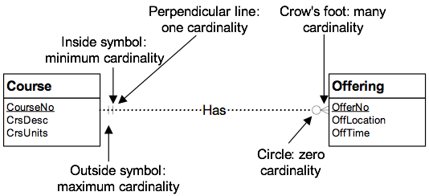
Cardinality Notation Example
Notice that
The “1-1” cardinality next to the Course means that “Each Offering has at least one and at most one Course”
The “0-many” cardinality next to the Offering means that “Each Course may have zero offerings and may have many offerings”
Notes:
Here is another example, where we have two entities, the course enticing with attributes…and the offering entity with ….and the relationship that shows that a course has an offering (or is offered) we can see the cardinality represntation,

Slide 23
One-to-one Relationships
Student
StudentAccount
| |
Owns
0 |
studentID
userID
Cardinality
The maximum number involved in a 1 to 1 relationship is one
Each student can own zero or one (expressed as “0 |”) account and each account is owned by exactly one (expressed as “||”) student

Slide 24
One-to-many Relationships
Department
| |
Has
|
Professor
DeptNo
ProfID
Cardinality
One-to-many , e.g., each department has many professors:
Each department can have one or more (expressed as “ | ”) professors and each professor is affiliated with one and only one (expressed as “| |”) department.

Slide 25
Many-to-Many Relationships
Students
Courses
Student Id
Student name Age
Sex
Take
Course Id
Section Id
Course Description
Location
Many-to-many, e.g., many students take many courses:
Each student can take 1 or more courses and each course can enroll many students.

Slide 26
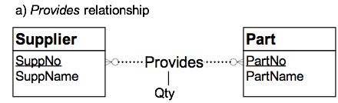
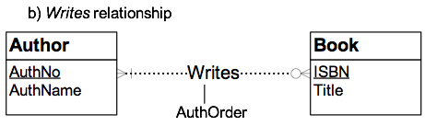
Relationships can also have attributes
Student
Course
Takes
courseNo
studentID
sectionNo
registrationDate

Slide 27
Review
An entity is a collection of objects with the same properties (attributes):
Students (student name, student id, age, sex, etc. )
Courses (course id, section id, course description, location, etc..)
A primary key is an attribute whose value is unique in each instance:
Student id in the students entity
A relationship is an association among entities:
Students take courses (take is a relationship)
Cardinalities describe the number of instances that participate in a relationship
Notes:
Last time we discussed ER diagrams.

Slide 28
In-class (simple) example: Create the following ERDs
A painter can paint many paintings; each painting is painted by one painter. A gallery can have many paintings. A painting can be exhibited by a gallery.
Try variations in the cardinalities among the entities, and see the resulting differences in semantics.

