Slide 1
From a business narrative to an Entity - Relationship Model to a Relational Database

Slide 2

Questions
How can we create an ER diagram from scratch?
How can we go from an ER diagram to a design for a database?
How can we use SQL to create the database in a relational database?
Notes:
Last time we discussed ER diagrams.

Slide 3
Outline
Step-by-step procedure for converting narrative data into Entity-Relationship Diagram
Application of the procedure for designing a DB for water-utility company
Common problems during ER Design

Slide 4
From Narrative to ER diagram
The procedure for analysis:
Identify entities and attributes
Determine primary keys
Identify relationships
Determine relationship cardinalities
Refine the ERD

Slide 5
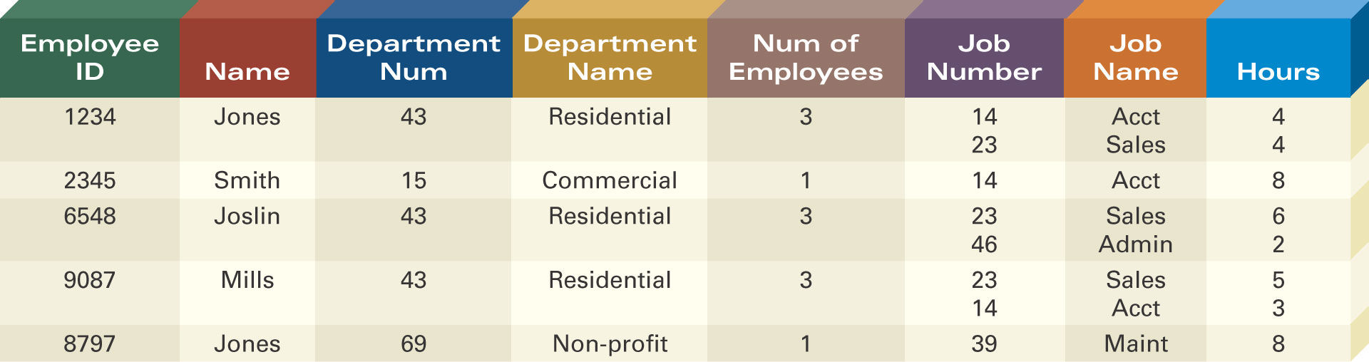
Defining Entity Classes and Primary Keys
What are the entity classes and primary keys for the report below?
What entities/tables should we create?
Are there fields that are redundant once you create the tables?

Slide 6
More advanced example…

Slide 7
Example: Water-Utility Database
Customer database for a municipal water utility
Business Narrative:
Customer has number, name, billing address, type, applicable rate, collection of meters.
Available meter data is number, address, size, model.
Employee periodically reads each meter. Reading has meter reading number, timestamp, consumption level, and employee number.
Bills are based on most recent meter readings and applicable rates.
Rate has rate number, description, fixed and variable dollar amounts, consumption threshold.

Slide 8
Step 1: Identify Entities and Attributes
For entities, find nouns that describe people, places, things, and events
For attributes, look for details about the entities
Difficult decision: Attributes vs. Entities
Simplicity principal: consider as an attribute unless other details are presented.
Example : Should an address be an attribute or a separate entity? Advantages and disadvantages?
Notes:
For example, which one of the two should we choose?

Slide 9
Step 2: Determine primary keys
Stable: never change after assigned
Each entity should have one and only one (good choice: automatically generated values, eg StudentId, CourseId)
What about the following PKs for a person?
Credit card
Phone number
PassportID
SSN
Notes:
SSN: immigrants (outside US) don’t have one. PPl lose it . PPl don’t want to share their SSN.

Slide 10
Water utility DB: Entities & attributes
Customer has number, name, billing address, type, applicable rate, collection of meters.
Available meter data is number, address, size, model.
Employee periodically reads each meter. Reading has meter reading number, timestamp, consumption level, and employee number.
Bills are based on most recent meter readings and applicable rates.
Rate has rate number, description, fixed and variable dollar amounts, consumption threshold.

Slide 11
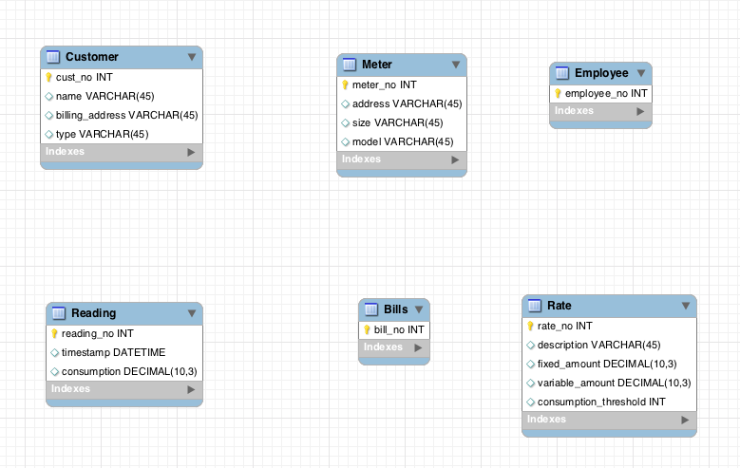
Entities & Attributes

Slide 12
Step 3: Identify Relationships and determine cardinalities
Identify relationships connecting previously identified entity types
Relationships = associations among nouns representing entity types
Identify maximum cardinalities and minimum cardinalities

Slide 13
Identify Relationships
Customer has number, name, billing address, type, applicable rate, collection of meters.
Available meter data is number, address, size, model.
Employee periodically reads each meter. Reading has meter reading number, timestamp, consumption level, and employee number.
Bills are based on most recent meter readings and applicable rates.
Rate has rate number, description, fixed and variable dollar amounts, consumption threshold.

Slide 14
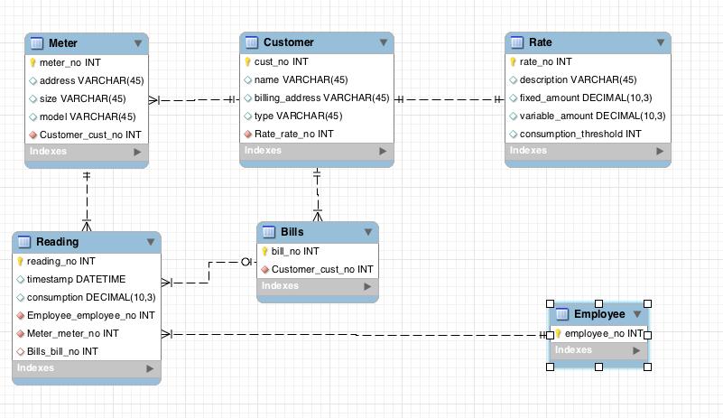
Water Utility: Relationships & Cardinalities

Slide 15
ERD refinements
We constructed initial ERD
However, several refinements can be made
Typical list of refinements:
Attributes -> Entities
Splitting compound attributes

Slide 16
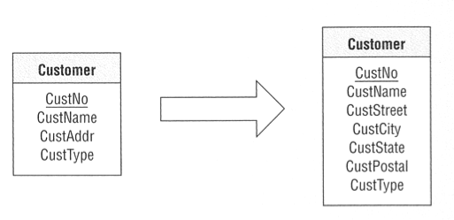
Splitting attributes
Customer Address is a compound attribute. Maybe we need to search by city?

Slide 17
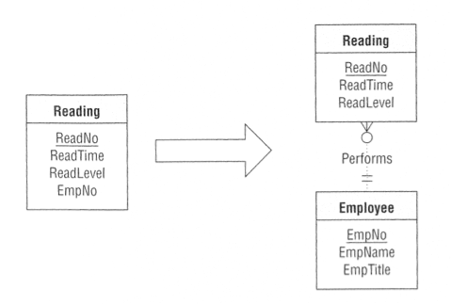
Attributes -> Entities
Readings are done by employees. What if we know something about them (e.g. name, title)?

Slide 18
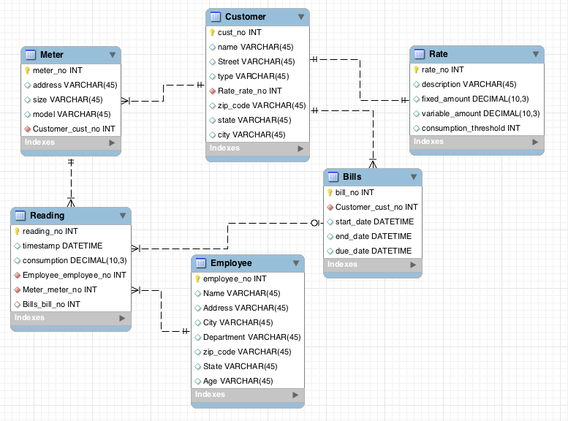
Final ERD

Slide 19
From ER diagrams to Tables

Slide 20
ER Diagram → Relational Model
Step 0: Identify:
Entities
Relationships (many-to-many, one-to-many, one-to-one)
Special attributes (primary key)
Step 1: Entities
Step 2: Many-to-many relationships
Step 3: One-to-many relationships
Step 4: One-to-one relationships

Slide 21
Example - Water Utility

Slide 22
Step 0: Entities map to Tables
Each entity maps to a table
Each attribute maps to a column in the table
The primary key of the entity maps to the primary key of the table
Primary keys are underlined

Slide 23
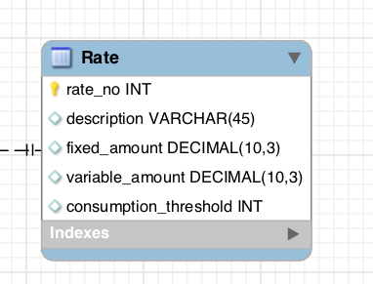
Step 1: Water Utility Entities
Rate
Customer
Meter
Reading
Employee
Bill
Rate
Rate_no | Description | Fixed amount | Variable amount | Consumption Threshold
R1278 | Rate descr 1 | 40 | 10 | 0.7
R982 | Rate descr 3 | 70 | 20 | 0.7
R1908 | Rate descr 7 | 120 | Null | Null

Slide 24
Step 2: One to many relationships
For each One-to-Many relationship
Add a foreign key (FK) to the table corresponding to the “many” entity

Slide 25
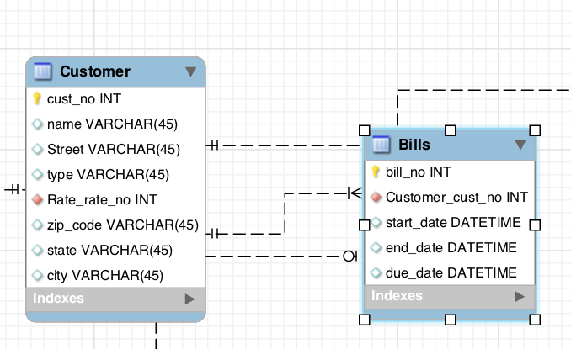
Step 2: Example
Foreign Key

Slide 26
Step 3: One to one Relationships
We treat One-to-One relationship similarly as we treat One-to-Many relationship
Option 1: Add a Foreign Key to either of the two tables
Option 2: Merge the two tables (sometimes ok, sometimes bad style)

Slide 27
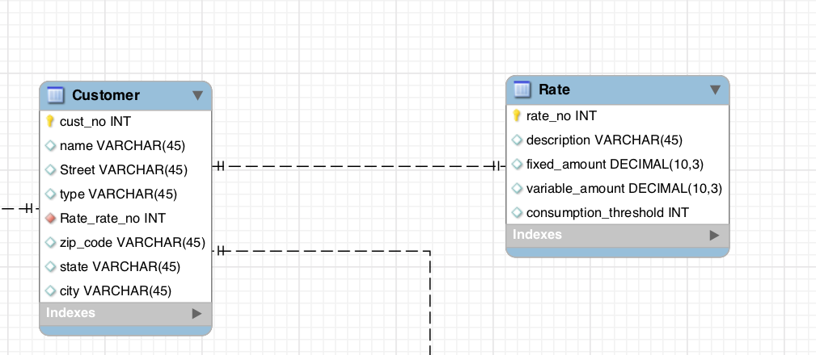
Step 3: Example
Foreign Key

Slide 28
Step 4: Many to many relationships
Need to introduce bridge table (Each Many-to-Many relationship becomes a separate table)
The primary key of the bridge table is the combination of the primary keys of the entity types participating in the relationship
Each of the primary keys stored in the bridge table is a foreign key, pointing to the original entity table

Slide 29
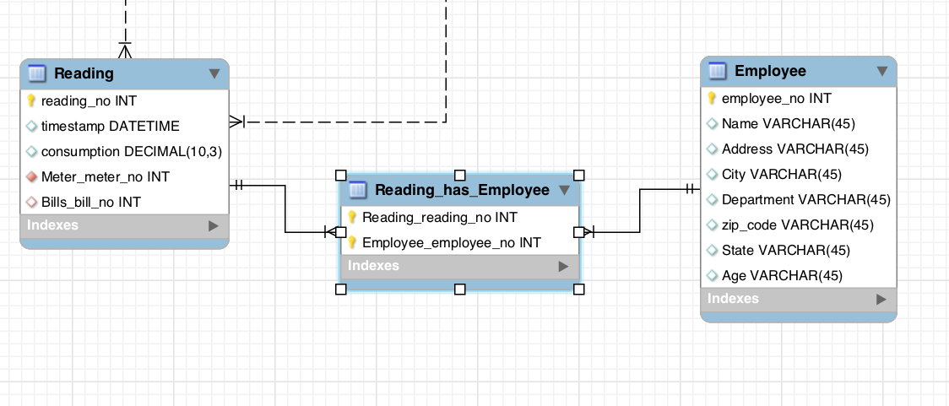
Step 4: Example
Lets assume that a reading can be done by many employees
Reading No | Employee No
Reading No | Timestamp | …
Employee No | Name | …

Slide 30
Final Results
Meter (meter_no, address, size, model, cust_no)
Customer (cust_no, name, street, type, rate_no, zip_code, state, city)
Rate (rate_no, description, fixed_amount, variable_amount, consumption_threshold)
Reading (reading_no,timestamp,consumption, meter_no, bill_no)
Reading_has_Employee (reading_no, employee_no)
Employee (employee_no, name, address, city, dept, zip_code, state, age)
Bills (bill_no, cust_no, start_date, end_date, due_date)

Slide 31
Creating Tables in SQL

Slide 32
SQL Statements to create tables
CREATE TABLE table_name
(
column_name1 data_type(size),
column_name2 data_type(size),
column_name3 data_type(size),
....
);

Slide 33
SQL Statements to create tables
CREATE TABLE Rate ( id INT, name VARCHAR(20), price FLOAT, startdate DATE );

Slide 34
Define primary key
CREATE TABLE Rate ( id INT, name VARCHAR(20), price FLOAT, startdate DATE,
PRIMARY KEY(id)
);

Slide 35
Define FOREIGN KEY
CREATE TABLE Rate ( id INT,
customerid INT, price FLOAT, startdate DATE,
PRIMARY KEY(id)
FOREIGN KEY (customerid) REFERENCES Customer(id) );

Slide 36
“Enforcing participation” in a relationship
To specify that a relationship has a minimum cardinality of one, we specify that the attribute cannot be NULL (ie empty)
In this case, the rate needs to be associated with a customer
CREATE TABLE Rate ( id INT,
customerid INT NOT NULL, price FLOAT, startdate DATE,
PRIMARY KEY(id),
FOREIGN KEY (customerid) REFERENCES Customer(id) );

Slide 37
“Enforcing 1-1” in a relationship
To specify that a relationship has a maximum cardinality of one, we specify that the foreign key is UNIQUE
In this case, the rate needs to be associated with a customer, and a customer can be assigned with only one rate (due to the UNIQUE)
CREATE TABLE Rate ( id INT,
customerid INT NOT NULL, price FLOAT, startdate DATE,
PRIMARY KEY(id),
UNIQUE (customerid),
FOREIGN KEY (customerid) REFERENCES Customer(id) );

Slide 38
Facilitating the process in practice
MySQL Workbench many of these steps for you:
Create the ER diagram
Go to Database -> Forward Engineer -> Follow the instructions
Your database schema is (almost) ready!
Often, you need to fine-tune the output based on what we learned

Slide 39
Summary of ER modeling
ER model is popular for conceptual design
Constructs are expressive, intuitive and graphical.
Basic constructs: entity types, relationships (cardinalities), and attributes
ER modeling is subjective!
There are often many ways to model a given scenario!
Analyzing alternatives is key
ER modeling is iterative!
Resulting diagram should be analyzed and refined further.

Slide 40
In-class exercise: (if we have time) Create the following ERDs and tables
NoFuture Records has decided to store information about musicians who perform on its albums (as well as other company data) in a database.
Each musician that records at NoFuture has an SSN, a name, an address, and a phone number. Poorly paid musicians often share the same address, and no address has more than one phone.
Each instrument used in songs recorded at NoFuture has a unique identification number, a name (e.g., guitar, synthesizer, ﬂute) and a musical key (e.g., C, B-ﬂat, E-ﬂat).
Each album recorded on the NoFuture label has a unique identification number, a title, a copyright date, a format, and an album identifier.
Each song recorded at NoFuture has a title and an author.
Each musician may play several instruments, and a given instrument may be played by several musicians.
Each album has a number of songs on it, but no song may appear on more than one album.
Each song is performed by one or more musicians, and a musician may perform a number of songs.
Each album has exactly one musician who acts as its producer. A musician may produce several albums.

