Slide 1

Technical Paper Presentation
Track Number: 1A
Paper ID: 328
Paper Title: Detection of Fake News using Machine Learning
Authors: Sakshi Neeraj, Leena Singh, Sudhanshu Tripathi, Nidhi Malik

Slide 2

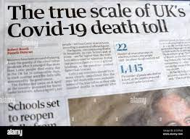


Presentation Flow
Introduction to the problem of Fake News
Work Flow of the proposed model generation
Review and Results of the methodology
Conclusion
References

Slide 3
Introduction
Inaccurate or deceptive information that is reported as news is termed fake news.
Regulation of false news causes challenges in the dissemination of accurate information and leads to misconceptions that endanger national cohesion and individual tranquility.
Contemporary research has evidenced that false news is proliferating at an astounding level, leading to its widespread popularization. The propagation of anti-vaccination content during the Covid 19 catastrophe is a glaring example of this.
Tim Berners-Lee, who established the World Wide Web, himself asserted that fake news constituted one of the most significant and worrisome new internet concerns that need to be addressed.
The primary idea behind this presentation is to provide true news and fake news dataset to ML algorithms for the creation of classification models, and then use these models to determine whether a news story is real or phony.

Slide 4
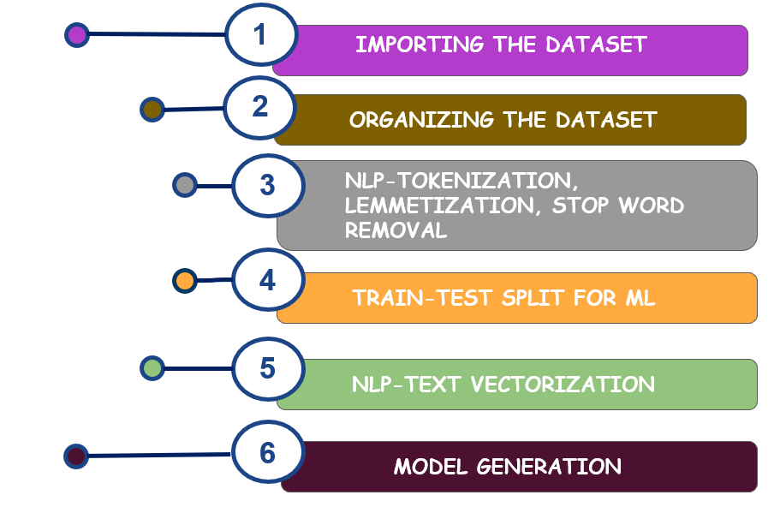
Work Flow

Slide 5
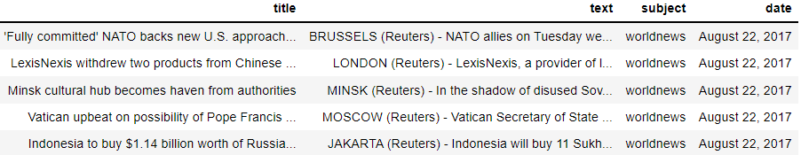
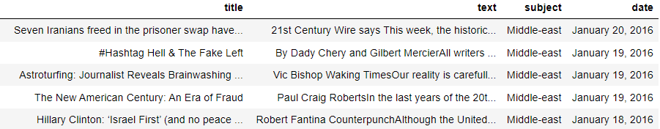
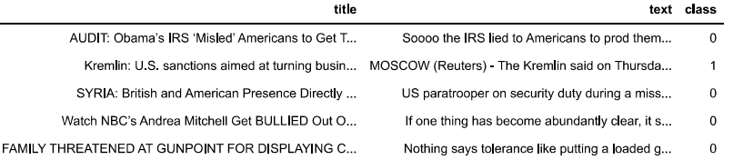
Dataset Organization
True News
Fake News
Merged Organized Dataset

Slide 6
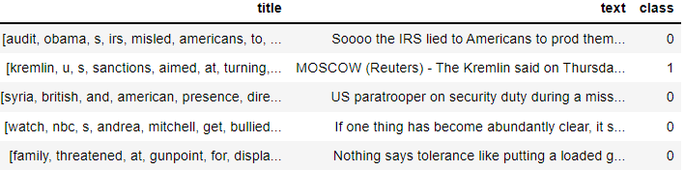
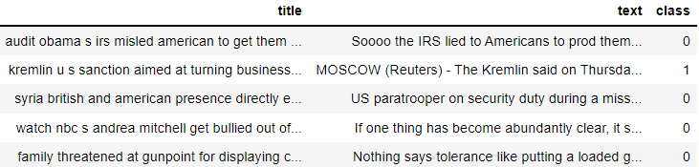
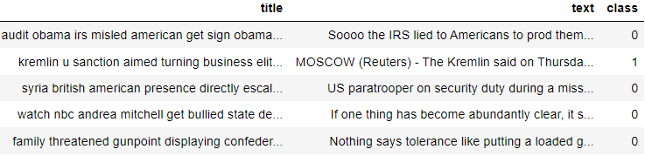
NLP on the title of the news
Tokenization
Lemmatization
Stop Word Removal

Slide 7
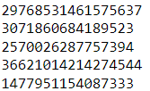
Model Generation
The dataset is divided into 80:20 for training and testing purposes respectively
Further “title” of the news is vectorized using term frequency-inverse document frequency vectorizer
The preprocessed dataset is then used to produce various ML models for classifying the news as real or fake and the independent variable for classification is taken to be the “title” of the news.

Slide 8
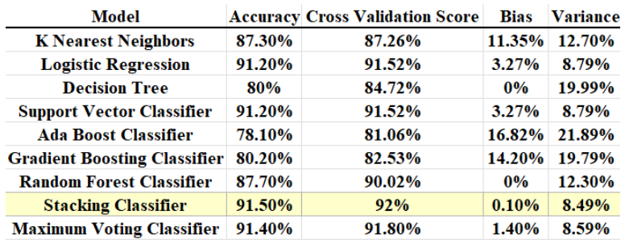
Results
Scores of each model
Stacking classifier constructed by custom ensembling K Nearest neighbors and Support Vector Classifier as the base models and Logistic Regression as the meta model has the highest accuracy

Slide 9
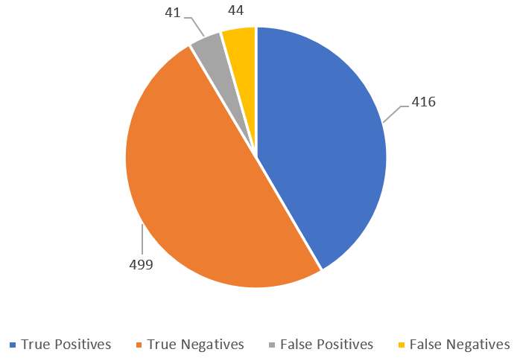
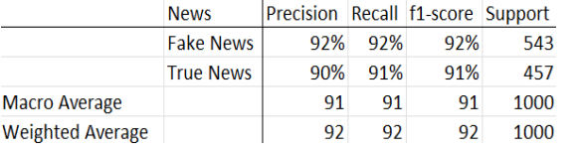
Results
Classification report for Stacking Classifier
Whenever a model predicts a news piece as true, it is 90% correct and whenever it predicts it to be false, it is 92% correct. The model detects 91% of true news and 92% of false news.
Pictorial representation of confusion matrix for Stacking Classifier

Slide 10
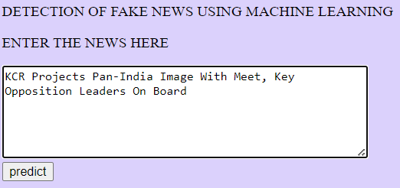
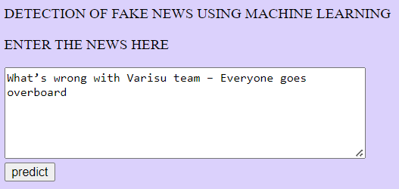
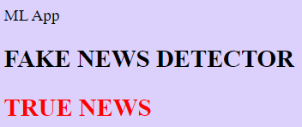
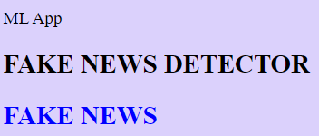
User Interface for the Detector

Slide 11
Conclusion
Transmission of inaccurate news pieces causes serious impact on the cultural well-being of a society and has been a core subject of concern for quite a while.
This presentation was designed to manifest and isolate original news from counterfeit news pieces by making use of varied ML frameworks.
Steps for NLP like tokenization, lemmatization, and vectorization, have been used for data pre-processing preparatory to building the classifier.
A custom-ensembling ML approach created by stacking three distinct algorithms—K Nearest Neighbors, Logistic Regression, and SVC, showed an accuracy of 91.5%, a bias of 0.1%, variance of 8.49% and a cross validation score with 10 folds amounting to 92%.

Slide 12

References
A. Ahmed, A. Aljabouh, P.K. Donepudi, and M.S. Choi, “Detecting Fake News Using Machine Learning : A Systematic Literature Review”, arXiv: 2102.04458, February 2021.
J.H. Friedman, “Data Mining and Statistics: What's the connection?, Computing Science and Statistics”, vol. 29(1), pp. 3–9, 1998.
N. Kaur and A. Solanki, “Sentiment Knowledge Discovery in Twitter Using CoreNLP Library”, 8th International Conference on Cloud Computing, Data Science & Engineering (Confluence), 2018.
N. Kaur and A. Solanki, “Sentiment Knowledge Discovery in Twitter Using CoreNLP Library”, 8th International Conference on Cloud Computing, Data Science & Engineering, 2018.
G. Guida, G. Mauri, "Evaluation of natural language processing systems: Issues and approaches", Proceedings of the IEEE, vol. 74 (7), pp. 1026– 1035, July 1986.
M.C. Buzea, S. Trausan-Matu, T. Rebedea, “Automatic Fake News Detection for Romanian Online News”, 2022.
S.B. Parikh and P.K. Atrey, “Media-Rich Fake News Detection: A Survey”, IEEE Conference on Multimedia Information Processing and Retrieval (MIPR) pp. 436-441, April 2018.
S. Helmstetter, and H. Paulheim, “Weakly supervised learning for fake news detection on Twitter”, IEEE/ACM International Conference on Advances in Social Networks Analysis and Mining (ASONAM) pp. 274-277, August 2018.
H. Allcott, M. Gentzkow, "Social media and fake news in the 2016 Election", Journal of Economic Perspectives, vol. 31(2), pp. 211– 236, May 2017.
Y. Chen, N.J. Conroy, and V.L. Rubin, “Misleading online content: Recognizing clickbait as false news”. Proceedings of the 2015 ACM on Workshop on Multimodal Deception Detection pp. 15-19, November 2015.
G. Hinton, S. Osindero, and Y. The, “A fast learning algorithm for deep belief nets. Neural Computation”, 2006.
Goldsborough, Reid, "Understanding Facebook's News Feed". Tech Directions, Vol. 76 (9), May 2017.
M. Garrahan and T. Bradshaw, R. Waters, "Harsh truths about fake news for Facebook, Google and Twitter", Financial Times, January 2017.
N. Kumar, S. Sharma, “Survey Analysis on the usage and Impact of Whatsapp Messenger”, Global Journal of Enterprise Information System.
A. Ahmad, Y. Muhammad, Y. Suhail, A. Muhammad Ovais, "Fake News Detection Using Machine Learning Ensemble Methods", 2020.
J. Swartz, "The World Wide Web's inventor warns it's in peril on 28th anniversary”, USA Today, March 2017.
M. Bleigh, "The Once And Future Web Platform", TechCrunch, May 2014.

