Slide 1
System Performance Information Real Time Dashboard

Slide 2
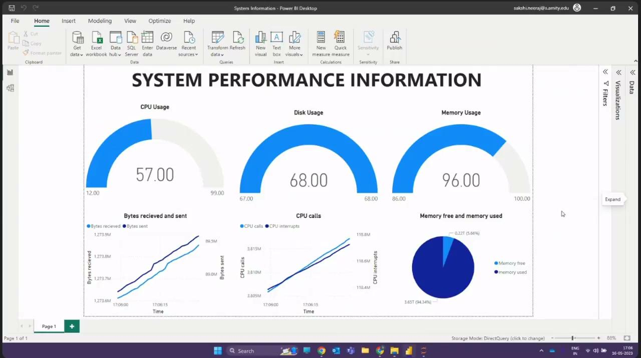

Slide 3
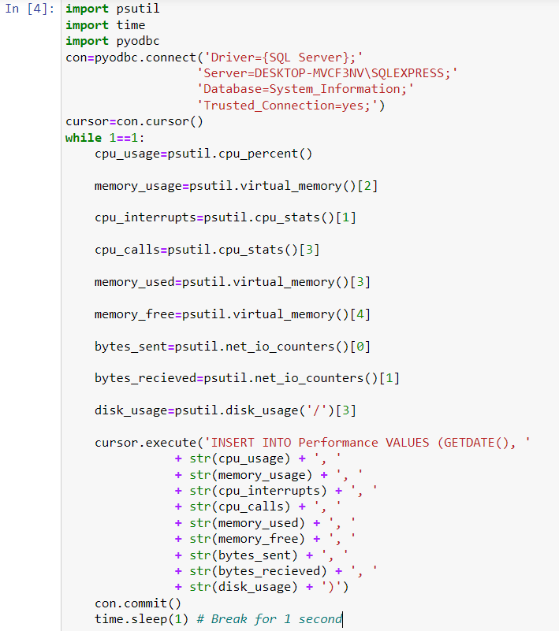
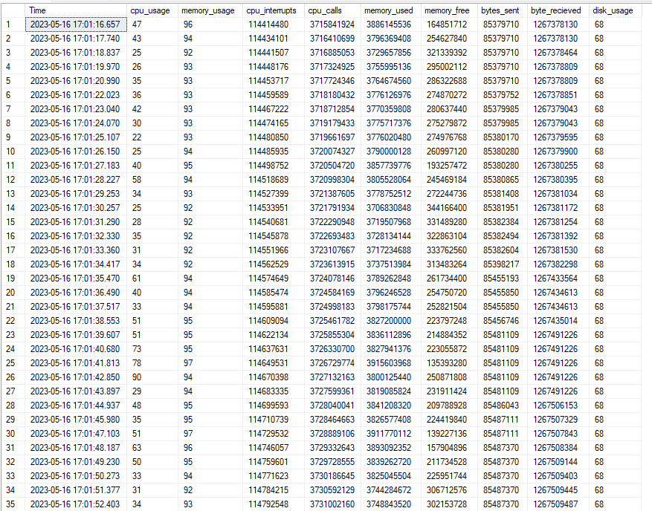
Data in SQL Database
System Information retrieval and connection to SQL using Python

Slide 4
CPU USAGE
CPU usage refers to the amount of processing power or resources that a computer's central processing unit (CPU) is utilizing at a given time. It indicates the percentage of the CPU's capacity being used to execute various tasks or processes.
DISK USAGE
Disk usage refers to the amount of storage space occupied by files, folders, and system data on a computer's hard disk drive (HDD) or solid-state drive (SSD). It represents the utilization of the available disk space.

Slide 5
MEMORY USAGE
Computer memory, often referred to as random-access memory (RAM), is a volatile form of storage that provides fast access to data and instructions for the CPU. When a program or process is executed, it requires a certain amount of memory to hold its code, variables, and other temporary data.
BYTES SENT AND RECEIVED
These typically refers to the amount of data transmitted over a network interface. It represents the volume of data received and sent by the network adapter or network interface card (NIC) in the computer.

Slide 6
CPU CALLS
CPU calls are specific functions or interfaces provided by the operating system that allow programs to request services from the operating system kernel. These calls enable programs to interact with hardware devices, access files, allocate memory, perform I/O operations, and other privileged operations.
CPU INTERRUPTS
CPU interrupt is a signal that interrupts the normal execution of a program and causes the CPU to temporarily suspend its current task to handle the interrupt request.

