Slide 1

Quantum AI

Slide 2
Team Members
Akash
Sakshi
Jagadeesh
Sai Pranit

Slide 3
Introduction
Aim of study: Identify key diabetes risk factors
Explore demographics and health behaviors

Slide 4
Data set summary
Dataset Summary253,680 rows, 22 columns
Mix of discrete (15) and continuous (7) features
No missing values, duplicates removed

Slide 5
Data Cleaning Steps
Checked for null values (none found)
Removed duplicates to ensure integrity
Verified data types for each feature

Slide 6
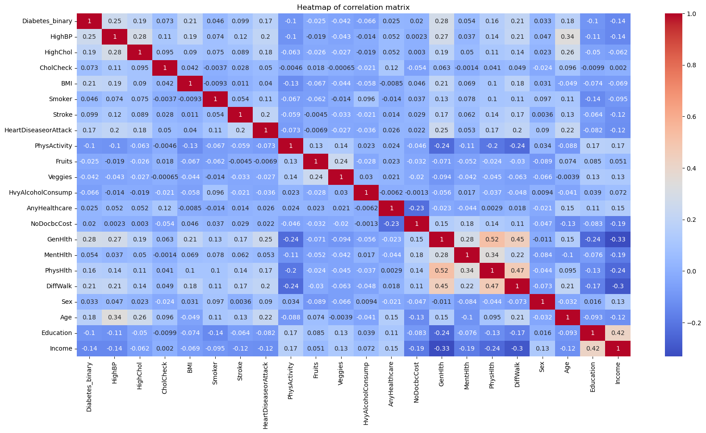
Correlation
The correlation heatmap shows relationships between the columns.
GenHlth and PhysHlth have a strong positive correlation.
GenHlth and Income have a strong negative correlation.

Slide 7
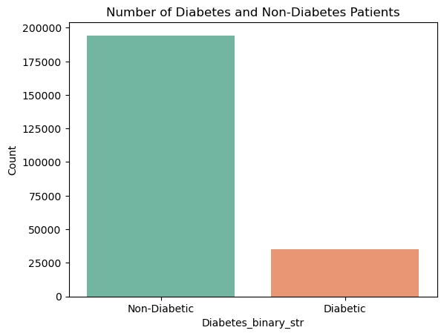
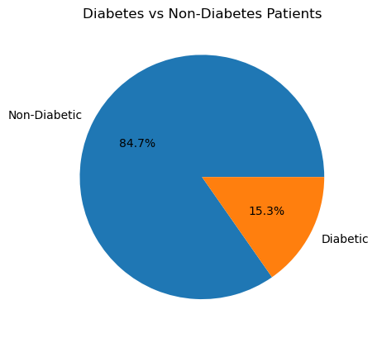
No of diabetic and non Diabetic

Slide 8
Major Factors Related to Diabetes_binary
HighBP,
HighChol,
BMI,
Smoking,
Stroke,
Heart Disease or Attack,
Physical Activity,
Age,
Education,
Income

Slide 9
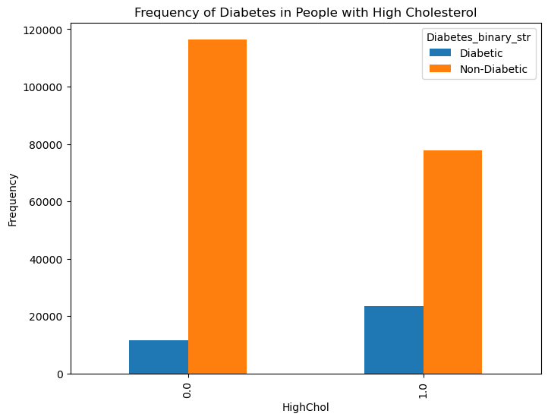
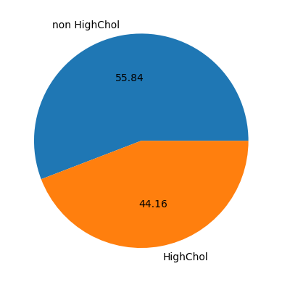
Relationship Between HighChol and Diabetes_binary
HighChol plays an important role in diabetes. As HighChol cases increase, diabetes cases also rise.

Slide 10
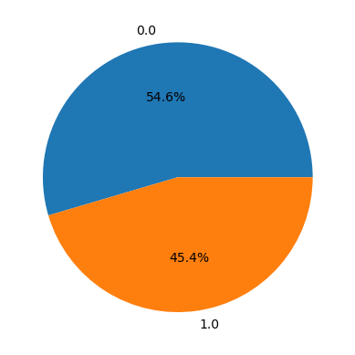
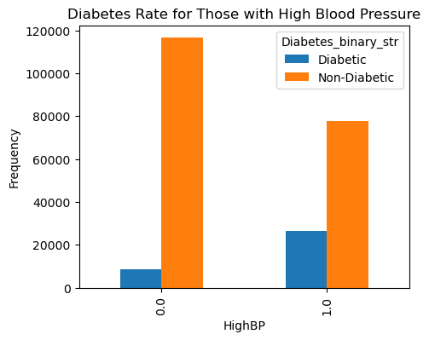
Relationship Between HighBP and Diabetes_binary
HighBP is a play a major role in Diabetes. When cases of high BP increases then cases of Diabetes also increases.

Slide 11
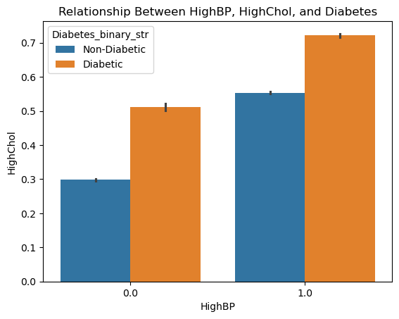
Analyzing the combined impact of HighBP and HighChol on diabetes.
Acording to this data, HighBP and HighChol both togather increase the risk of diabetes.

Slide 12
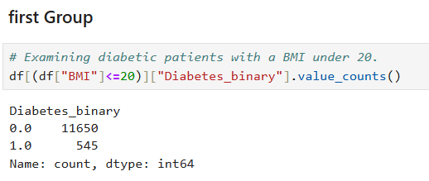
Relationship Between BMI and Diabetes_binary
Dividing the BMI into Three groups (BMI<=20,(BMI>20 and BMI<=50),(BMI>50 and BMI<=100))

Slide 13
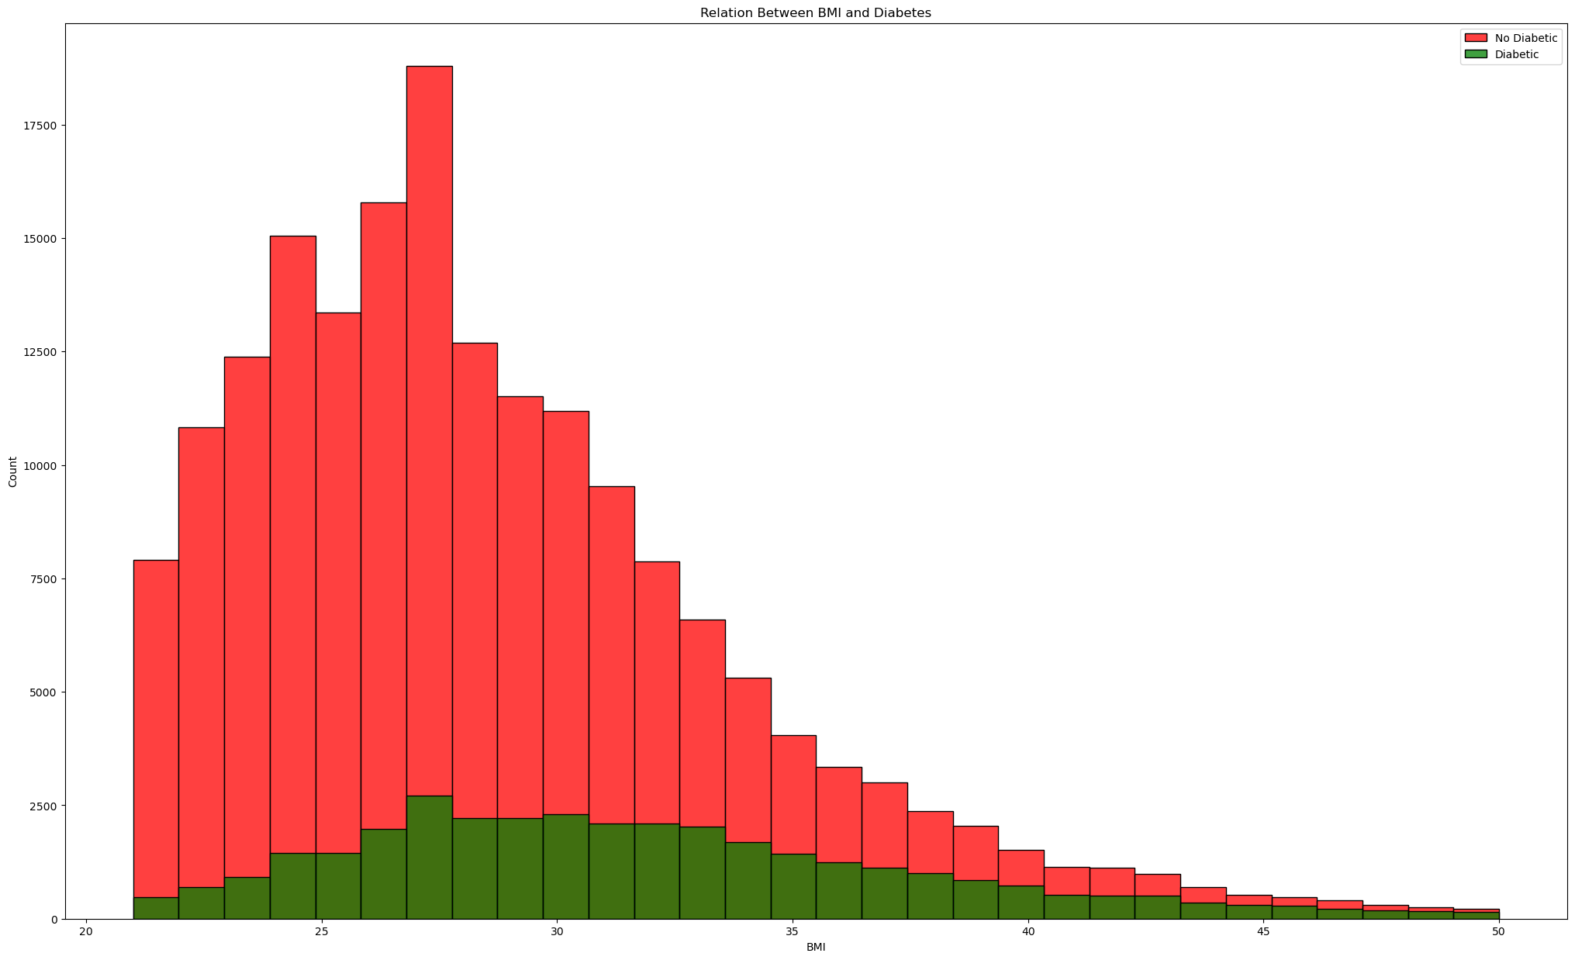
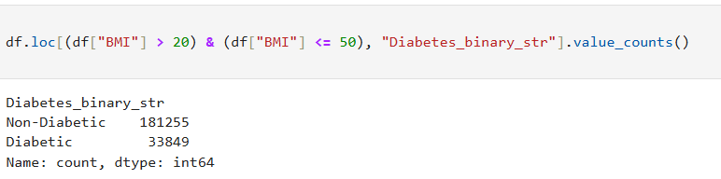
Second group

Slide 14
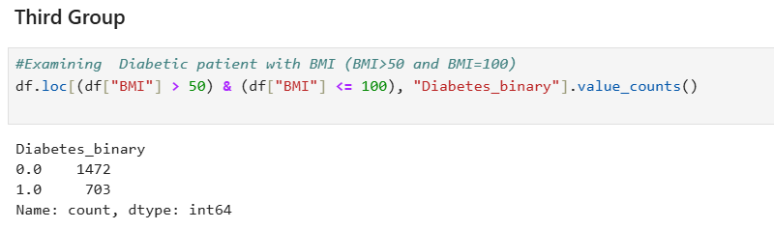
Third Group

Slide 15
Insights from BMI:
Most diabetic people have a BMI between 20 and 50.
215,104 people have a BMI in this range.
33,849 diabetic people have a BMI between 20 and 50. Form this we can make a conclusion that the second BMI group has a significant impact on diabetes.
There are also some outliers in the BMI data.

Slide 16
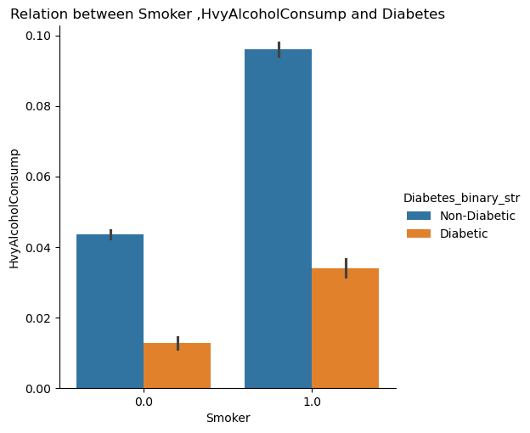
The combined effect of smoking and heavy alcohol consumption on diabetes.
The data shows that smoking and heavy alcohol consumption together increase the risk of diabetes.

Slide 17
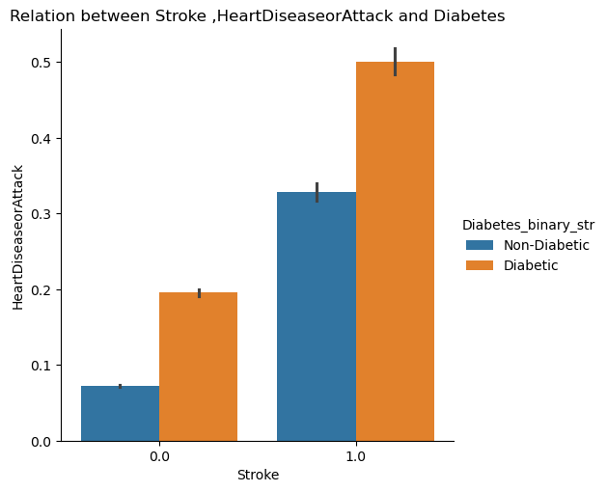
The combined effect of stroke and heart disease or attack on diabetes.
The data shows that stroke and heart disease or attack together increase the risk of diabetes.

Slide 18
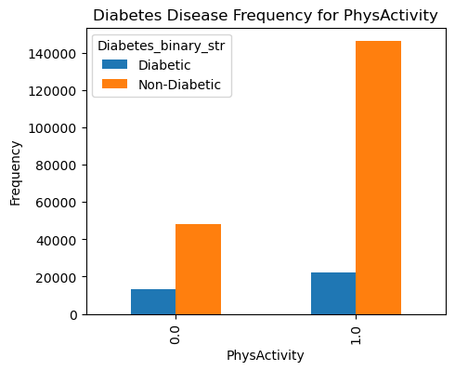
The effect of physical activity
Physical activity lowers the risk of diabetes.

Slide 19
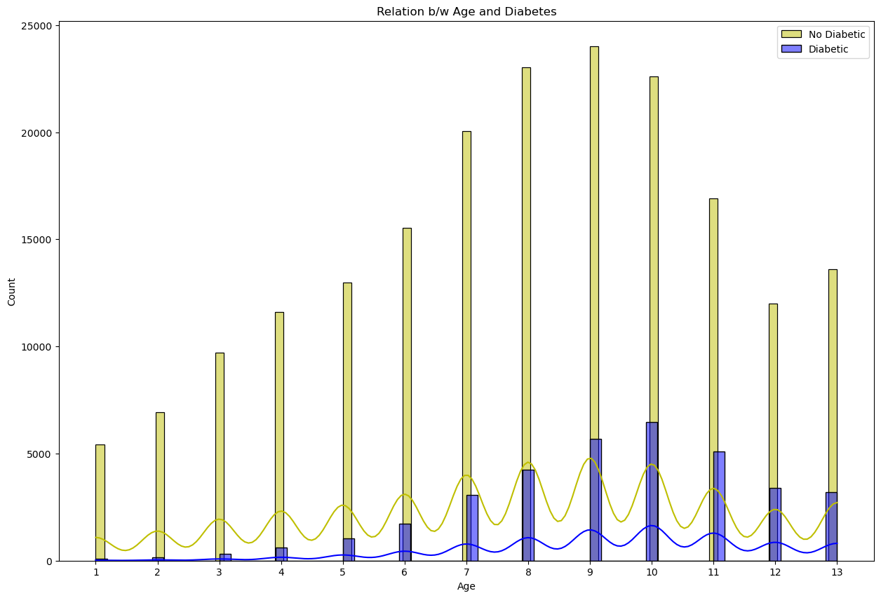
Relation between age and Diabetes
People over 45 are more at risk for diabetes than younger people. As age increases, the number of diabetic people also rises.

Slide 20
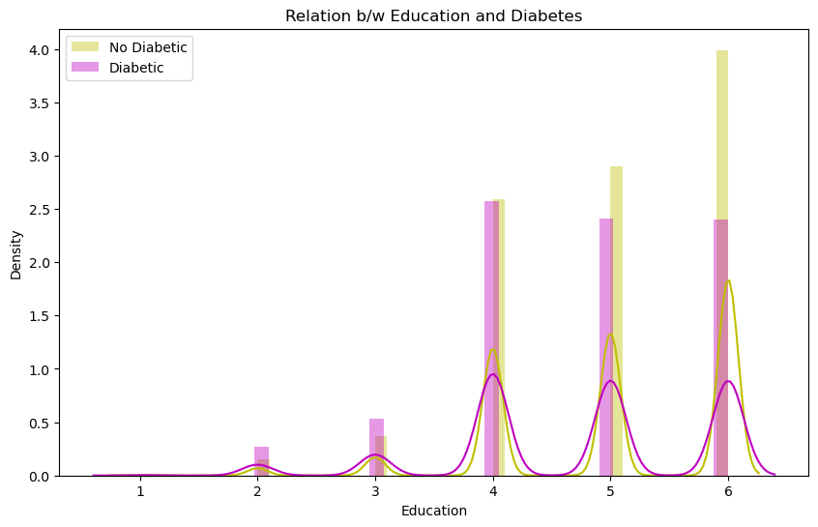
Relation between Education and Diabetes
As education levels increase, the number of diabetic people decreases.

Slide 21
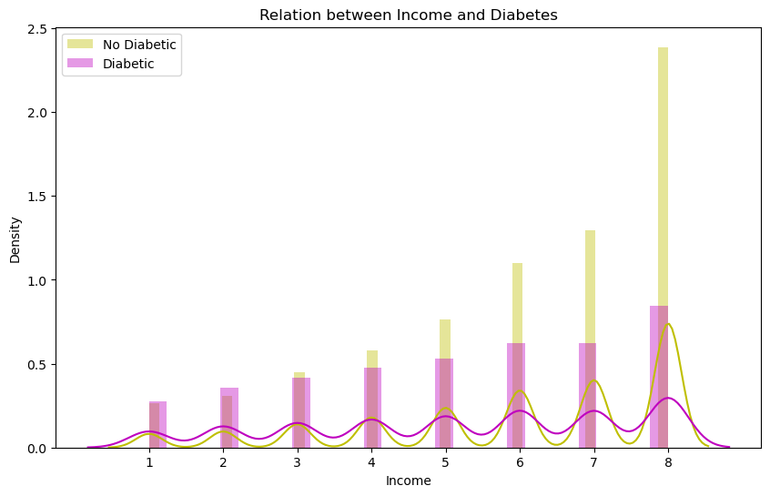
Relation Between Income and Diabetes
People with lower income are at a higher risk of diabetes compared to those with higher income.

Slide 22

THANK YOU

