Slide 1

CEO & CMO Insights Presentation
By- Sakshi Aher

Slide 2

OBJECTIVES
Identify Revenue Trends
Focus on High-Performing Markets
Analyze monthly sales patterns to highlight seasonal trends and peaks
Determine the top revenue-generating countries (excluding the UK) and assess their potential for further investment.
Explore Expansion Opportunities
Retain Key Customers
Pinpoint high-value customers to develop strategies that ensure loyalty and sustained revenue.
Identify regions with strong product demand, excluding the UK, to guide market expansion plans.

Slide 3
KEY AREAS OF ANALYSIS
1. Monthly Revenue Trends
Seasonal patterns indicate peak months .
Focus on promotions and inventory during these periods.
2. Top Revenue-Generating Countries
Excluding UK, Germany and France are key markets.
Targeted marketing campaigns recommended.
3. Top Customers by Revenue
Focus on retaining high-value customers with loyalty programs.
4. Product Demand by Country
High demand in regions like Australia and the Netherlands.
Expansion opportunities identified.

Slide 4
DATA PREPARATION
c
Data Visualization
Data Cleaning
Calculate Revenue
Data Validation
Remove incorrect records (negative quantities and unit prices below $0).
Quantity × Unit Price.
Verified data for accuracy before analysis
Tool: Tableau for visualization and insights generation

Slide 5

"DATA INSIGHTS AND VISUAL ANALYSIS"

Slide 6

1. MONTHLY REVENUE TRENDS IN 2011
1. MONTHLY REVENUE TRENDS IN 2011
October and November show the highest revenue, due to seasonal demand, likely influenced by holiday shopping.
November 2011 is the best-performing month, indicating a significant spike in consumer activity.
The lowest revenue is observed in February 2011 and December 2011 possibly due to post-holiday slowdowns.

Slide 7
2. TOP 10 COUNTRIES BY REVENUE & THEIR QUANTITY
Top Revenue-Generating Countries:
NETHERLANDS
EIRE
GERMANY
The Netherland sold the highest quantity (200,937 units), indicating strong market demand.
Low Revenue and Quantity:
NORWAY
PORTUGAL
Mid-Level Performers:
FRANCE
SPAIN

Slide 8
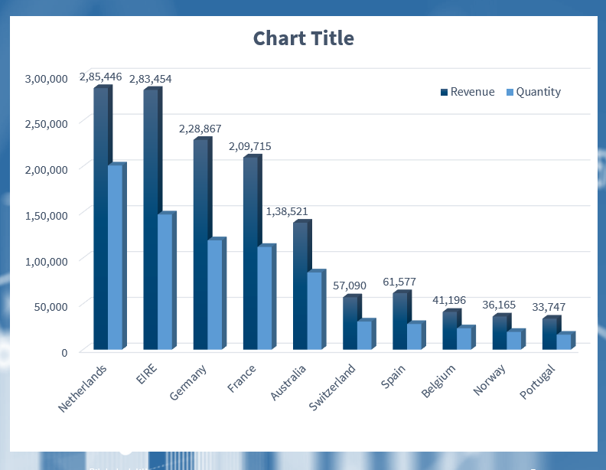
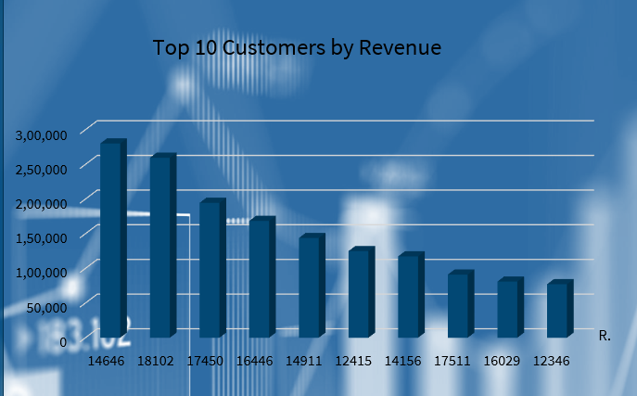
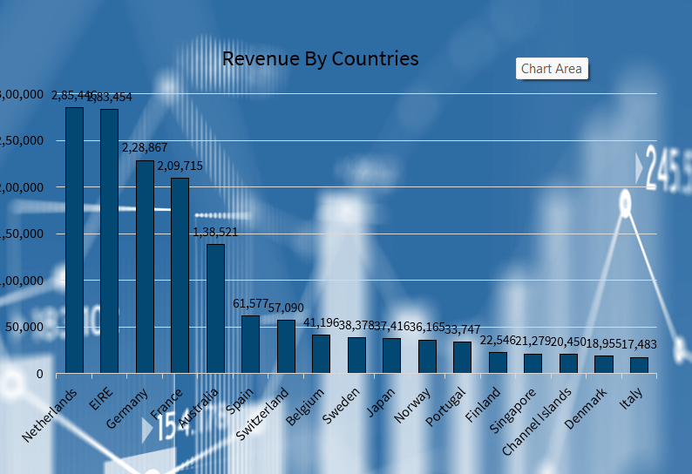
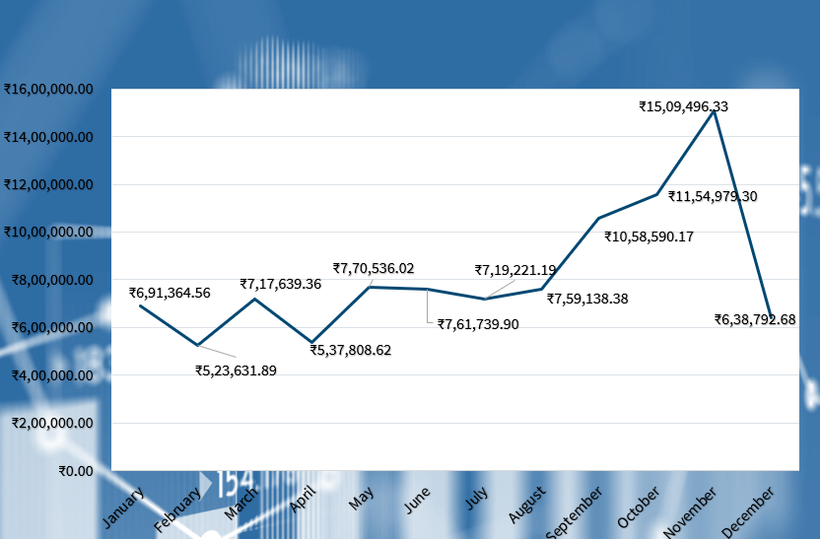

Slide 9
3. TOP 10 CUSTOMERS BY REVENUE
3. TOP 10 CUSTOMERS BY REVENUE
The highest revenue comes from Customer ID 14646 followed closely by Customer ID 18102 and Customer ID 17450.
Customers like 16446 (₹168,473) and 14911 (₹143,825) also contribute significantly, highlighting their importance to the business.
Customers such as 12346 (₹77,184) and 16029 (₹81,025) represent smaller revenue shares but offer opportunities for growth through targeted engagement strategies..

Slide 10
3. TOP 10 CUSTOMERS BY REVENUE
4. DEMAND BY REGION (EXCLUDING UK)
The Netherlands (₹285,446) and EIRE (₹283,454) are the highest revenue-generating countries, indicating strong demand and customer engagement.
Germany (₹228,867) and France (₹209,715) also contribute significantly, showing potential for further business expansion.
Australia (₹138,521), Spain (₹61,577), and Switzerland (₹57,090) show moderate revenue.
Belgium (₹41,196), Sweden (₹38,378), Japan (₹37,416), and Norway (₹36,165) have lower but steady revenue.
Portugal (₹33,747), Finland (₹22,546), Singapore (₹21,279), Channel Islands (₹20,450), Denmark (₹18,955), and Italy (₹17,483) contribute the least revenue.

Slide 11
Strategic Recommendations for Business Growth
1.Revenue Trends & Seasonality
2 . Top Revenue-Generating Countries
Insight: Revenue peaks in September–November, with a drop in December.
Recommendation:
Analyze seasonal demand drivers and optimize inventory.
Introduce early promotions before peak seasons.
Implement post-holiday campaigns to mitigate December decline.
Insight: Netherlands, EIRE, and Germany contribute the highest revenue (excluding the UK).
Recommendation:
Increase marketing spend in high-performing regions.
Expand localized promotions and partnerships.
Evaluate regional pricing strategies for competitiveness.
3. Top 10 High-Value Customers
4. Demand Analysis Across Countries
Insight: A small group of customers drives a significant share of revenue.
Recommendation:
Launch a VIP loyalty program with personalized offers.
Provide exclusive previews and early access to new products.
Assign dedicated account managers for top customers.
Insight: Several countries show strong demand, indicating expansion opportunities. Recommendation:
Conduct market feasibility studies before expansion.
Strengthen logistics and fulfillment networks in high-demand regions.
Implement localized customer support to enhance service experience.

Slide 12

CONCLUSION
Data-driven decisions will help in strategic expansion.
Focus on high-performing regions while improving weaker markets.
Customer retention and market expansion are key to future growth.

Slide 13

sakshi0201aher@gmail.com
+917841833719

