Slide 1

Mental Health Tracker: Bridging Gaps in Emotional Well-Being
Team Details Mentor Details
22BT04058-Sakshee Kulkarni Ms. Zalak Kansagra
22BT04024-Sakshi Desai

Slide 2
Mental Health Tracker: Bridging Gaps in Emotional Well-Being
Problem Statement
In today’s digital era, mental health issues are often reflected in social media activity. However, timely detection and intervention are lacking.
Our Mental Health Tracker addresses this gap by:
Analyzing social media posts or hashtags to identify emotional patterns.
Using sentiment analysis models to detect negative emotions such as sadness, anger, or fear.
Triggering instant responses:
Playing soothing music to uplift mood.
Suggesting interactive visual games to reduce stress and enhance well-being.

Slide 3
Mental Health Tracker: Bridging Gaps in Emotional Well-Being
Objectives
To analyze social media content for emotional indicators.
To detect negative emotions using sentiment analysis techniques.
To provide real-time emotional feedback using a simple and interactive GUI.
To offer soothing music and engaging visual games as instant mood boosters.
To showcase how AI can be used to gently support mental wellness without storing personal data.

Slide 4
Mental Health Tracker: Bridging Gaps in Emotional Well-Being
Tools and Technologies
Python – Core language for the full application: sentiment analysis, GUI, and games.
TensorFlow/Keras – For building the LSTM-based emotion classification model.
Scikit-learn – Used for data preprocessing and model evaluation.
Tkinter – To design the GUI for emotion display and user interaction.
Pygame – For developing interactive games (e.g., Bubble Pop, Flower Bloom).
pygame.mixer – To play soothing music during negative mood detection.

Slide 5
Mental Health Tracker: Bridging Gaps in Emotional Well-Being
Methodology
Example : "i dont know i feel so lost"
True Emotion: sad
1. Tokenization
Each word in the sentence is converted to a number using the tokenizer.
Let’s assume the tokenizer gives:
["i", "dont", "know", "i", "feel", "so", "lost"]
→ [12, 53, 87, 12, 89, 30, 205]
2. Padding
The model expects a fixed length (e.g. 50), so we add 0s at the end:
[12, 53, 87, 12, 89, 30, 205, 0, 0, ..., 0] # Total = 50

Slide 6
Mental Health Tracker: Bridging Gaps in Emotional Well-Being
Methodology
3. Model Prediction The LSTM model processes the padded sequence and understands: "feel so lost" = strong indicator of sadness. It gives output probabilities like: [0.02, 0.03, 0.05, 0.85, 0.03, 0.02] (Here, each number is a probability for one emotion) Assume class mapping: 0 = anger, 1 = fear, 2 = joy, 3 = sad, 4 = love, 5 = surprise So, the predicted emotion is: "sad" (because 0.85 is the highest)

Slide 7
Mental Health Tracker: Bridging Gaps in Emotional Well-Being
Methodology
4. Final Response Since it's a negative emotion: Soothing music starts playing in the background to help relax the user. An uplifting game is suggested (Flower Bloom or Bubble Pop ) to cheer them up. A motivational quote is shown to inspire hope and strength. A cheerful emoji appears to visually uplift the mood.

Slide 8
Mental Health Tracker: Bridging Gaps in Emotional Well-Being
Algorithm:
1. Preprocessing:
Clean and tokenize social media text
Convert to padded sequences using tokenizer
2. Emotion Prediction (LSTM):
Pass input to the trained LSTM model
Predict emotion based on text context
3. Trigger Response:
If emotion is negative (e.g., sad, fear): → Play soothing music → Suggest visual game via GUI

Slide 9
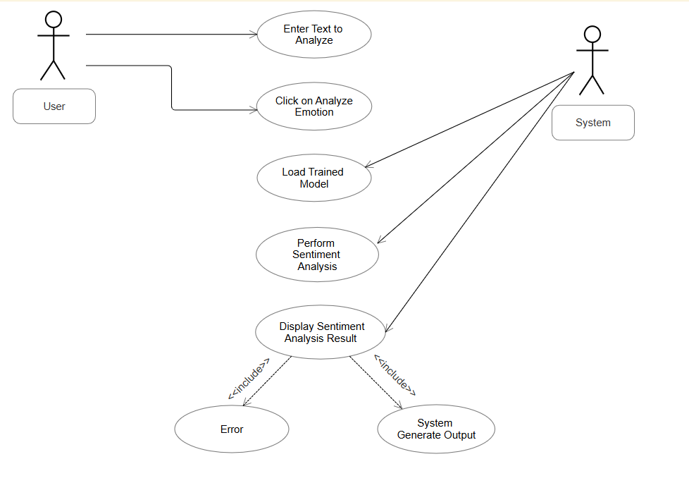
Mental Health Tracker: Bridging Gaps in Emotional Well-Being
Use Case Diagram

Slide 10
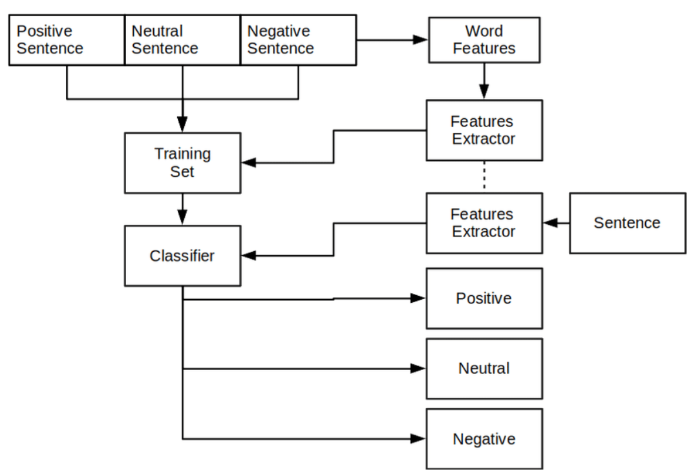
Mental Health Tracker: Bridging Gaps in Emotional Well-Being
Architecture Diagram

Slide 11
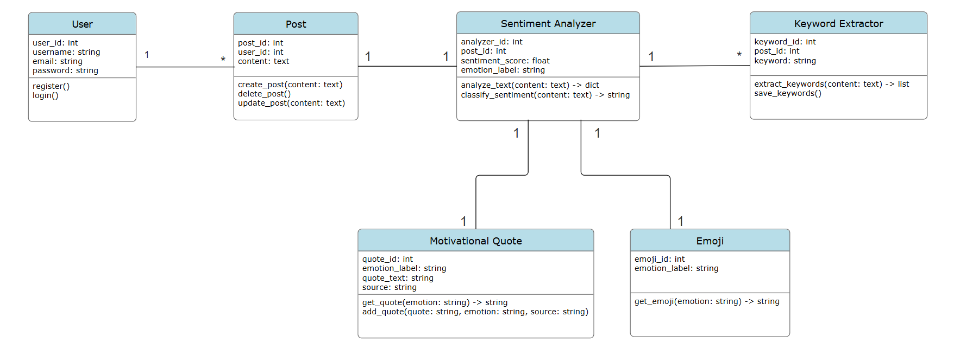
Mental Health Tracker: Bridging Gaps in Emotional Well-Being
Class Diagram

Slide 12
Project Title
Results
Real-Time Feedback: Instant analysis through an intuitive interface.
Motivational Quotes: Gemini API provided mood-boosting quotes.
Interactive Games: Games like "Bubble Pop" aided stress relief.
Impact: Successfully combines emotion tracking, motivational support, and fun activities.

Slide 13
Thank You..

