Slide 1
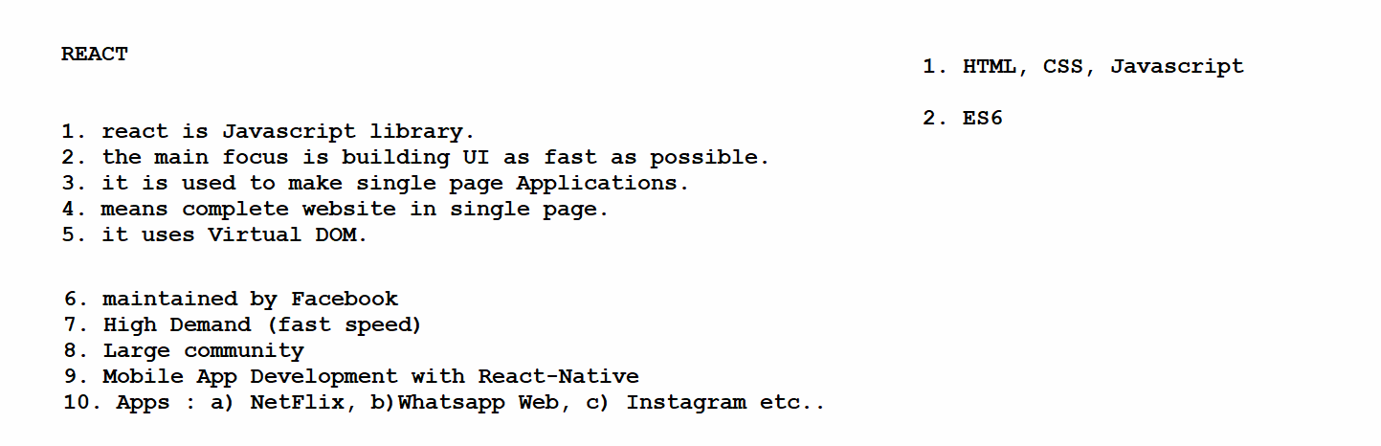

Slide 2
Environment set up for ReactJS 1. install Node and NPM 2. vs code

Slide 3
1. Create a folder 2. Create a react project -> npx create-react-app app-name 3. inside the folder cd app-name 4. open it on vs code -> code . 5. run the project -> npm start

Slide 4
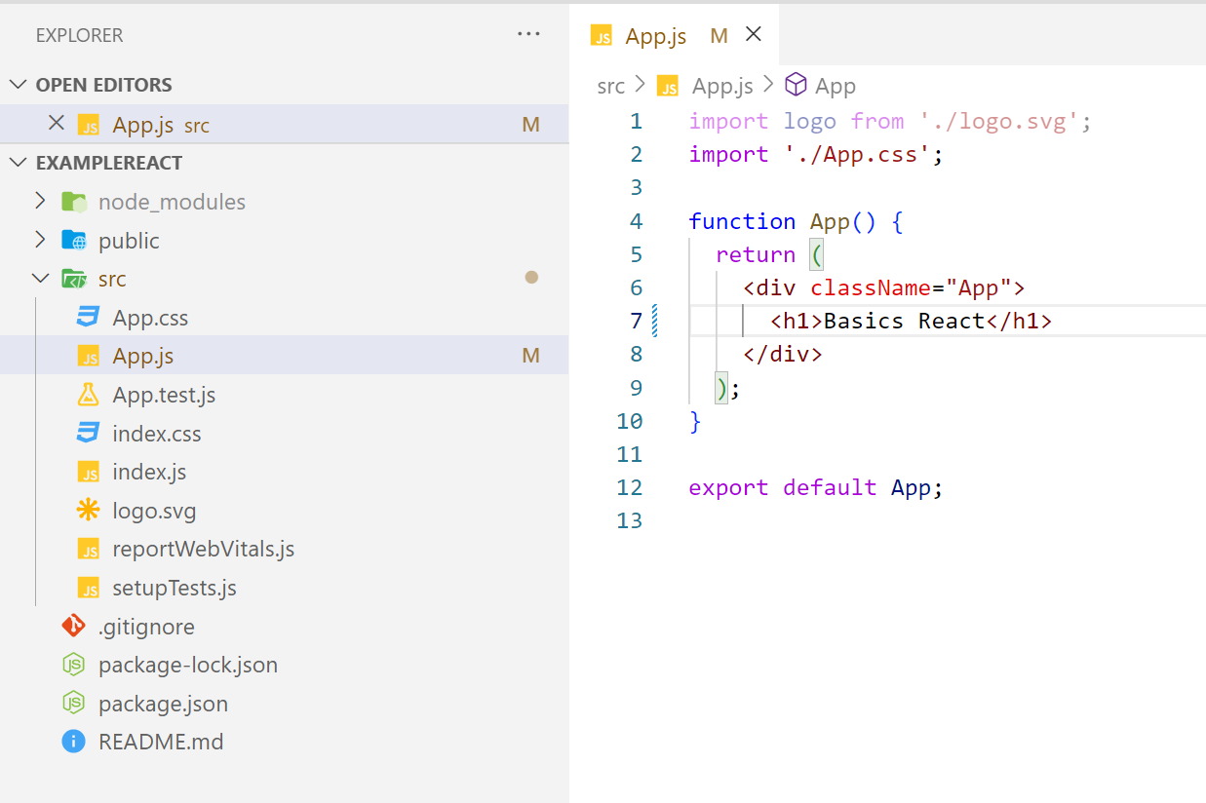
Hello world

Slide 5
Components : A piece of code that can be reused. Such as functions but they are more powerful than functions header, footer etc…

Slide 6
Types of Components : 1. functional components 2. class component 3. HOC (Hight order component ) 4. pure component 5. controlled component 6. uncontrolled component

Slide 7
Functional components :

Slide 8
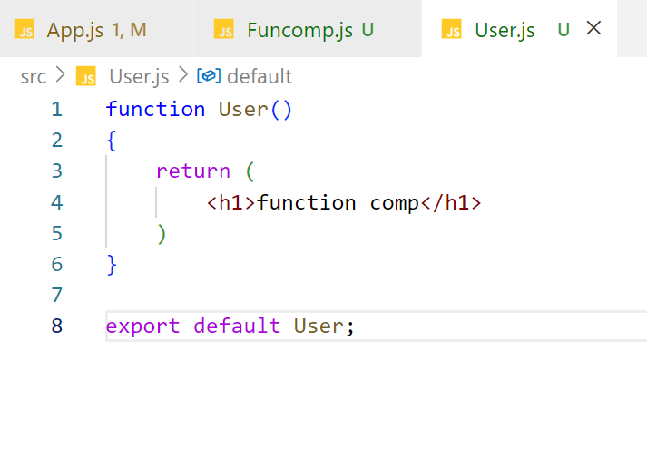
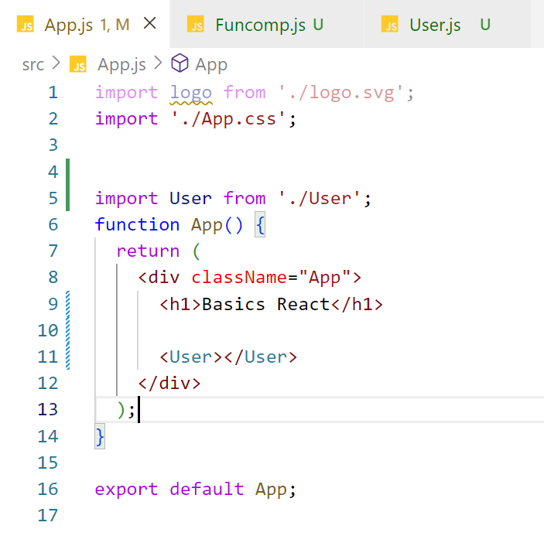

Slide 9
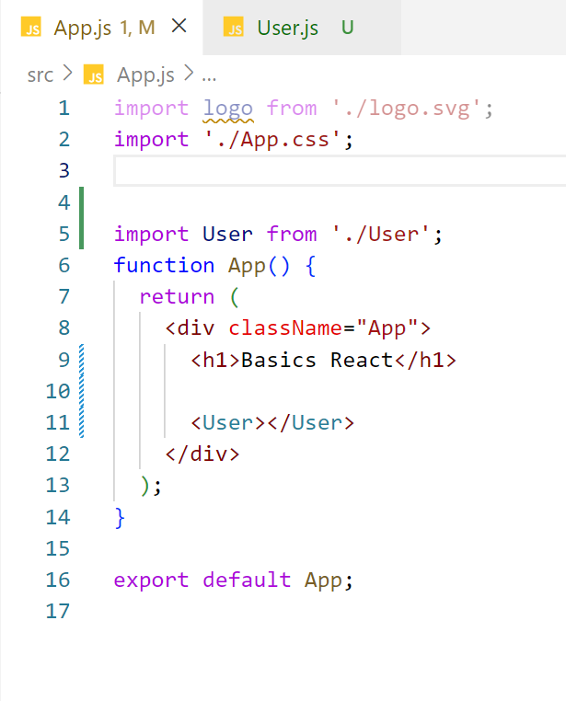
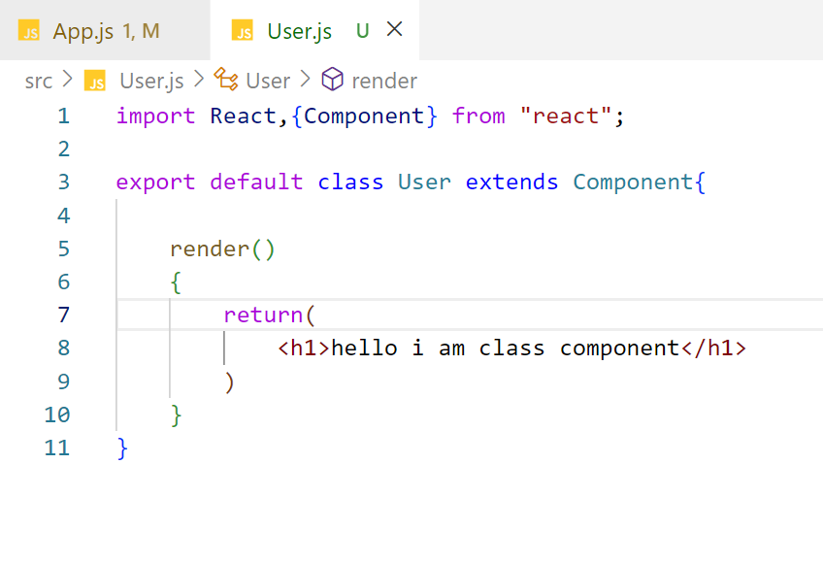
Class component

Slide 10
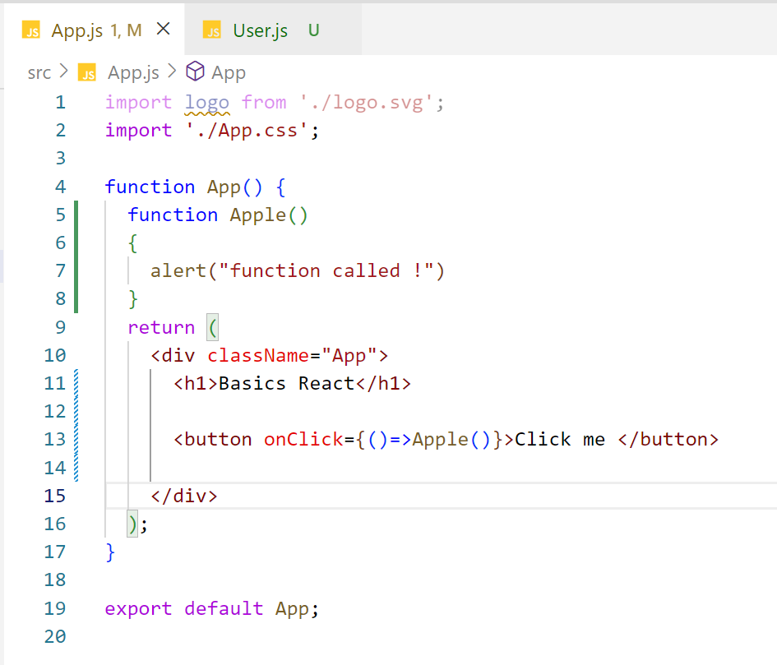
Click event and function

Slide 11
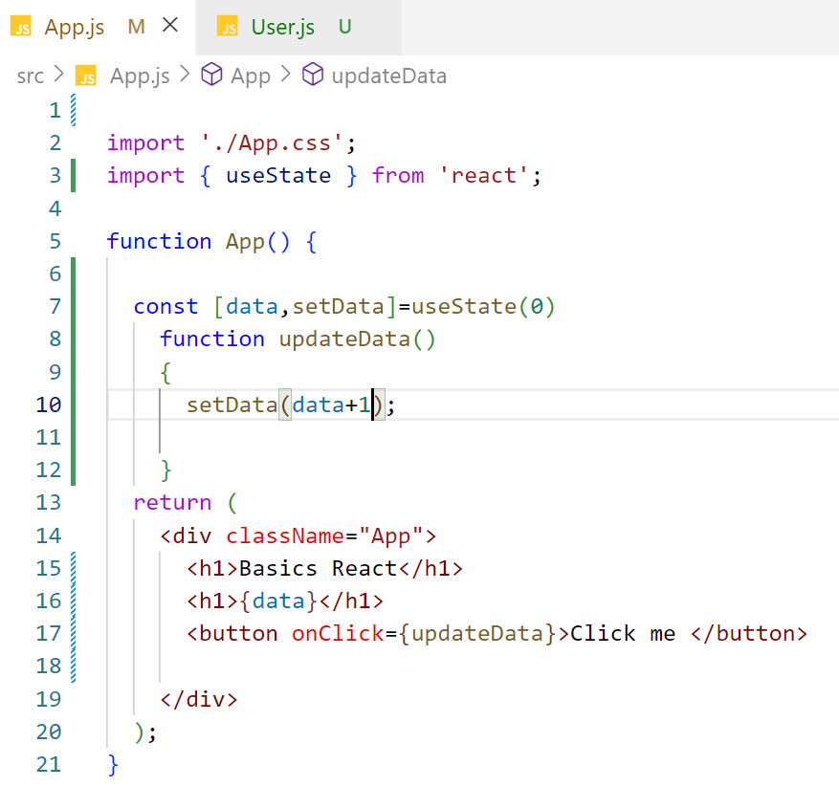
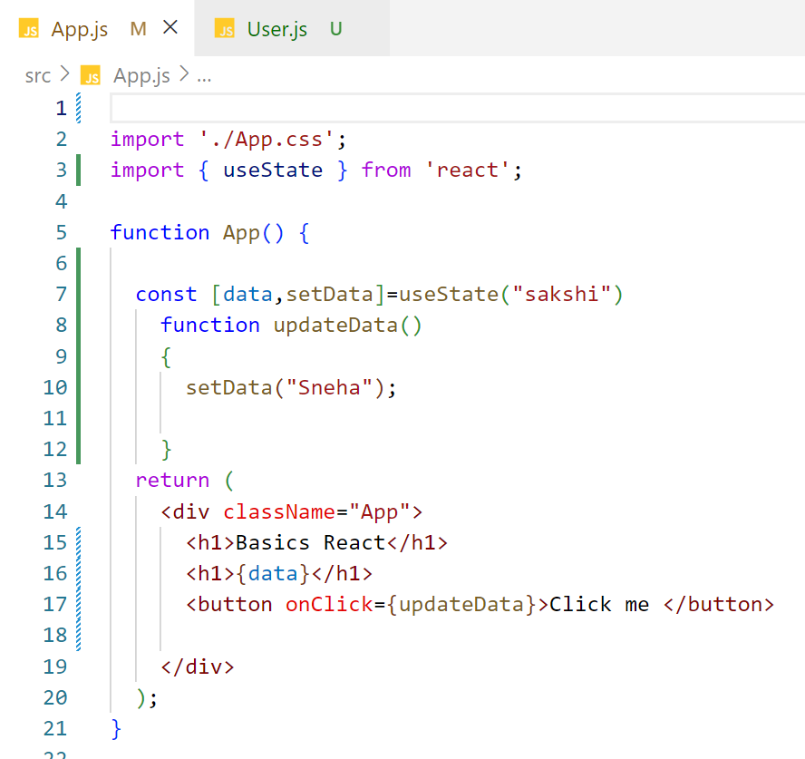
state

Slide 12
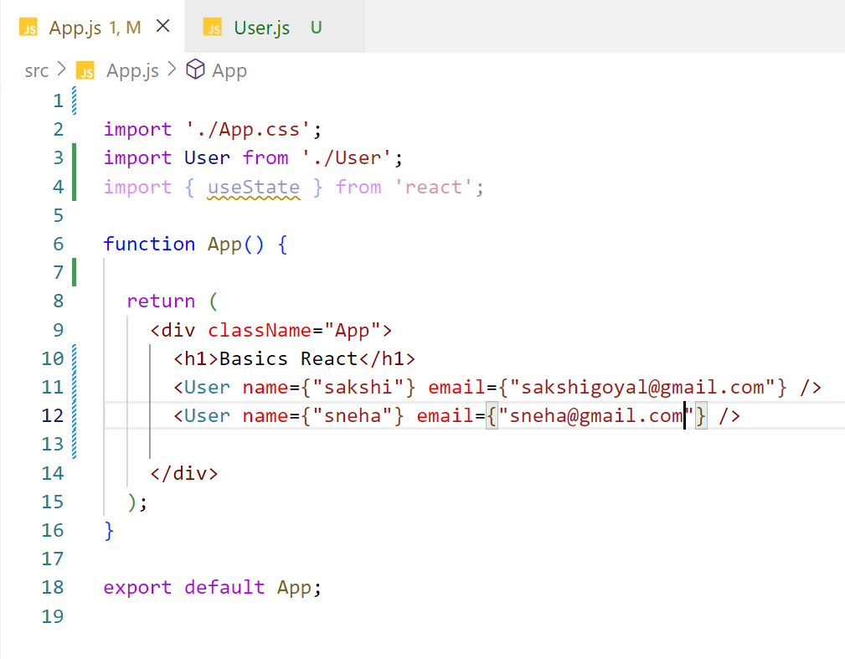
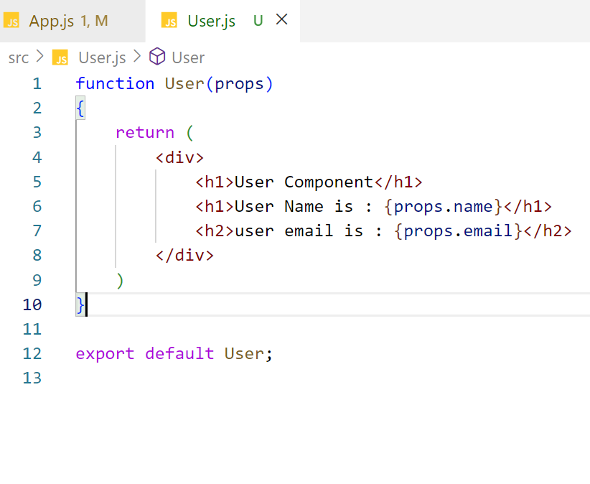
Props

Slide 13
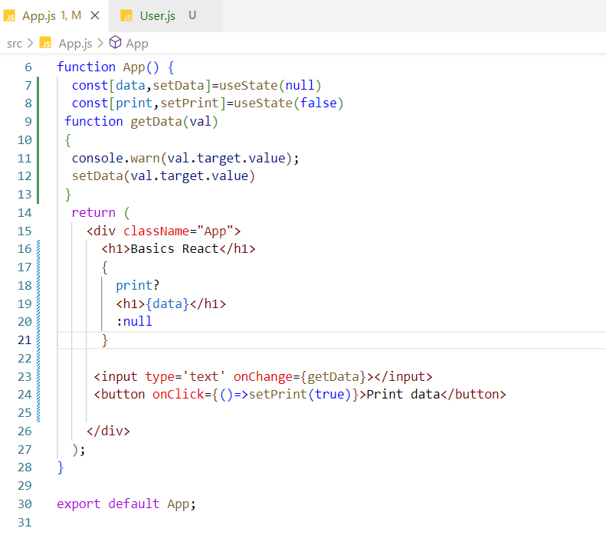
Get input box value

Slide 14
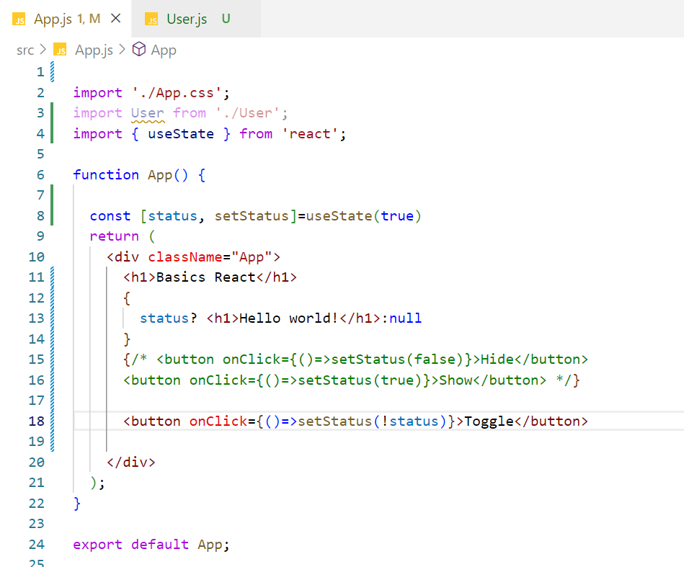
Hide and Show elements

Slide 15
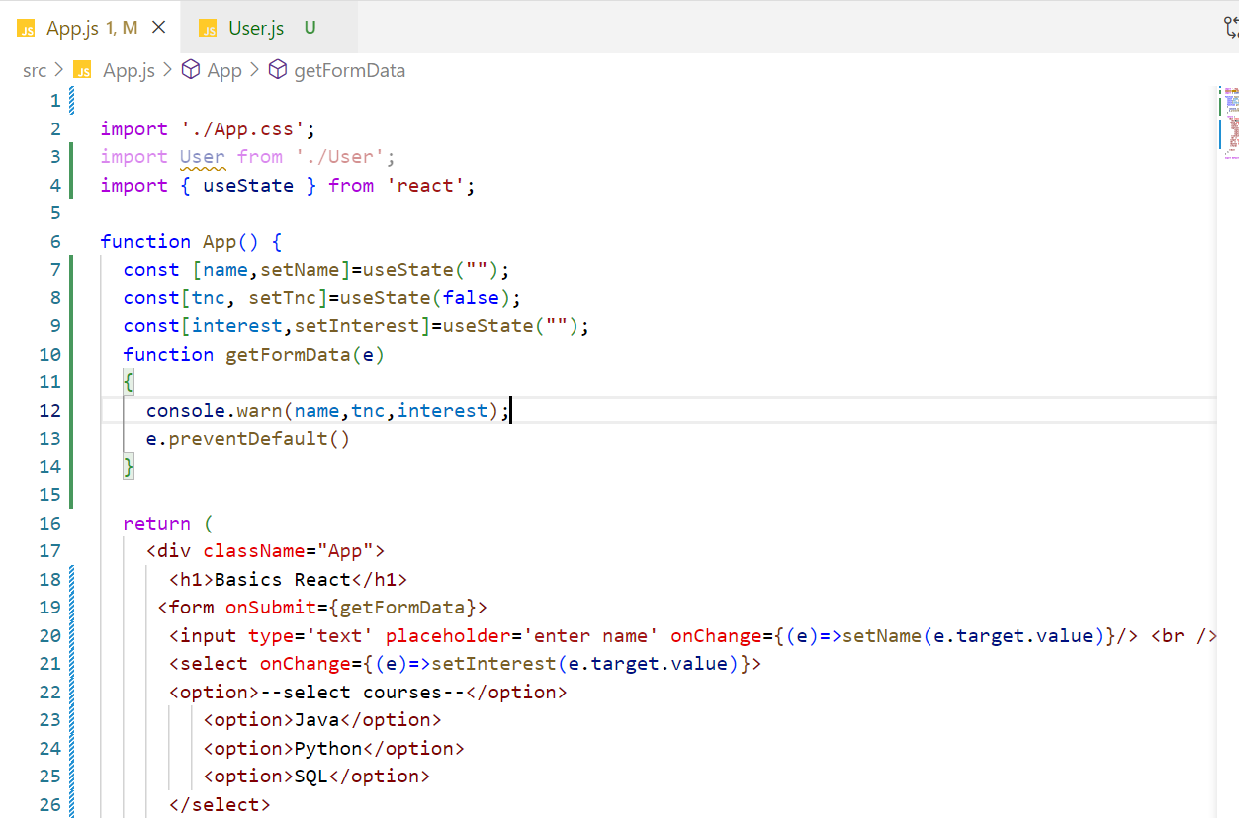
Basic Form

Slide 16
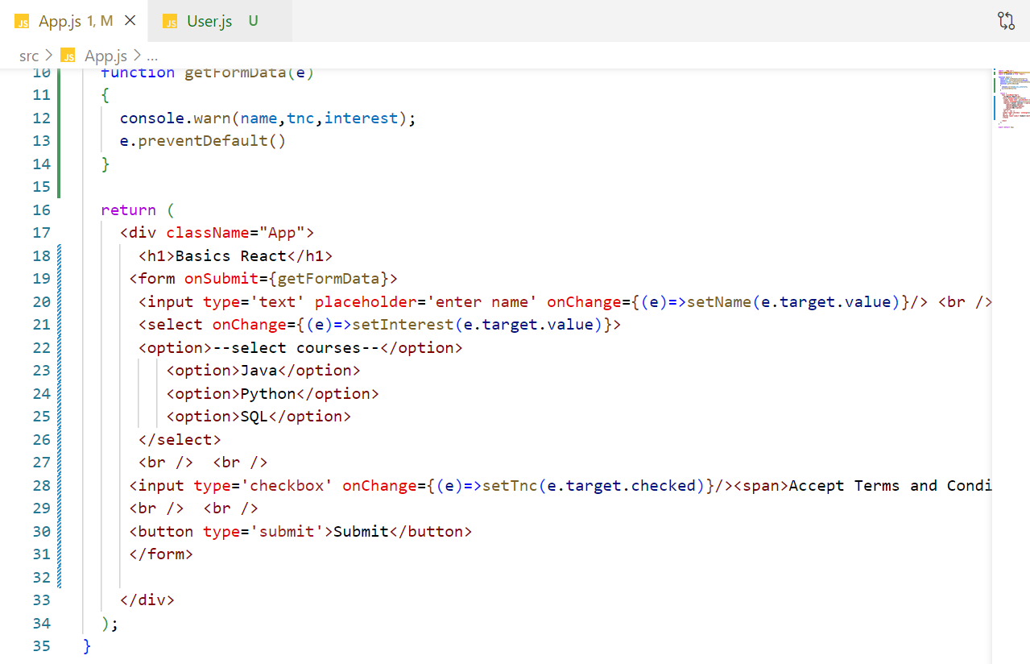

Slide 17
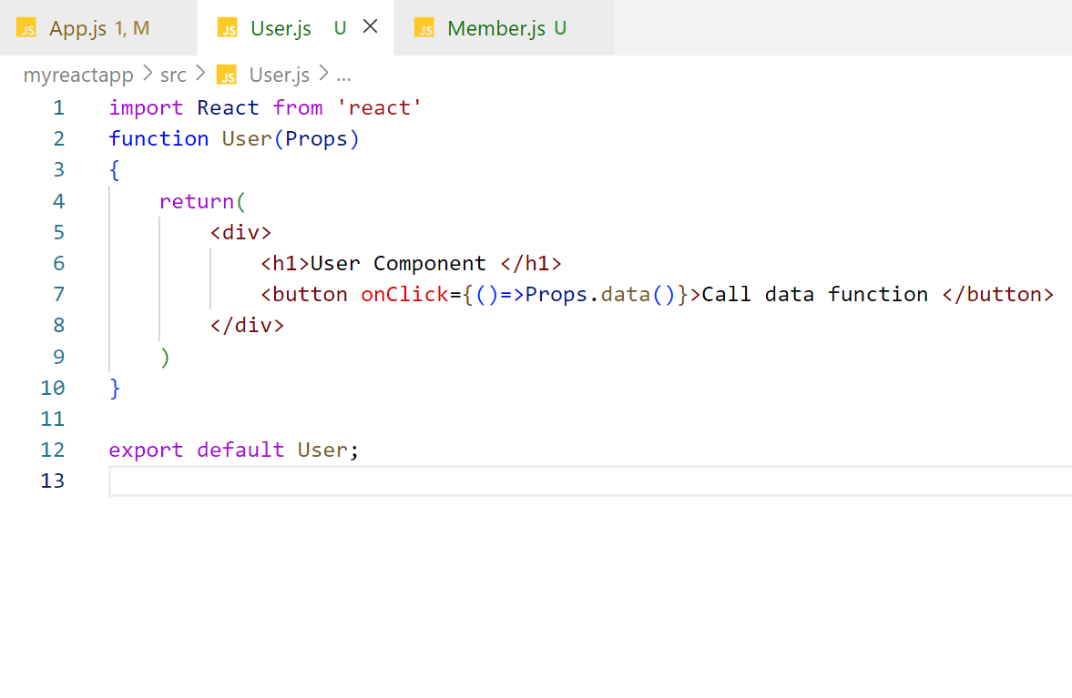
Pass function as props

Slide 18
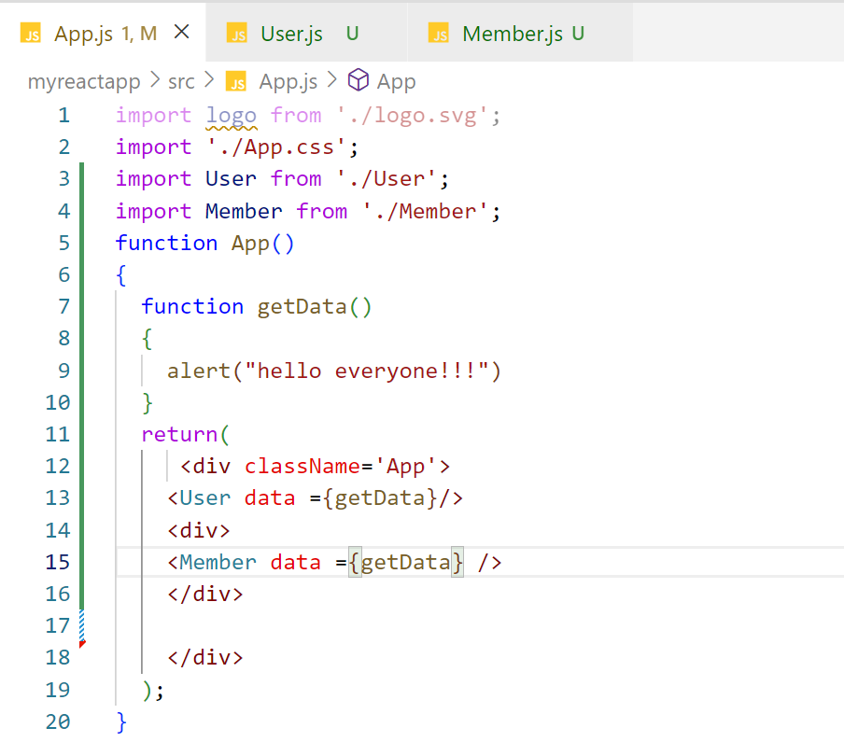

Slide 19
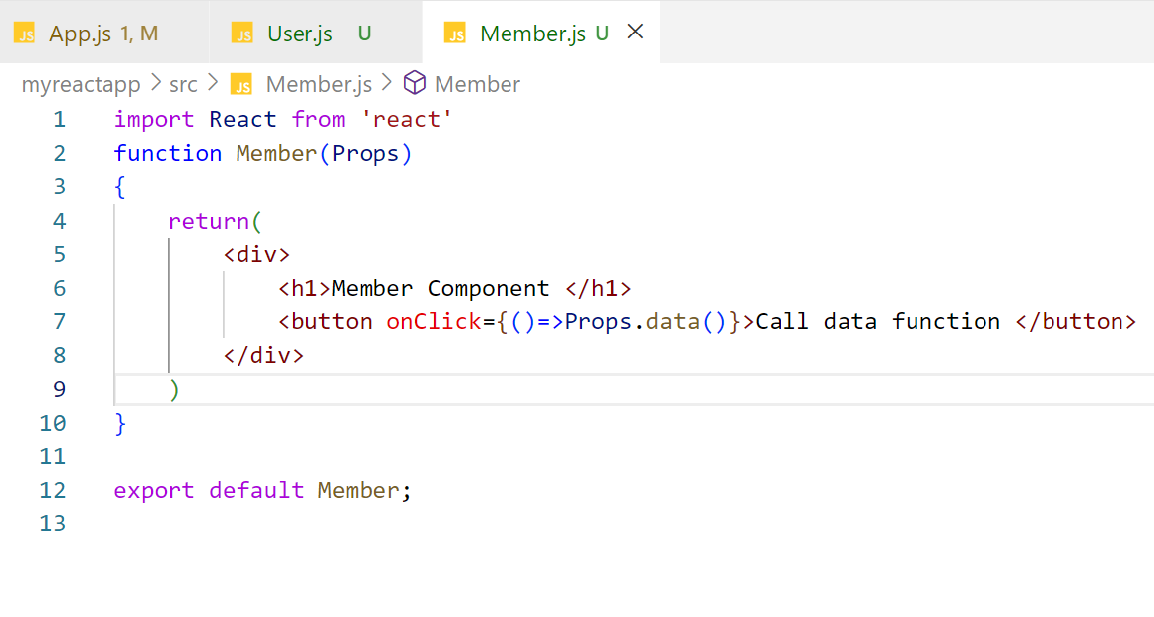

Slide 20
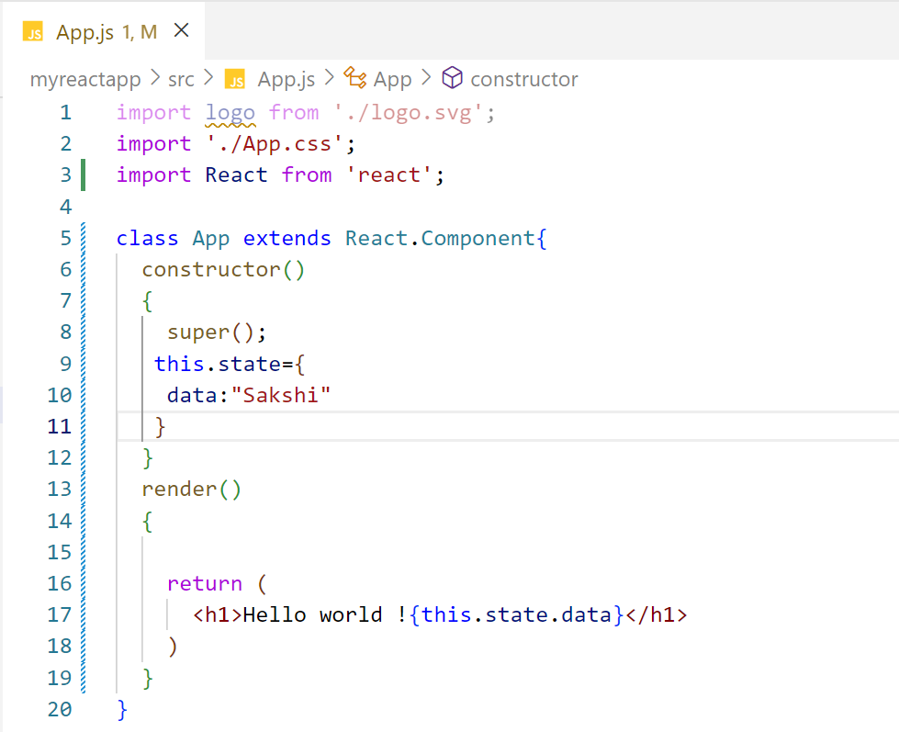
React Constructors

Slide 21
Life cycle of React

Slide 22
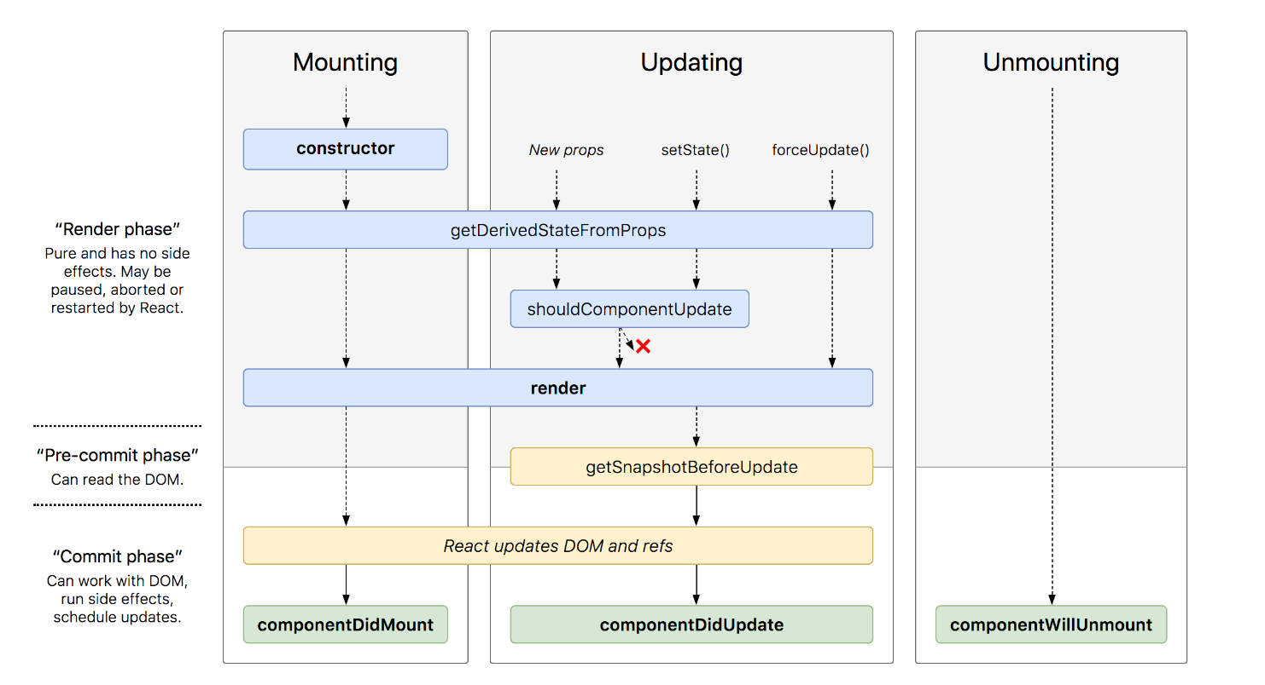

Slide 23
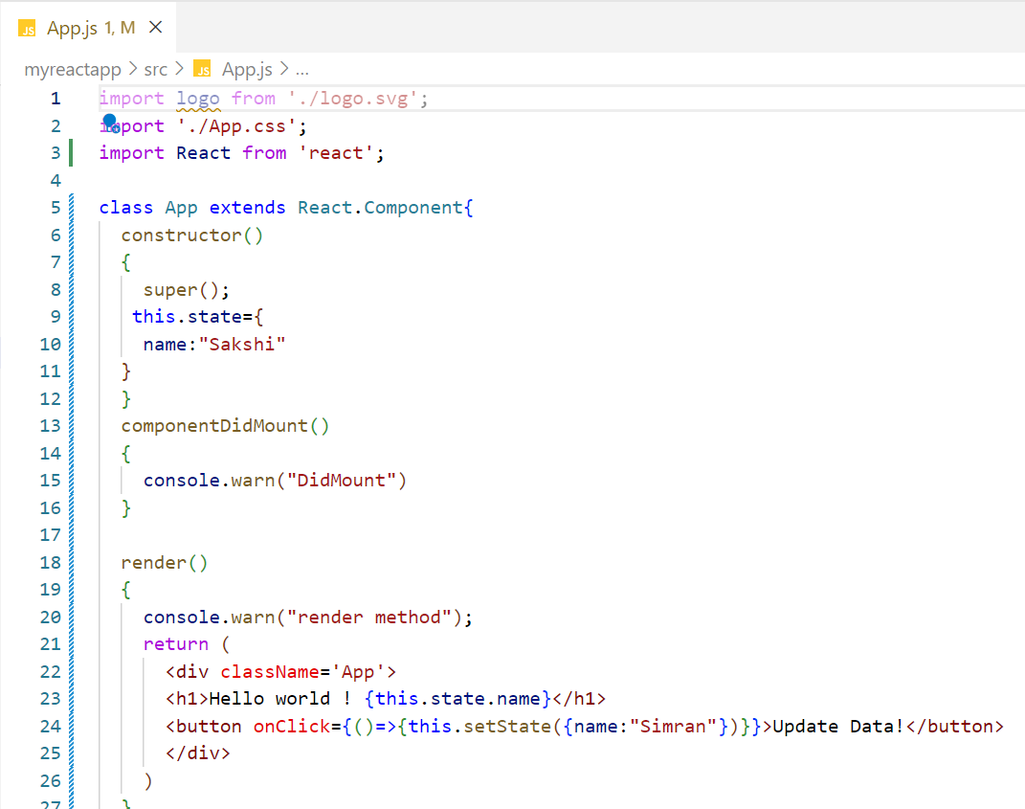
ComponentDidMount method

Slide 24
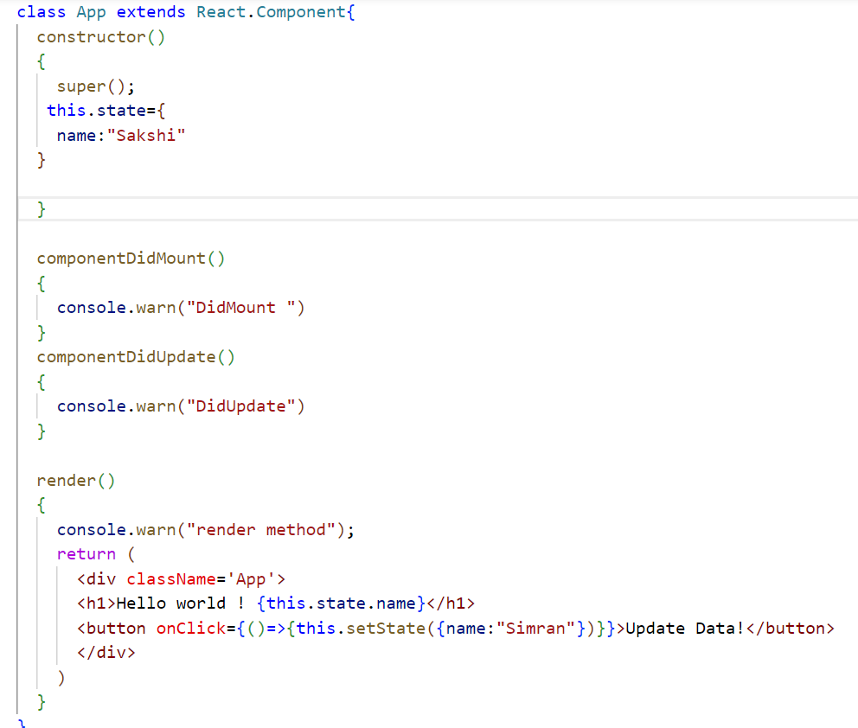
componentDidUpdate method

Slide 25
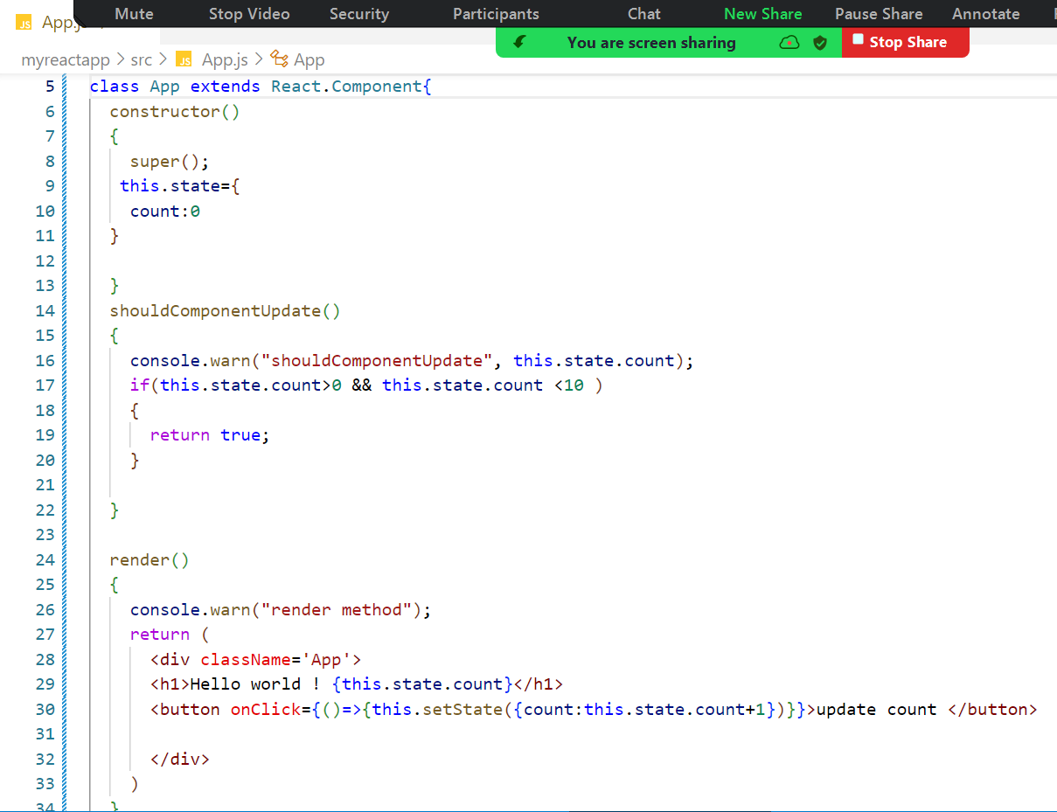
shouldComponentUpdate

Slide 26
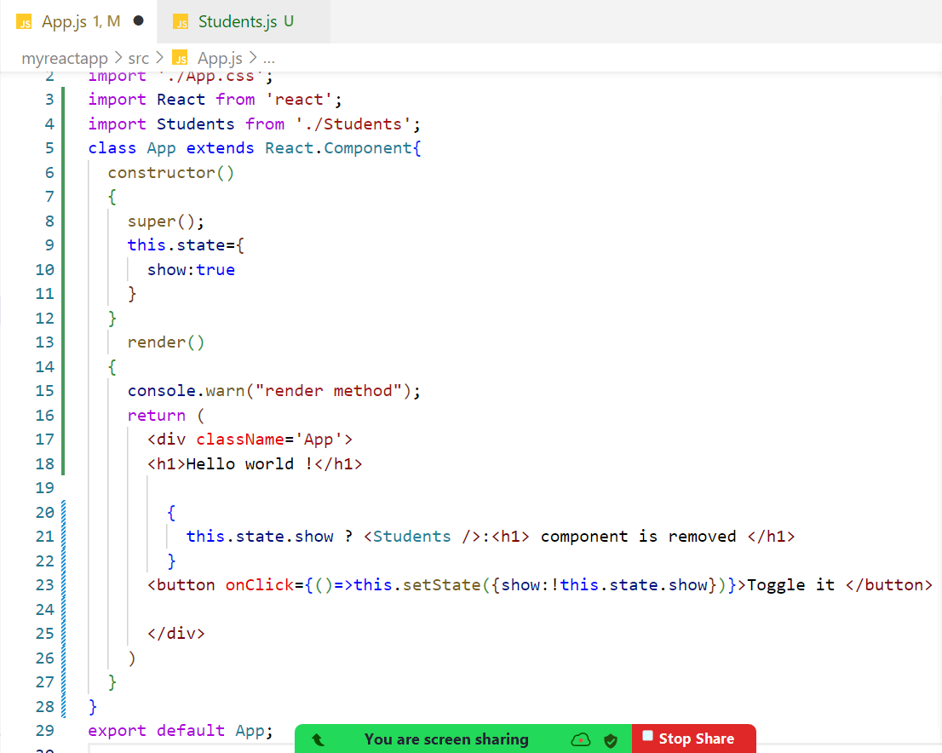
componentWillunmount

Slide 27
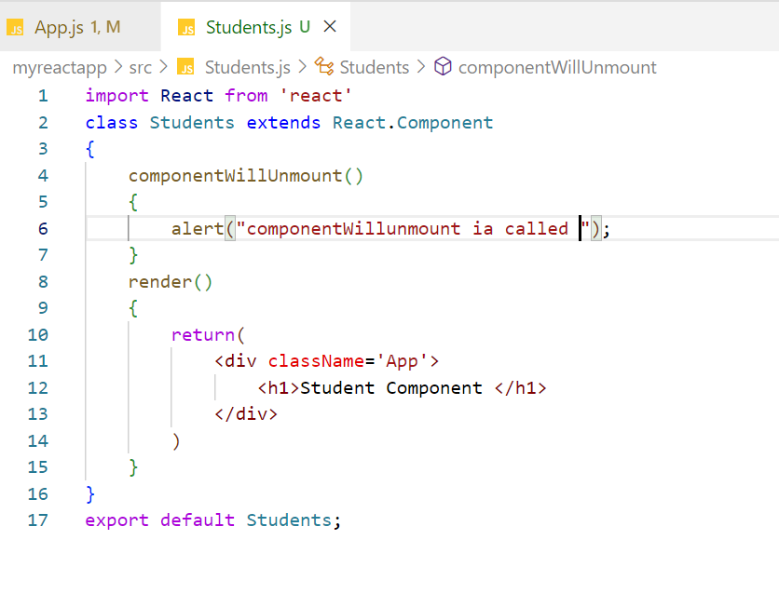

Slide 28
Hooks
With hook, we can use class component features in functional components such as state, life cycle, pure components etc…

Slide 29
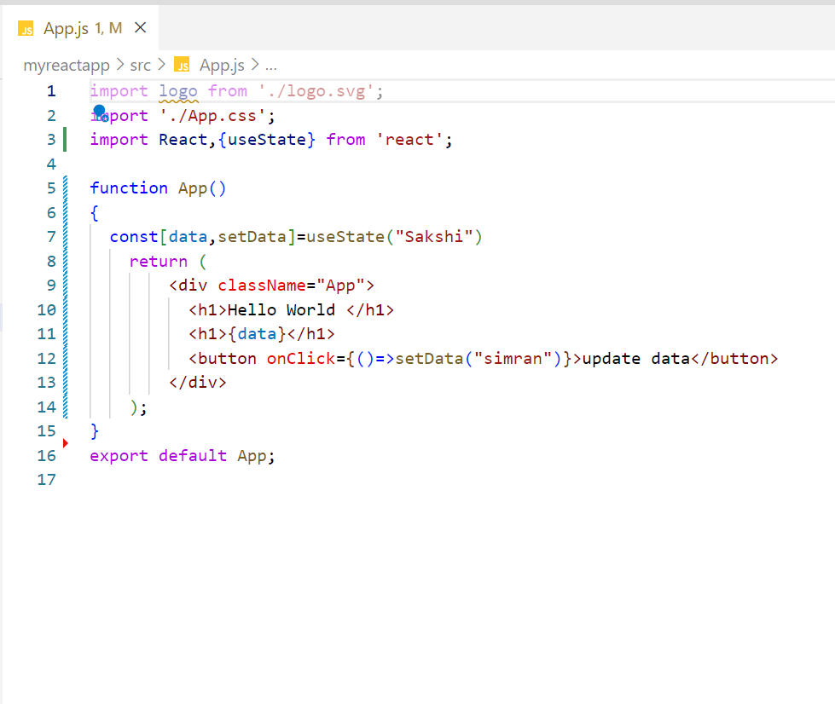
useState

Slide 30
useEffect

