Slide 1
IT 12 Data structure and algorithms- Stack and Queue

Slide 2
Stack data structure
Stack is a linear data structure which operates in LIFO (Last in First Out) manner. The top pointer provides top value of the stack.
Basic Operations
push() − Pushing (storing) an element on the stack.
pop() − Removing (accessing) an element from the stack.

Slide 3
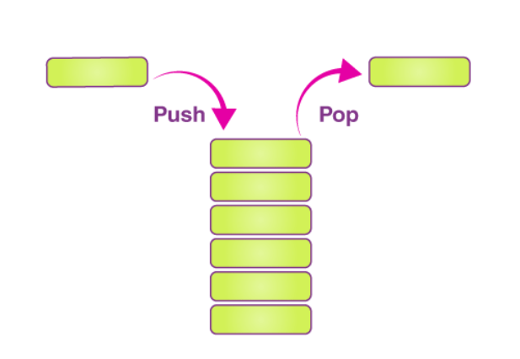
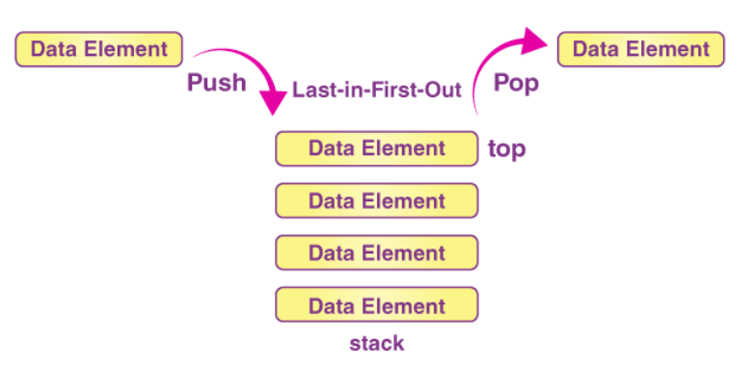

Slide 4
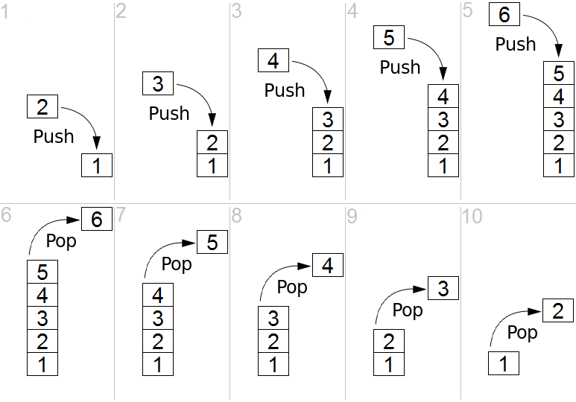
Stack Operations

Slide 5
Applications
Function calls
Recursion
Arithmetic Expression evaluation
Syntax parsing
Memory management
Backtracking

Slide 6
Queue data structure
A Queue is a linear structure which follows a particular order in which the operations are performed. The order is First In First Out (FIFO). A good example of a queue is any queue of customers for a resource where the customer that came first is served first.
Basic Operations
enqueue() − insert (add) an item to the queue.
dequeue() − remove (access) an item from the queue.
front and rear pointers

Slide 7
Types of queue
Linear Queue
Circular Queue
Priority Queue
Double Ended Queue (Dque)

Slide 8
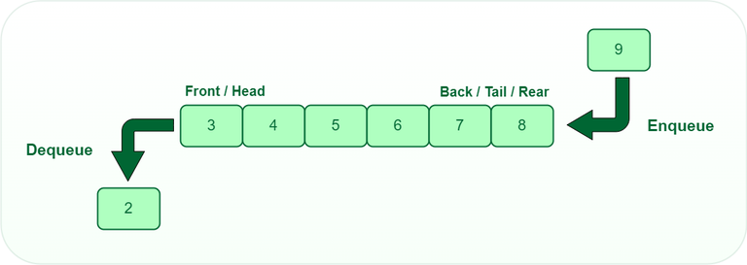
Queue Operations

Slide 9
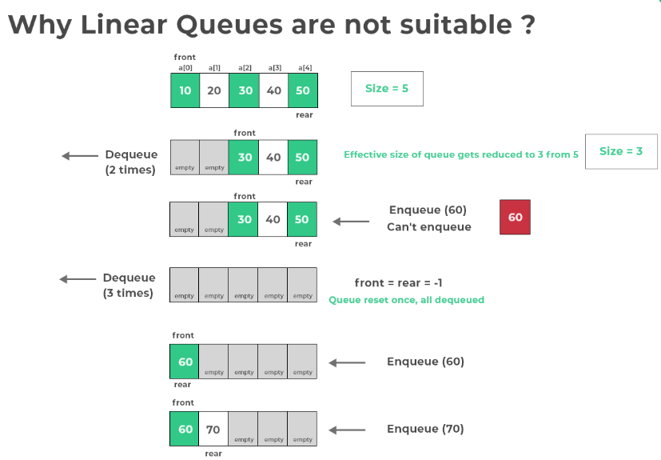

Slide 10
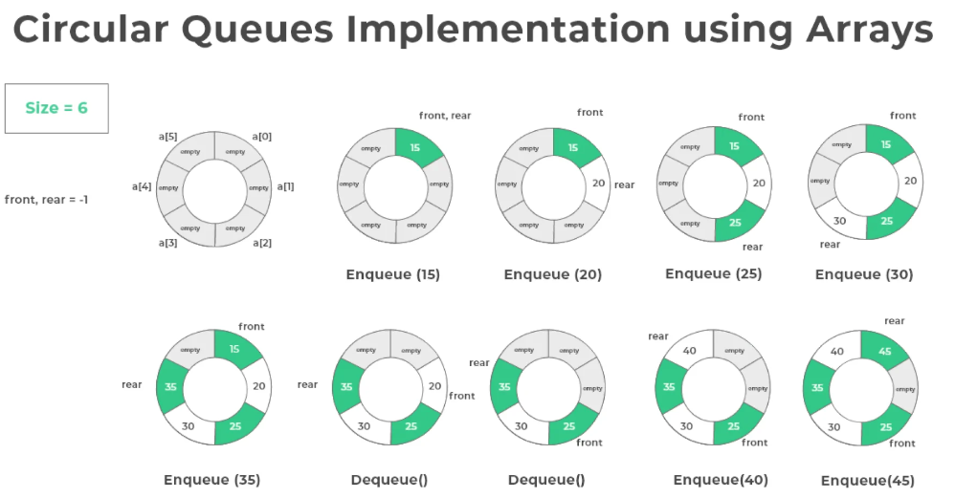

Slide 11
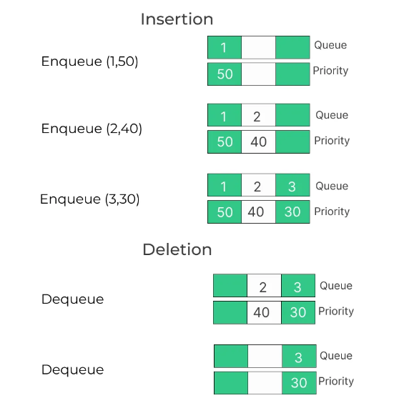
Priority Queue

Slide 12
Applications
CPU scheduling
Printer Spooling
In routers
Handling website traffic
Resource Allocation
BFS algorithm
Standby Flyers
Auctions
Stock Market

