Slide 1





Intelligent Network Routing using Reinforcement Learning
Team ID: CU_CP_Team_10181
Team Leader: Ketul Kasodiya
Team Member 1: Pranjal Panchal
Team Member 2: Sakshi Makwana
Under the mentorship of,
Palwinder Singh
Notes:
Slide Duration: 5 min
Objective: To get an insight about Design Thinking
Procedure:
Explanation:
Introduce the topic "Design Thinking"
Design thinking is a creative approach to problem-solving that puts people at the center.
It starts with understanding the needs of those who will use what you're designing.
Then, it involves brainstorming ideas, prototyping solutions, and testing them to see what works best.
It's about being open-minded, collaborative, and willing to try new things to come up with innovative solutions that really fit people's needs.
Learning outcome: Students will be introduced to the topic Design Thinking.

Slide 2


Content:
Problem Statement
Project Overview – Introduction
End Users
Wow Factor in Project
Modelling/Block Diagram/Flow of Project
Result/outcomes
Conclusion
Future Perspective
Source
https://www.freepik.com/
Notes:
Slide duration: 5 min
Objective: To know the content of the lesson.
Procedure:
Tell students what they are going to learn today.
Discuss each topics given in the slide.
Learning Outcome: Students will get to know the content of today's lesson.

Slide 3
Problem Statement
Our project focuses on applying Reinforcement Learning (Q-learning) to make computer network routing smarter and more adaptive.
In normal networks, data packets always follow the shortest path, even if that path is crowded. This often leads to network congestion, packet loss, and delays.
With Q-learning, the network router learns from its past experiences — it gets rewards for choosing good paths and penalties for poor ones.
Over time, it understands which routes are faster, less congested, and more reliable, just like how humans learn by trial and error.
This approach helps the network distribute traffic more evenly, avoid overloaded links, and improve overall packet delivery.
In simple terms, our project teaches the network to “think and learn” on its own rather than follow fixed rules.
Notes:
Total duration: 5mins
Learning Objective: In this slide, the trainer will explain the students what they will learn and be able to apply in the real life situations.
Procedure: Discuss the above as the outcome of the session
Learning outcome: Students will understand the learning outcome in this slide.

Slide 4
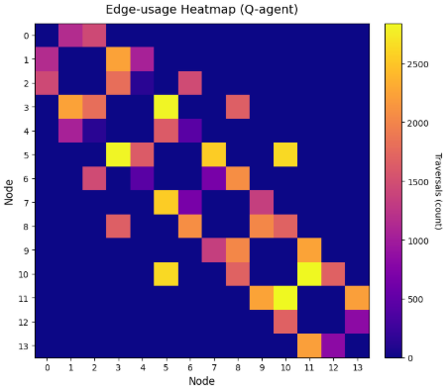
Objectives of Our Project
To apply Q-learning, a Reinforcement Learning technique, for intelligent routing.
To make the agent learn optimal paths between nodes automatically.
To compare Q-learning performance with:
Shortest Path (SP)
Random Routing (RR)
To evaluate based on:
Packet Delivery Ratio (PDR)
Average hops per delivery
Mean link utilization
To visualize the entire learning process using graphs and heatmaps.
Notes:
Total duration: 5mins
Learning Objective: In this slide, the trainer will explain the students what they will learn and be able to apply in the real life situations.
Procedure: Discuss the above as the outcome of the session
Learning outcome: Students will understand the learning outcome in this slide.

Slide 5
Who Will Use This Project?
This project can be useful for anyone working with computer networks and routing systems.
The end users include:
Network Engineers and Researchers:
To test and design smarter routing algorithms that can adapt to real-time traffic conditions.
Educational Institutions:
For teaching how Reinforcement Learning (Q-learning) can be applied beyond games, in real systems like networks.
Internet Service Providers (ISPs):
To explore how AI can improve data transmission efficiency and reduce network congestion.
Students & Developers:
As a learning model to understand AI-driven optimization in networks.
Notes:
Total duration: 5mins
Learning Objective: In this slide, the trainer will explain the students what they will learn and be able to apply in the real life situations.
Procedure: Discuss the above as the outcome of the session
Learning outcome: Students will understand the learning outcome in this slide.

Slide 6
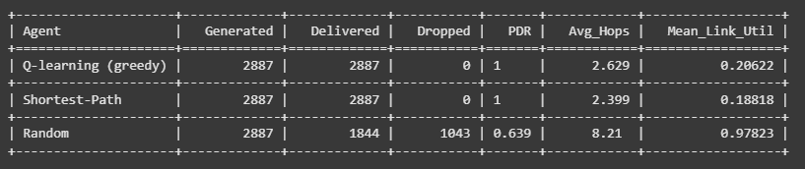
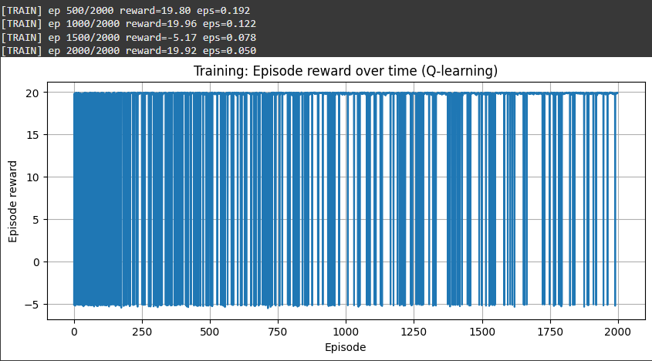
What Makes Our Project Unique
Our project applies Reinforcement Learning to a network routing environment, which is not commonly explored at a student level
The system doesn’t rely on fixed paths, it learns dynamically from its own experience.
It improves network performance without any manual tuning.
The agent learns to balance traffic and avoid congestion intelligently.
The project provides clear visual evidence - training curves, graphs, and topology visuals, that show learning in action.
It bridges two domains: Artificial Intelligence + Computer Networking, showing interdisciplinary innovation.
Notes:
Total duration: 5mins
Learning Objective: In this slide, the trainer will explain the students what they will learn and be able to apply in the real life situations.
Procedure: Discuss the above as the outcome of the session
Learning outcome: Students will understand the learning outcome in this slide.

Slide 7
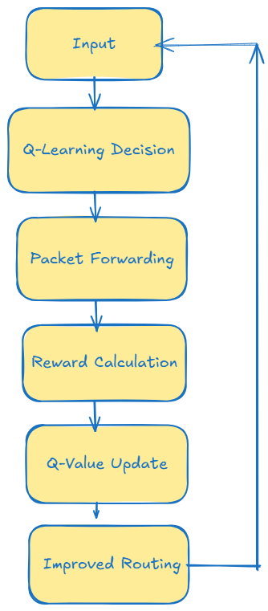
Model of the System
The system uses Q-learning to improve network routing. Each node acts as an intelligent agent that learns the best path for packets based on experience and rewards. Over time, nodes adapt to changing network conditions, avoiding congestion and optimizing delivery.
Main Components and Steps:
Input (Packets): Packets are generated at source nodes.
Q-Learning Decision: Node selects the next hop using its Q-table
(ε-greedy policy).
3. Packet Forwarding: Packet moves to the chosen node.
4. Q-Value Update: Reward (+1 for success, -1 for drop) updates the Q-table.
5. Improved Routing: Nodes learn optimal paths over time.
6. Loop: Process repeats for new packets.
Notes:
Total duration: 5mins
Learning Objective: In this slide, the trainer will explain the students what they will learn and be able to apply in the real life situations.
Procedure: Discuss the above as the outcome of the session
Learning outcome: Students will understand the learning outcome in this slide.

Slide 8
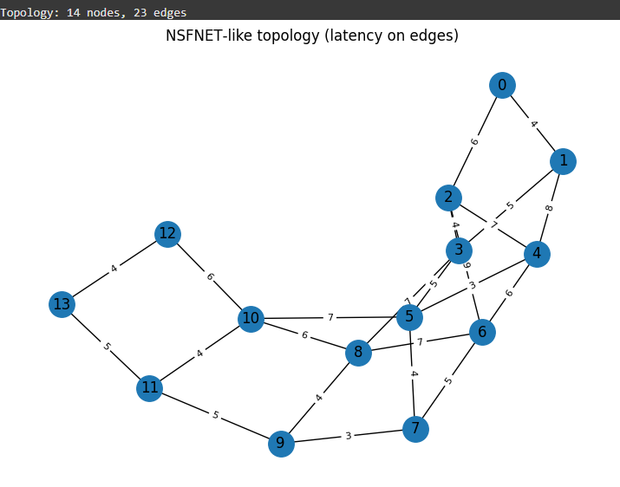
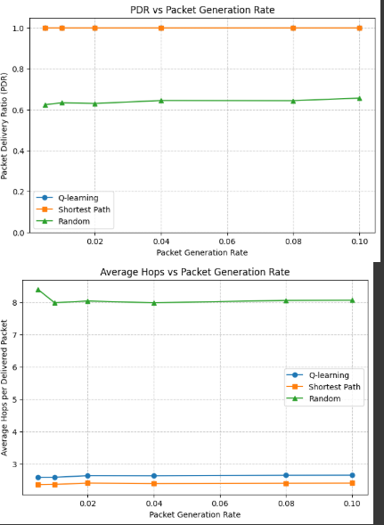
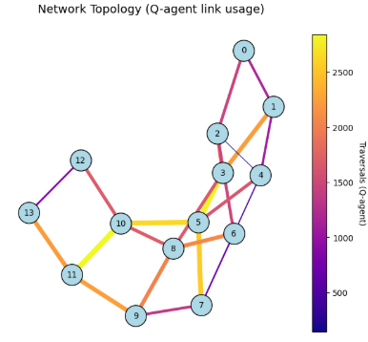
Results and Observations
After training and testing, the Q-learning agent shows better performance than traditional routing methods. It learns to deliver packets efficiently while avoiding congestion.
Key Observations:
Higher Packet Delivery Ratio: More packets reach their destinations compared to Shortest Path and Random Routing.
Balanced Average Hops: Learns paths that avoid unnecessary detours.
Efficient Link Utilization: Traffic is distributed to prevent bottlenecks.
Adaptability: Maintains performance even with increased network traffic or changing conditions.
Notes:
Total duration: 5mins
Learning Objective: In this slide, the trainer will explain the students what they will learn and be able to apply in the real life situations.
Procedure: Discuss the above as the outcome of the session
Learning outcome: Students will understand the learning outcome in this slide.

Slide 9
Conclusion
This project shows that Q-learning can significantly improve network routing by letting nodes make adaptive, intelligent decisions rather than relying on static shortest paths. Each node acts as an autonomous agent, learning optimal paths through trial and reward, resulting in better delivery and network efficiency.
Interesting Highlights:
Smarter Routing: The agent sometimes chooses slightly longer paths to avoid congested links, which is more efficient than simply following the shortest path.
Custom Reward System: Rewards encourage successful packet delivery, penalize drops and loops, and slightly penalize latency, guiding the agent toward globally optimal routes.
Adaptive Behaviour: The agent adjusts routing decisions under different network conditions, handling heavier traffic efficiently.
Insightful Analysis: You can observe which links the agent prefers through metrics like link usage or heatmaps, highlighting how learning shapes network behaviour.
Robust Performance: Q-learning maintains balanced hops, link utilization, and delivery ratios even as network traffic varies, demonstrating intelligent adaptability.
Overall, the project proves that reinforcement learning can make networks smarter, more adaptive, and more resilient, while offering insights into the agent’s learning behaviour.
Source
https://www.freepik.com/
Notes:
Slide duration: 5 min
Objective: To get clarity about the lesson is well received among students.
Procedure:
Ask: What did you learn from the lesson?
What is your takeaways from the lesson?
How this lesson is going to help you in your personal and professional life.
How are you going to implement this lesson?

Slide 10
Future Enhancement
This project can be expanded and improved in several ways to handle larger and more dynamic networks:
Deep Q-Learning (DQN): Handle larger state-action spaces for real-world networks with many nodes.
Dynamic Traffic Simulation: Introduce varying traffic loads in real-time to make routing decisions more realistic.
Software Defined Networking (SDN) Integration: Combine Q-learning with SDN for centralized, real-time network optimization.
Energy-Efficient Routing: Implement rewards that penalize high energy usage, reducing network power consumption.
Multi-Agent Coordination: Multiple nodes can learn cooperatively, improving overall network throughput and stability.
Advanced Visualization: Display network behaviour through 3D dashboards or live traffic heatmaps for better monitoring.
These enhancements highlight the potential of reinforcement learning to make communication networks more intelligent, adaptive, and scalable.
Notes:
Total duration: 5mins
Learning Objective: In this slide, the trainer will explain the students what they will learn and be able to apply in the real life situations.
Procedure: Discuss the above as the outcome of the session
Learning outcome: Students will understand the learning outcome in this slide.

Slide 11
Thank You!!!!
Notes:
Time: 25 to 30 Sec

