Slide 1





Intelligent Network Routing using Reinforcement Learning
Team ID: CU_CP_Team_10181
Team Leader: Ketul Kasodiya
Team Member 1: Pranjal Panchal
Team Member 2: Sakshi Makwana
Under the mentorship of,
Palwinder Singh
Notes:
Slide Duration: 5 min
Objective: To get an insight about Design Thinking
Procedure:
Explanation:
Introduce the topic "Design Thinking"
Design thinking is a creative approach to problem-solving that puts people at the center.
It starts with understanding the needs of those who will use what you're designing.
Then, it involves brainstorming ideas, prototyping solutions, and testing them to see what works best.
It's about being open-minded, collaborative, and willing to try new things to come up with innovative solutions that really fit people's needs.
Learning outcome: Students will be introduced to the topic Design Thinking.

Slide 2
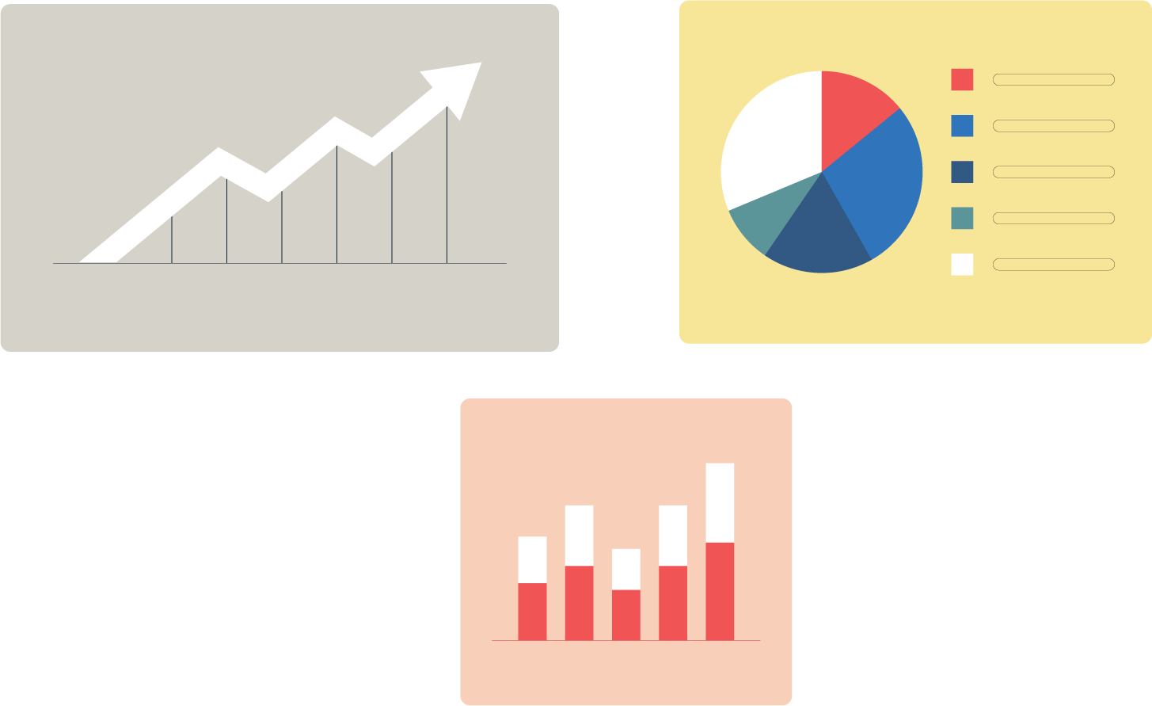


Content:
Problem Statement
Project Overview / Introduction
Flow of Project
Wow Factor in Project
Result/outcomes
Conclusion
Future Enhancement
Source
https://www.freepik.com/
Notes:
Slide duration: 5 min
Objective: To know the content of the lesson.
Procedure:
Tell students what they are going to learn today.
Discuss each topics given in the slide.
Learning Outcome: Students will get to know the content of today's lesson.

Slide 3
Problem Statement
Core Challenges
Learning to Route: Can routers figure out optimal paths on their own through rewards and penalties?
Adapting on the Fly: Can they adjust routes when congestion or link failures occur?
Balancing Trade-offs: Can the network deliver maximum packets with minimal delay and hops?
Our Approach
Using Q-Learning, a Reinforcement Learning method, we enable routers to evolve intelligently transforming static networks into adaptive, self-learning environments.
“Can routers learn to choose better paths the way humans avoid traffic?”
In most computer networks, routers still follow static shortest-path algorithms, even when those paths are overloaded or unstable, this results in congestion, packet loss, and delays, especially under dynamic network conditions.
Notes:
Total duration: 5mins
Learning Objective: In this slide, the trainer will explain the students what they will learn and be able to apply in the real life situations.
Procedure: Discuss the above as the outcome of the session
Learning outcome: Students will understand the learning outcome in this slide.

Slide 4
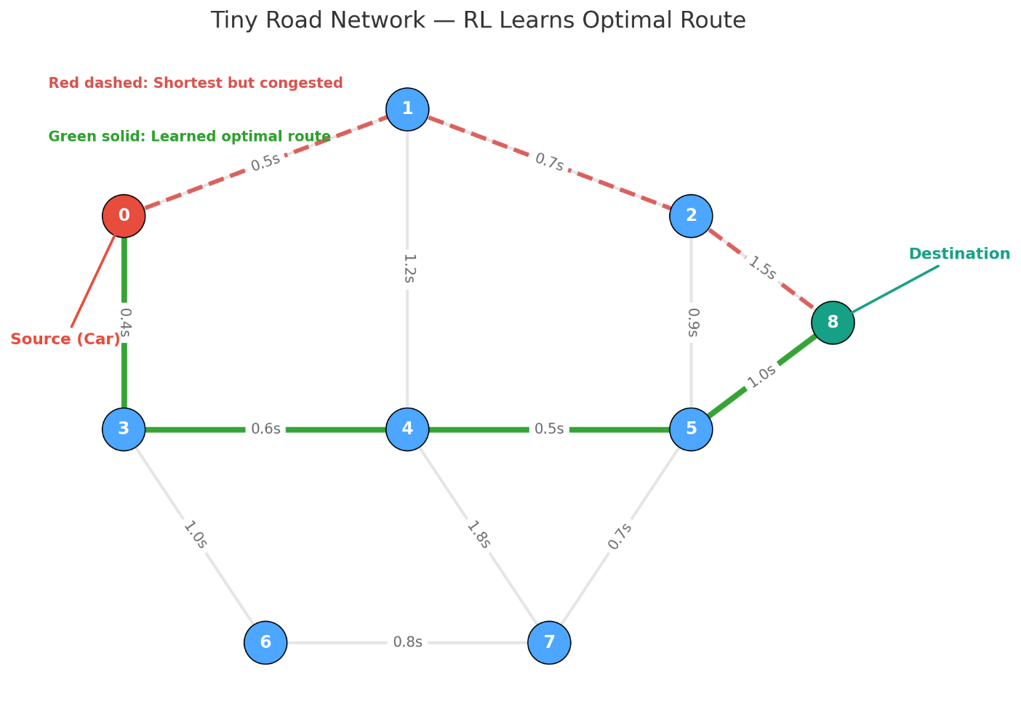
Project overview
We propose a Q-learning-driven routing architecture in which every router functions as a local learning agent. By interacting with the network environment, each node improves its next-hop decisions based on real-time outcomes.
Mechanism
Graph-based network representation
Q-learning agent evaluates neighbours before forwarding
Reward system reinforces:
  Success (delivery)
  Penalizes drop, loop, or excessive latency
Q-table evolves with experience
System converges to optimal and adaptive routing policies
Notes:
Total duration: 5mins
Learning Objective: In this slide, the trainer will explain the students what they will learn and be able to apply in the real life situations.
Procedure: Discuss the above as the outcome of the session
Learning outcome: Students will understand the learning outcome in this slide.

Slide 5
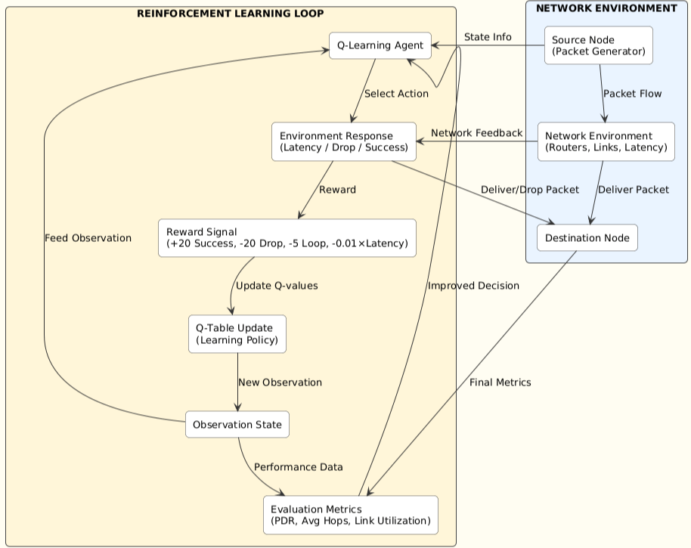
Project Flow
Network Setup: Packets are generated and sent through routers and links simulating real network conditions.
Action Selection: The Q-learning agent observes the state and selects routing actions.
Learning: The environment gives rewards or penalties based on delivery, drop, or delay; the agent updates its Q-table.
Evaluation: The improved routing policy is tested using metrics like PDR, average hops, and link utilization.
Notes:
Total duration: 5mins
Learning Objective: In this slide, the trainer will explain the students what they will learn and be able to apply in the real life situations.
Procedure: Discuss the above as the outcome of the session
Learning outcome: Students will understand the learning outcome in this slide.

Slide 6
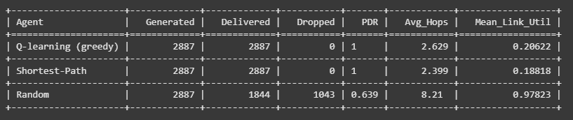
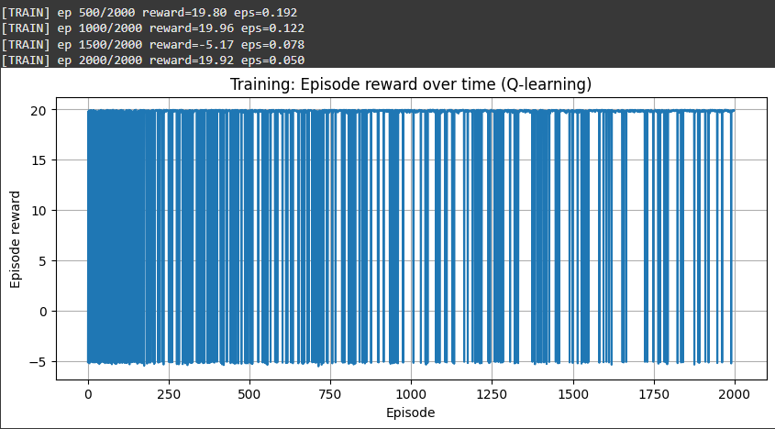
“WOW” Factor in the Project
Measured Results – Q-Learning vs. Traditional Routing
Interdisciplinary Innovation:
Bridges Artificial Intelligence and Computer Networking, creating a unique learning-based routing environment rarely explored at a student level.
Autonomous Intelligent Optimization:
The network learns and adapts on its own using Q-Learning, continuously improving routing decisions, balancing traffic, and minimizing congestion without any manual tuning.
Measured Performance:
Demonstrates higher packet delivery, lower latency, and better link utilization compared to traditional routing.
Learning in Action – Q-Learning Reward Convergence
Notes:
Total duration: 5mins
Learning Objective: In this slide, the trainer will explain the students what they will learn and be able to apply in the real life situations.
Procedure: Discuss the above as the outcome of the session
Learning outcome: Students will understand the learning outcome in this slide.

Slide 7
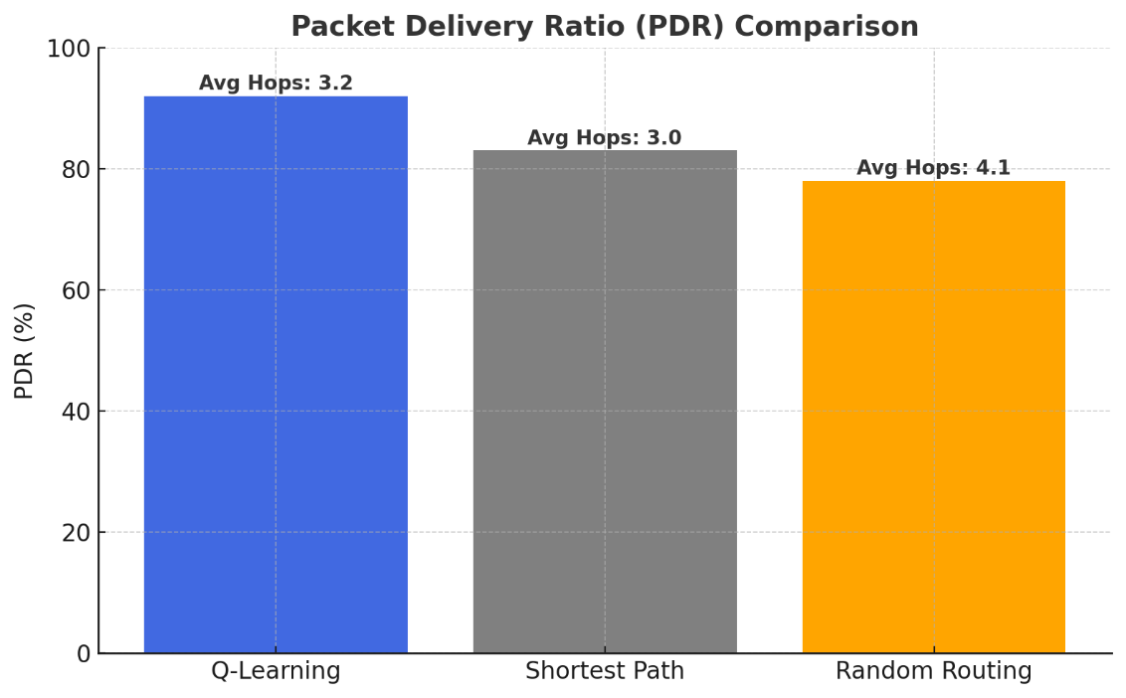
Results and Observations
Key Observations:
Higher Packet Delivery Ratio (PDR):
More packets successfully reached their destinations; Q-Learning achieved 92%, outperforming SP (83%) and RR (78%).
Balanced Link Utilization:
The agent automatically avoids congested links, distributing load intelligently across the network.
Adaptive Learning:
Maintains stable performance even when traffic load increases, showing strong adaptability.
After training and testing, the Q-learning agent shows better performance than traditional routing methods. It learns to deliver packets efficiently while avoiding congestion.
Notes:
Total duration: 5mins
Learning Objective: In this slide, the trainer will explain the students what they will learn and be able to apply in the real life situations.
Procedure: Discuss the above as the outcome of the session
Learning outcome: Students will understand the learning outcome in this slide.

Slide 8

Conclusion
A reinforcement learning agent was developed that learns efficient routing from experience, outperforming traditional static methods.
It demonstrates the potential of reinforcement learning in achieving autonomous and congestion-aware routing.
Through continuous rewards, the agent refines its routing decisions, improving packet delivery and reducing congestion.
Feedback from network outcomes further strengthens its learning, enhancing adaptability under dynamic network conditions.
Source
https://www.freepik.com/
Notes:
Slide duration: 5 min
Objective: To get clarity about the lesson is well received among students.
Procedure:
Ask: What did you learn from the lesson?
What is your takeaways from the lesson?
How this lesson is going to help you in your personal and professional life.
How are you going to implement this lesson?

Slide 9
Future Enhancement
This project can be expanded and improved in several ways to handle larger and more dynamic networks:
Predictive Congestion Control:
Incorporate traffic forecasting models to predict congestion early, enabling proactive rerouting and maintaining stable, high-performance routing.
Multi-Agent Collaboration:
Allow multiple routers to learn cooperatively, improving global optimization, speeding convergence, and increasing overall network resilience.
Integration with SDN:
Combine reinforcement learning with SDN controllers to enable real-time network visibility and fully adaptive routing under dynamic conditions.
Deep Q-Learning (DQN):
Extend the model using neural networks to generalize across large topologies and enable more scalable, intelligent routing decisions.
Notes:
Total duration: 5mins
Learning Objective: In this slide, the trainer will explain the students what they will learn and be able to apply in the real life situations.
Procedure: Discuss the above as the outcome of the session
Learning outcome: Students will understand the learning outcome in this slide.

Slide 10
Thank You!!!!
Notes:
Time: 25 to 30 Sec

