Slide 1

Project Title Seasonal Agriculture Performance Analysis
Name: SAKSHI
College Name: AJ Institute of Engineering and Technology Mangaluru
AICTE STU ID : STU6a65c726bea251785055014

Slide 2
PROBLEM STATEMENT
Agricultural activities are influenced by seasonal variations in environmental conditions, farming practices, resource availability and market conditions. As a result, agricultural performance may differ from one season to another. However, raw agricultural data does not clearly explain how agricultural performance changes across seasons or what patterns can be observed in different seasonal conditions. The problem is to analyze the given agricultural dataset and investigate seasonal differences in agricultural performance by identifying meaningful patterns, trends, relationships and variations within the available data.

Slide 3
Project Description
This project is a data analytics-based study that examines agricultural performance across different seasons, geographical regions and farming conditions.
The dataset includes information related to:
Crop and season
State and district
Rainfall and temperature
Soil conditions
Fertilizer and pesticide usage
Irrigation methods
Crop yield and production
Cost, revenue and profit
Water usage and efficiency
Disease and pest risk
Python-based data analysis and visualization techniques are used to identify seasonal differences and relationships between environmental conditions, resource usage and agricultural outcomes.

Slide 4
Objective
The primary objective of this project is to analyze agricultural data from different seasons and identify meaningful patterns, trends, relationships and differences in agricultural performance. Students should independently:
Explore and understand the dataset.
Clean and prepare the data for analysis.
Examine how agricultural performance varies across seasons.
Identify important seasonal patterns and trends.
Investigate relationships between seasonal conditions and agricultural outcomes.
Compare relevant groups within different seasons.
Identify significant differences or unusual patterns.
Apply appropriate statistical and visualization techniques.
Interpret findings based on evidence from the dataset.
Develop meaningful conclusions and data-driven recommendations.

Slide 5

WHO ARE THE END USERS?
1. Farmers
Understand seasonal crop performance.
Improve crop selection and resource planning.
2. Agricultural Planners
Compare agricultural performance across regions and seasons.
Support seasonal planning decisions.
3. Agricultural Researchers
Study environmental and agricultural relationships.
4. Government and Agricultural Departments
Use data-driven insights for agricultural planning.
Improve resource allocation.
5. Data Analysts
Perform agricultural trend and performance analysis.

Slide 6
Technology Used
Technology | Purpose
Python | Data Analysis
Pandas | Data loading, cleaning and manipulation
NumPy | Numerical operations
Matplotlib | Data visualization
Seaborn | Statistical visualization
Scipy | Statistical analysis
Jupyter Notebook | Complete project documentation

Slide 7
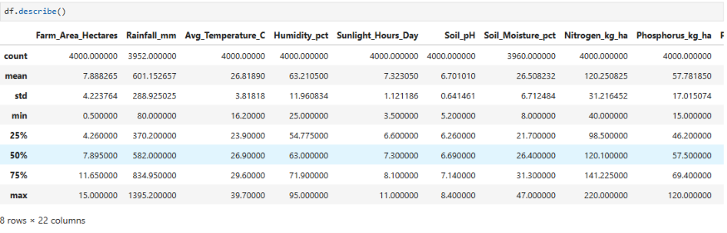
RESULTS

Slide 8
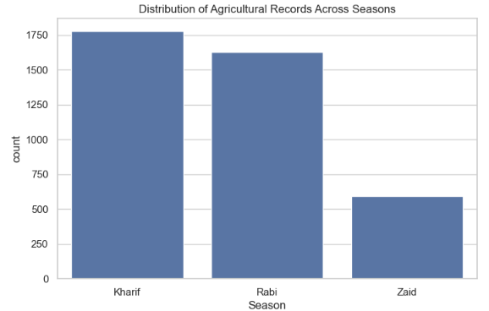
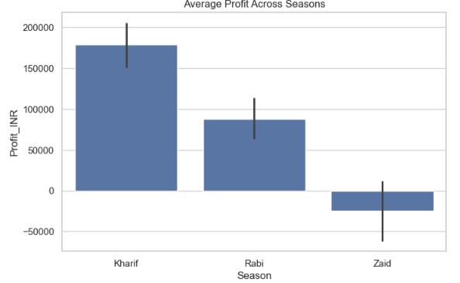

Slide 9
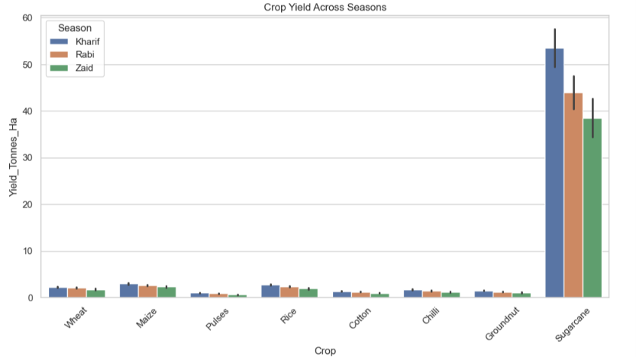

Slide 10
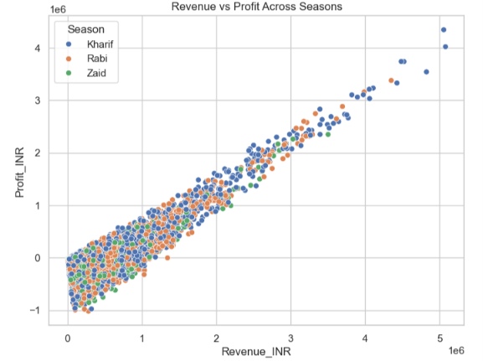
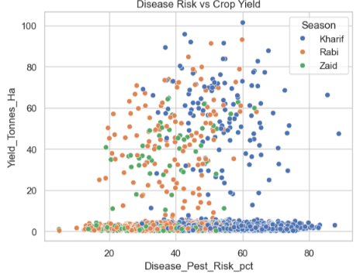

Slide 11
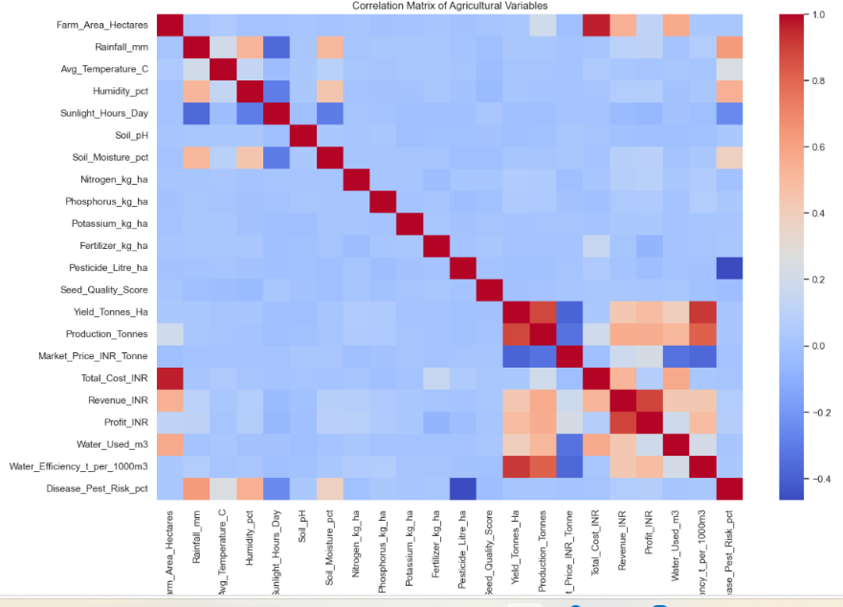

Slide 12
Future scope
Integrate real-time weather data.
Develop machine learning models for crop yield prediction.
Predict seasonal agricultural profitability.
Create a recommendation system for crop selection.
Develop a web dashboard for farmers and planners.
Integrate satellite and IoT agricultural data.
Build an early warning system for disease and pest risks.
Develop a mobile application for farmers.

Slide 13
GitHub Link
https://github.com/SakshiiiShetty/Major_project_Data_Analysis-

Slide 14
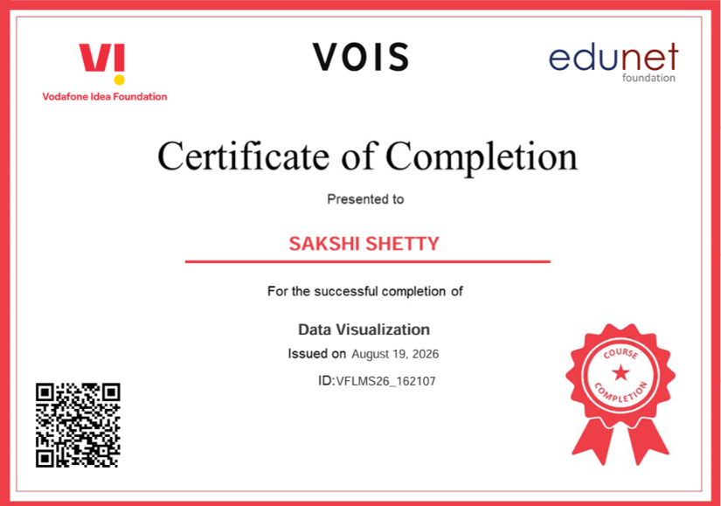
VOIS Course completion certificate - Course name- Data Visualization

Slide 15
Thank you
.
.

