Slide 1

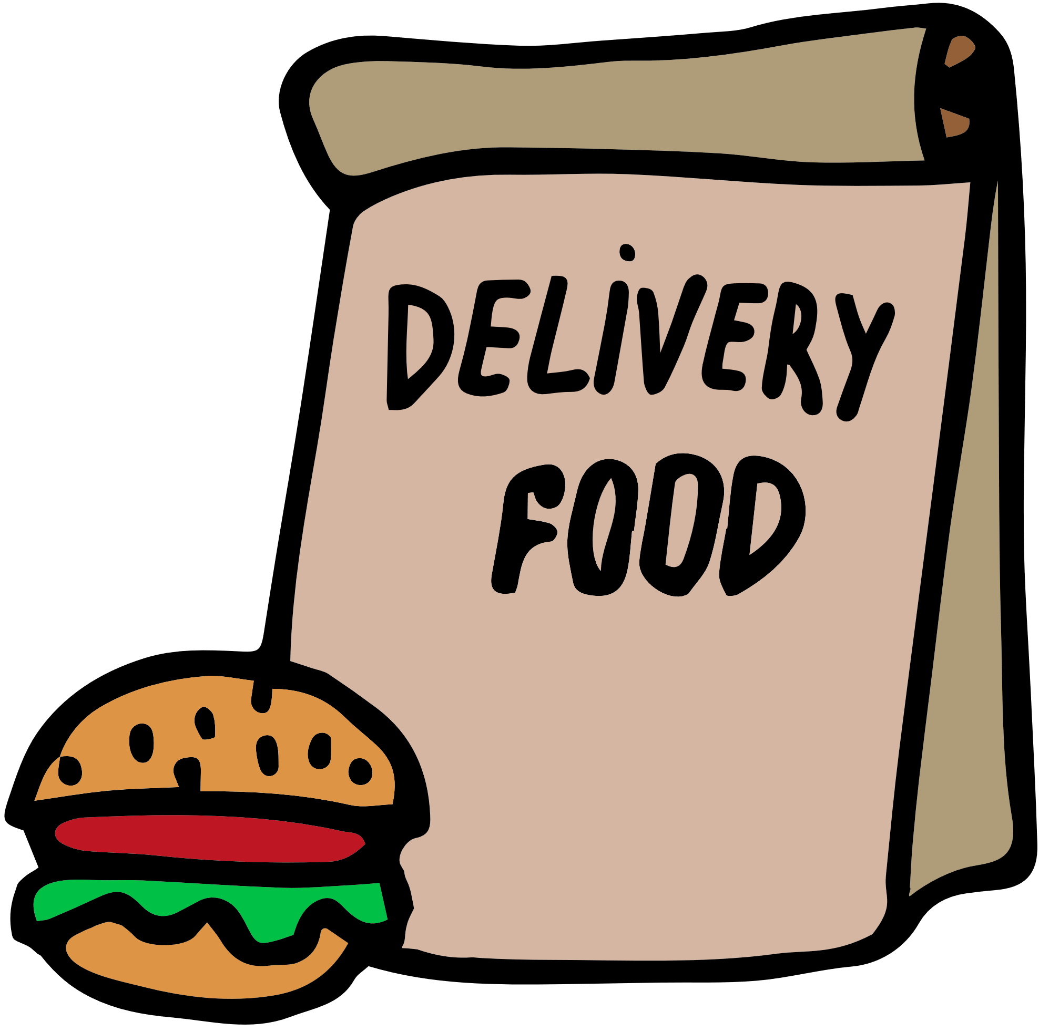
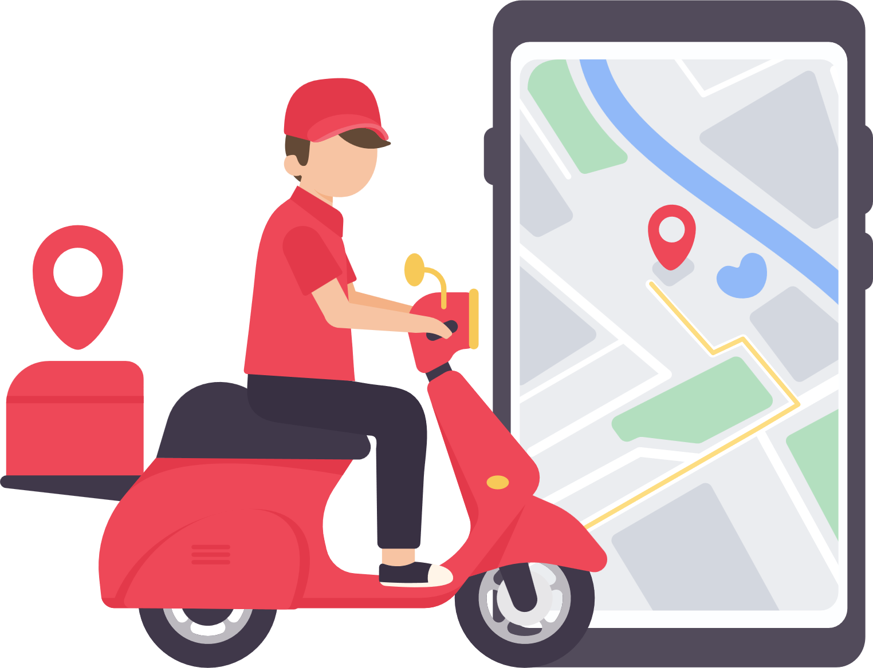


Comprehensive Data Analysis of :
Zomato - A Food Delivery Company
Using PostgreSQL

Slide 2
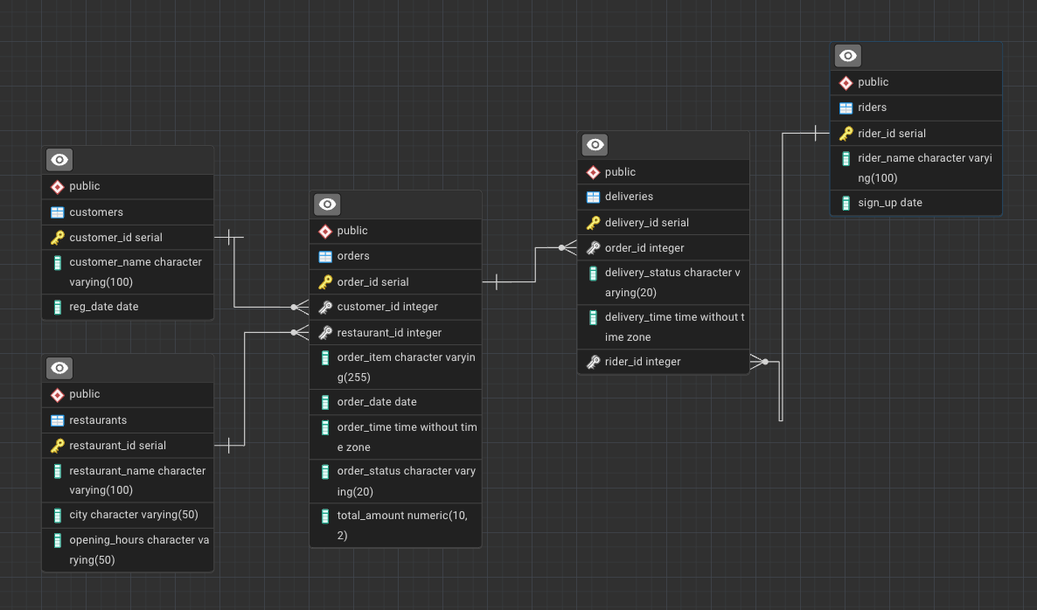

Database Setup (ERD Diagram)

Slide 3
Topics covered in this project:
Database Creation and Table Design (Database concepts, constraints)
Data Retrieval and Filtering (Basics SQL)
Aggregations and Grouping
Joining Tables (Left Join, Inner Join)
Window Functions(Row Number, Rank, Dense Rank, Lead, Lag)
Date and Time Functions
Conditional Logic
Subqueries
Ranking and Ordering
Data Segmentation (CASE STATEMENT)

Slide 4
Purpose of the project:
Writing 20 complex SQL queries showcasing problems solving and decision-making skills!
Customer Behaviour and Insights
Order and Sales Analysis
Restaurant Performance
Rider Efficiency and Performance
Operational Effectiveness

Slide 5
Let’s start;

Slide 6
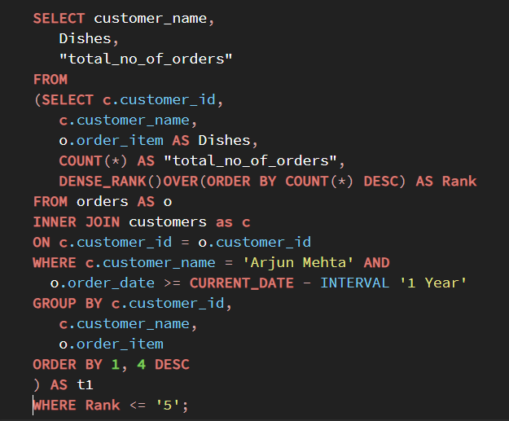
Business Problem 1
Top 5 Most Frequently Ordered Dishes
Find the top 5 most frequently ordered dishes by a specific customer in the last year.
Solution

Slide 7
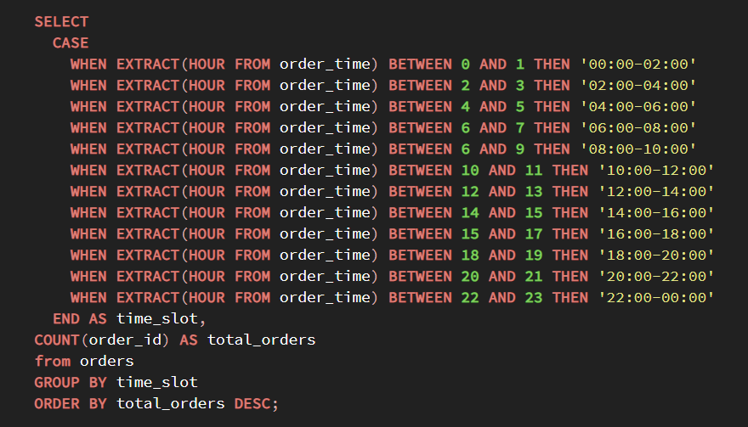
Business Problem 2
Popular Time Slots
Identify the time slots during which the most orders are placed, based on 2-hour intervals.
Solution

Slide 8
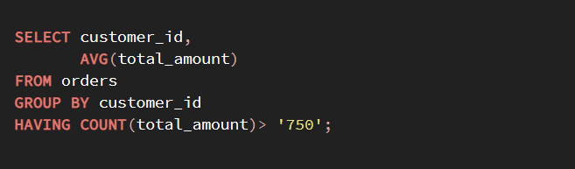
Business Problem 3
Order Value Analysis
Find the average order value per customer who has placed more than 750 orders.
Solution

Slide 9
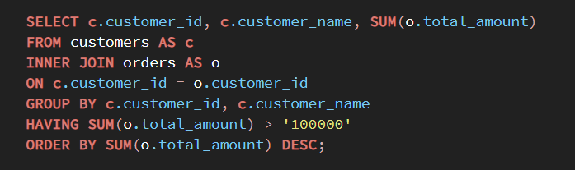
Business Problem 4
High-Value Customers
List the customers who have spent more than 100k in total on food orders.
Solution

Slide 10
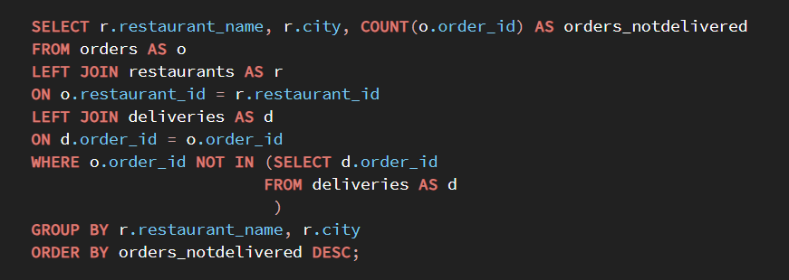
Business Problem 5
Orders Without Delivery:
Write a query to find orders that were placed but not delivered.
Solution

Slide 11
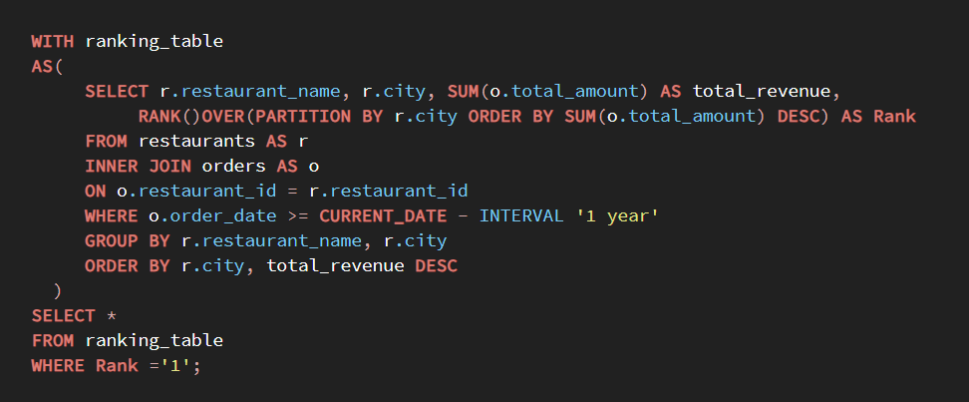
Business Problem 6
Restaurant Revenue Ranking:
Rank restaurants by their total revenue from last year, including their name, total revenue and rank within their city.
Solution

Slide 12
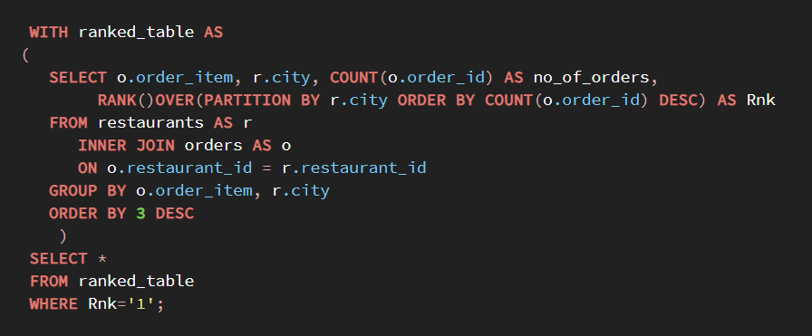
Business Problem 7
Most popular dish by city:
Identify the most popular dish in each city based on no of orders.
Solution

Slide 13
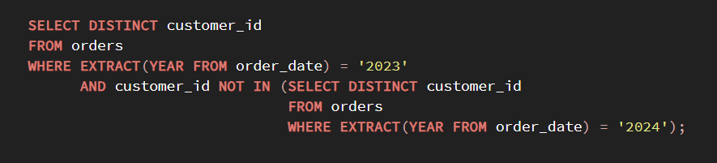
Business Problem 8
Customer Churn:
Find customers who haven’t placed an order in 2024 but did in 2023
Solution

Slide 14
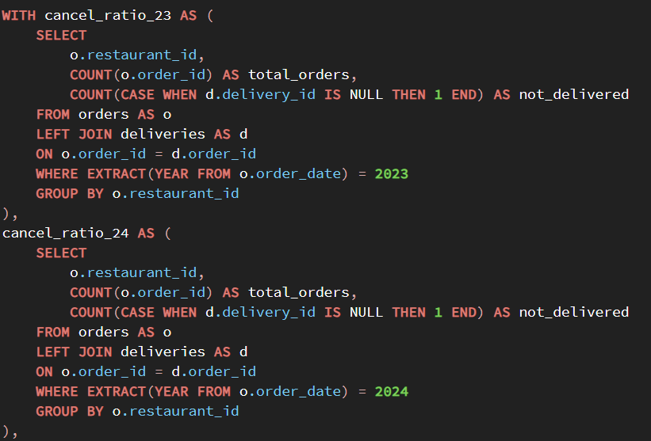
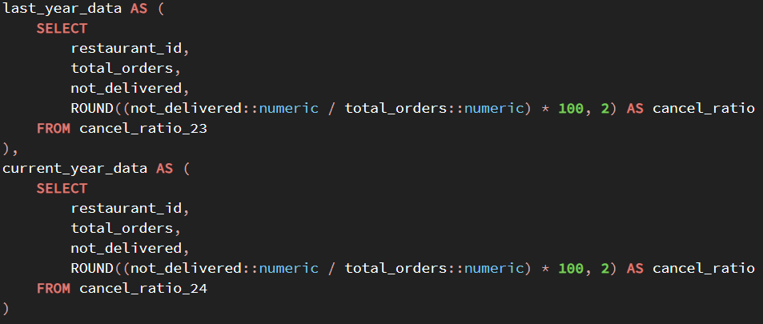
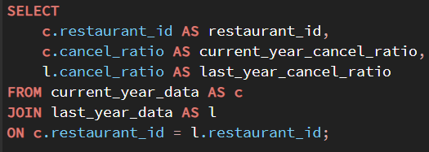
Business Problem 9
Cancellation rate comparison:
Calculate and compare the order cancellation rate for each restaurant between the current year and previous year.
Solution

Slide 15
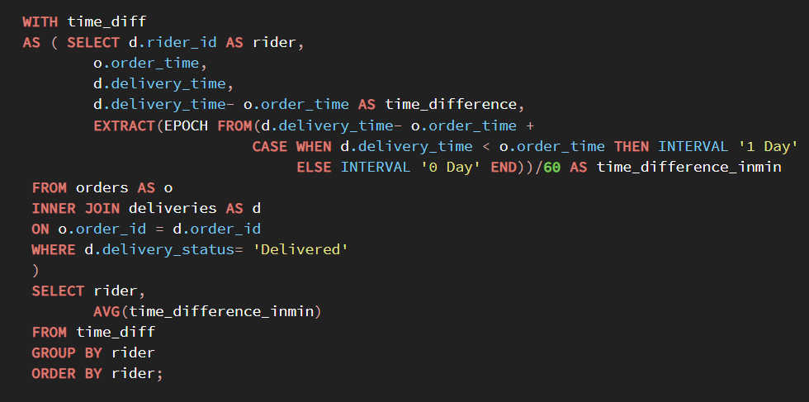
Business Problem 10
Rider average delivery time:
Determine each rider’s average delivery time.
Solution

Slide 16
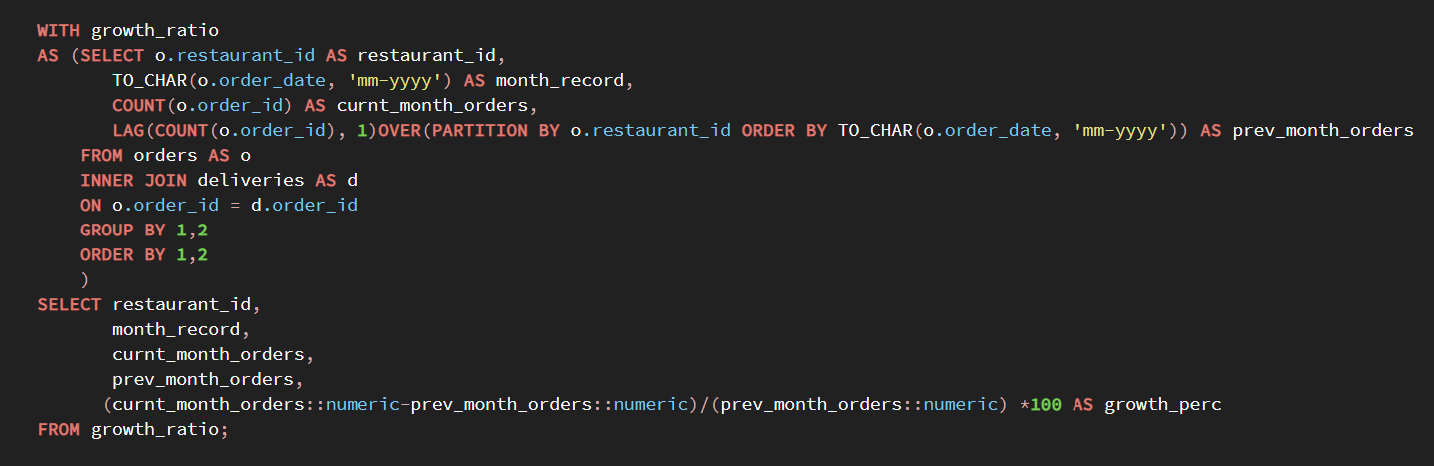
Business Problem 11
Monthly restaurant growth ratio:
Calculate each restaurant’s growth ratio based on the total no of delivered orders since it’s joining.
Solution

Slide 17
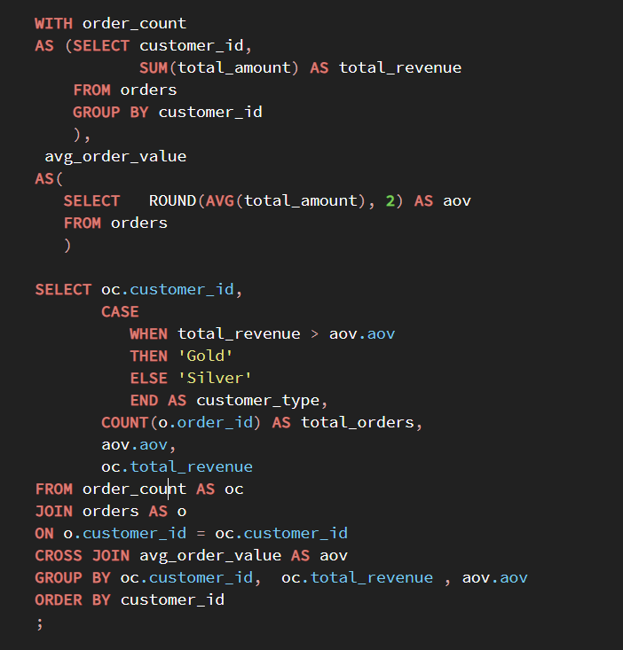
Business Problem 12
Customer Segmentation:
Segment customers into ‘Gold’ and ‘Silver’ groups based on their total spending compared to the average order value(AOV) . If a customer’s total spending exceeds AOV, label them as ‘Gold’ and others as ‘Silver’. Determine each segment’s total no of orders and total revenue.
Solution:

Slide 18
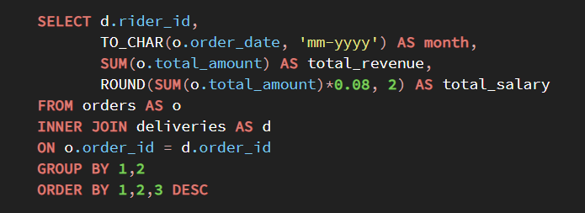
Business Problem 13
Rider monthly earnings:
Calculate each rider’s total monthly earnings, assuming they earn 8% of the order amount.
Solution

Slide 19
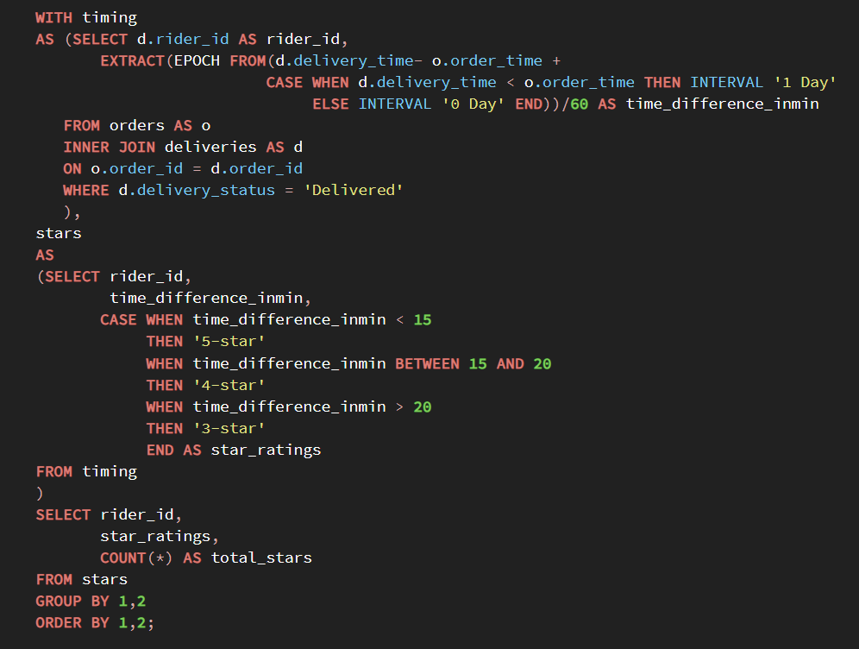
Business Problem 14
Rider ratings analysis:
Find the number of 5-star, 4 star and 3-star ratings each rider has. Riders receive this rating based on their delivery time. If orders are delivered in less than 15 minutes of the order received time, rider gets 5-star rating. If they deliver between 15 to 20 minutes, they get 4-star rating. If they deliver after 20 minutes, they get 3-star rating.
Solution:

Slide 20
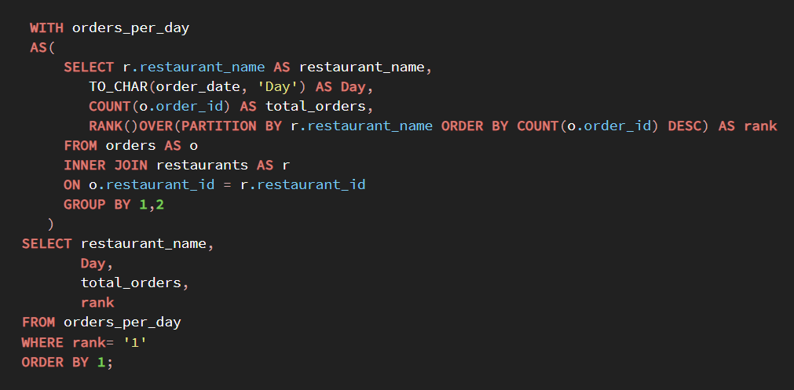
Business Problem 15
Order frequency by day:
Analyze order frequency per day of the week and identify peak day for each restaurant.
Solution:

Slide 21
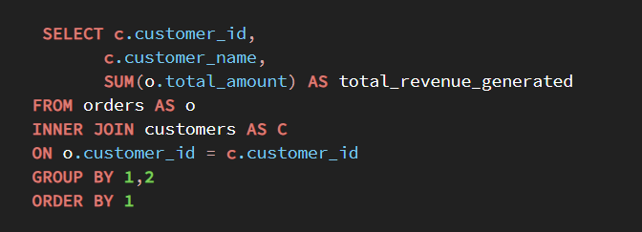
Business Problem 16
Customer lifetime value:
Calculate total revenue generated by each customer over all their orders.
Solution

Slide 22
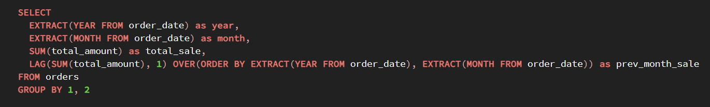
Business Problem 17
Monthly sales trends:
Identify sales trends by comparing each month’s total sales to the previous month.
Solution

Slide 23
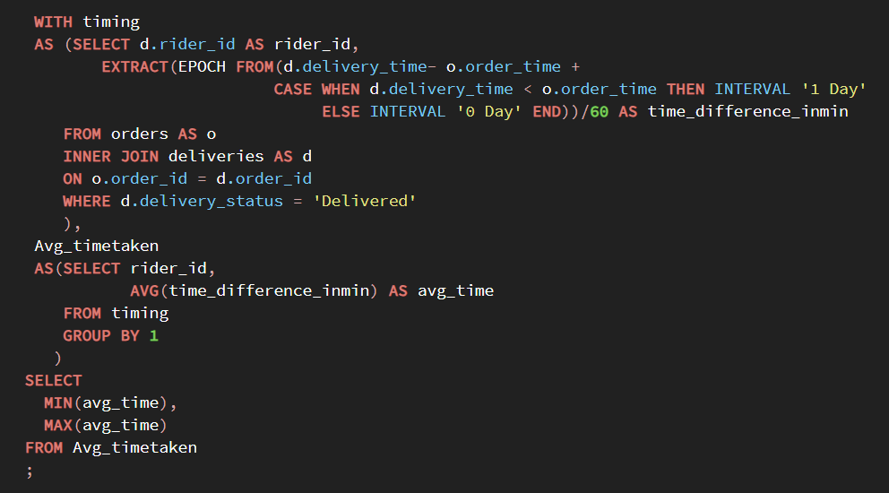
Business Problem 18
Rider Efficiency:
Evaluate rider efficiency by determining average delivery times and identifying those with lowest and highest averages.
Solution:

Slide 24
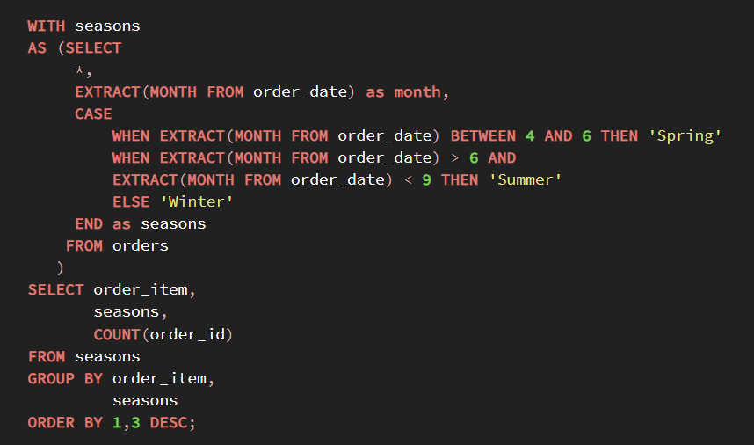
Business Problem 19
Order time popularity:
Track the popularity of specific order items over time and identify seasonal demand spikes.
Solution

Slide 25
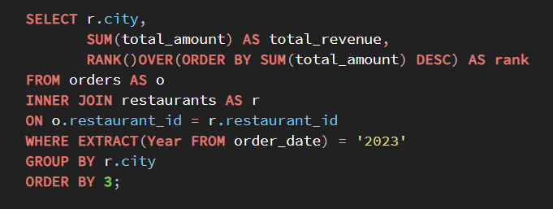
Business Problem 20
Ranking City:
Rank each city based on the total revenue for last year 2023.
Solution

Slide 26
Conclusion
This project highlights my ability to handle complex SQL queries and provides solutions to real-world business problems in the context of a food delivery service like Zomato. The approach taken here demonstrates a structured problem-solving methodology, data manipulation skills, and the ability to derive actionable insights from data.

Slide 27
Thank you!

