Slide 1

CHATBOT BASED ON RETRIVEL AUGUMENT GENERATION
VIDIPT VASHIST
(MA22M025)
Indian Institute of Technology Madras
Department of Mathematics
MA5990 M.Tech Project

Slide 2
CONTENT
INTRODUCTION
RETRIVAL AUGUMENT GENERATION
BENEFITS
PROBLEM STATEMENT
INTERNAL DOCUMENT RAG SYSTEM
WEB SEARCH RAG SYSTEM
METHODLOGY
HIGH LEVEL TECHNICAL FLOW
ARCHITECTURE
LIVE DEMO
USE CASES
FUTURE SCOPE

Slide 3
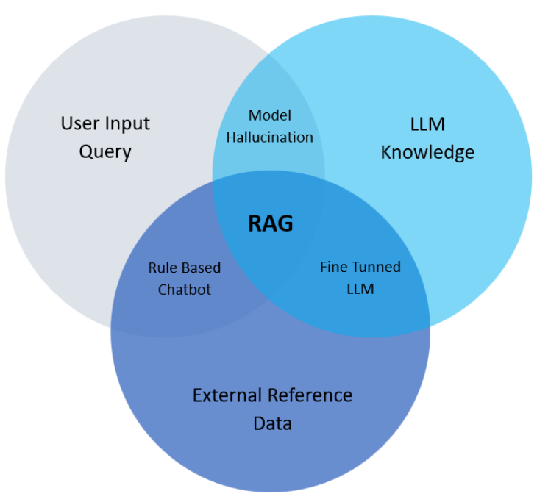
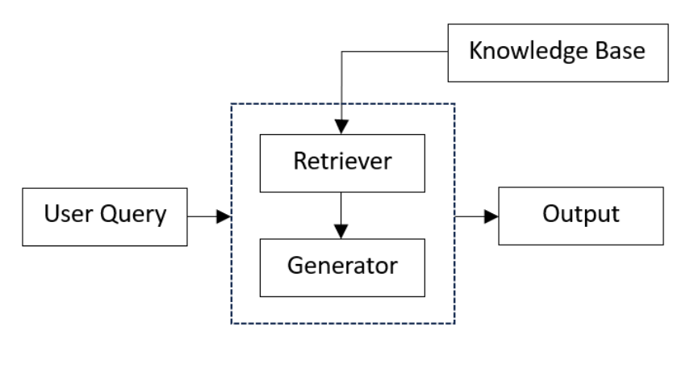
INTRODUCTION
RETRIVEL AUGUMENT GENERATION, is a groundbreaking paradigm in natural language processing that combines the strengths of retrieval-based and generation-based approaches. This innovative framework combines the best aspects of different methodologies to achieve impressive results in a wide range of NLP tasks.
TECHNICAL OVERVIEW
BENEFITS FOR RAG
Core Idea: Retriever + Generation

Slide 4
PROBLEM STATMENT
The main goal of this project is to achieve two things:
INTERNAL DOCUMENT RAG SYSTEM
WEB SEARCH RAG SYSTEM
MOTIVATION: Extracting information from private PDF files can pose significant challenges for organizations, leading to complexity and inefficiency in their data extraction processes. This challenge impedes their capacity to effectively utilize internal knowledge, resulting in missed chances for improved customer interactions and a competitive advantage in the market
GOAL: to create a reliable and open-source system that can efficiently extract information from private PDF files
MOTIVATION: Navigating the vast expanse of the internet can be quite the challenge when it comes to finding relevant and accurate information in a timely manner. While search engines have become essential for finding information, many users struggle to refine their search queries for more accurate results.
GOAL: to develop a user-friendly web application that utilizes web scraping techniques to gather relevant data from online sources.

Slide 5
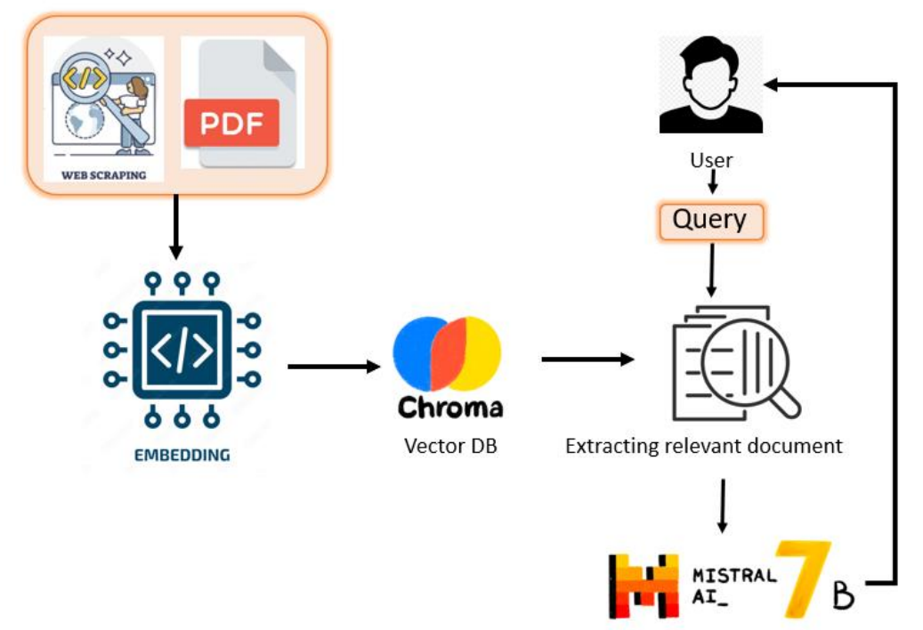
METHODLOGY
HIGH LEVEL TECHNICAL FLOW: for showcasing technology frame work used for project,
Document Ingestion: Llama Index
Creating Embedding: all-MiniLM-L6-v2 Architecture
Vector Database: Chroma DB
Generator: Mistral-7B-Instruct-v0.2
Support framework: Langchain

Slide 6
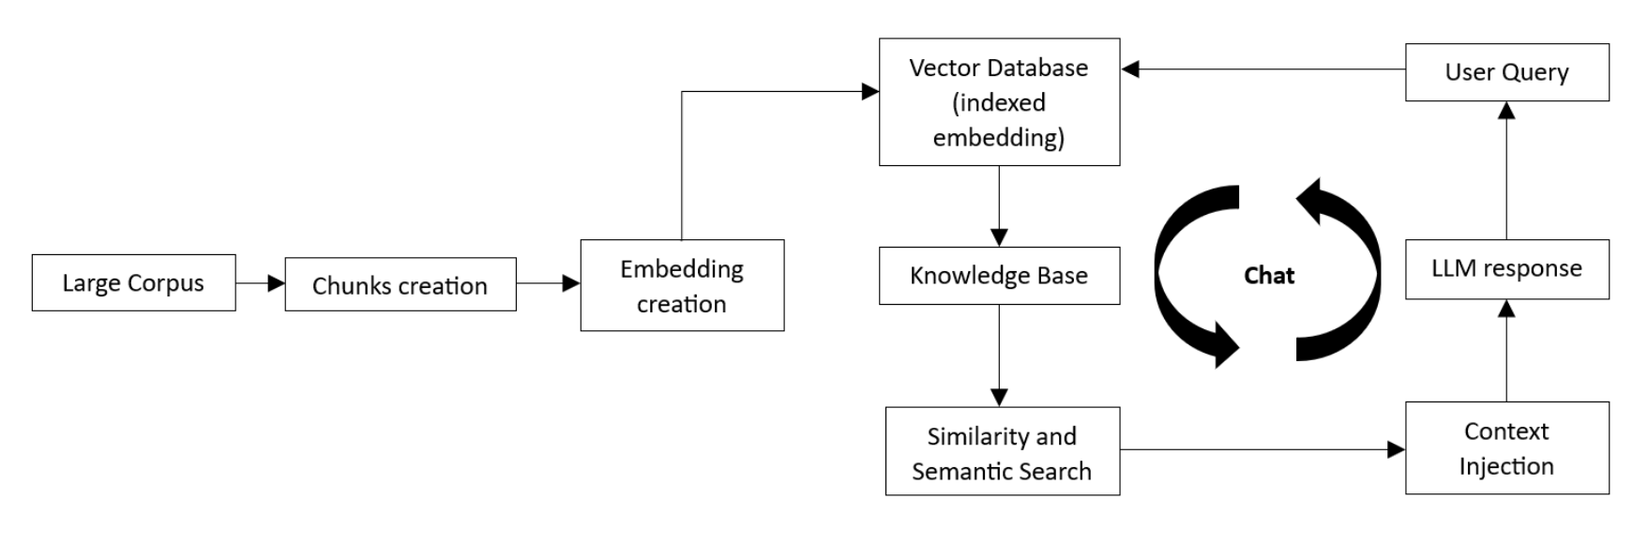
METHODLOGY
Custom Architecture for RAG system

Slide 7
LIVE DEMO FOR PROJECT

Slide 8
FUTURE SCOPE
As technology continues to evolve and new challenges emerge for future work, ranging from the exploration of new large language models (LLMs) to the advancement of RAG architectures:
Integration of Multimodal Information
Fine-Tuning Techniques and Optimization
Addressing Privacy and Security Concerns

Slide 9
THANK YOU

