Slide 1
DevSecOps Pipeline
TEAM 4

Slide 2
Vision

Slide 3
Importance of project
Devops pipeline integrated with security features hence DevSecops pipeline
Three types of scans are performed before deployment to production environment
1] SCA- Software composition analysis
2] SAST- Static Application Security Testing
3] DAST- Dynamic Application Security testing
Automated CI/CD pipeline with no manual intervention
Detailed report is generated for SCA and SAST to detect the vulnerabilities and its cause
Implemented the pipeline using Azure devops and deployed resources using console as well as terraform

Slide 4
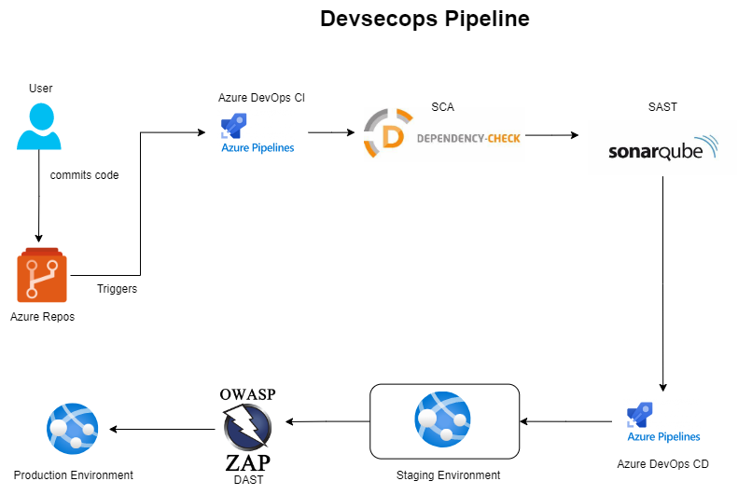
Architecture diagram

Slide 5
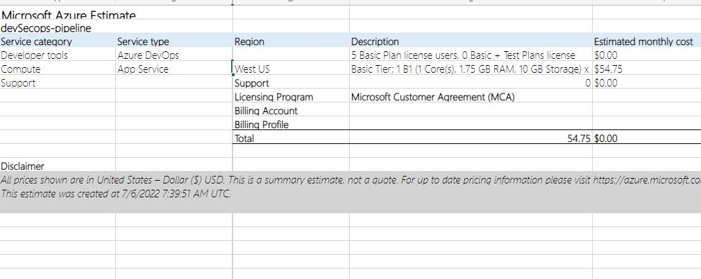
Cost Estimation

