Slide 1


Nutan Maharashtra Vidya Prasarak Mandal’s NUTAN COLLEGE OF ENGINEERING AND RESEARCH Under Administrative Support of Pimpri Chinchwad Education Trust ISO 21001:2018 EOMS Certified
Project Presentation
Presentation on
AI Based Forest Monitoring System
By
Utkarsh Pol (Roll No.22)
Shravani Waghawale(Roll No.35)
Aarti Lugade (Roll no.45)
Sakshi Pawar(Roll No.51)
Under the guidance of
Dr .Dhanashree Kulkarni
Department of Computer Science Engineering (Artificial Intelligence)

Slide 2
Nutan Maharashtra Vidya Prasarak Mandal’s NUTAN COLLEGE OF ENGINEERING AND RESEARCH Under Administrative Support of Pimpri Chinchwad Education Trust ISO 21001:2018 EOMS Certified
Project Presentation
Introduction
Forests play a crucial role in maintaining ecological balance by supporting biodiversity, regulating climate, and providing numerous resources. However, deforestation, habitat loss, and environmental degradation pose significant challenges. Technological advancements, particularly in image analytics and artificial intelligence, have enabled better monitoring and management of forest resources. This study focuses on tree counting, species identification, canopy segmentation, deforestation detection to enhance forest conservation efforts.

Slide 3
Nutan Maharashtra Vidya Prasarak Mandal’s NUTAN COLLEGE OF ENGINEERING AND RESEARCH Under Administrative Support of Pimpri Chinchwad Education Trust ISO 21001:2018 EOMS Certified
Project Presentation
Problem Statement
Monitoring and managing forests manually is labor-intensive, time-consuming, and prone to errors. Traditional methods lack efficiency in assessing tree species, detecting deforestation, and tracking wildlife populations. There is a need for an automated system that utilizes advanced image processing and AI techniques to analyze forest landscapes accurately and efficiently.

Slide 4
Nutan Maharashtra Vidya Prasarak Mandal’s NUTAN COLLEGE OF ENGINEERING AND RESEARCH Under Administrative Support of Pimpri Chinchwad Education Trust ISO 21001:2018 EOMS Certified
Project Presentation
Problem Solution
To address these challenges, we propose an AI-based image analytics system that leverages deep learning for tree counting and species classification, ensuring accurate and efficient monitoring. The system incorporates canopy segmentation models to analyze forest density and health, providing valuable insights into vegetation coverage. Additionally, it utilizes satellite imagery and advanced algorithms to detect deforestation trends, enabling timely intervention. For wildlife monitoring, AI-based object detection models will be employed to identify and track animals, supporting biodiversity conservation. This automated system will deliver real-time, data-driven insights, enhancing forest management and conservation efforts.

Slide 5
Nutan Maharashtra Vidya Prasarak Mandal’s NUTAN COLLEGE OF ENGINEERING AND RESEARCH Under Administrative Support of Pimpri Chinchwad Education Trust ISO 21001:2018 EOMS Certified
Project Presentation
Objectives
Tree counting.: Develop an automated AI model to accurately detect and count trees using arial imagery.
​Tree Species Identification – Implement deep learning techniques to classify different tree species based on leaf patterns, bark texture, and spectral data.​
Canopy Segmentation – Utilize image segmentation models to analyze forest canopy density for better ecosystem assessment.​
Deforestation Detection – Apply arial image processing and identify deforestation patterns over time.

Slide 6

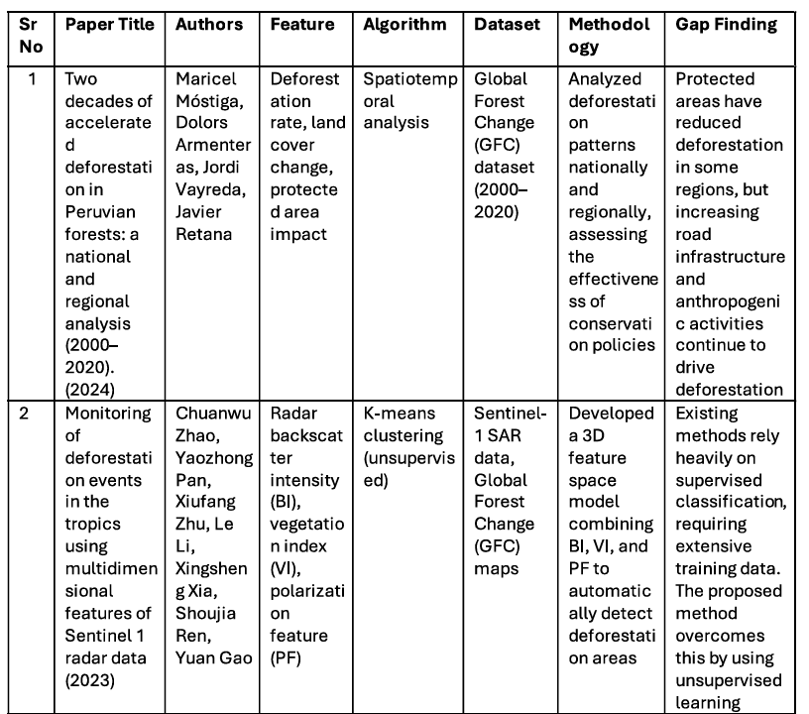
Project Presentation
Literature Survey

Slide 7
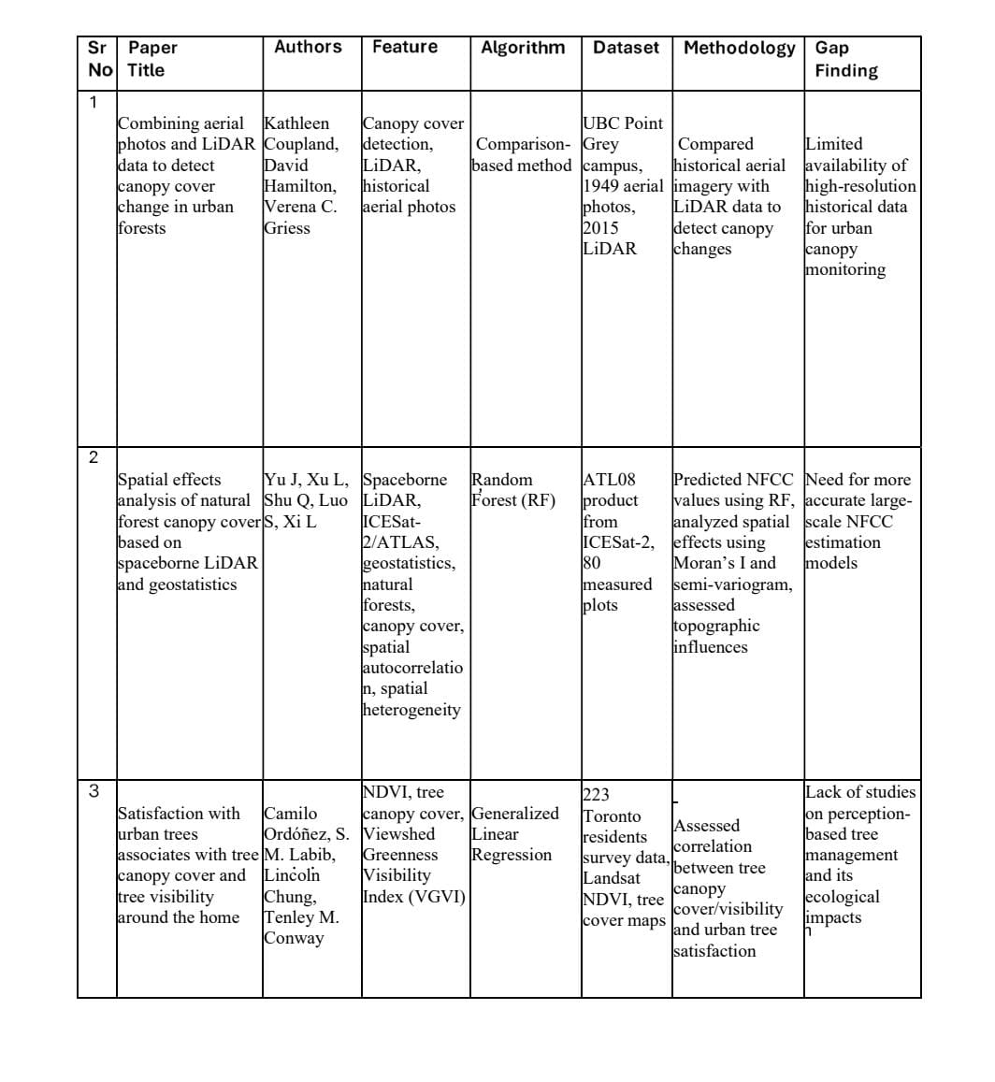
Project Presentation

Slide 8
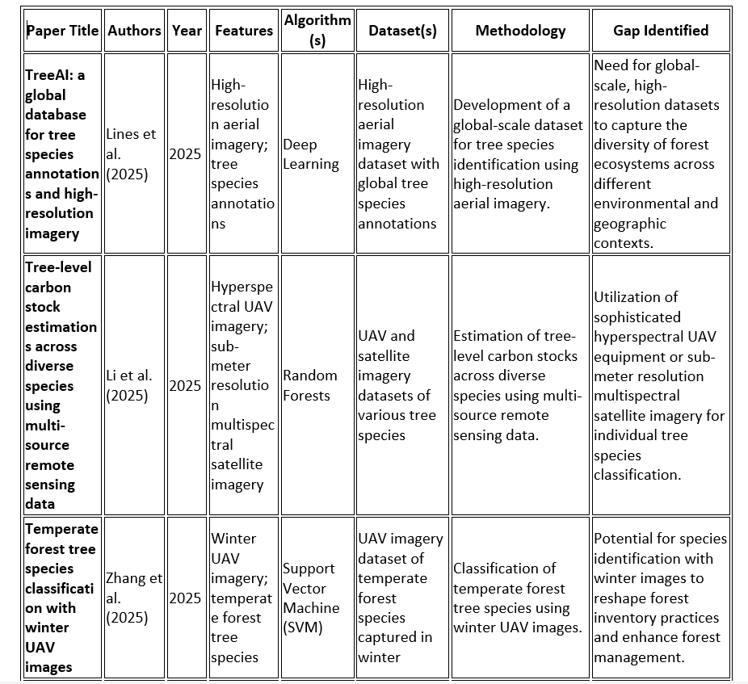
Project Presentation

Slide 9
Project Presentation
Methodology
Data Collection – Gather satellite images, drone imagery, and camera trap photos from various sources, including remote sensing satellites and field surveys.
​Preprocessing – Enhance image quality by applying noise reduction, contrast adjustments, and image segmentation to improve feature extraction.
​Model Development – Train deep learning models for tree counting, species identification, canopy segmentation, deforestation detection.
Feature Extraction & Classification – Use advanced image processing techniques such as CNNs, U-Net, VGG16 analysis, and object detection algorithms to analyze and categorize forest elements.
​Testing & Validation – Evaluate model accuracy by comparing AI-generated results with ground-truth data and existing forest records.​
Implementation & Analysis – Apply the trained models to new datasets to study forest composition, detect deforestation patterns, and classify wildlife.

Slide 10
Project Presentation
Algorithm
Machine Learning (ML) is a subfield of artificial intelligence (AI) that enables computers to learn from data and make decisions or predictions without being explicitly programmed.In simple terms, it allows machines to improve their performance on a task by automatically finding patterns in data and using those patterns to make accurate predictions or classifications.
Deep-learning: Deep Learning is a subset of machine learning that uses artificial neural networks to process and analyze data. It mimics the way the human brain works, allowing computers to learn patterns and make decisions with minimal human intervention

Slide 11
Project Presentation
Technique used
VGG16: VGG16 is a deep learning model used for image classification. It has 16 layers and uses small 3x3 filters to extract features like edges and shapes from images. Developed by the Visual Geometry Group at Oxford, it is simple and effective for recognizing objects. In forest projects, VGG16 can help identify tree species from aerial images.
U-net: UNet is a deep learning model used for image segmentation, where it classifies each pixel in an image. It has a U-shaped architecture with an encoder-decoder structure and skip connections to retain detailed information. UNet is commonly used for tasks like segmenting tree canopies or deforestation detection in satellite images.

Slide 12
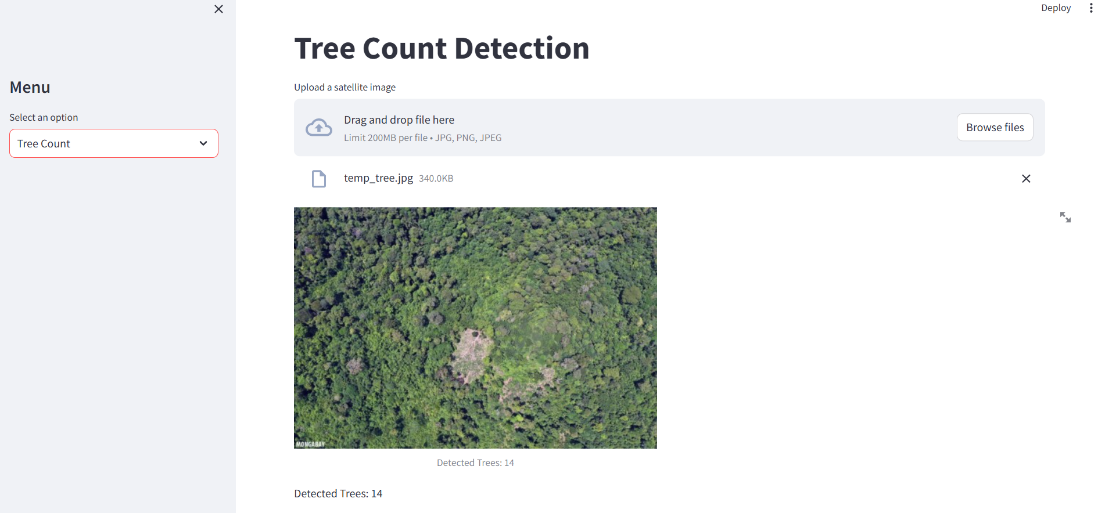
Project Presentation
Experiment Result
Tree counting

Slide 13
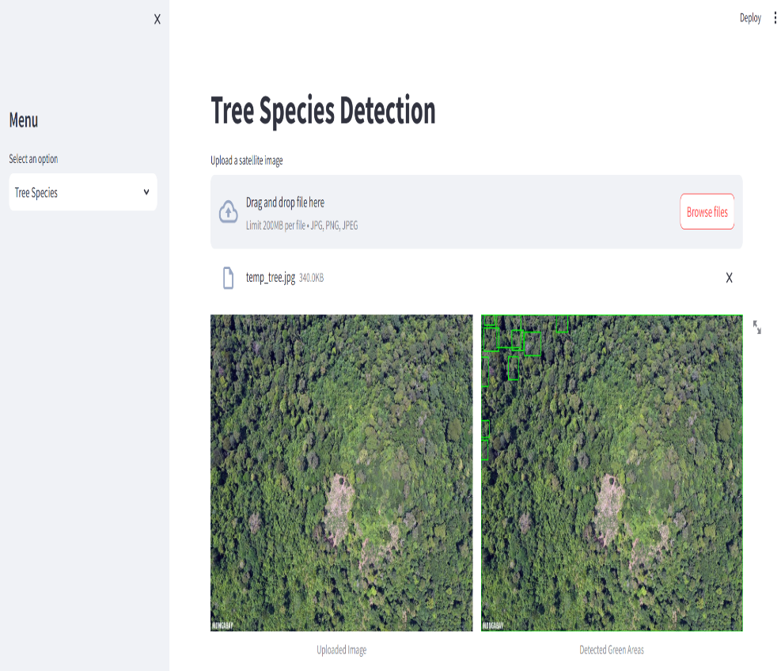
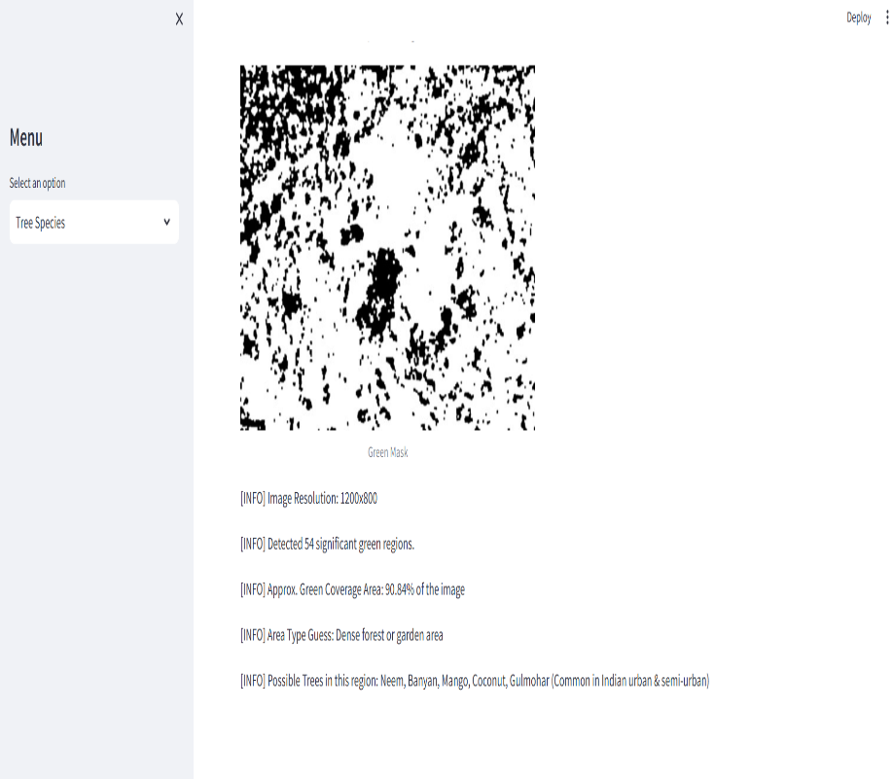
Nutan Maharashtra Vidya Prasarak Mandal’s NUTAN COLLEGE OF ENGINEERING AND RESEARCH Under Administrative Support of Pimpri Chinchwad Education Trust ISO 21001:2018 EOMS Certified
Project Presentation
Tree Species

Slide 14
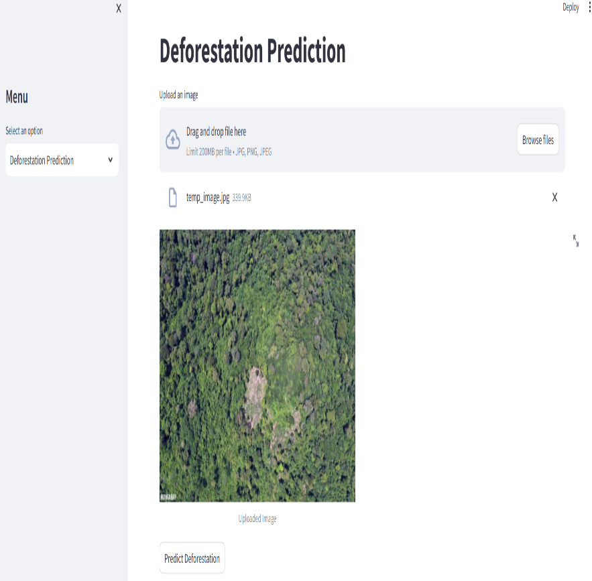
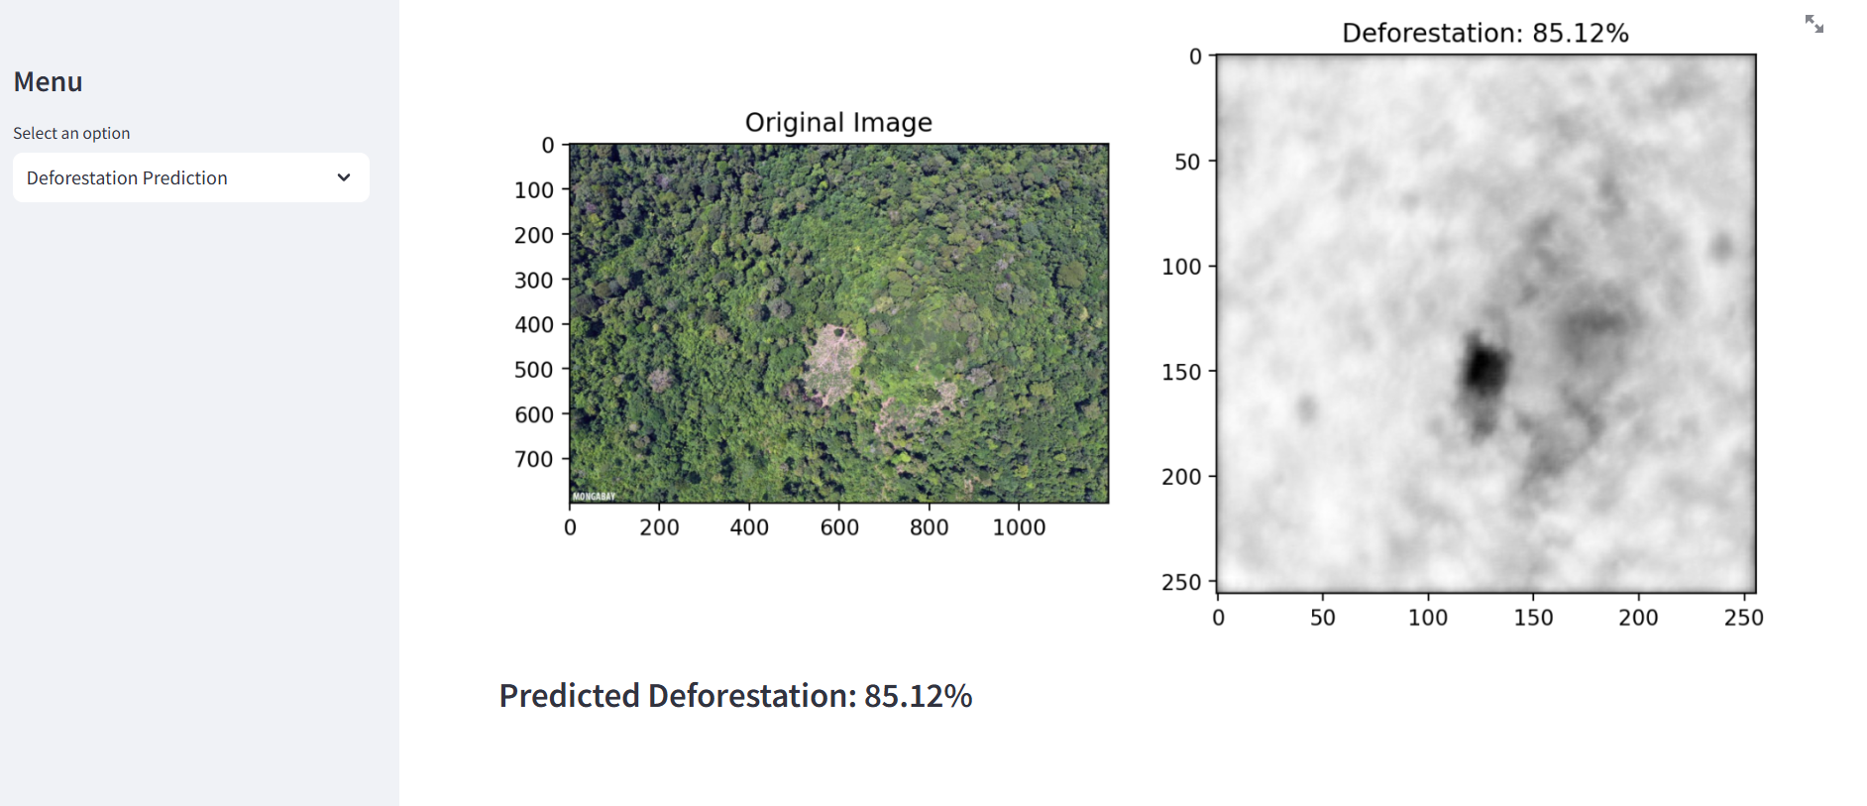
Project Presentation
Deforestration Detection

Slide 15
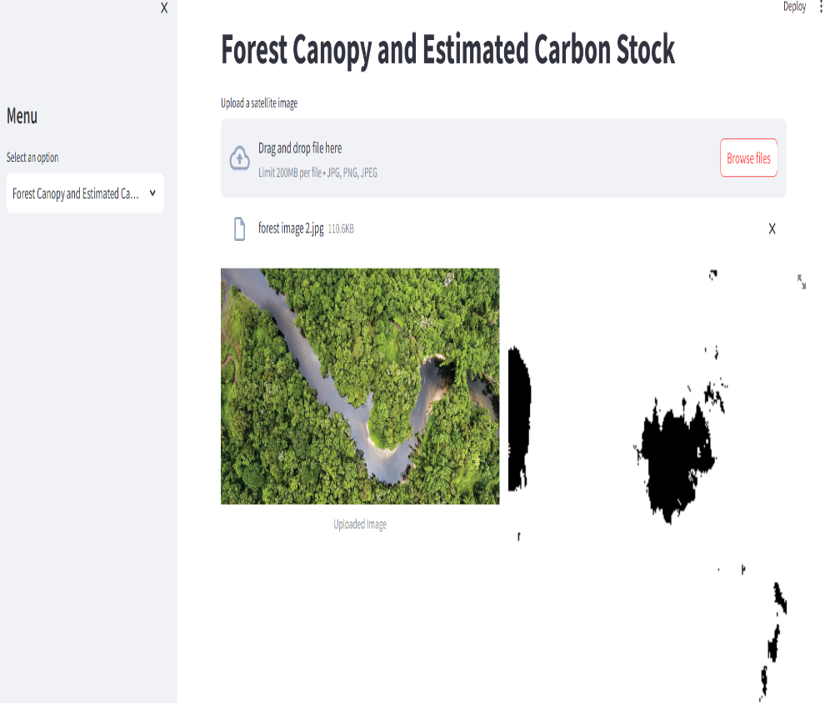
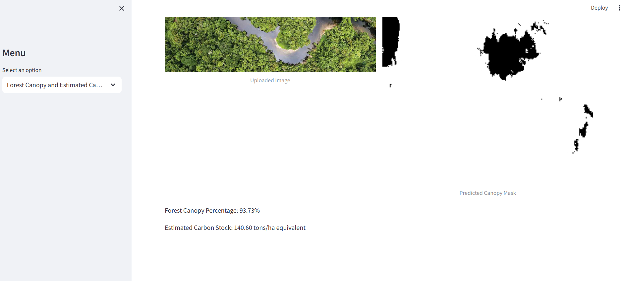
Project Presentation
Canopy Segmentation

Slide 16
Project Presentation
Conclusion
This project demonstrates how artificial intelligence, when combined with remote sensing, can revolutionize forest monitoring. By integrating key modules tree counting, tree species identification, canopy cover analysis, and deforestation detection into a single system, this solution enables efficient forest management. With ongoing improvements, such a system can become an essential tool for environmental protection, policy-making, and global sustainability efforts.

Slide 17
Project Presentation
References
[1] Maricel Móstiga, Dolors Armenteras, Jordi Vayreda, Two decades of accelerated deforestation in Peruvian forests: a national and regional analysis (2000–2020), 2024.​
[2] Chuanwu Zhao, Yaozhong Panl, Xiufang Zhu, Le Li, Xingsheng Xia, Shoujia Ren and Yuan Gao, Monitoring of deforestation events in the tropics using multidimensional features of Sentinel 1 radar data, 2023.
​[3] Gabor Fodor, Marcos V. Conde, Rapid Deforestation and Burned Area Detection using Deep Multimodal Learning on Satellite Imagery, 2023.
​[4] Mabel Ortega Adarme , Raul Queiroz Feitosa , Patrick Nigri Happ ,Claudio Aparecido De Almeida and Alessandra Rodrigues Gomes, Evaluation of Deep Learning Techniques for Deforestation Detection in the Brazilian Amazon and Cerrado Biomes From Remote Sensing Imagery, 2020.
​[5] Imran Md Jelas, Mohd Asyraf Zulkifley, Mardina Abdullah1 and Martin Spraggon, Deforestation detection using deep learning-based semantic segmentation techniques: a systematic review, 2024

Slide 18
Project Presentation
[9] Kathleen Coupland, David Hamilton, Verena C. Griess , Combining aerial photos and LiDAR data to detect canopy cover change in urban forests ,(2022)
[10] Camilo Ordóñez, S. M. Labib, Lincoln Chung, Tenley M. Conway , Satisfaction with urban trees associates with tree canopy cover and tree visibility around the home, (2023)
[11] Zhang et al, Temperate forest tree species classification with winter UAV images(2025)
[12] Yudaputra et al, Tree species identification in ex situ conservation areas using WorldView-2 Satellite Data and Machine Learning Methods: a case study in the Bogor , (2023)

Slide 19
Project Presentation
THANK YOU

Slide 20
Project Presentation
.
Fig3: Forest AI Asistant

Slide 21
Project Presentation

Slide 22
Project Phase II

